Slide 1

CAPSTONE PROJECT
Start Up Funding – Consumer Internet
by Simerjeet Kaur

Slide 2



Architecture
Data Cleaning
Data Manipulation
Data Visualization

Slide 3
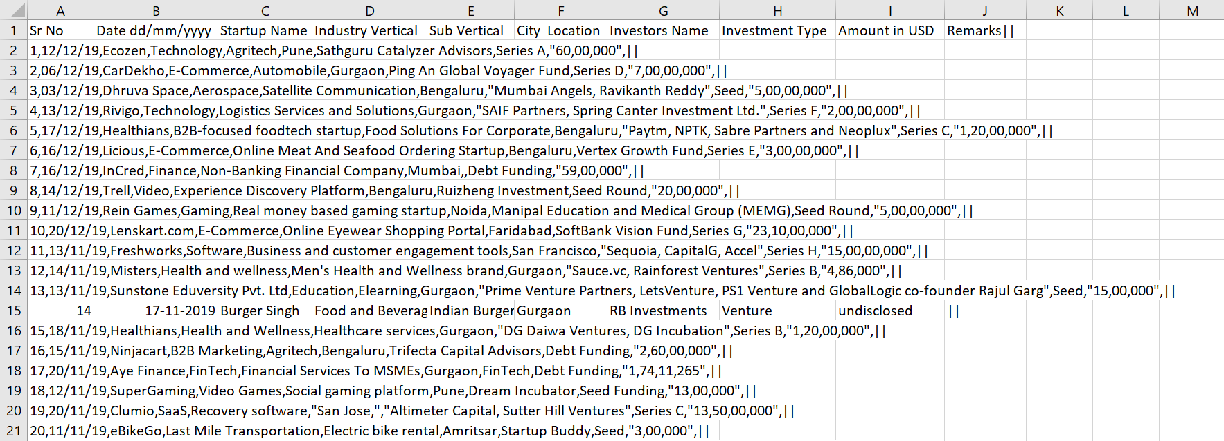
Data Cleaning
Spitting the column
Removing unwanted characters
Removing duplicate values
Dropping unwanted column
Deleting empty rows

Slide 4
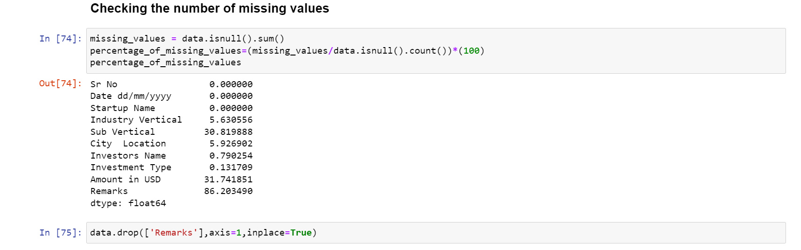
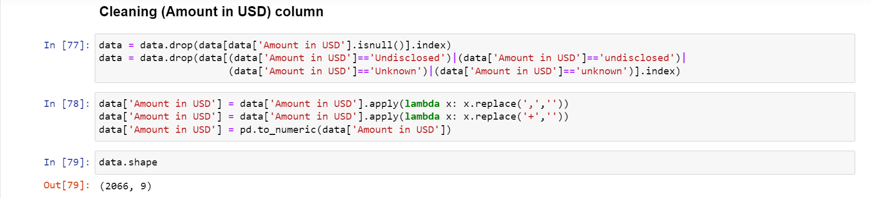
Data Cleaning

Slide 5
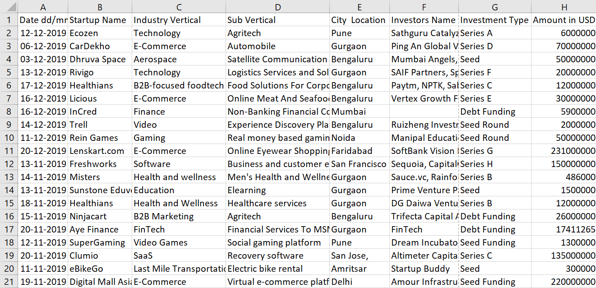
Data Cleaning

Slide 6
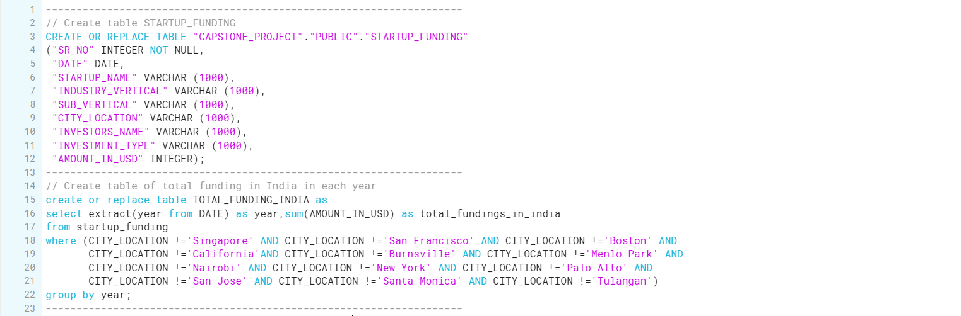
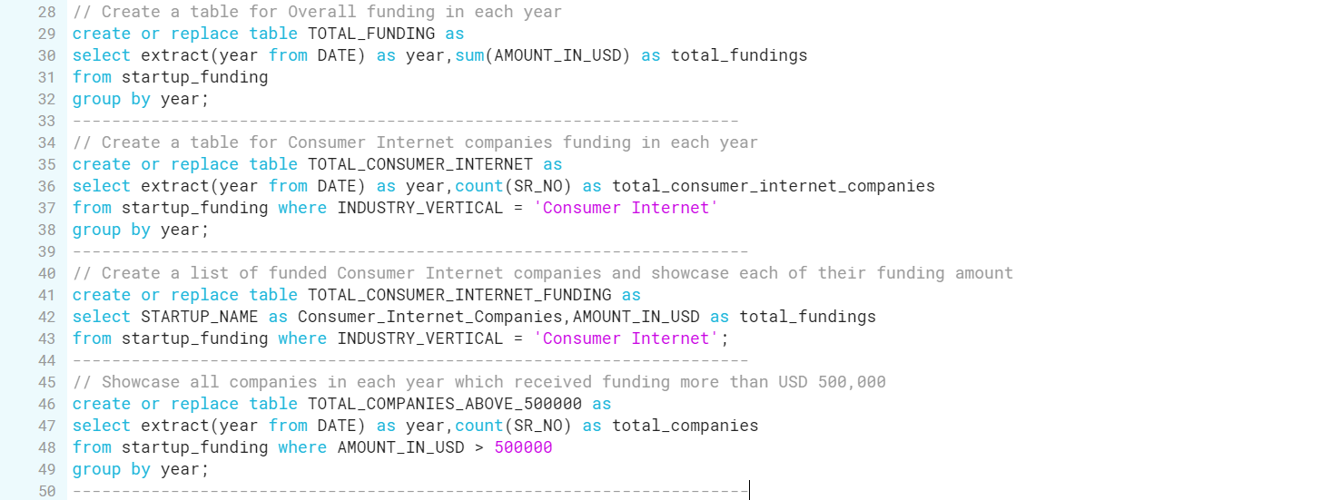
Data Manipulation

Slide 7
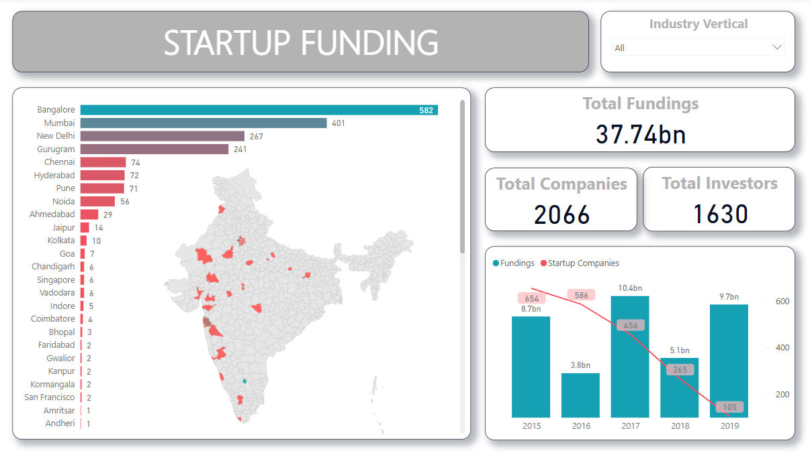
Data Visualization

Slide 8
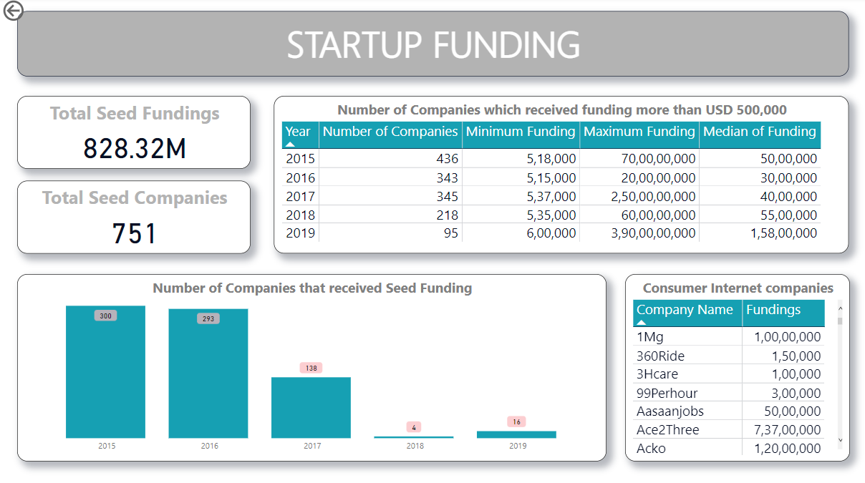
Data Visualization

