Slide 1
DDS Analytics
Talent Management Solution for Frito Lay
SMU DDS: Case Study 2
By: Simerpreet Reddy
Date: 03/11/2020

Slide 2
Present DDS Analytics Talent Management Solution will provide insights on - > The top factors that lead to turn over at Frito Lay. > Job role related trends at Frito Lay. Also present - > Models to predict attrition . > and monthly salary.
Purpose

Slide 3
Source Data
The analysis is based on the CaseStudy2-data.csv provided by Frito Lay.
The data set contains 870 records containing the following details:
Age
Attrition
education
years of experience
job level and role
satisfaction at job, work life balance and manager relationship
financial numbers
and other details

Slide 4

Data Modeling

Slide 5
Model to Predict Attrition
Attrition
KNN
Naïve Bayes
Naïve bayes provided accuracy >86%

Slide 6
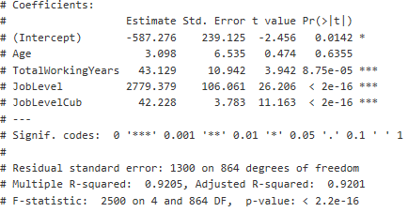
Model to Predict Salary
Linear Regression

Slide 7
Job Role Specific Trends

Slide 8
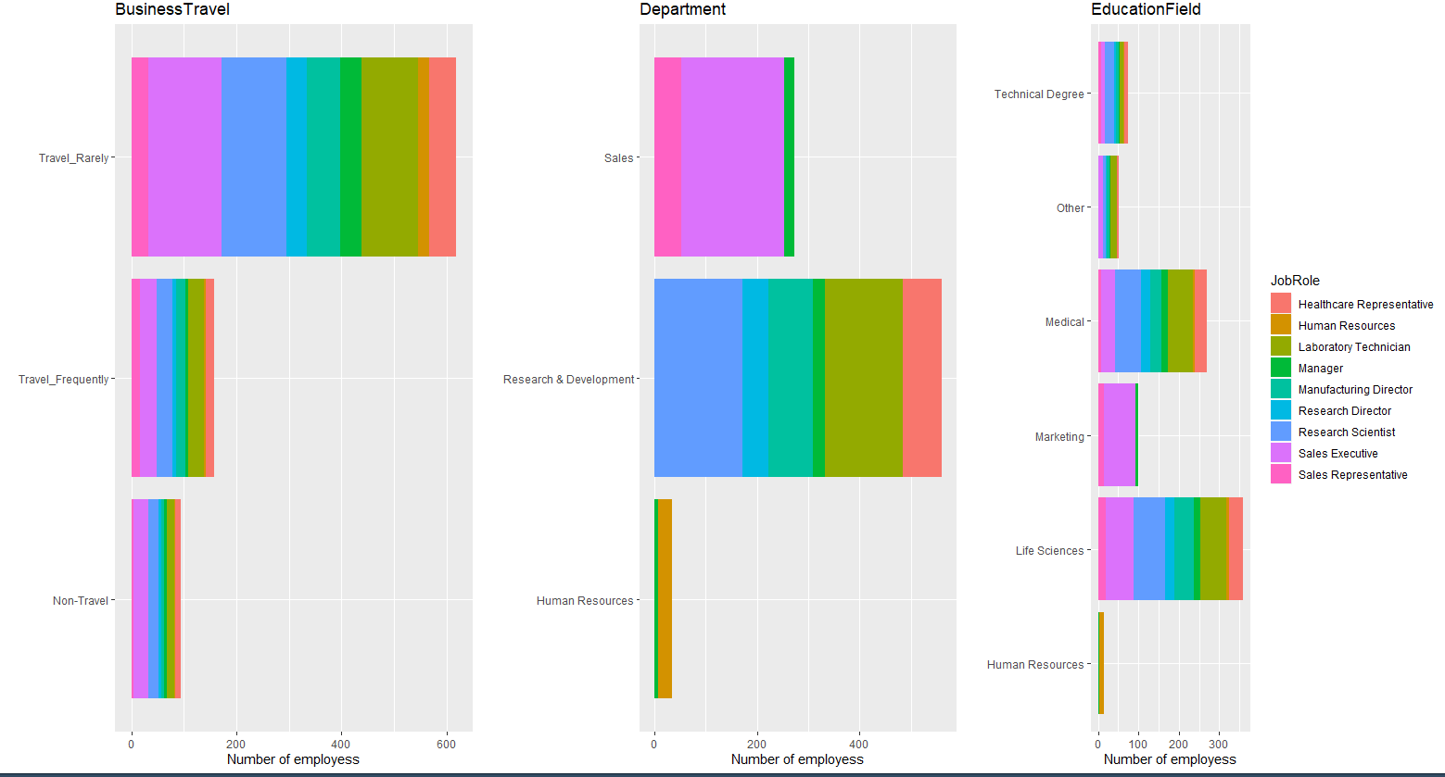

Job Role by different measures
Majority of sales executives travel rarely opposed to the common practice of more travel in Sales jobs

Slide 9
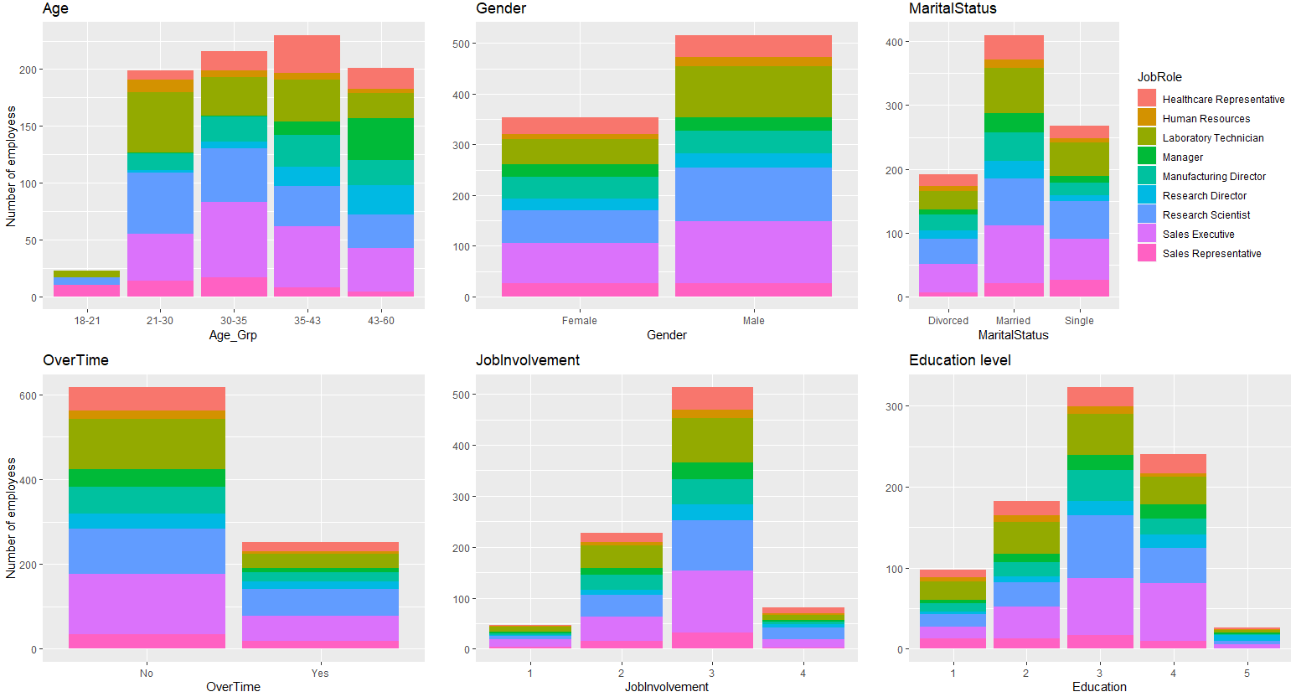
Job Role by different measures contd.
Sales Executives and Research Scientist do the most Overtime work, and both the groups rated Job Involvement at 3

Slide 10
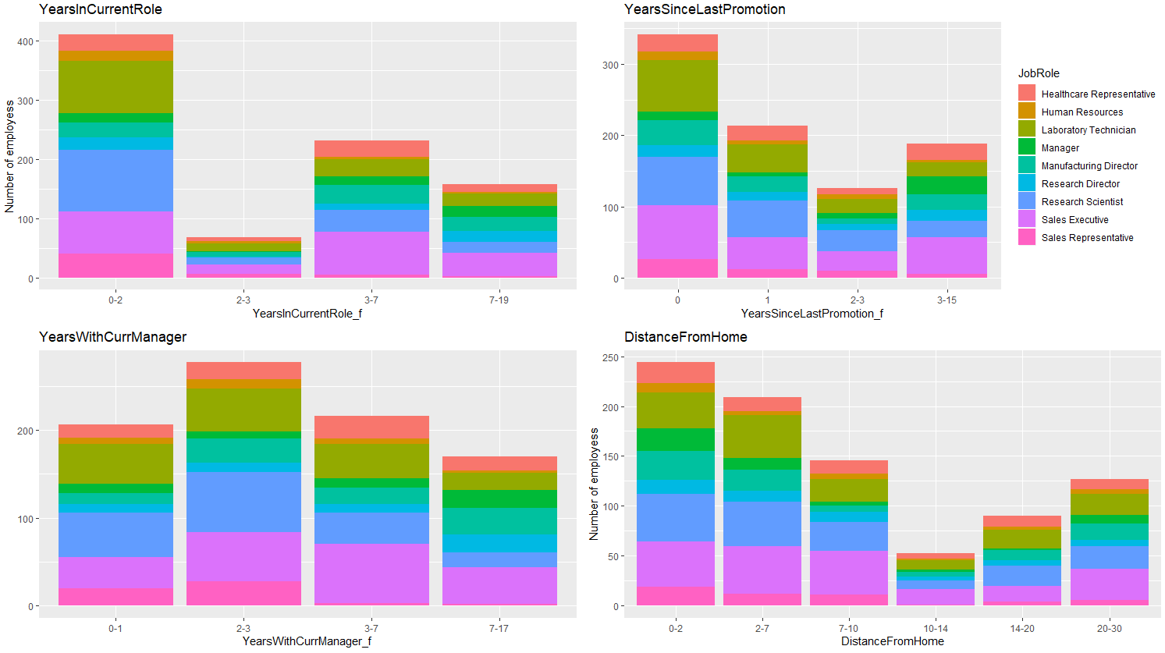
Job Role by different measures contd.
A lot of the Lab Techs and Research Scientist are new in their current roles
Most of the employees have been promoted recently (0-1 yrs.) and, also live close by to the office (2-7mi)

Slide 11
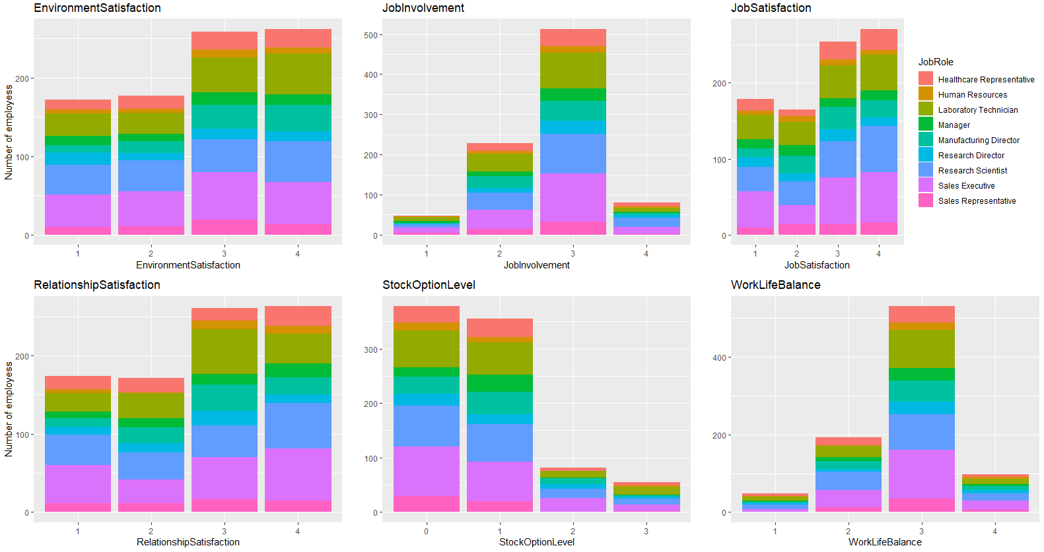
Most Lab Techs have the Env. Satisfaction 3/4
Job Role by different measures contd.
Sales Executives and Research Scientist have Relationship Satisfaction – 3/4
and, work life balance - 3

Slide 12
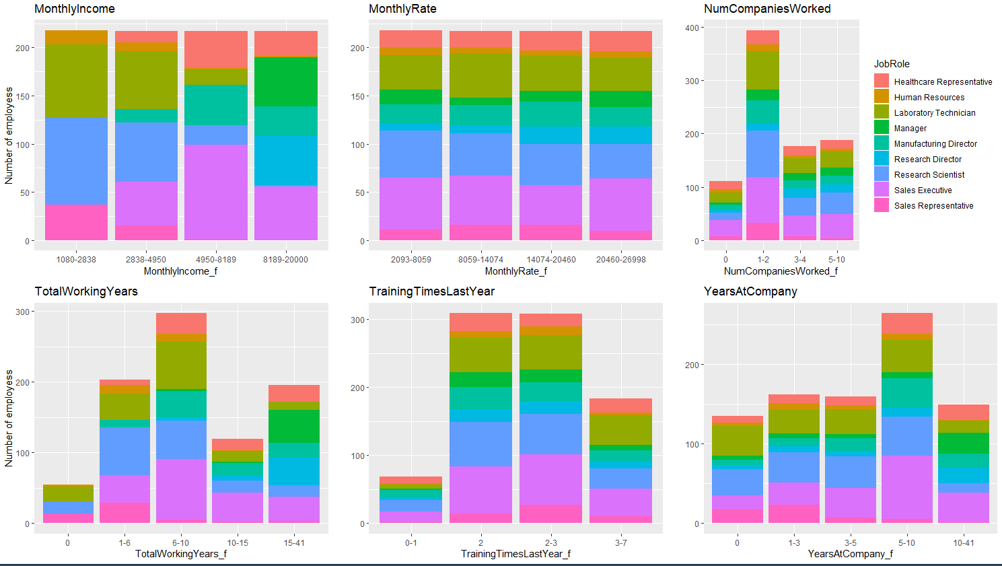
Most of the managers have been in the company for >10 yrs
Job Role by different measures contd.
Lab Techs and Research Scientist have lower monthly income but the monthly rate looks competitive.
Most of the employees have worked in 1-4 other companies

Slide 13
Attrition Analysis

Slide 14
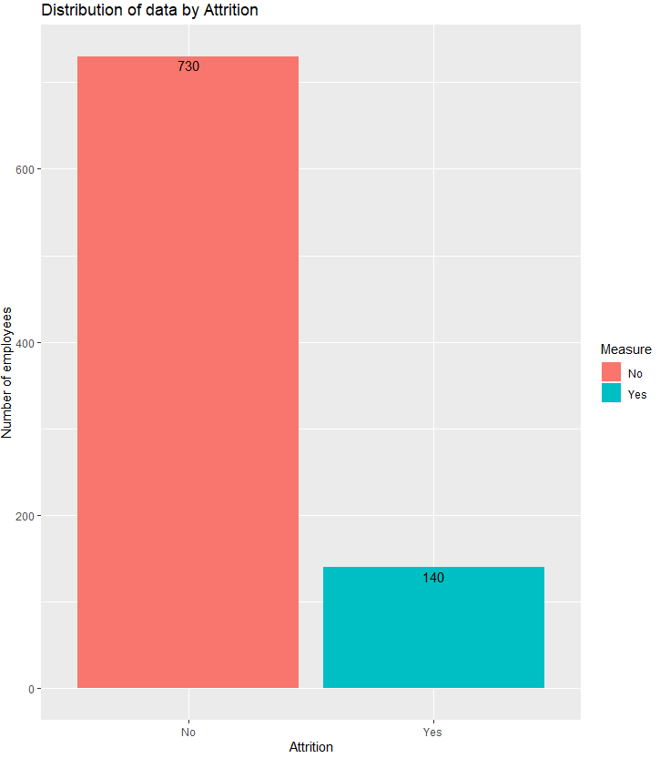
Distribution of data by Attrition
Attrition Rate = 16%
Attrition Rate = 16%
All numbers represent %

Slide 15
Top factors leading to Attrition

Slide 16
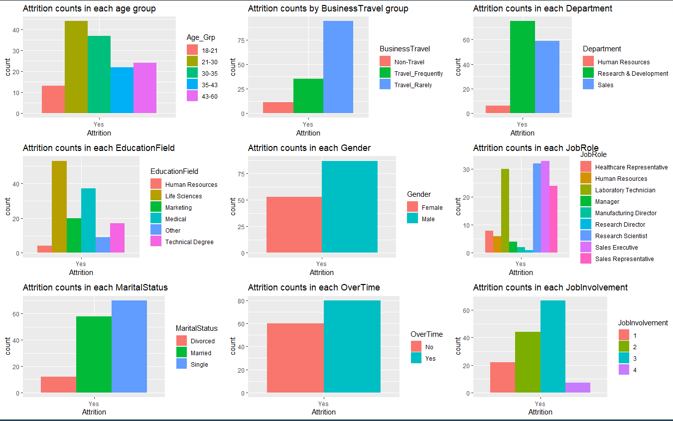
Attrition by different measures

Slide 17
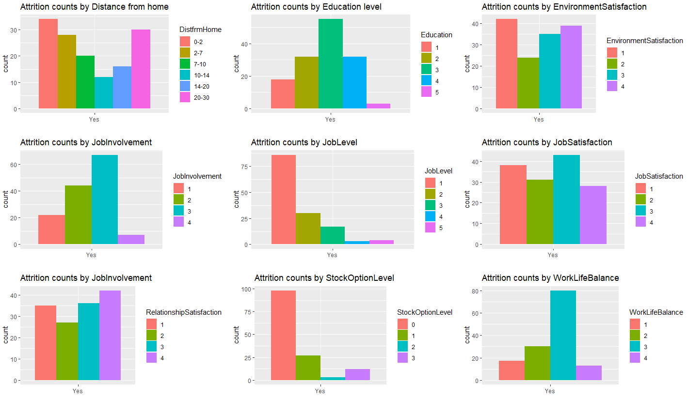
Attrition by different measures contd.

Slide 18
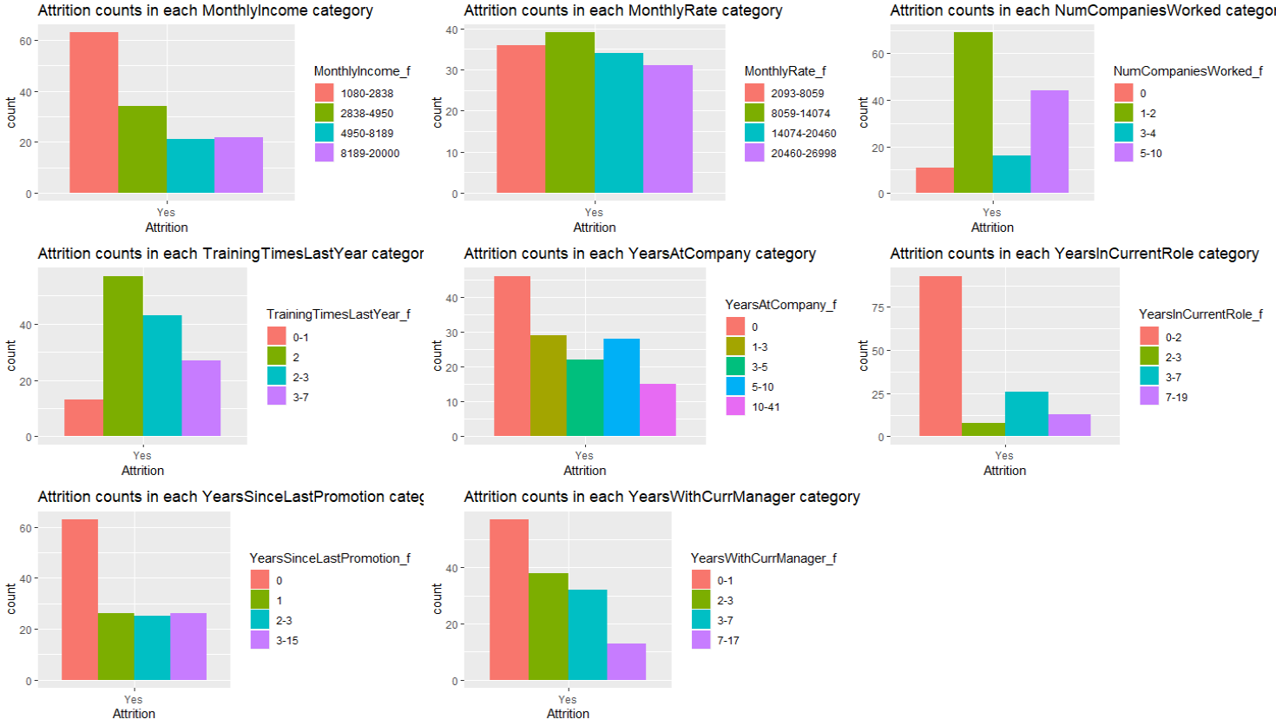
Attrition by different measures contd.

Slide 19
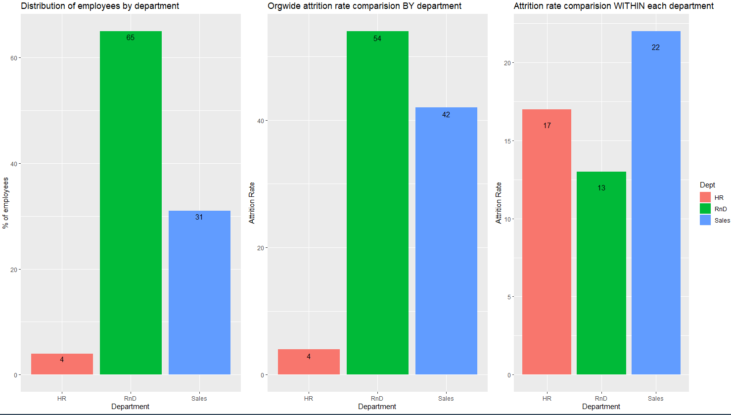
Attrition Analysis by Department
22% of employees in Sales department left the company compared to 13% in RnD
All numbers represent %

Slide 20
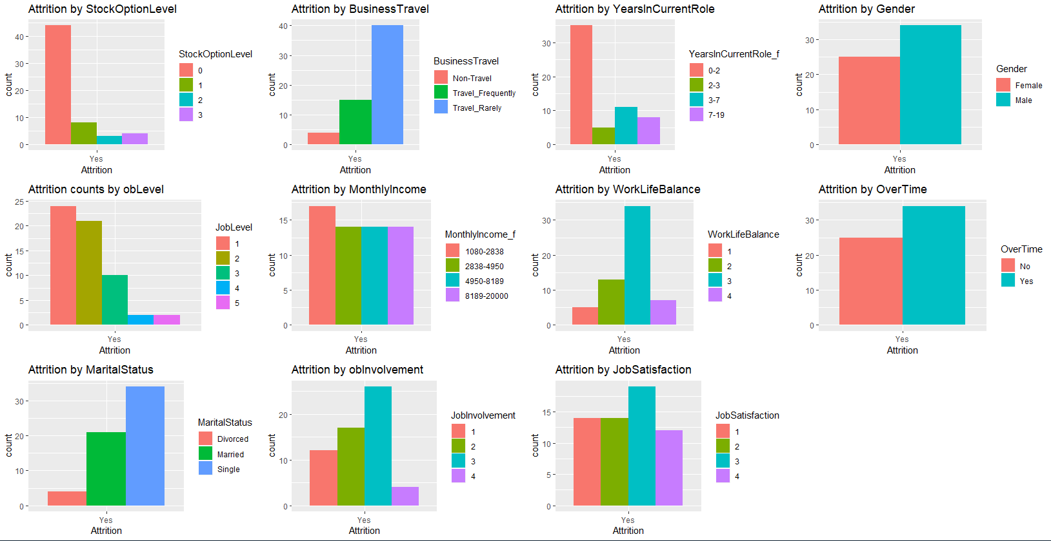
Attrition Sales Department deep dive

Slide 21
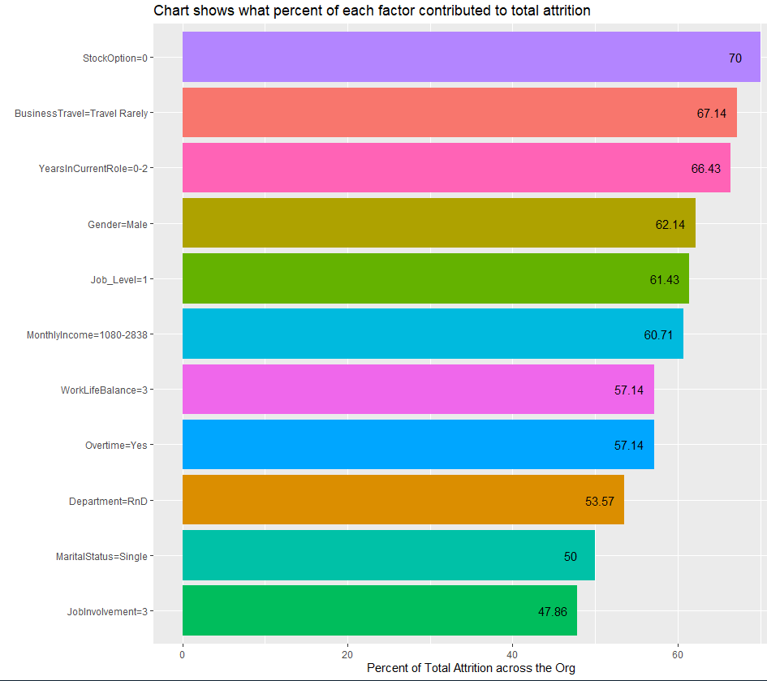
Top factors influencing Attrition
All numbers represent %

