Slide 1
COVID-19: Influence of Vaccine Rates on the Death Rates in US SMU MSDS 6373 – Time Series Submitted by: Simerpreet Reddy & Tai Chowdhury Date: March- 28th - 2021

Slide 2
Introduction
COVID-19 :
Contagious disease caused by severe acute respiratory syndrome coronavirus 2 (SARS-CoV-2).
Has led to an ongoing pandemic.
Vaccination introduced in the US in Dec. 2020.
Objective of the Analyses: Analyze influence of Covid-19 Vaccination Rates on the Death Rates in the US. Additional details such as ‘# of Hospitalizations’ and ‘# of ICU patients’ will also be analyzed as part of the multivariate analysis.
Data set*: Daily data since the first vaccine got administered in the US i.e., 12/21/20 through 03/26/2021 (96 observations).
Columns: 96 observations with the following attributes: Date, New Cases per million, New Deaths per million, New ICU patients per million, New Hospitalizations per million, New Vaccinations per million
Source: Coronavirus (COVID-19) Vaccinations - Statistics and Research - Our World in Data. It is updated daily and includes data on confirmed cases, deaths, hospitalizations, testing, and vaccinations as well as other variables of potential interest.
* We have full data set as well beginning 1/23/2020 for initial visualization.
 | Worldwide | United States
Total# of Confirmed Cases | 124M | 30M
Total# of Deaths | 2.7M | 550K
Notes:
https://www.worldometers.info/coronavirus/?utm_campaign=homeAdUOA?Si

Slide 3
Time series Analysis

Slide 4
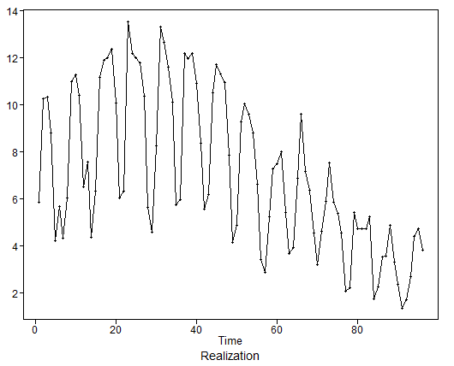
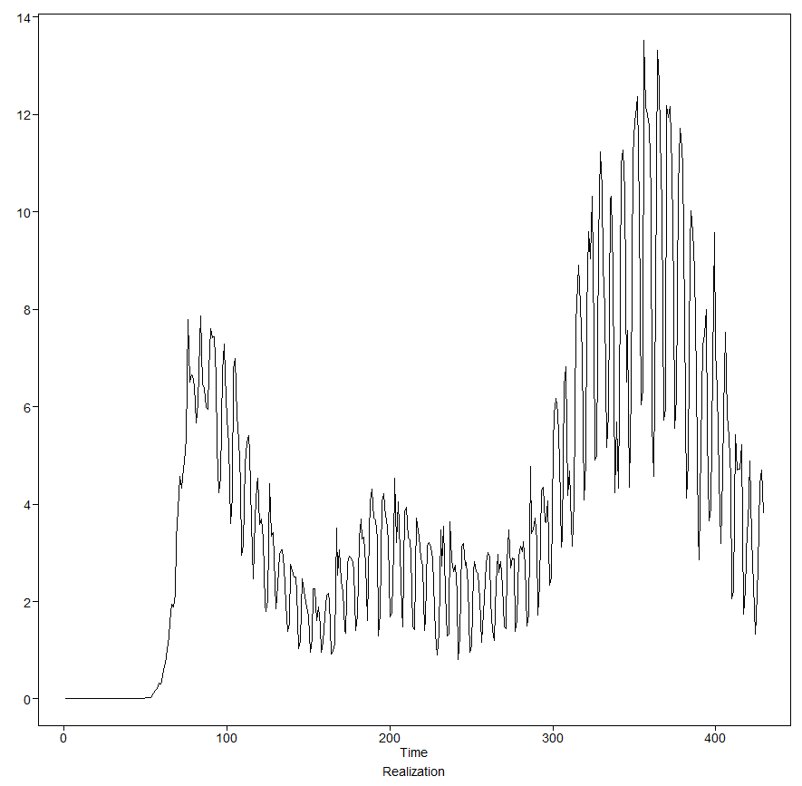
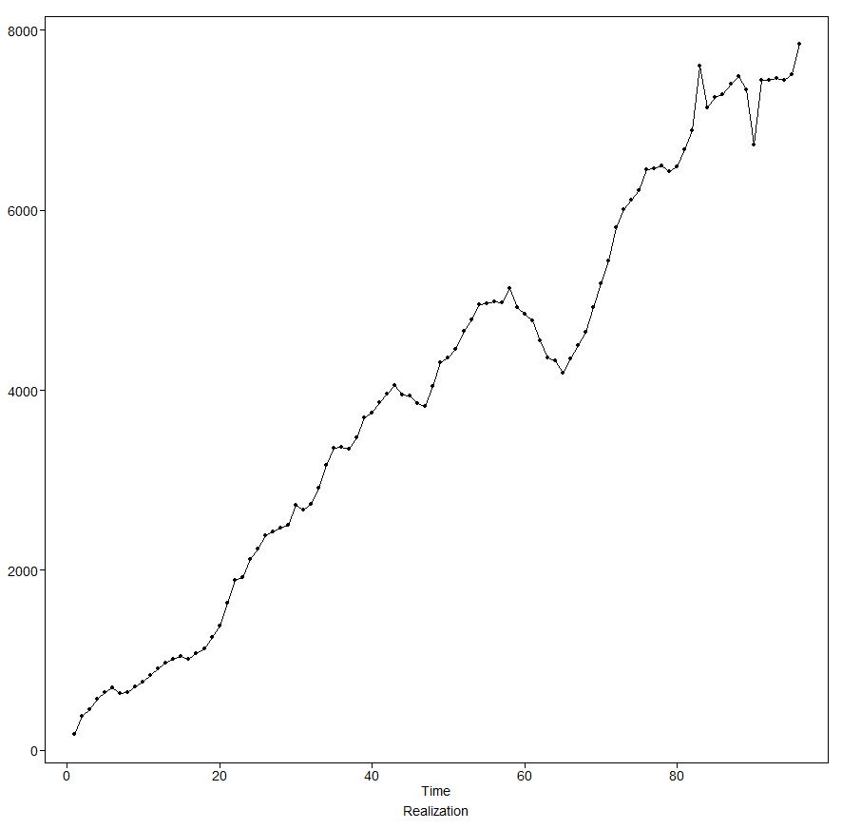
New Deaths per million per day since 01/23/2020
Visualizing time series
First vaccine administered in the US
New COVID-19 Deaths per million per day since 12/21/2020
New COVID-19 Vaccinations per million per day since 12/21/2020
Notes:
https://www.worldometers.info/coronavirus/?utm_campaign=homeAdUOA?Si

Slide 5
Univariate Analysis

Slide 6
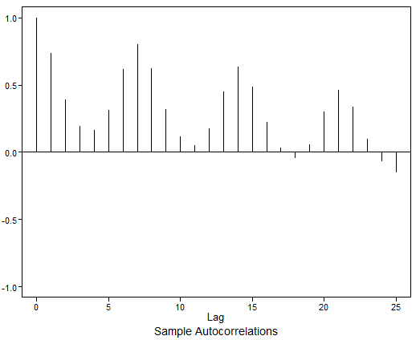
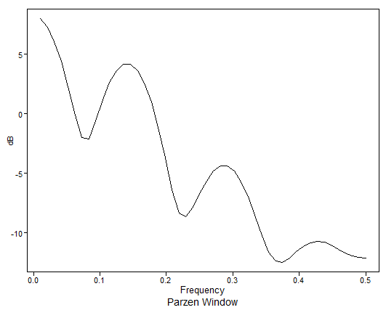
New Deaths per million per day since 12/21/2020
0.1407 ~ 7-day trend
Non- Stationary wandering data
Autocorrelations are correlated (not white noise).
Damped sinusoidal ACFs indicate seasonality.
Frequency peak at 0.1407 indicates weekly trend (1/0.1407 ~ 7)
Notes:
https://www.worldometers.info/coronavirus/?utm_campaign=homeAdUOA?Si

Slide 7
Building ARIMA Models

Slide 8
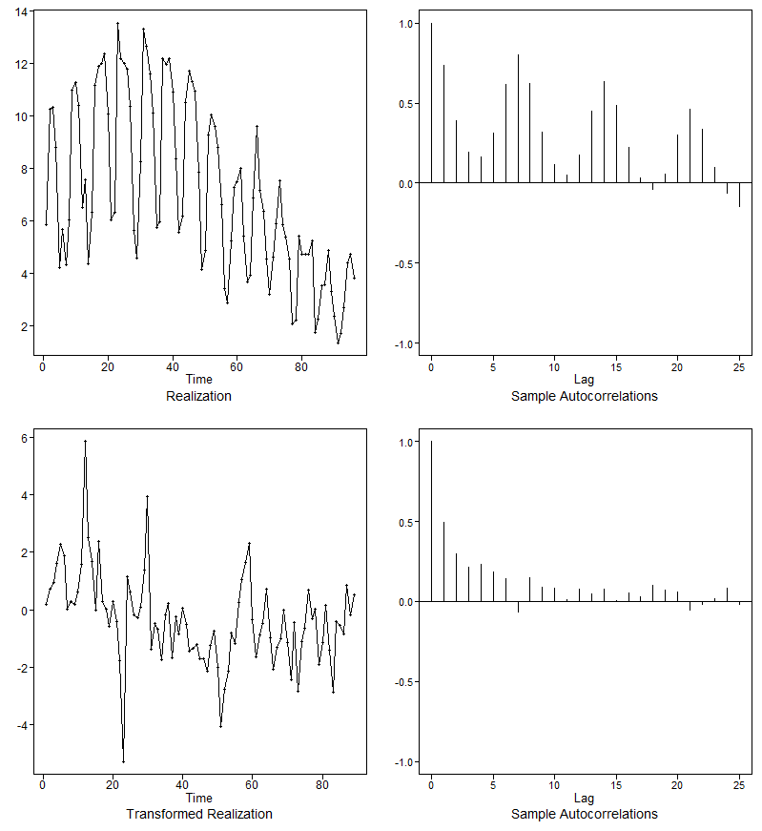
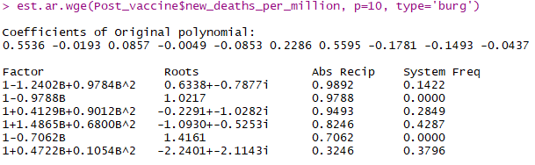
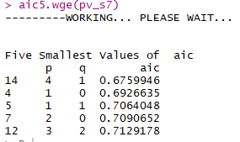
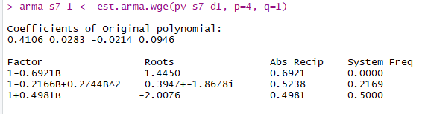



Model 1: ARIMA: Seasonal (1-B⁷) term
Overfitting

Slide 9
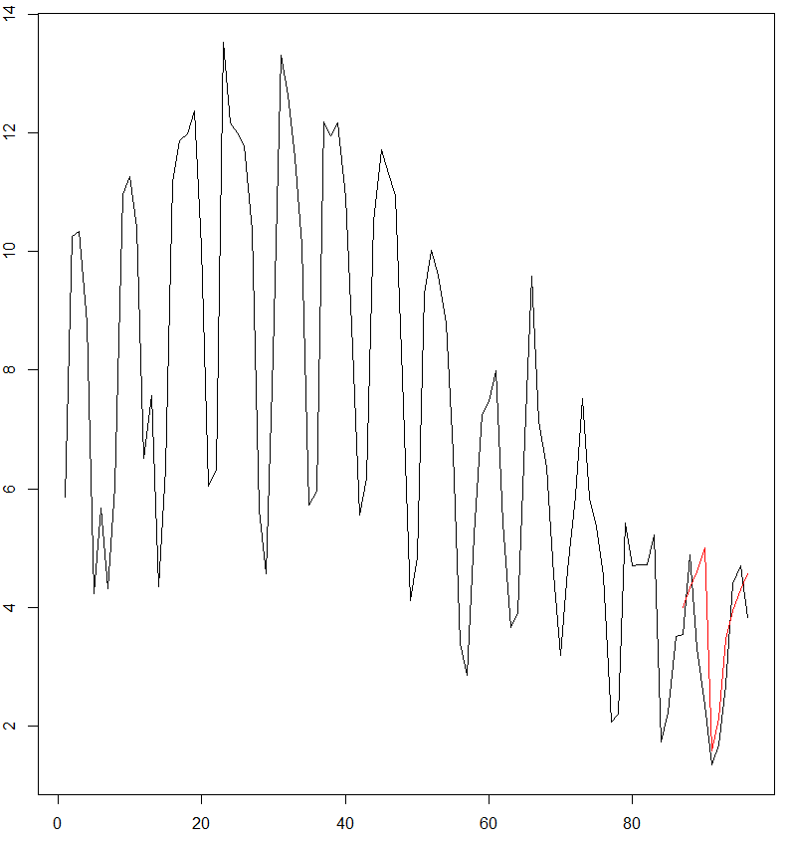
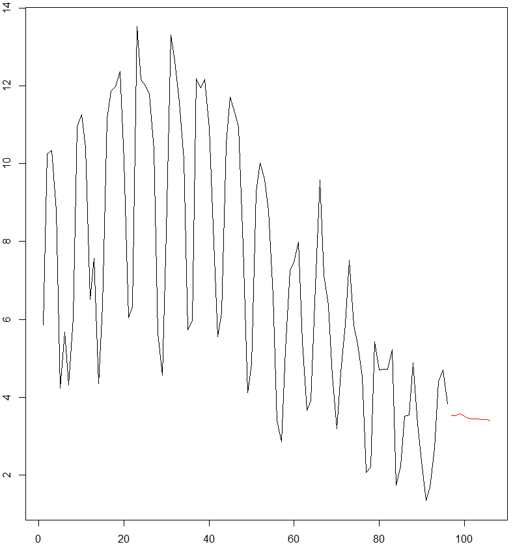
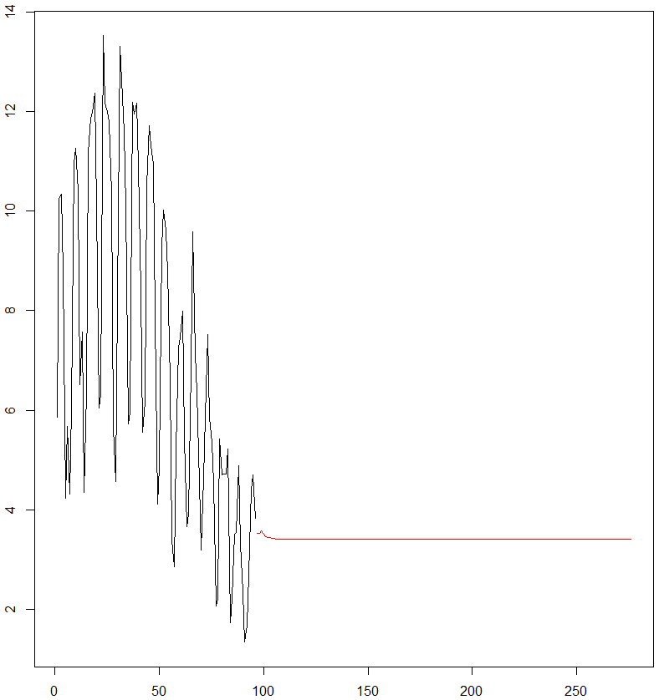
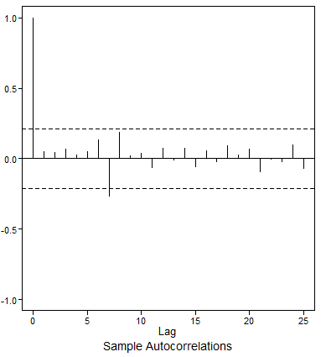
10-day forecast using ARIMA(4,0,1), s=7 with nlast=T
Forecasting – ARIMA(4,0,1) ,s =7
Model equation: (1 – B⁷)φ₄ (B) (X_{t} – 7.09 ) = (1 - 0.99B) a_{t} , σ_{a}² = 1.96
φ₄ (B) = (1 - 0.41B - 0.028B² + 0.02B³ - 0.09B⁴)
AIC | ASE | Rolling Window ASE
0.81 | 1.095 | 89.41
Short term forecast (n=10)
Long term forecast (n=180)
ACF of Model Residuals
Indication of non-white noise

Slide 10
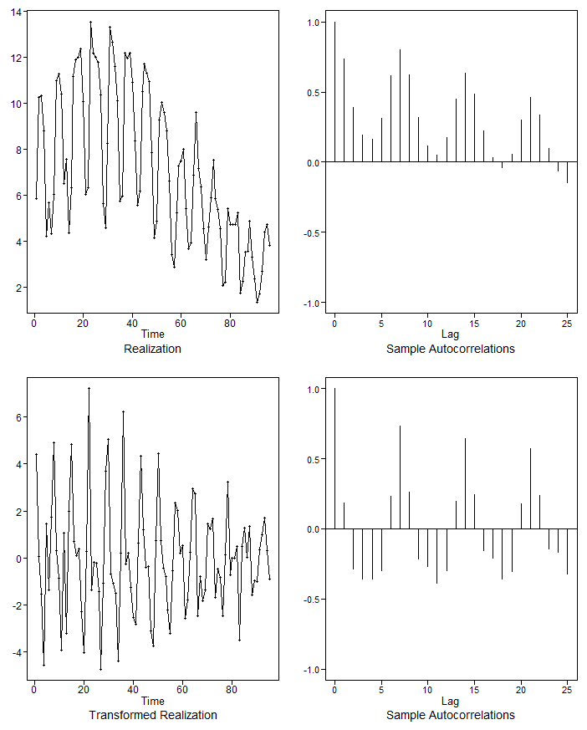
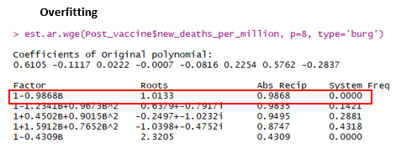

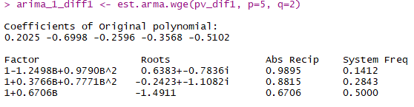


Model 2: ARIMA: First difference (1-B) term

Slide 11
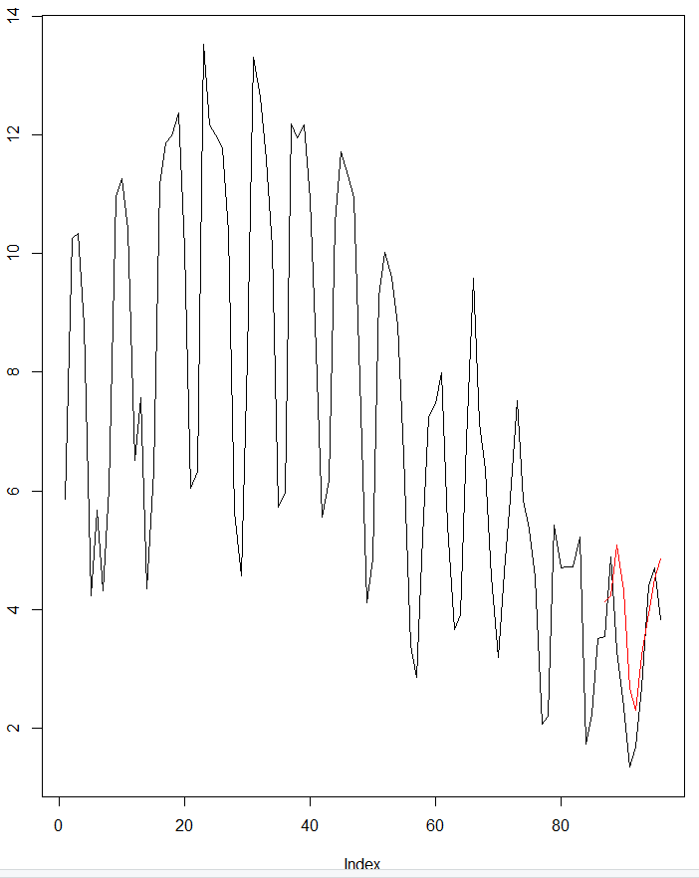
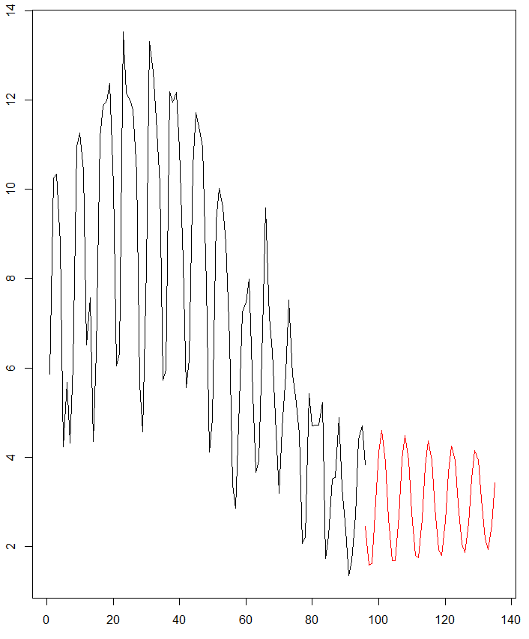
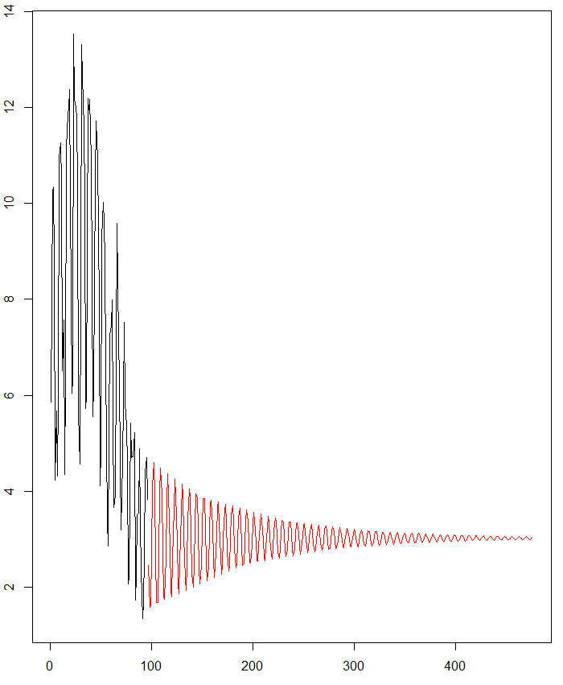
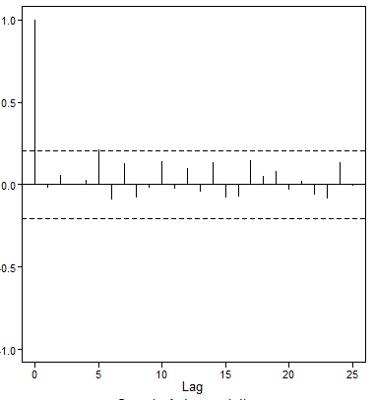
10-day forecast using ARIMA(5,1,2) with nlast=T
Forecasting – ARIMA(5,1,2),s=0
Model equation: (1 – B)φ₅ (B) (X_{t} – 7.09 ) = (1 - 0.69B + 0.46B²) a_{t} , σ_{a}² = 1.63
φ₅ (B) = (1 - 0.2B + 0.7B² + 0.27B³ + 0.35B⁴ + 0.5B⁵)
 | AIC | ASE | Rolling Window ASE
ARIMA(5,1,2), s=0 | 0.65 | 1.16 | 2.01
ARIMA(4,0,1), s=7 | 0.81 | 1.095 | 89.41
Short term forecast (n=40)
Long term forecast (n=380)
ACF of Model Residuals
Slight indication against white noise

Slide 12
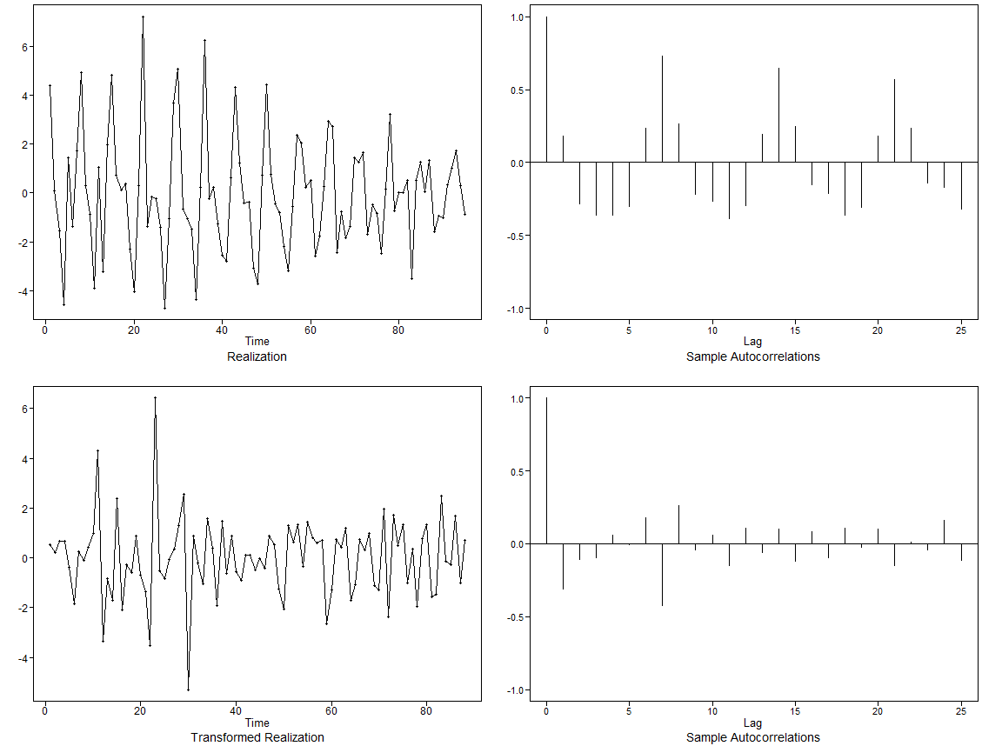
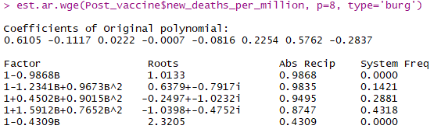
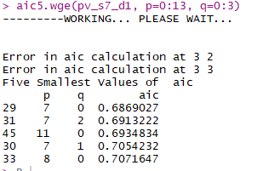
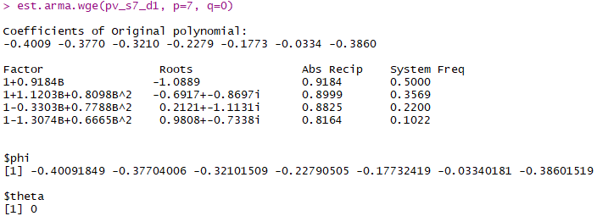

Model 3: ARIMA: (1-B) plus seasonality (1-B⁷) term

Slide 13
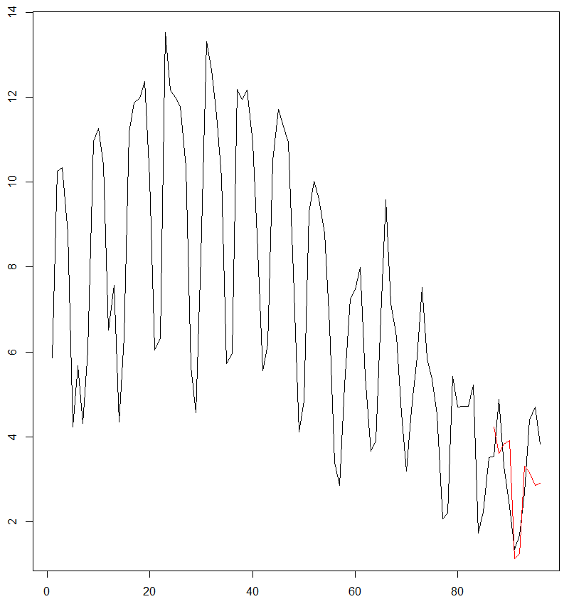
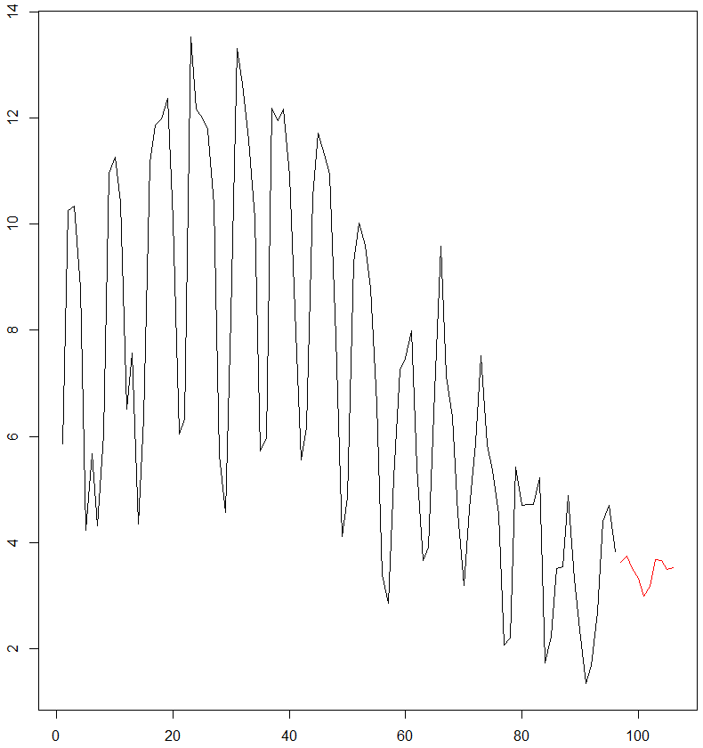
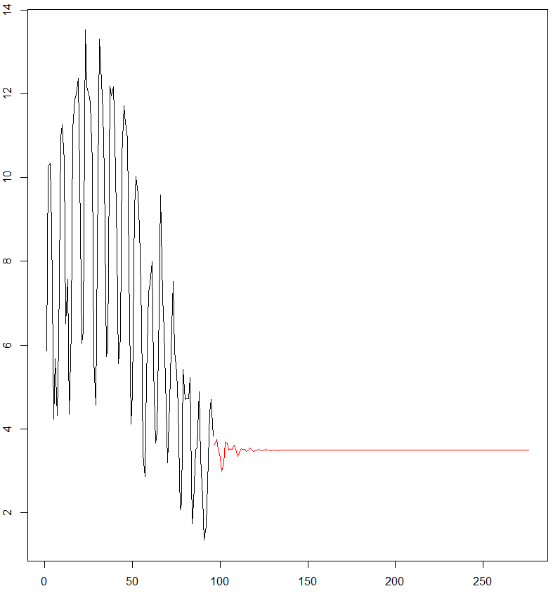
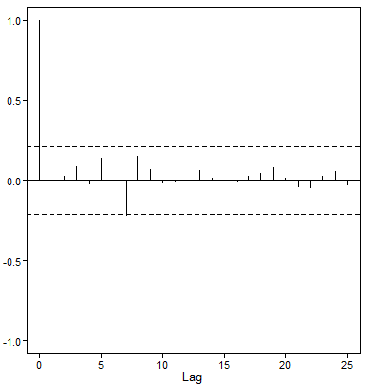
10-day forecast using ARIMA(5,1,2) with nlast=T
Forecasting – ARIMA(7,1,0) with s=7
Model equation: (1 – B)(1 – B⁷)φ₇ (B) (X_{t} – 7.09 ) = a_{t} , σ_{a}² = 1.657
φ₇ (B) = (1 + 0.40B + 0.37B² + 0.32B³ + 0.23B⁴ + 0.18B⁵ + 0.03B⁶ + 0.38B⁷)
 | AIC | ASE | Rolling Window ASE
ARIMA (7,1,0), s=7 | 0.68 | 1.12 | 1.92
ARIMA(5,1,2), S=0 | 0.65 | 1.16 | 2.01
ARIMA(4,0,1), s=7 | 0.81 | 1.095 | 89.41
Short term forecast (n=10)
Long term forecast (n=180)
ACF of Model Residuals

Slide 14
Next Steps

Slide 15
Next Steps
Explore more ARIMA/ARUMA models.
Study model residuals in detail.
Build Multivariate and VAR models using the following attributes:
New Vaccinations per million
New Cases per million
New ICU patients per million
New Hospitalizations per million
Neural Network
Ensemble Model

