Slide 1

Advanced Analytics on Budweiser data
SMU DDS: Case Study 1
By: Simerpreet Reddy
Date: 01/22/2020

Slide 2
Provide insights from Beers and Breweries data on following aspects: Brewery and beer distribution by State Comparison of ABV and IBU by- State Beer Style – IPA and Other Ales *ABV - Alcohol by Volume IBU - International Bitterness Unit IPA - India Pale Ale
Purpose

Slide 3
Source Data
The analysis is based on the following Budweiser data:
Beers: Contains the following details for 2410 Budweiser Beers:
Beer Name
ABV
IBU
Beer Style
Ounces
and the brewery it comes from.
Breweries: Contains the details for 558 Budweiser Breweries:
Brewery name
City
and State the brewery is located in.

Slide 4
INSIGHTS FROM THE ANALYSIS

Slide 5
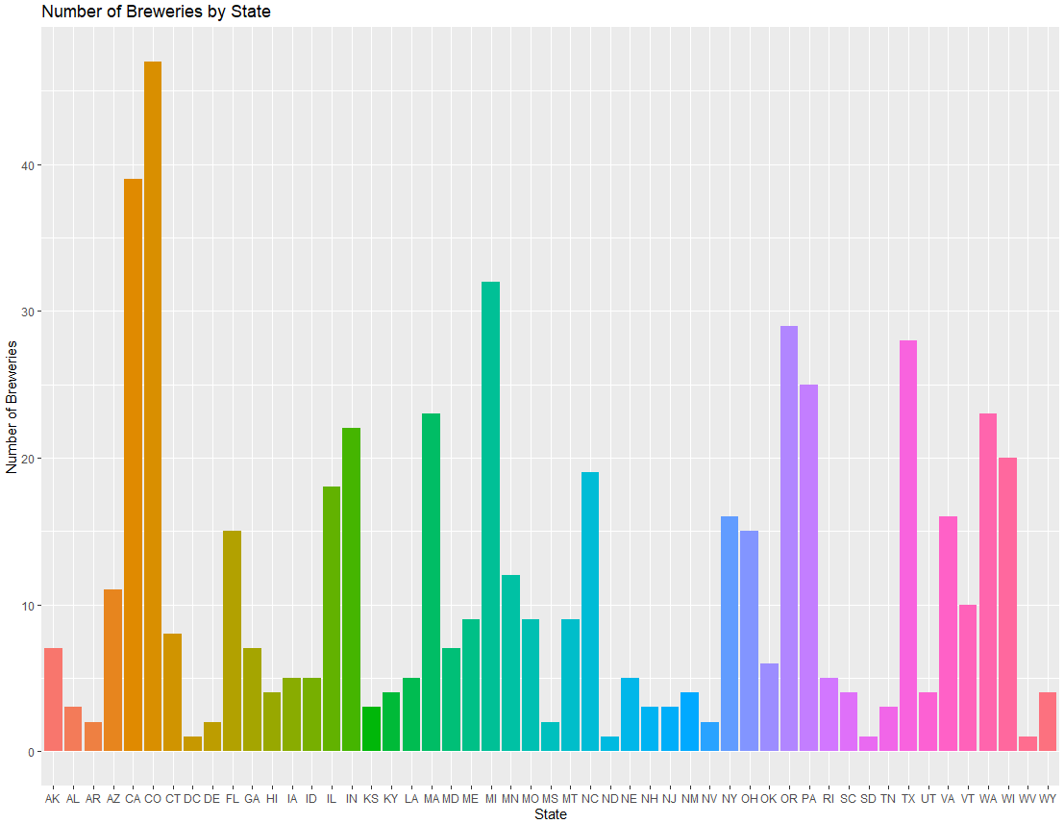
Number of Breweries by State
Most number of breweries
47 in CO
Followed by CA at 39
Least number of Breweries:
1 each in
WV, DC, SD and ND

Slide 6
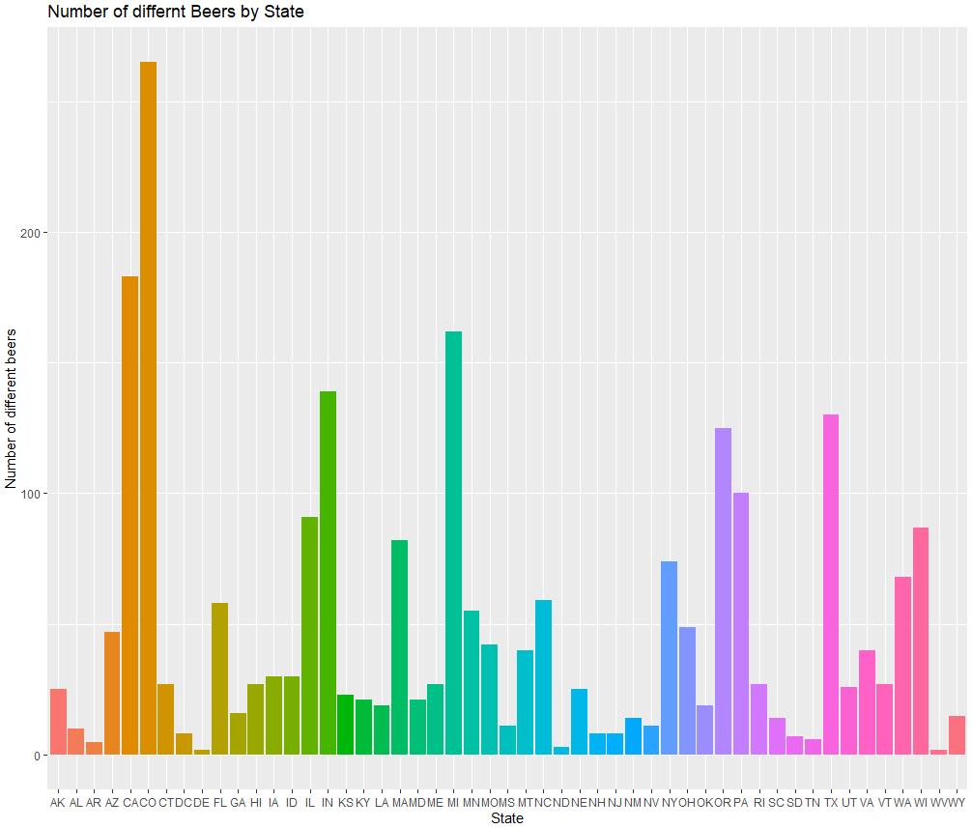
Number of different beers by State
State with the greatest number of beers
CO, followed by CA.

Slide 7
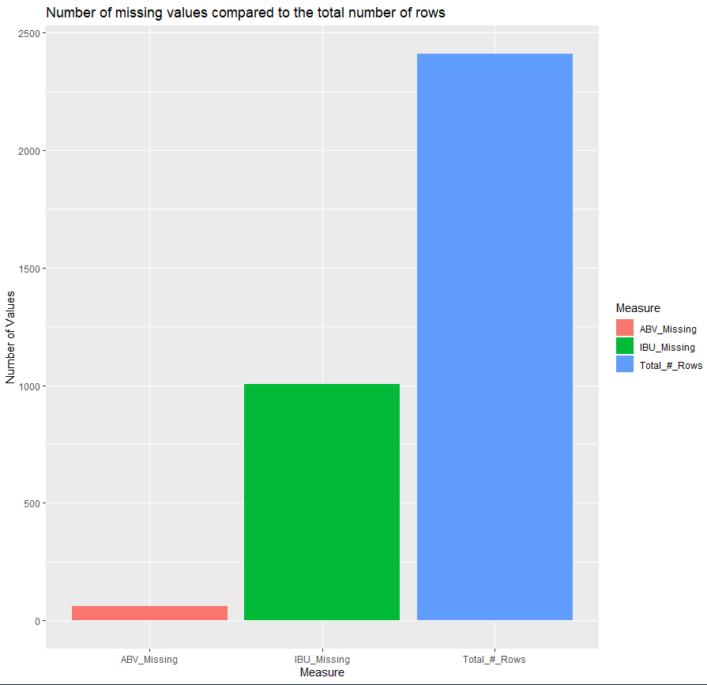
Missing value points
Total Number of Rows in the data set : 2410
Measure | # of Missing Rows
ABV | 62
IBU | 1005

Slide 8
Addressing Missing Values

Slide 9
Factors influencing ABV and IBU
Beer Style*
State the beer comes from – is data equally distributed?
*Analysis focuses primarily on IPAs and Other Ales
Notes:
As the number of rows with missing IBU and ABV is pretty high, I decided to replace the nulls with some comparable data which is the median value by each State and Beer Style category.

Slide 10
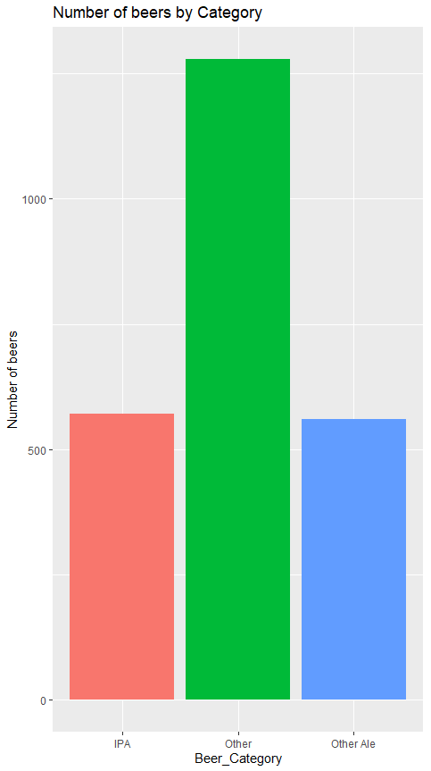
Beer Category

Slide 11
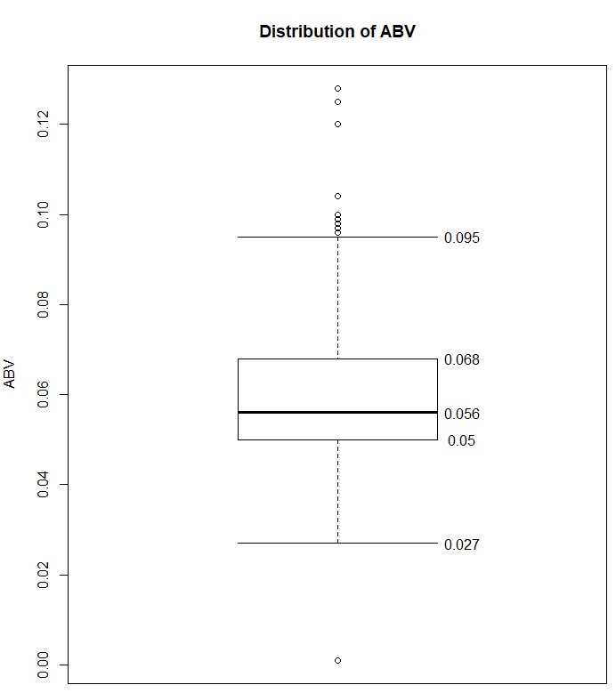
Distribution of ABV

Slide 12
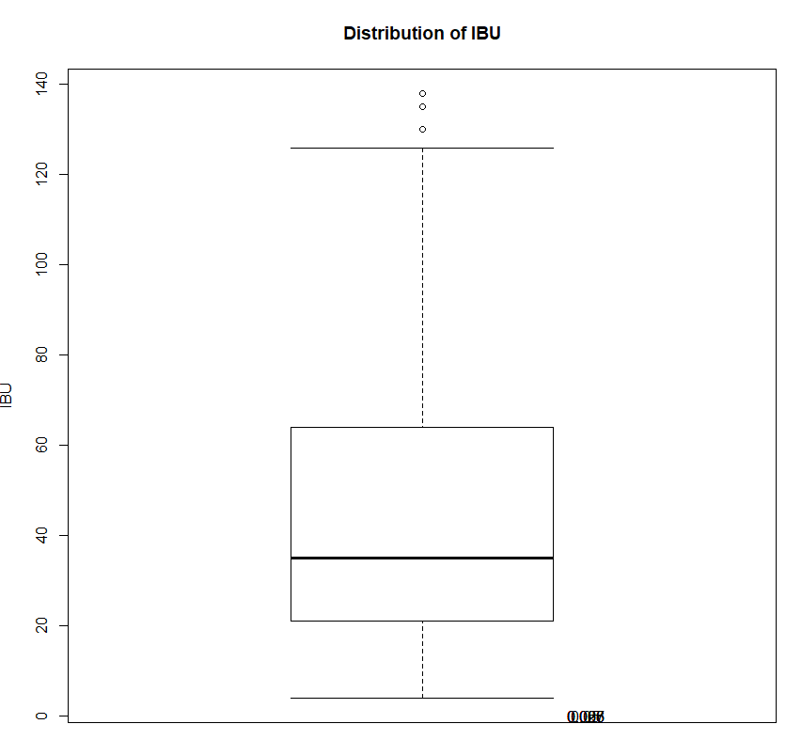
Distribution of IBU

Slide 13
Approach to handle missing values
As there are outliers in the data
Replaced missing values by Median (not mean) by each Beer Category
*Analysis focuses primarily on IPAs and Other Ales
Notes:
As the number of rows with missing IBU and ABV is pretty high, I decided to replace the nulls with some comparable data which is the median value by each State and Beer Style category.

Slide 14
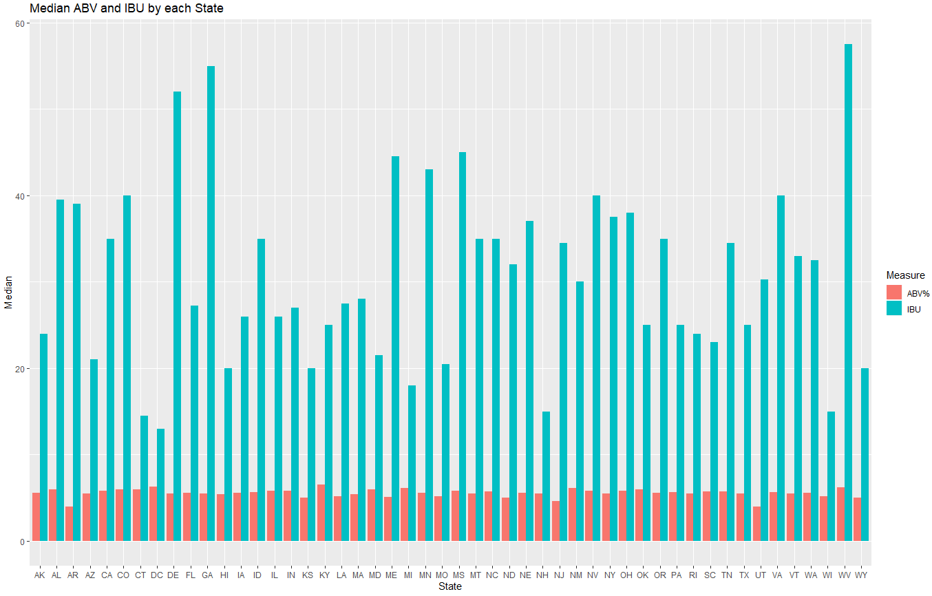
Median ABV and IBU by each State

Slide 15
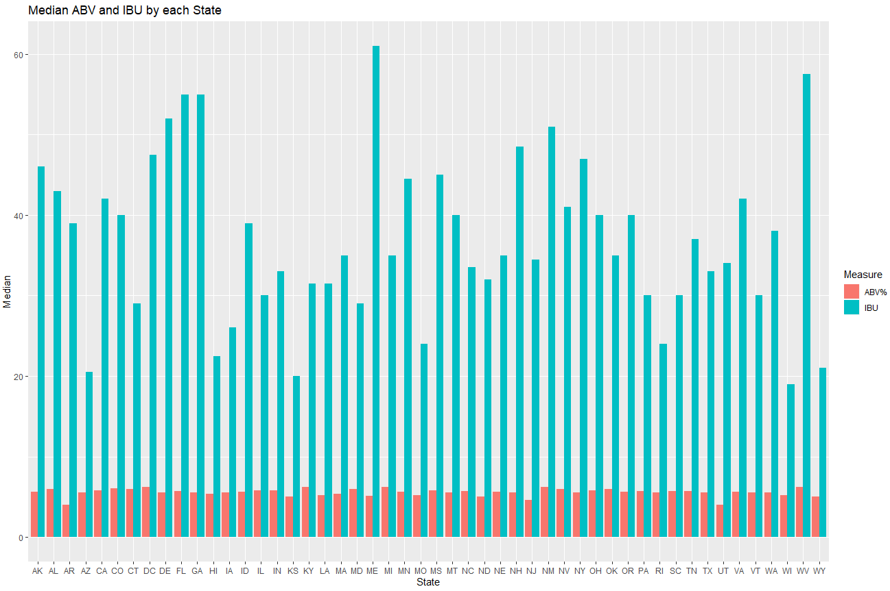
Median ABV and IBU by each State – Raw Data

Slide 16
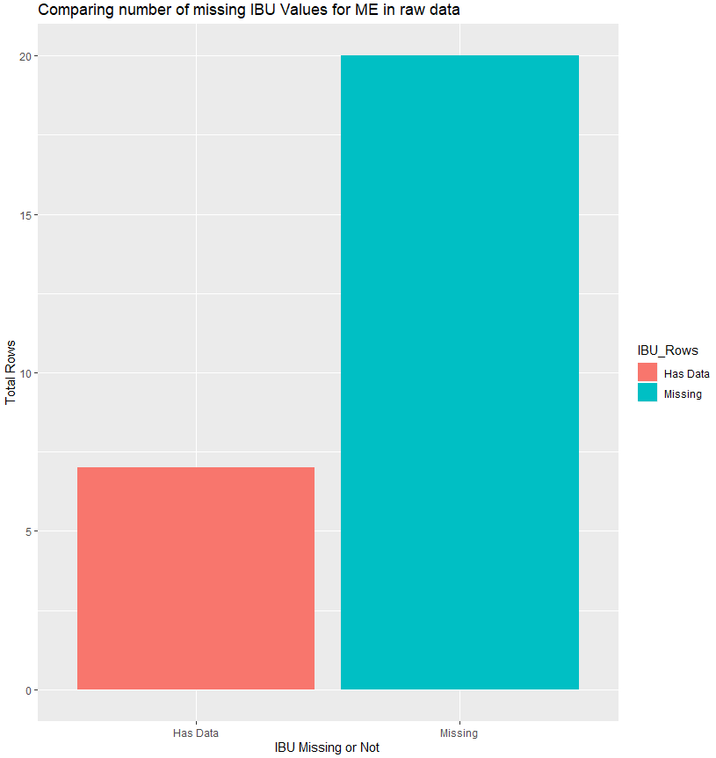
MAINE Data

Slide 17
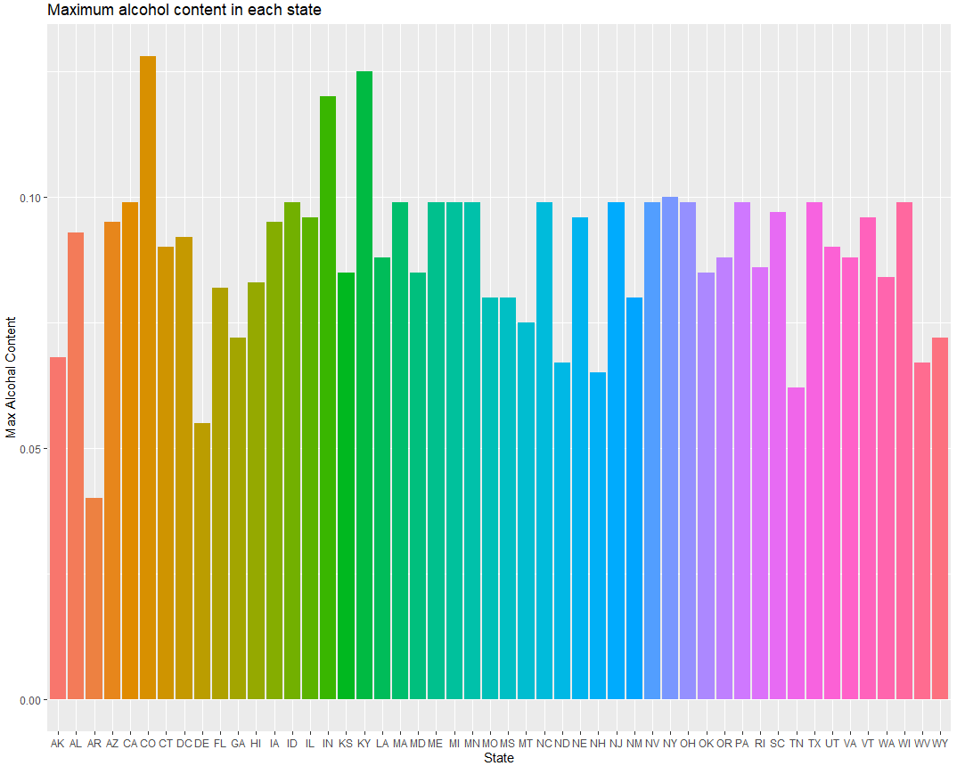
States by maximum alcohol content
CO has the beer with the max alcohol content 12.8%

Slide 18
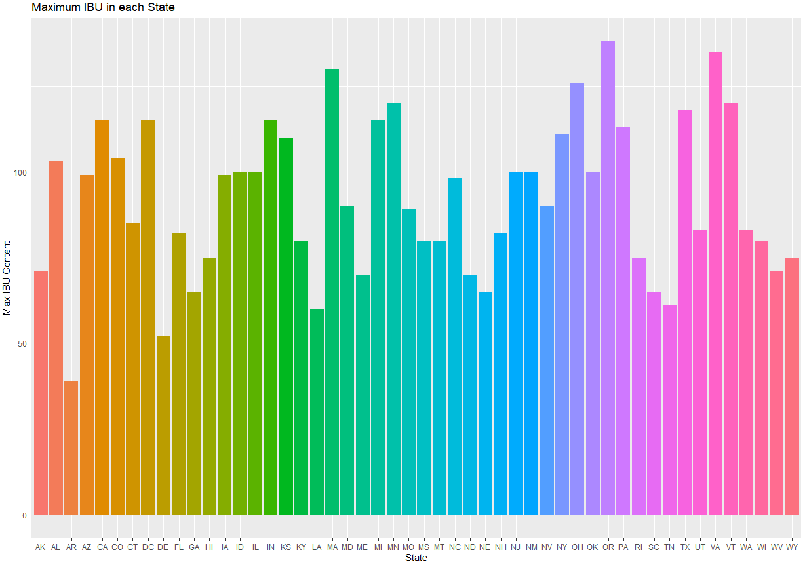
States by most bitter beer
OR has the most bitter beer
IBU=138

Slide 19
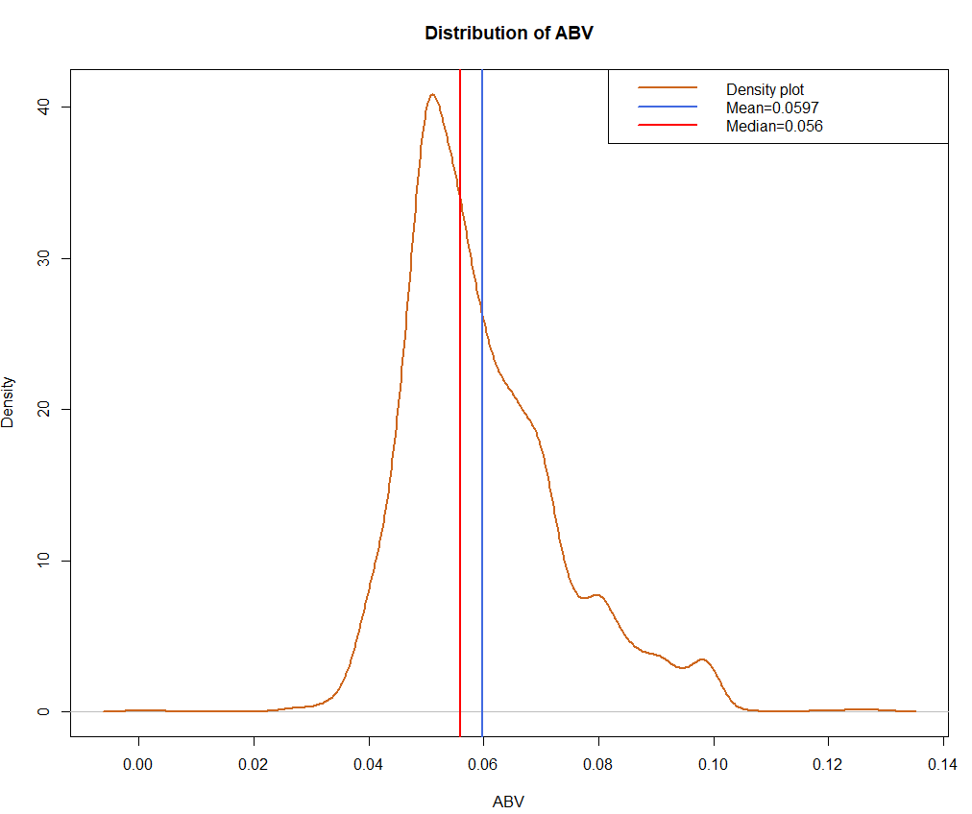
Distribution of ABV variable

Slide 20
Relationship between ABV and IBU

Slide 21
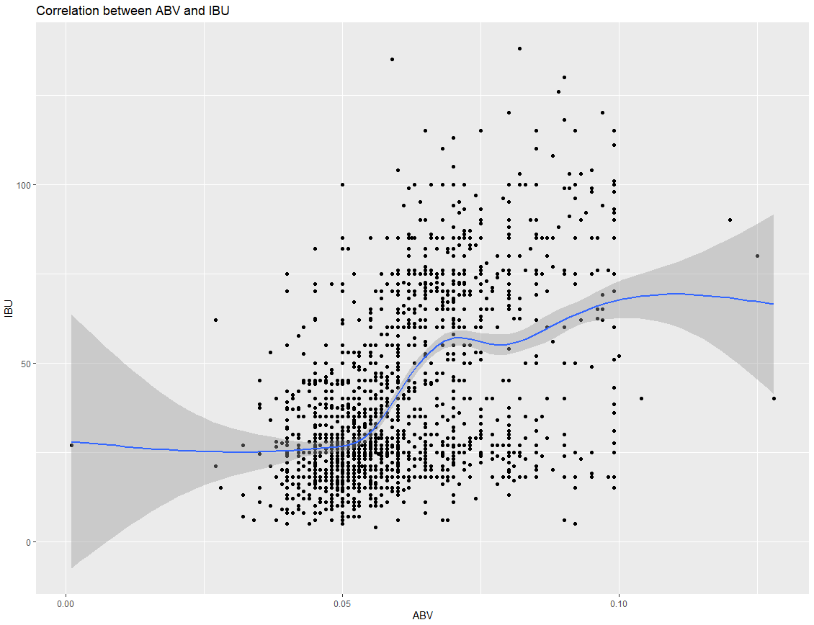
Correlation between bitterness of the beer and it's alcoholic content

Slide 22
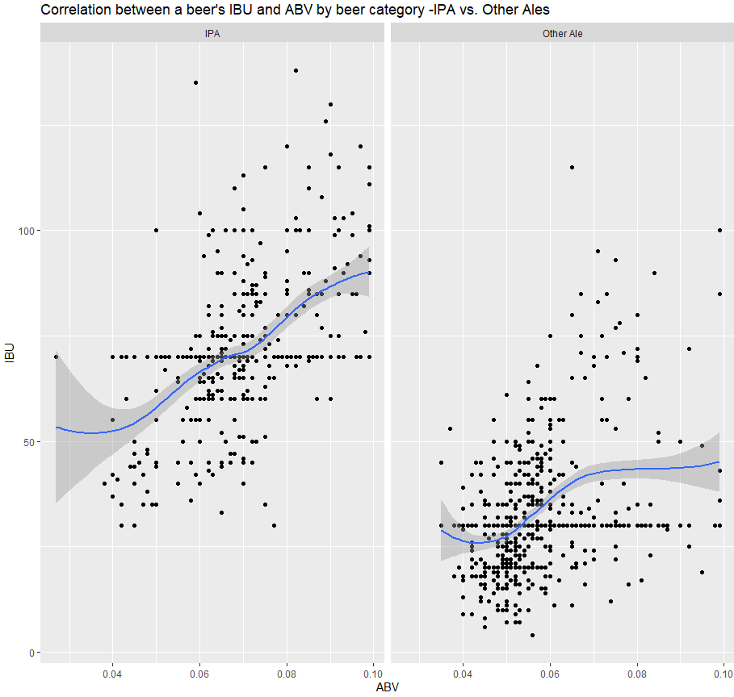
Correlation between bitterness of the beer and it's alcoholic content

Slide 23
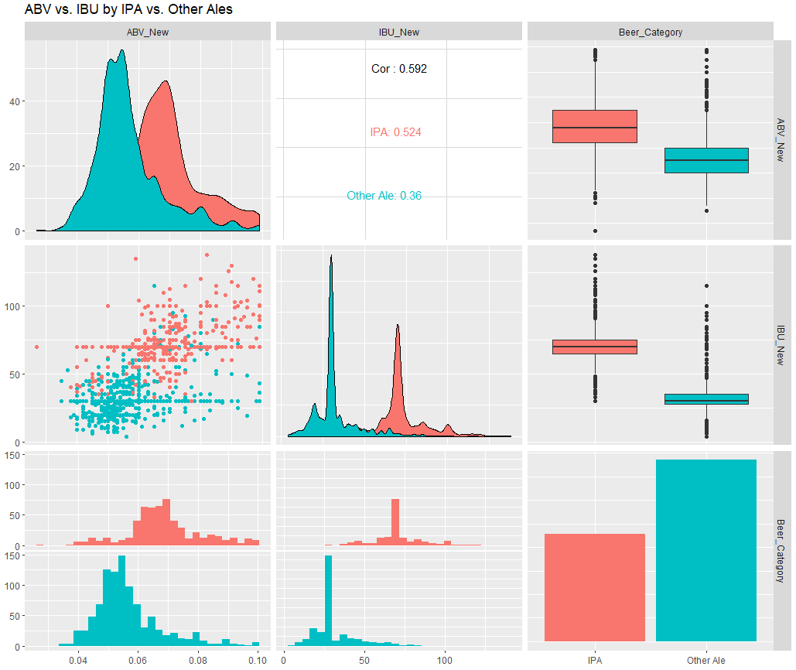
ABV and IBU comparison by Beer Categories

Slide 24
Modeling the data

Slide 25
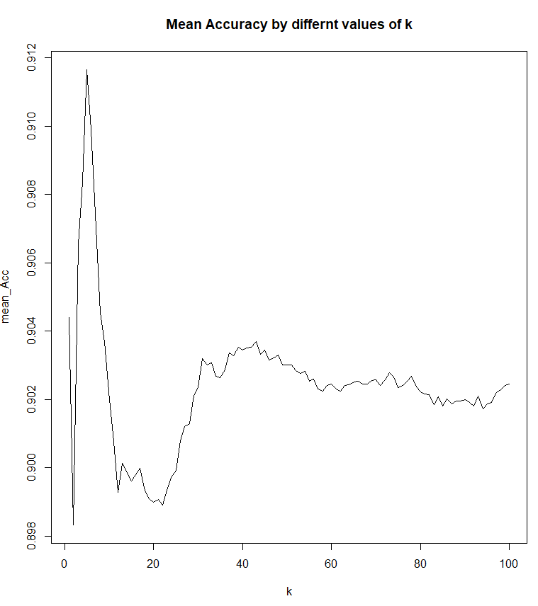
Used KNN Model to categorize Beers on ABV and IBU measures
~92% Accuracy for k=5

Slide 26
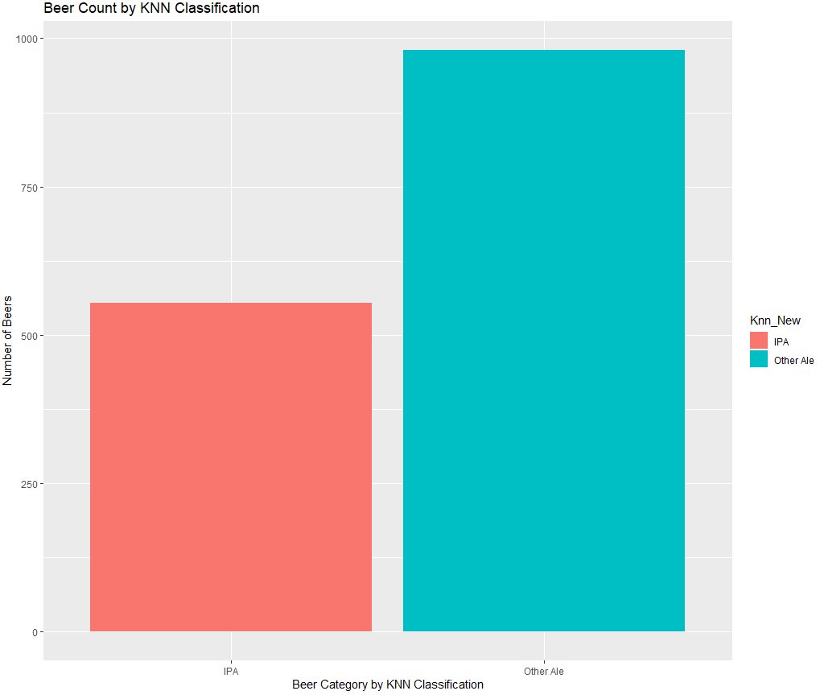
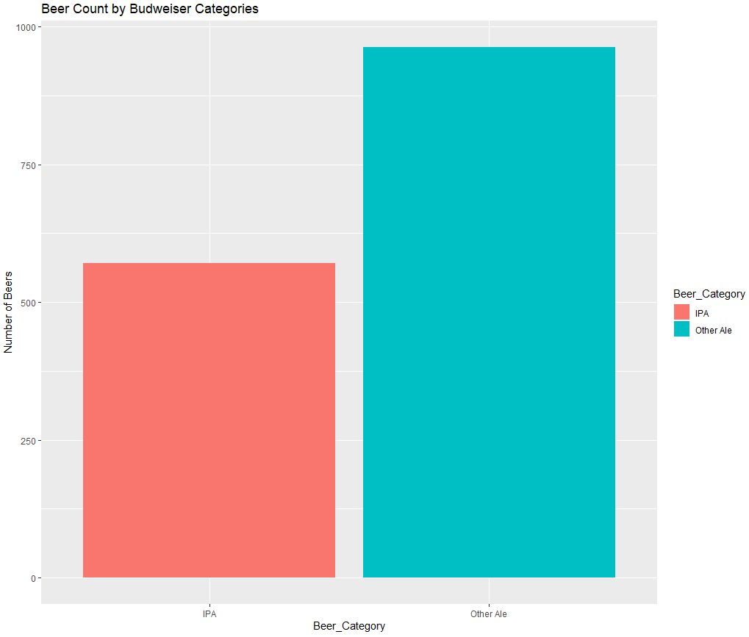
Beer Category Conflicts

Slide 27
Conclusion based on KNN model
Among all IPA and Other Ales, 119 Beers seem to have been miscategorized
68 miscategorized as IPA
51 miscategorized as Other Ales

Slide 28
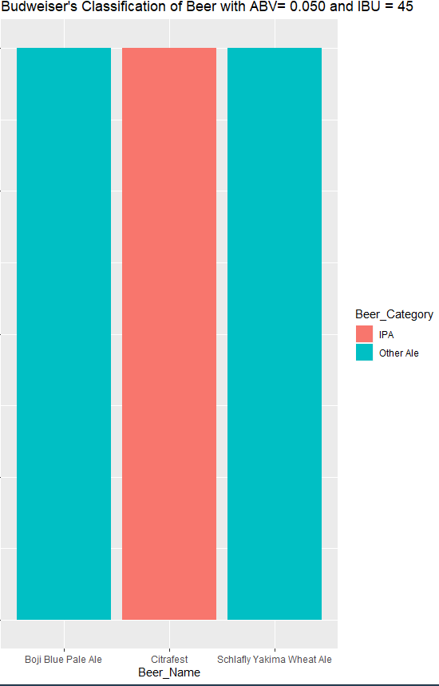
An example of Beer Category Conflicts

Slide 29
Take Away
Conflicting ‘beer style’ and ‘expected taste’ can affect the sale of the beer, so we need to correct the classification
119 beers are candidates for re-classification for Beer Style based on their Alcohol content and bitterness levels.

