Slide 1



ACCFIN4063: Psychology and Financial Markets
In-class experiment: Market prices with private information
Dr Hormoz Ramian
Dr Ufuk Güçbilmez

Slide 2
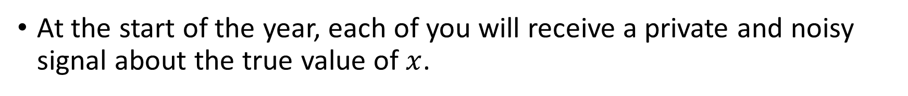
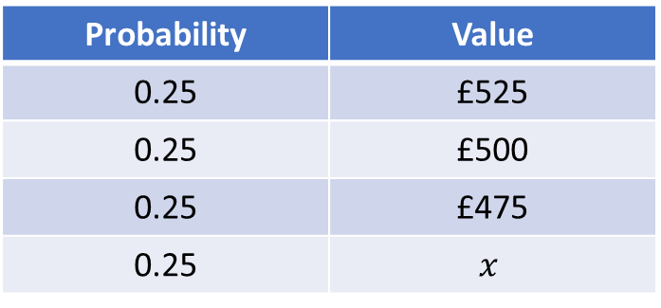
Background
A stock is currently trading for £500.
At the end of the year, the value of the stock will be:
Probability | Value
0.25 | £525
0.25 | £500
0.25 | £475
0.25 | $$x$$
At the start of the year, each of you will receive a private and noisy signal about the true value of $x$.

Slide 3
Your task
There will be 10 to 15 trading rounds during the year.
In each round, you are required to submit:
Bid quote: The maximum price at which you’re willing to buy the stock.
Ask quote: The minimum price at which you’re willing to sell the stock.

Slide 4
Market clearing
At the end of each round, the market is cleared centrally.
And, one of the three following things will happen:
Your bid quote will be executed and your stock holdings will increase by 1 share.
Your ask quote will be executed and your stock holdings will decrease by 1 share.
Neither of your quotes will be executed and your stock holdings will not change.

Slide 5
Example
Say, your bid quote is £499 and your ask quote is £501.
Then, at the end of the round, you may end up:
Buying 1 share for £499 or less.
Selling 1 share for £501 or more.
Neither buying nor selling any shares.

Slide 6
Your objective
You should aim to buy low and sell high across trading rounds to make a profit.
At the end of each round, you will be able to observe the quotes and profits/losses of all traders (including yourself).
Your ultimate objective is to maximise your total profit across trading rounds.

