Slide 1
OpenStreetMap address base: ready for prime time?
Maxim Dubinin
sim@gis-lab.info
SotM Baltics 2013

Slide 2
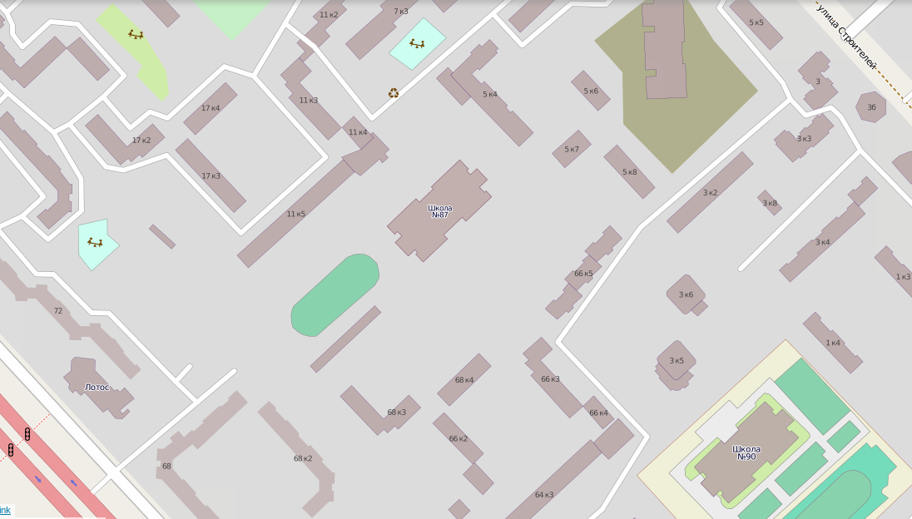

Slide 3
The Question
Can OpenStreetMap address database be used to create complete geographic datasets?

Slide 4
Setup
Creation of data layers for different features
Large areas (Russia)
Thousands objects
Practical applications

Slide 5
You will find answers here for...
How good is OSM address database and fully automatic geocoding?
How much does postprocessing help?
How is completeness distributed across Russia?
How good is the quality compared to other geocoders?

Slide 6
...but, nothing about...
What are the mistakes of geocoding and how it can be improved?
What is the right scheme for addressing?
When will OSM take over the world?

Slide 7
Some definitions
Result — correct lat/long for an address
Result ~ data preparation + geocoding + postprocessing
Data prep — make well structured address
Geocoding — find lat/long for it with osm.org.ru
Postprocessing — fix it manually if wrong

Slide 8
Examples
OpenPolice — where are the local cops in Moscow
Elections — where are the voting stations in Moscow
Orphanages — where are the children orphanages in Russia

Slide 9
Question 1
How good is OSM address database and fully automatic geocoding?
How much does postprocessing help?
How is quality distributed across Russia?
How good is the quality compared to other geocoders?

Slide 10
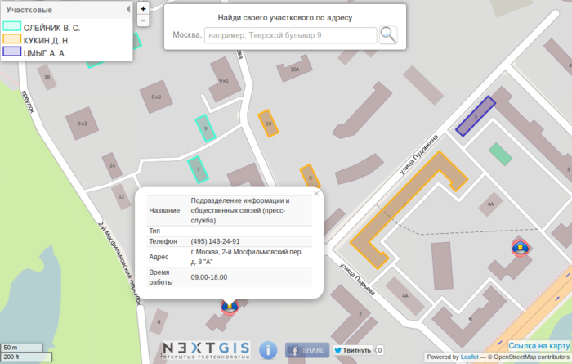
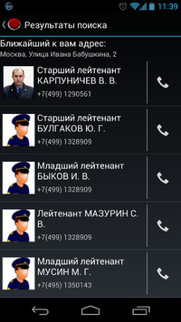
OpenPolice
Extract all addresses from 112.ru
Geocode them
Relate them to buildings in Moscow to get areas of responsibility
http://gis-lab.info/qa/openpolice.html

Slide 11
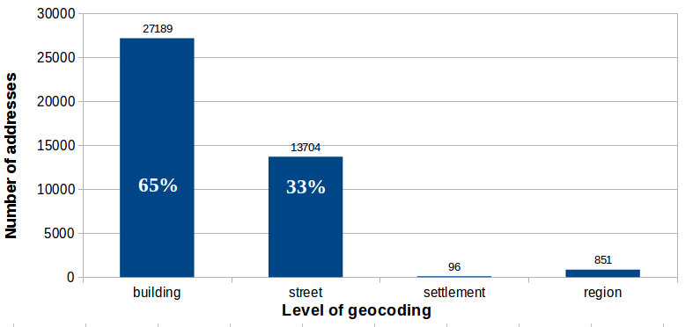
Results
Total: ~41000 addresses in Moscow

Slide 12
Question 2
How good is OSM address database and fully automatic geocoding?
How much does postprocessing help?
How is quality distributed across Russia?
How good is the quality compared to other geocoders?

Slide 13
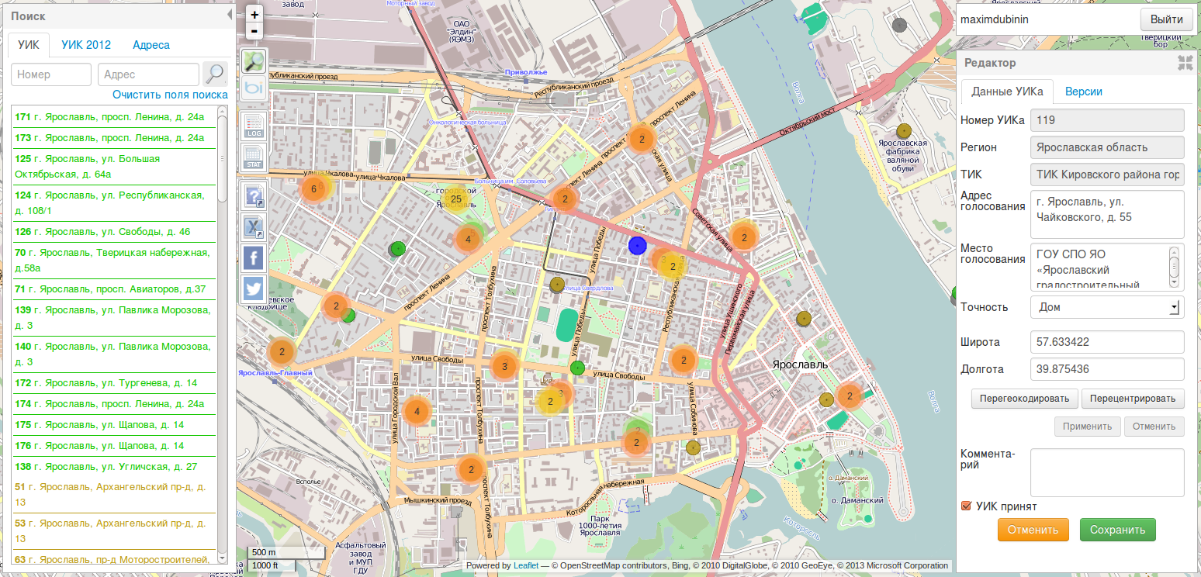
Voting comissions
Extract all addresses from public database
Geocode them
Crowdsource post-processing
http://uikgeo.gis-lab.info

Slide 14
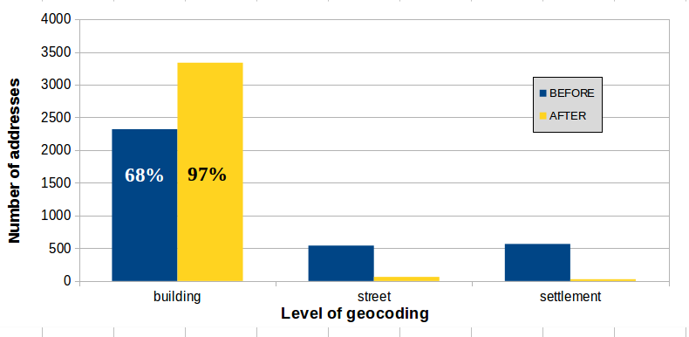
Results
Total: ~3500 addresses in Moscow
Before post-processing VS after post-processing

Slide 15
Question 3
How good is OSM address database and fully automatic geocoding?
How much does postprocessing help?
How is completeness distributed across Russia?
How good is quality compared to other geocoders?

Slide 16
Orphanages
Extract all addresses from public database
Geocode and post-process them
All regions of Russia, ~5000 orphanages total, mean 50 per region
http://gis-lab.info/qa/detdom.html

Slide 17
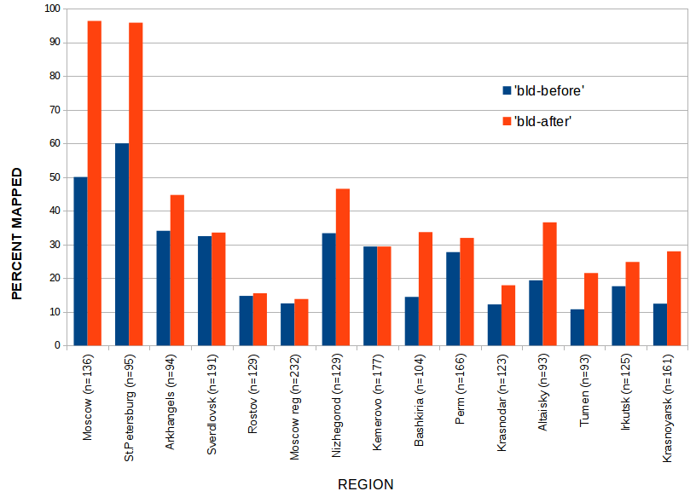
Orphanages
Buildings before and after post-proc, % total

Slide 18
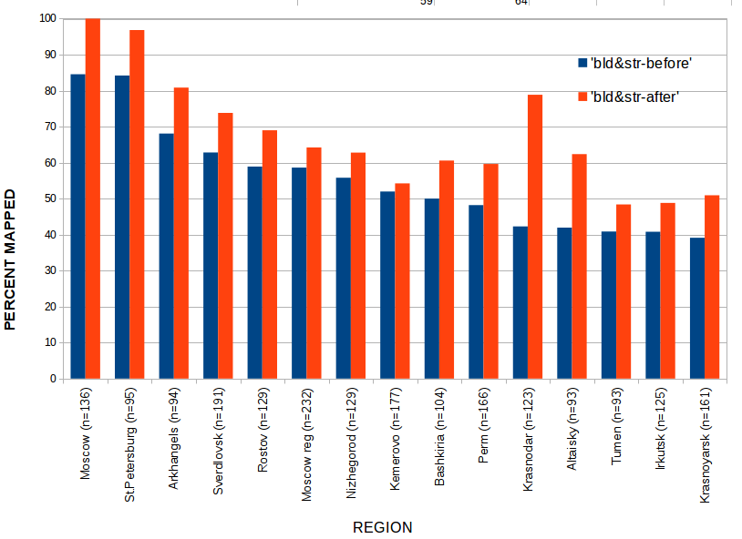
Orphanages
Buildings and streets before and after post-proc, % total

Slide 19
Question 4
How good is OSM address database and fully automatic geocoding?
How much does postprocessing help?
How is quality distributed across Russia?
How good is the quality compared to other geocoders?

Slide 20
No project, just comparison
Take few hundreds of addresses in different parts of Russia
Geocode them with OSM and Yandex
For each point, assign score: Building = 3, street = 2, settlement = 1
Sum the scores up
Compare

Slide 21
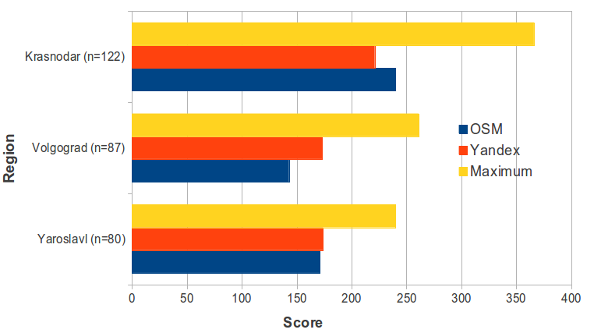
OSM vs Yandex
Summed scores for geocoding accuracy

Slide 22
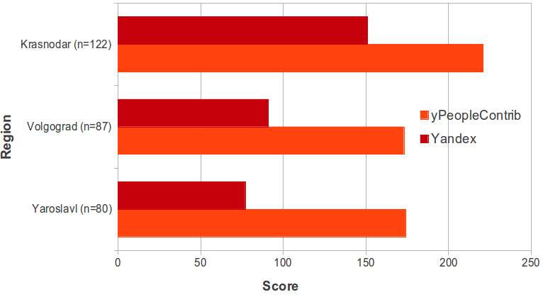
Yandex
Yandex People's map contribution to total score

Slide 23
How to get better?
Map more ;)
Improve automatic geocoding
Create positive feedback loop with geocoding projects

Slide 24
Sources for this presentation
https://github.com/simgislab/osmaddress-sotmbaltics13
Check README.md for data sources

