Slide 1


DESCRIPTIVE STATISTICAL CALCULATOR
(DATA SCIENCE 542 PROJECT)
-Simi Sudhakaran
& Sanjeev Thapar

Slide 2
WHY?
How is descriptive statistics used in business?
Descriptive statistics are used to summarize and describe total numbers. Looking at statistical numbers such as mean, or the average number, mode, or the most frequent number, or median, or the middle number, helps managers monitor business activities and make decisions.
What is the importance of descriptive statistics in business?
Descriptive statistics are very important because if we simply presented our raw data it would be hard to visualize what the data was showing, especially if there was a lot of it. Descriptive statistics therefore enables us to present the data in a more meaningful way, which allows simpler interpretation of the data
Examples in Real world:
The shooting percentage in basketball is a descriptive statistic that summarizes the performance of a player or a team
The use of descriptive and summary statistics has an extensive history and, indeed, the simple tabulation of populations and of economic data was the first way the topic of statistics appeared. More recently, a collection of summarization techniques has been formulated under the heading of exploratory data analysis: an example of such a technique is the box plot
Investors and brokers may use a historical account of return behavior by performing empirical and analytical analyses on their investments in order to make better investing decisions in the future.

Slide 3
WHAT?
There are four major types of descriptive statistics:
Measures of Frequency: * Count, Percent, Frequency.
Measures of Central Tendency. * Mean, Median, and Mode.
Measures of Dispersion or Variation. * Range, Variance, Standard Deviation.
Measures of Position. * Percentile Ranks, Quartile Ranks.
The five-number summary is a set of descriptive statistics that provides information about a dataset. It consists of the five most important sample percentiles:
the sample minimum (smallest observation)
the lower quartile or first quartile
the median (the middle value)
the upper quartile or third quartile
the sample maximum (largest observation)

Slide 4
HOW?
Python:
We leveraged Python which has long been known as a simple programming language to pick up, from a syntax point of view.
Python also has an active community with a vast selection of libraries and resources.
You have a programming platform that makes sense to use with emerging technologies like machine learning and data science.
Project Features:
Capability of soliciting User Input via manual entry and excel input
Manual calculations of each function so that you understand the math behind the scenes
Modular design for add/deleting functionality without affecting core functionality
Graphical Output to help the user to pay attention, understand, remember, and use the information you share with them.
Efficient coding methods to maximize efficiency for fast results
Measures of Frequency and Percentile
Rank not considered for this project

Slide 5
APPENDIX

Slide 6
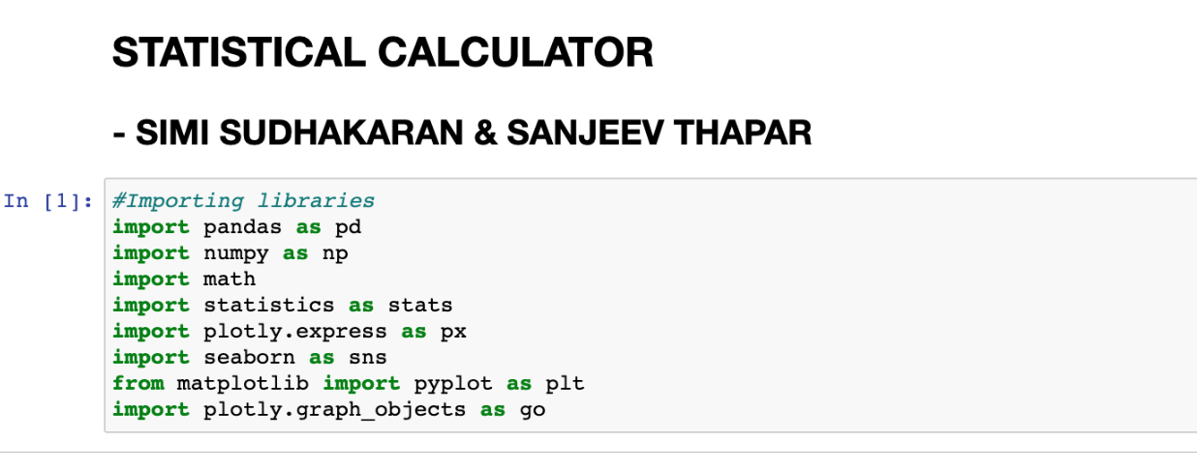
Importing Libraries

Slide 7
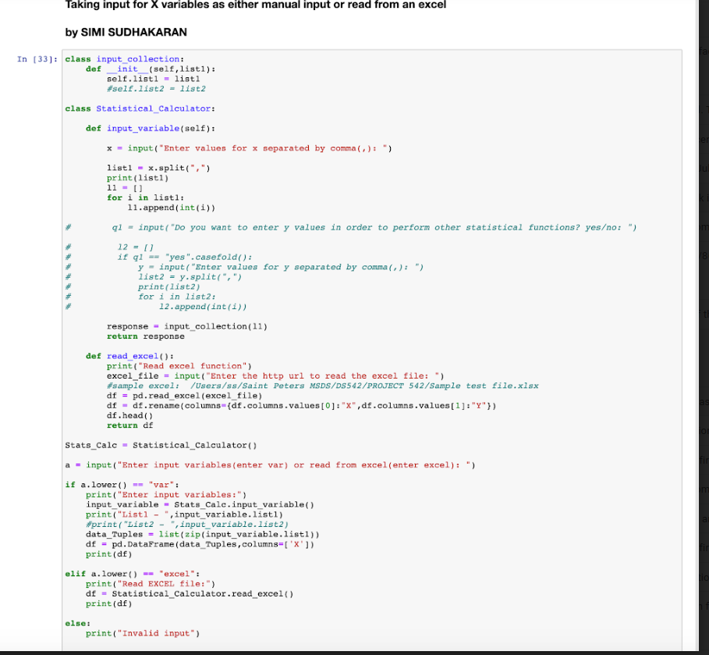
Soliciting Input Code

Slide 8
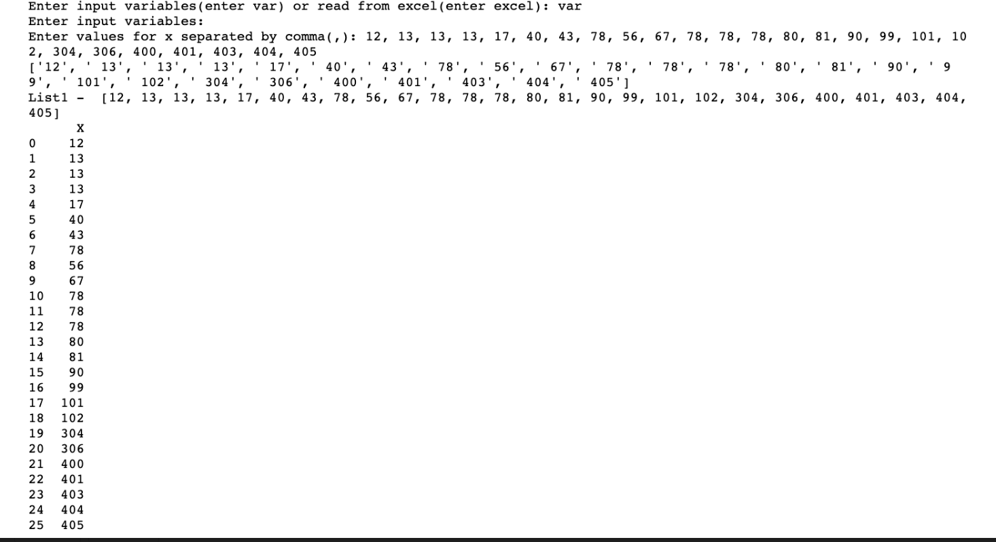
User Input

Slide 9
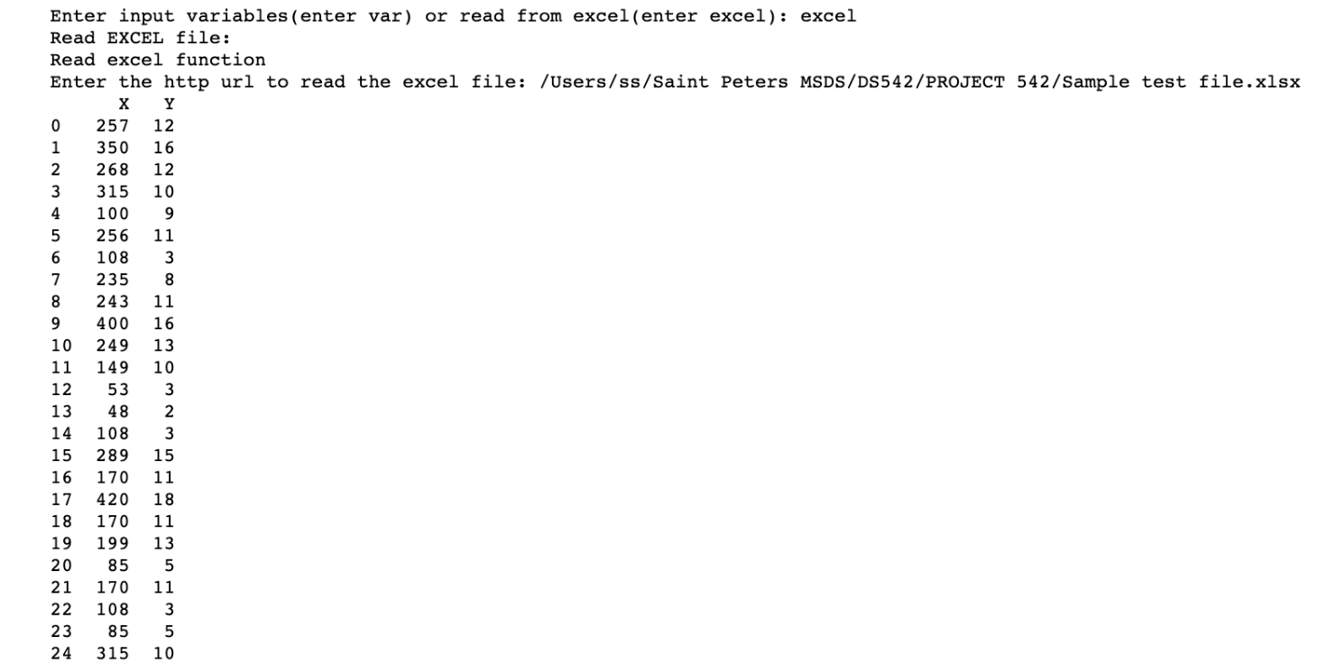
Reading the excel file

Slide 10
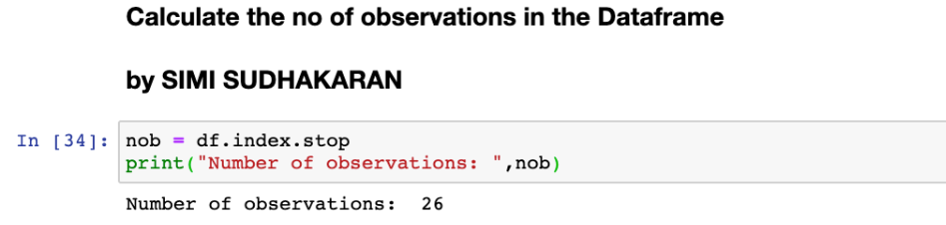
Count of observations

Slide 11
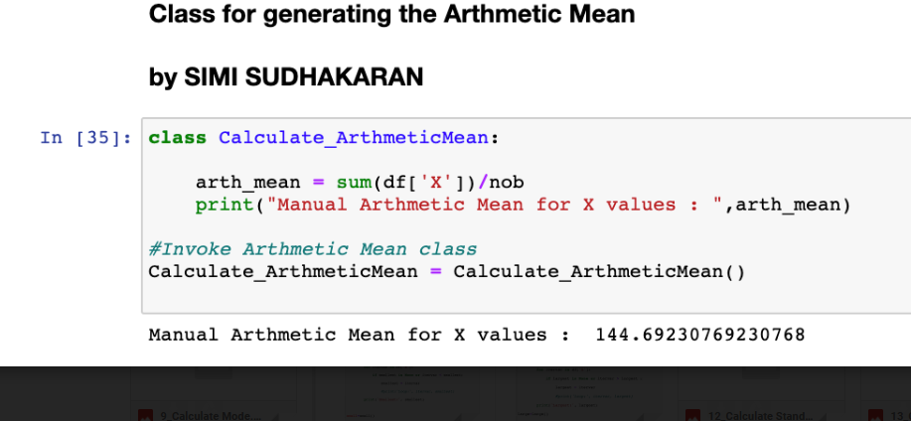
Arthmetic Mean

Slide 12
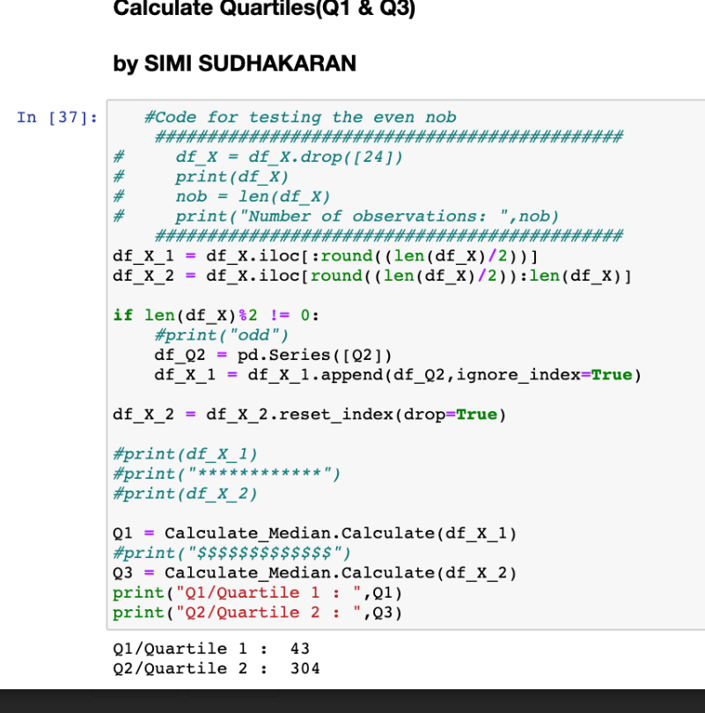
Quartile 1 & 3

Slide 13
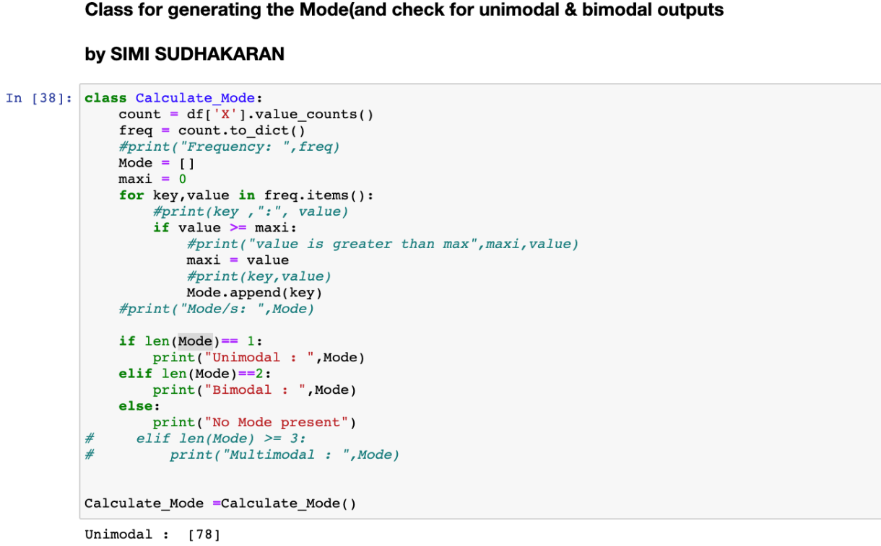
Mode
(Unimodal & Bimodal)

Slide 14
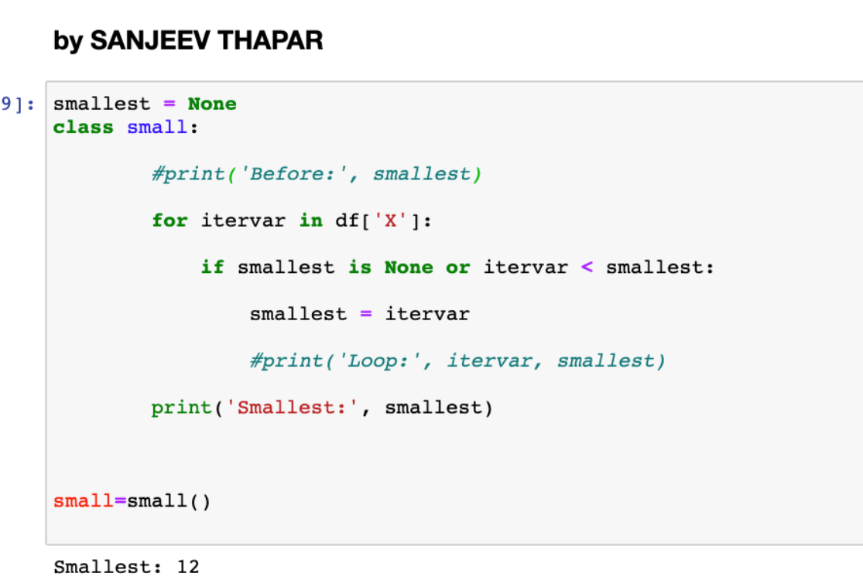
Minimum

Slide 15
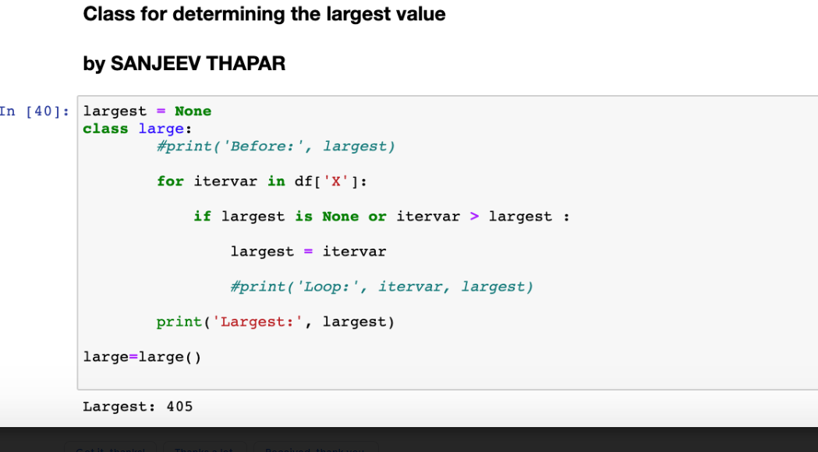
Maximum

Slide 16
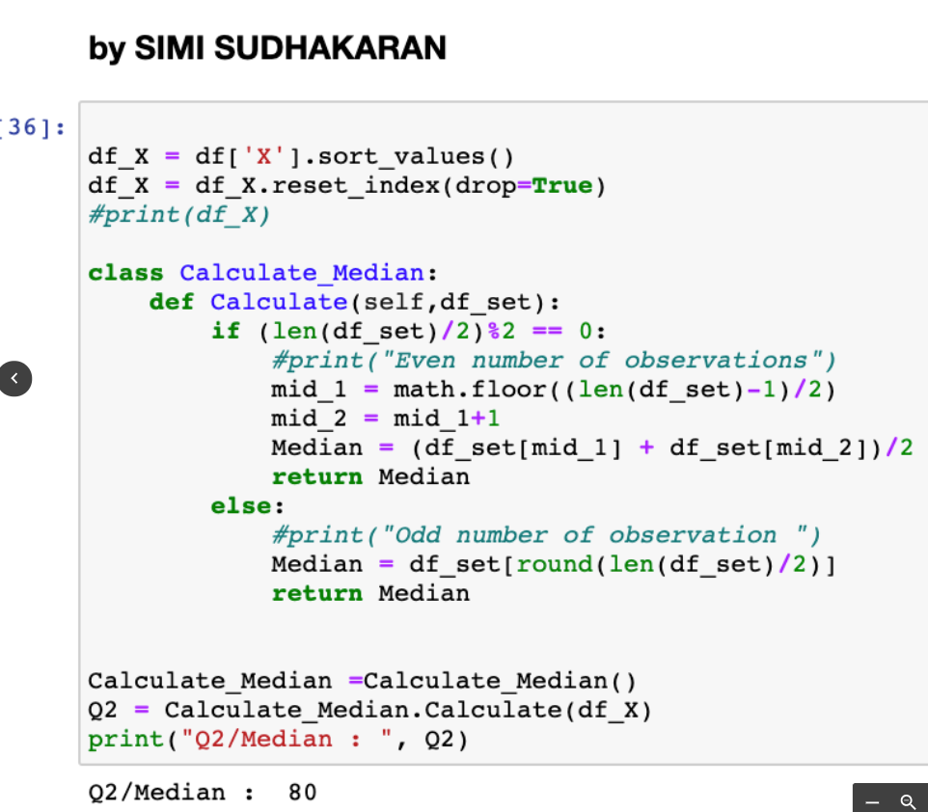
Median
(Quartile 2)

Slide 17
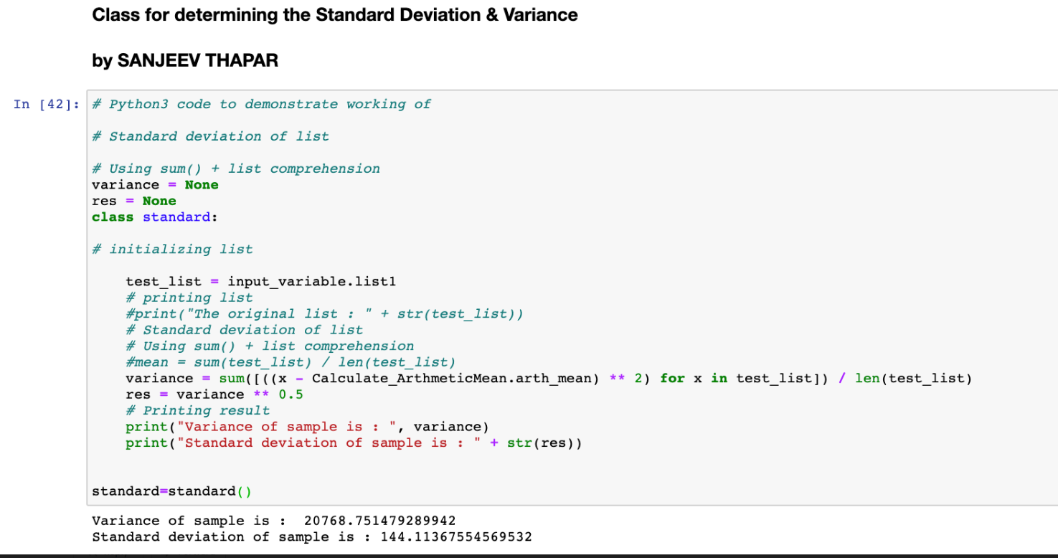
Standard Deviation and Variance

Slide 18
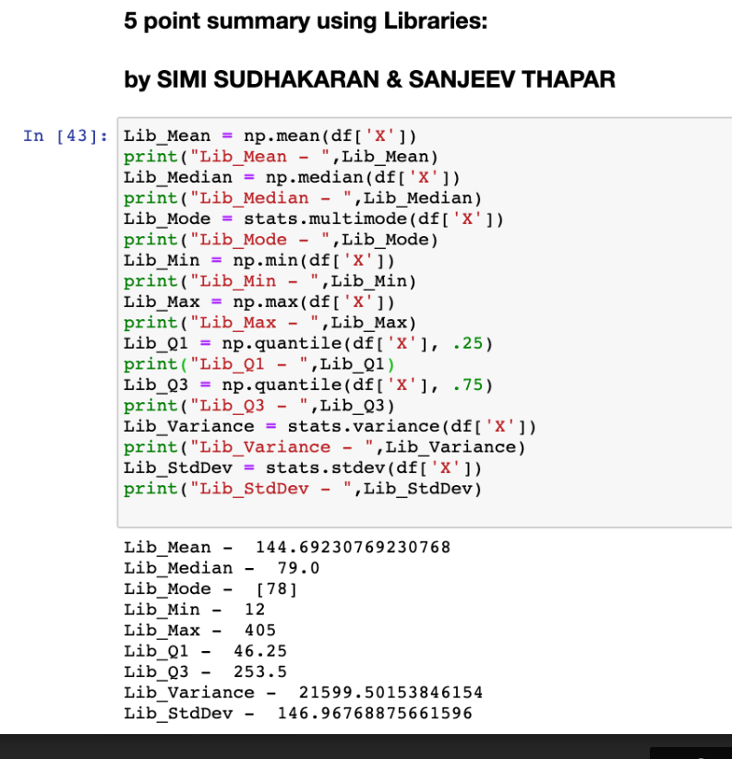
Statistical
calculations
using libraries

Slide 19
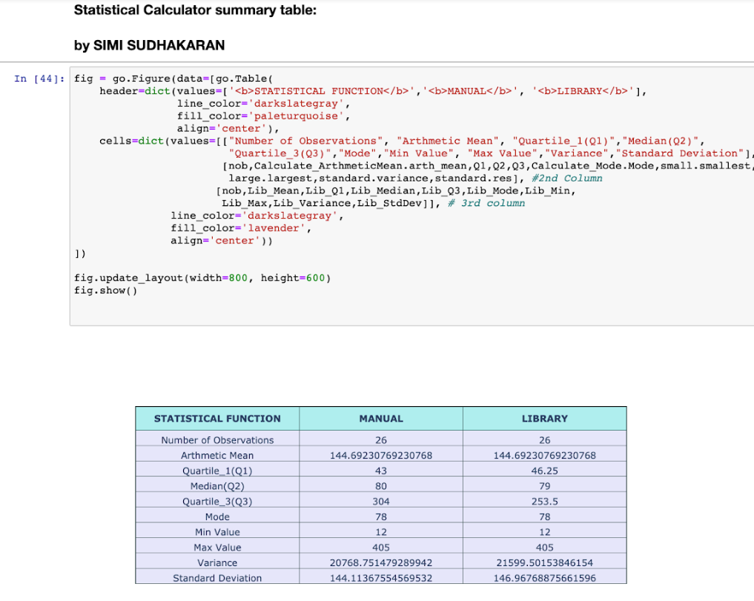
Statistical function table (using plotly) comparing manual and library values

Slide 20
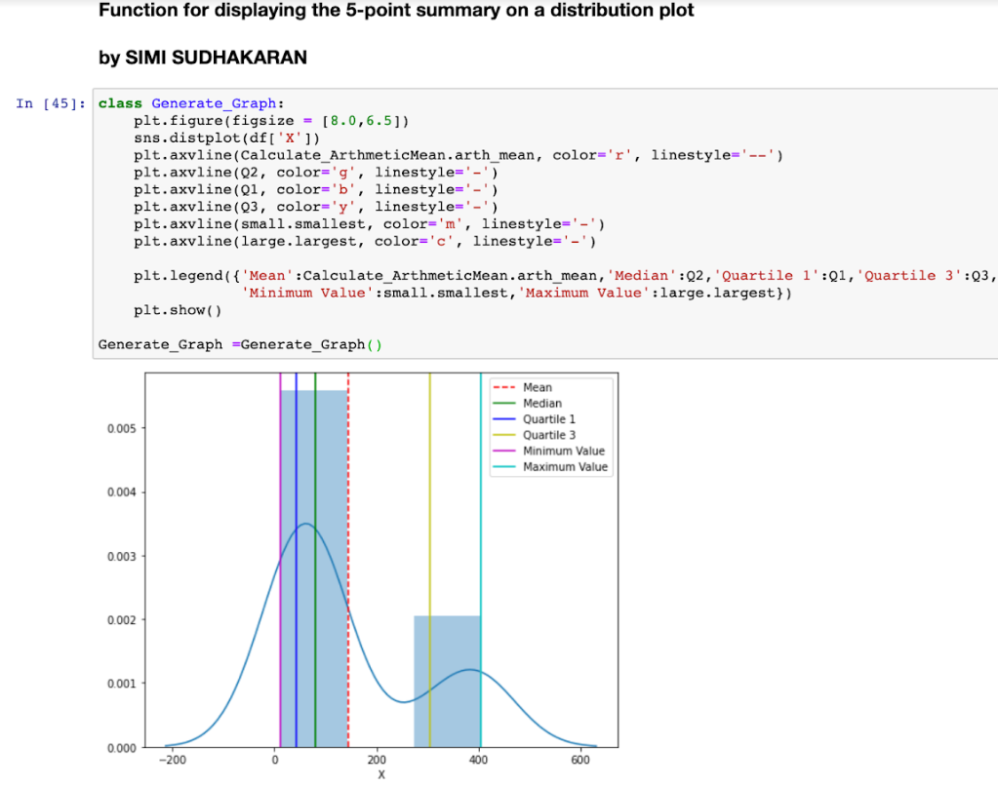
5 Point Summary Distribution plot

Slide 21
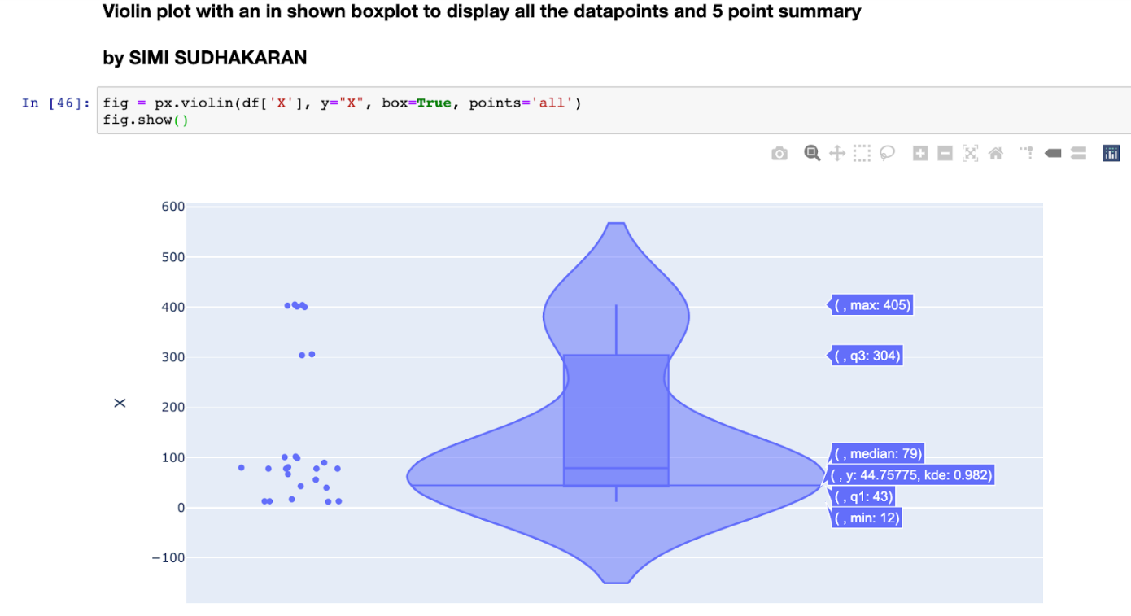
Violin plot using plotly

Slide 22
The end

