Slide 1
Neural Networks in Reasearching and Improving ASD Symptoms
Borș Alexandra-Maria
Siminischi Alexandru-Sebastian
Coordonator: Prof. Rebenciuc Mihai
„Politehnica” University of Bucharest, Romania

Slide 2
Contents
Abstract
Key Words
Introduction: a. Autism b. Artificial Intelligence c. Game Theory
Guess The Word Game
Conclusion
References

Slide 3
Abstract
A condition that needs a lot of care, autism is largely misunderstood, especially at a young age. Imagination of children with ASDs is captive with no way to be expressed, having diﬀiculties in developing an understanding of spoken language so they resort to nonverbal communication. q This research paper aims to study patterns in cognitive behavior of people with ASD to see if we can facilitate them with better means of education through Game Theory. To support the research we implemented neural networks to see if/ how much people with ASDs can benefit from such an approach. By developing a program like this we want to also help medical professionals with a better understanding of them. Besides this, the program can help in improving their communication skills /and find a better way to communicate ideas and emotions.

Slide 4
Key Words
Autism Spectrum Disorder
Children
Communication
Artificial Intelligence
Game Theory

Slide 5
Introduction a. Autism
Autism spectrum disorders (ASD) are typically characterized by diﬀiculties in communicating and forming relationships with other people. This is often misunderstood, slowly developing and accumulating frustration that can eventually be released in an unhealthy manner, fact that leads to rigidity, anxiety and even depression when it comes to social interactions. ASDs have a negative effect on children’s developing education, their goals and strategies to accomplish them. There is a set of seven features of individuals with autism and these are: (a) inability to relate themselves to people and situations, (b) poor language development, (c) echolalia, (d) excellent rote memory, (e) perseveration and repetitive behavior, (f) anxiously obsessive with sameness, (g) good cognitive potentialities and generally normal appearance. Individuals and groups of children with autism spectrum disorders have distinct developmental patterns. Many children with ASDs have relative strengths that they might use to supplement their learning in areas where they struggle. A child with great visual-spatial abilities, for example, might learn to interpret words to cue social conduct. Tasks having a clear finish or that demand thought about how to get from one point to another may encourage a child with good nonverbal problem-solving skills.

Slide 6
Introduction b. Artificial Intelligence
Patients with ASD have communication, behavior, and social interaction difficulties, which might include repetitive behavior, impatience, and attention issues. People with ASD will benefit greatly from AI.
Through this application, we want to facilitate the communication of children with autism and to better understand their feelings and experiences.
We want to build a chatbot with real time face emotion recognition through AI and neural networks in Python, so that it is easier to follow the reactions and responses of the child with ASD.
Also, the communication of the affected child with the chatbot can be done in 2 ways: by writing or through speech recognition. By speech recognition we want to improve the speech of the child with autism but there is also the possibility to use the keyboard to communicate with the chatbot.
We have included in this application a sum game called "Guess the Word" through which we want to track the user's reactions to different words in various categories. If he guesses the word, he will receive 5 points each.
By making available at this time the following categories of words: animals, body parts, colors, fruits, shapes, vegetables, vehicles we want to extend these with certain events in children's lives that made them feel good like birthday cake, gifts.

Slide 7
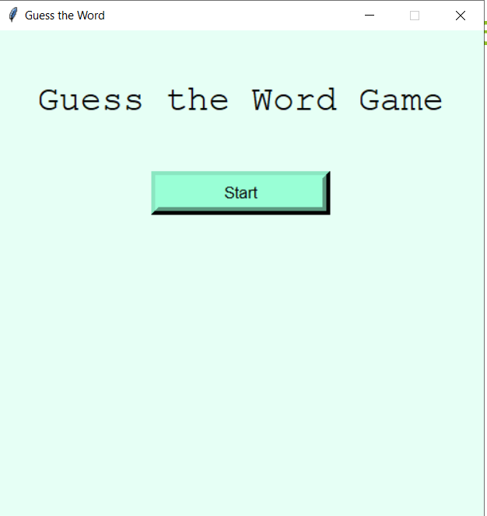
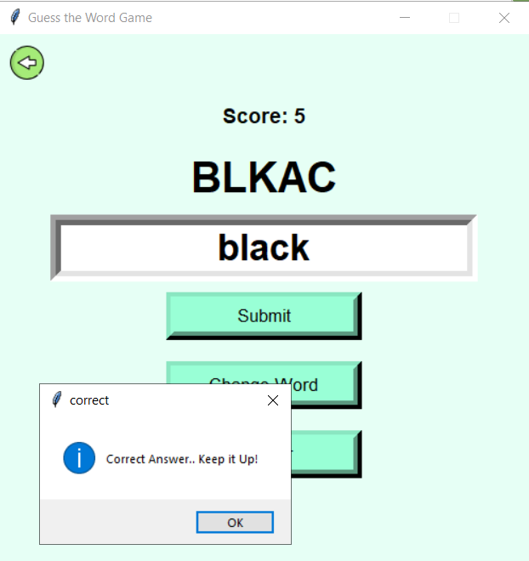
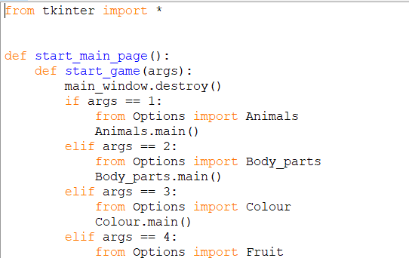
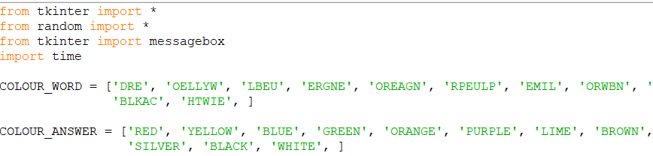
Guess The Word Game
.

Slide 8
Conclusion
Although this application is good for the needs of children with ASD, the improvement of symptoms by such methods still needs to be investigated to see how it works.

Slide 9
References
1.Educating Children with Autism – Catherine Lord and James P. McGee 2. Teacher Needs for Educating Children with Autism Spectrum Disorders in the General Education Classroom – Kim Finch, Robert Watson, Cynthia MacGregor, Natalie Precise 3. https://www.nationalelfservice.net/learning-disabilities/autistic-spectrum-disorder/video-games-autism/ 4. Game Theory: An Introduction – E. N. Barron
5. A Primer in Game Theory Contents – Deepak Kumar

