Slide 1
HPC Monitor System Development
- MiLe Shi, YuXian Wu, YuHang Wang
Instructor: ZhuoZhao Li

Slide 2
Overview of Our Project
A system to monitor multiple high-performance computing clusters in SUSTech.
Based on Prometheus monitor, including components like Node Exporter and Alertmanager.
Using Java SpringBoot, Mybatis, Mysql, Docker tools to help develop.

Slide 3
Overview of Our Project
Based on existing work.
Still have innovations and a lot works to do, including
an RBAC Permission system
further exploration on Prometheus monitor, Node exorter, and Alertmanager
Refractor most of existing code
Deployed on testing cluster and works well

Slide 4
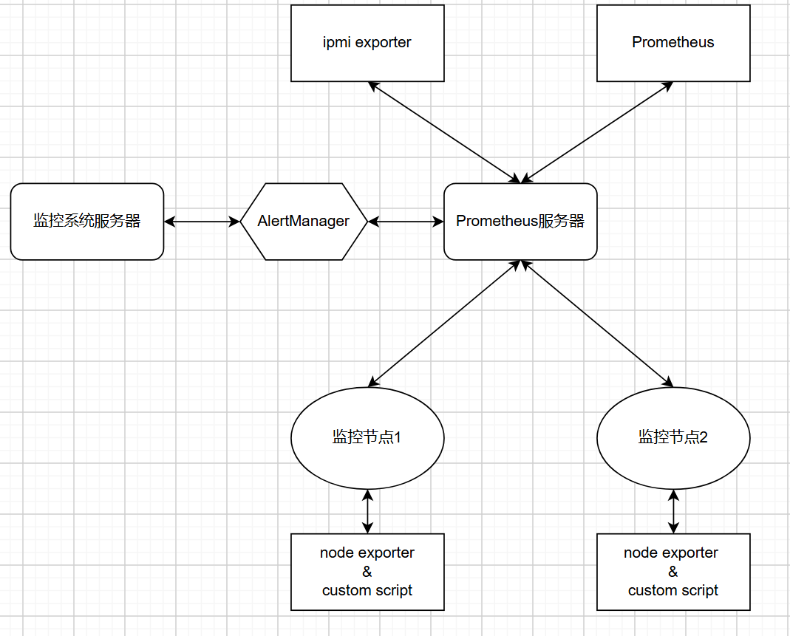
Architecture
Three main types of servers
main server
run our java web application
Prometheus server
run Prometheus monitor
pull metrics from exproters
trigger alerts and push them to alertmaneger
Compute nodes
nodes that need monitor
run exporters and scripts
expose metrics to HTTP endpoint

Slide 5
Issues of Our Project
Issues
Lack of permission management
Need of software-level metrics collection
Incompleteness of Alerts management and classification
Dependency on Docker Environment
weak existing code quality

Slide 6
What We Have Explored?
Exploration
find useful Prometheus components
Node exporter to scrape software level metrics
Alertmanager to group and routing alerts to our java application
utilize more robust permission control
use RBAC model to better manager permissions

Slide 7
What We Have Done?
Java Application
Implement User-Role-Permission system for dynamic access control
Enable more dynamic cluster management
Add custom alerting rule logic
Allow further specification of devices and manual alert handling
Refactor CAPTCHA logic for improved robustness
Prometheus Monitor
Use Node Exporter and custom shell script to scrape GPU metrics
Integrate Alertmanager for automated alert management and pushing
Vue Frontend
Update dashboard to display cpu utilization rate
Add autocomplete function for Prometheus expression
Diapaly corresponding devices for every cluster

Slide 9
Java Application

Slide 10
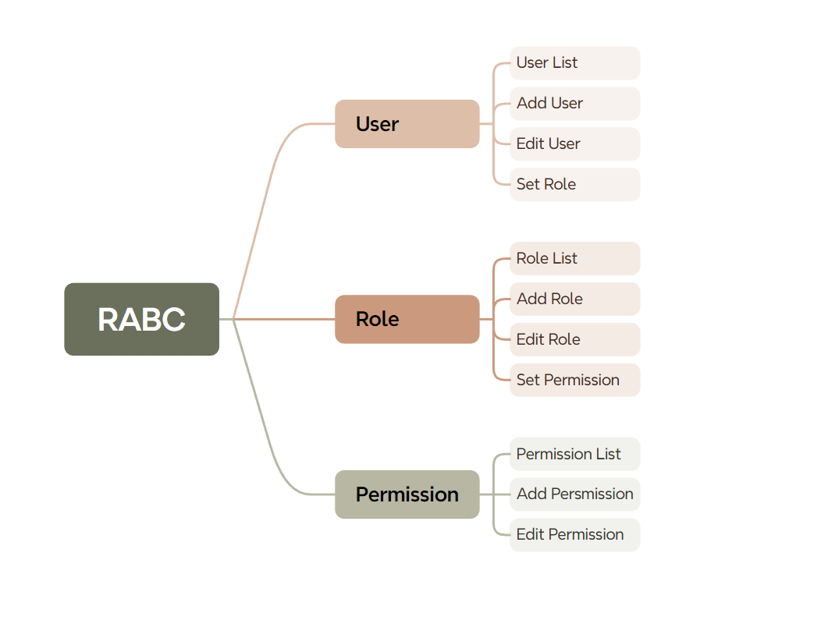
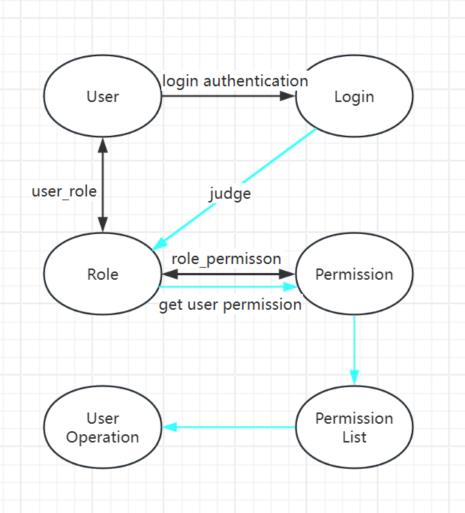
Role-based access control(RBAC)

Slide 11
Role-based access control(RBAC)
· Principles of
database design

Slide 12
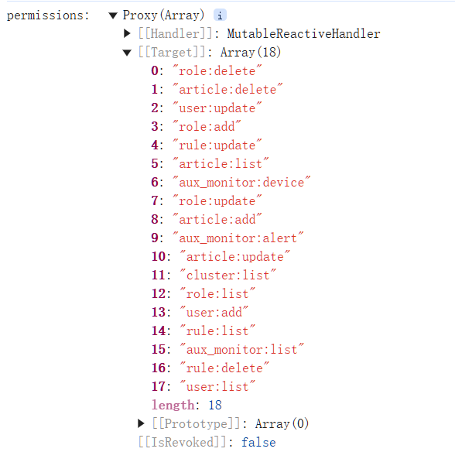
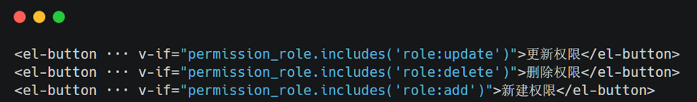
Role-based access control(RBAC)
· when we click any page, we’ll check whether this user
has the permission to operate this page
· The judgment of the front-end call

Slide 13
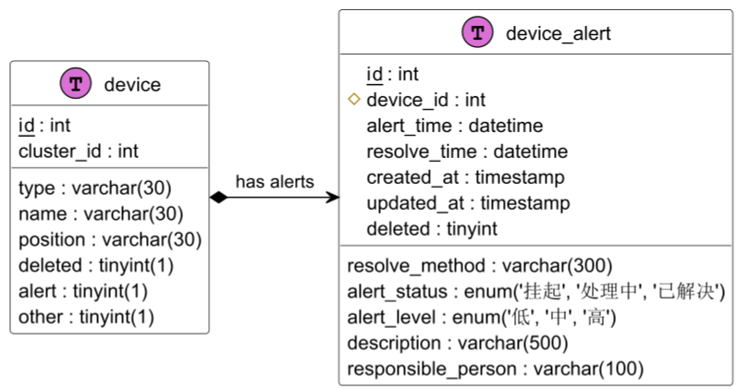
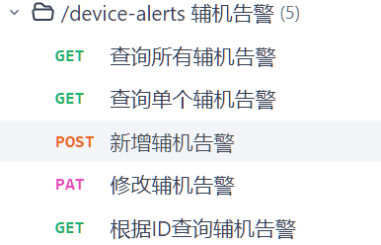
Extension of Devices Management
· Add the alarm table for managing devices
· new interface

Slide 14
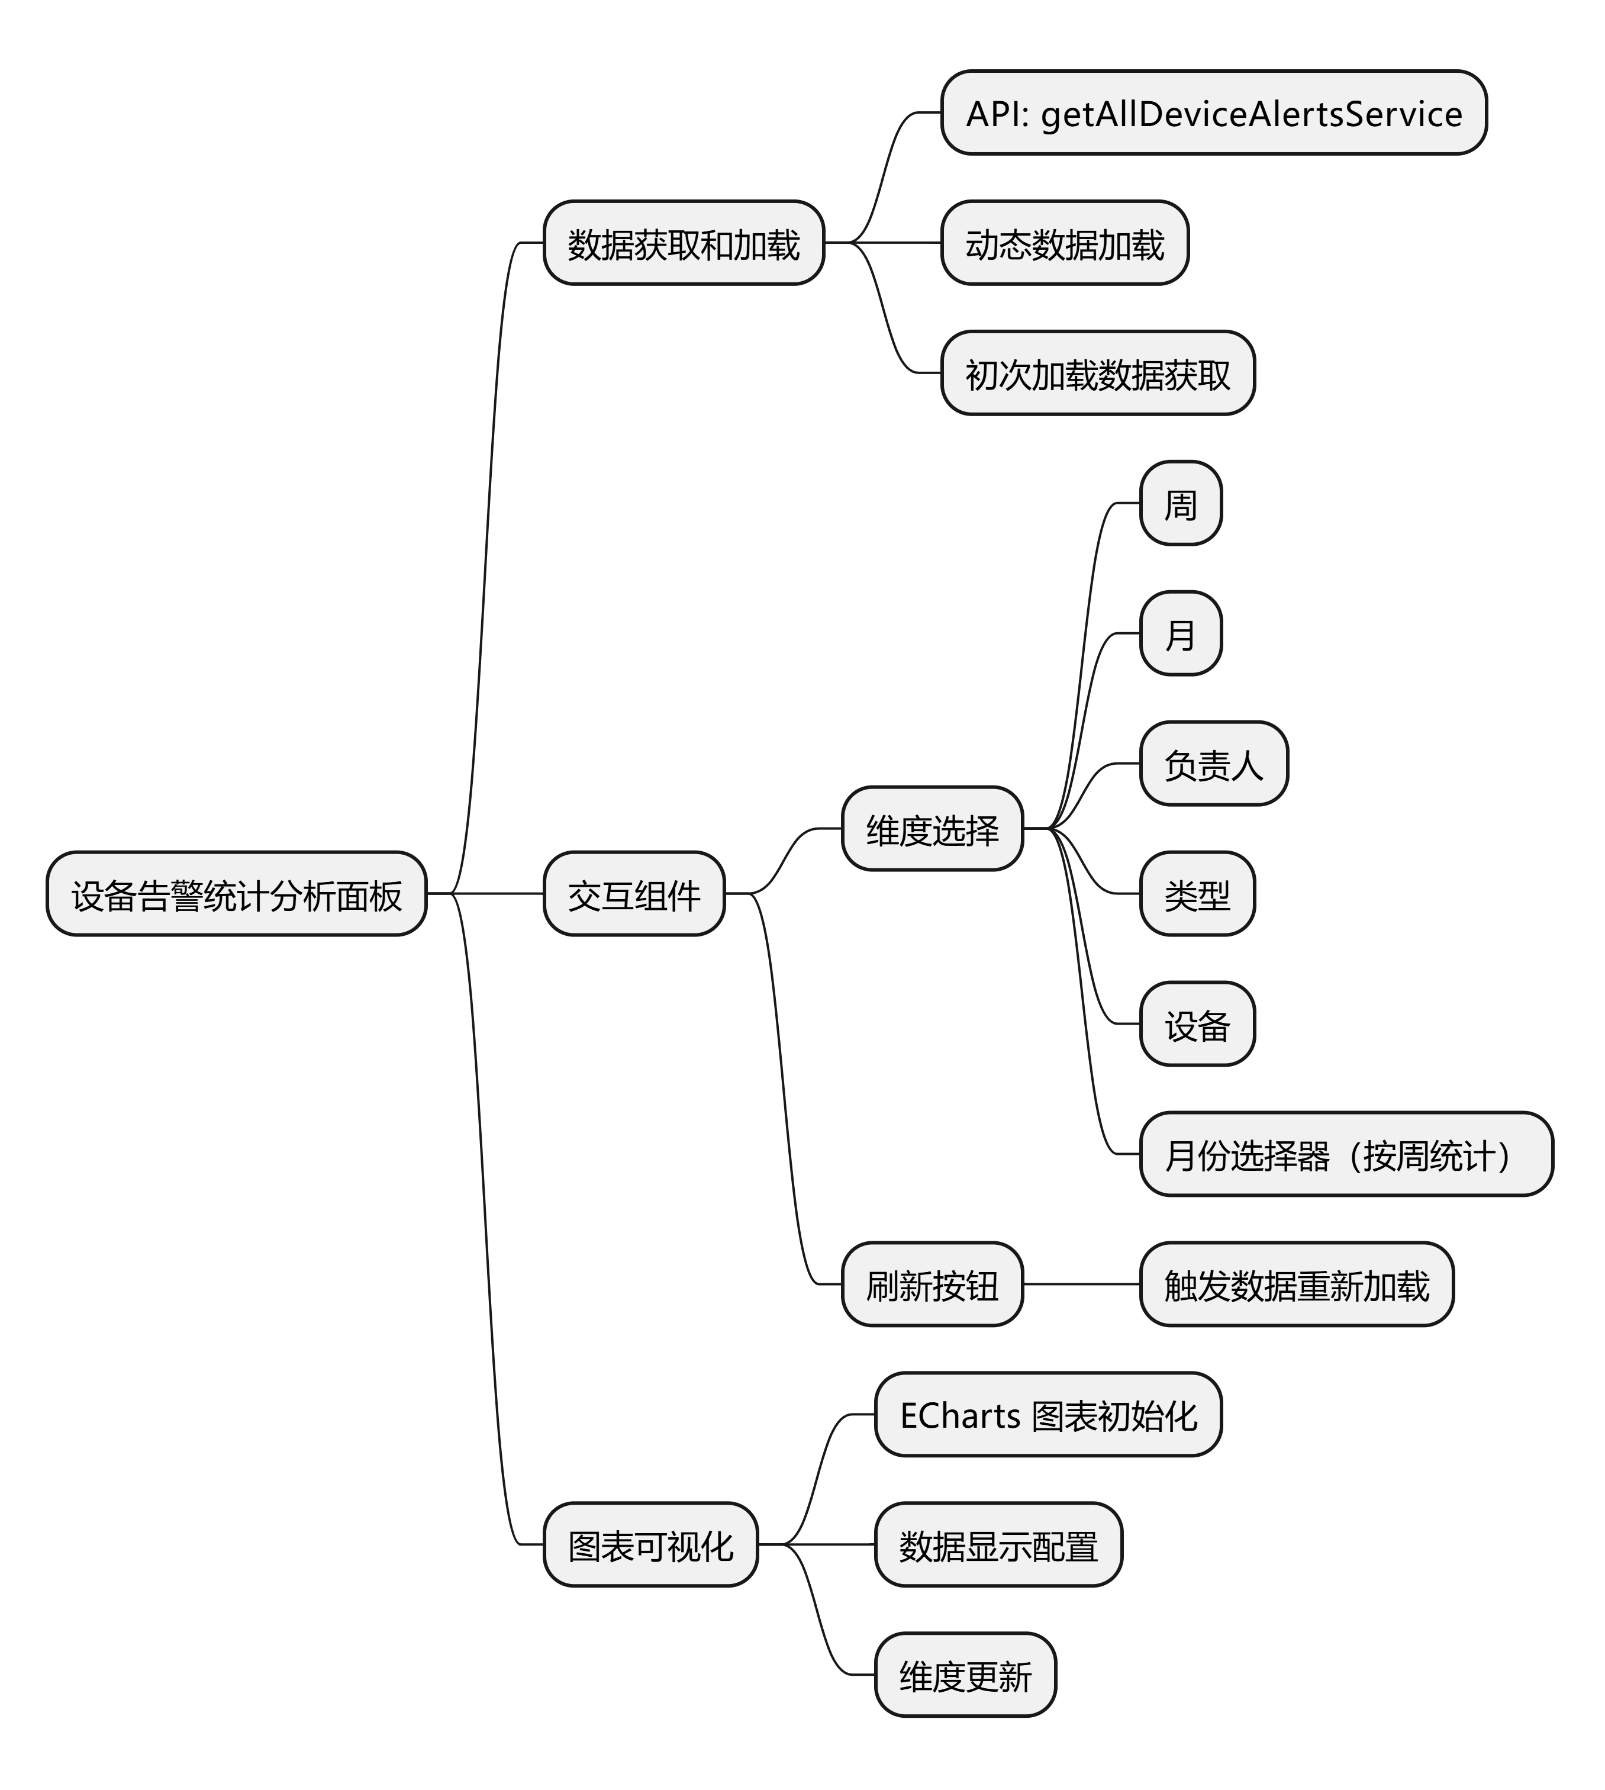

Extension of Devices Management
· A dynamic statistical analysis
panel is created by Vue.js
framework and ECharts library.

Slide 15
Dynamic Cluster Managment

Slide 16
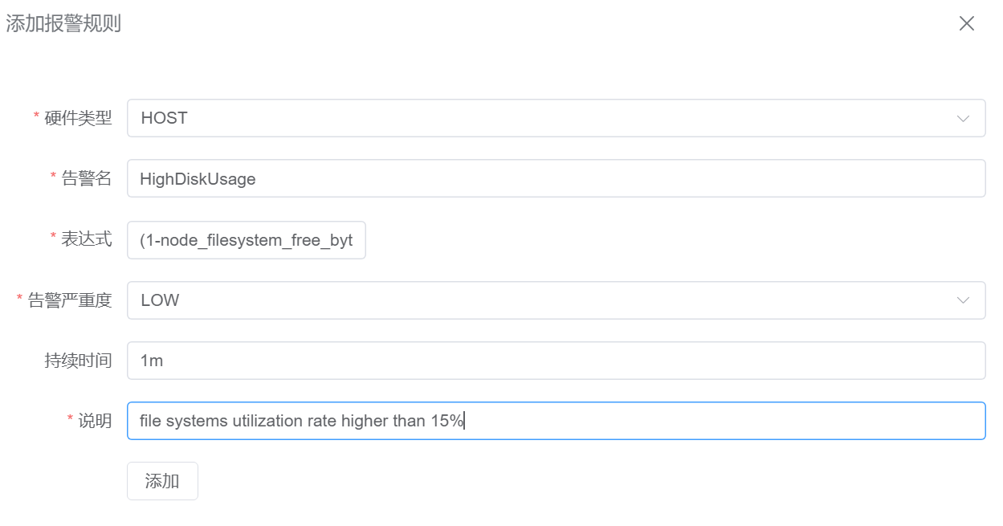
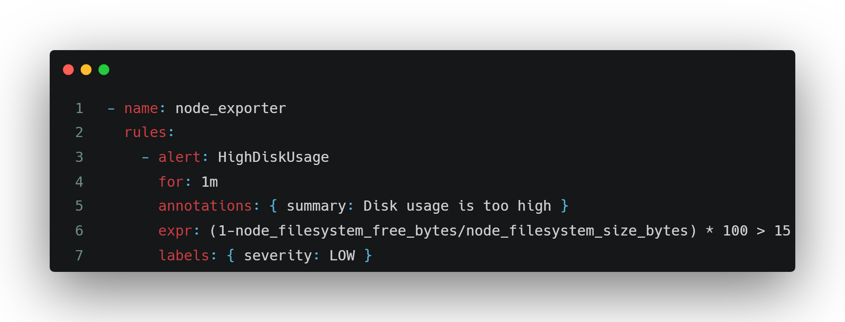
Custom Alerting Rules
1. Define the basic info including
a valid Prometheus expression
2. Then this rule will appear in rule.yaml,
one of configuration files for Prometheus

Slide 17
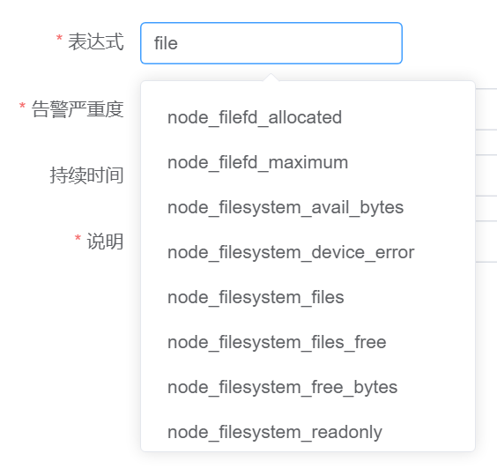
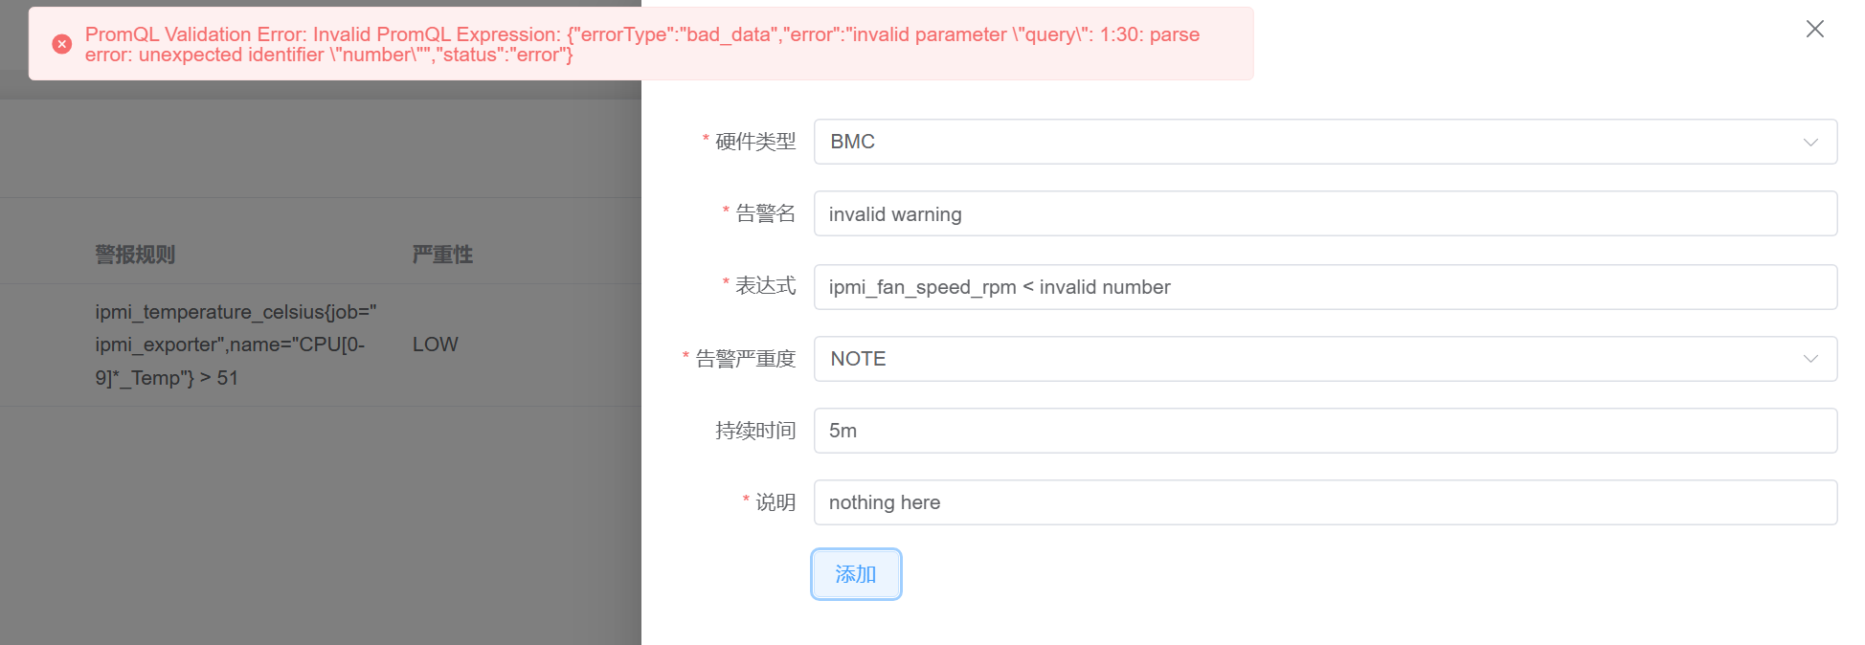
Autocomplete and Validation
Auto Complete
Expression Validation

Slide 18
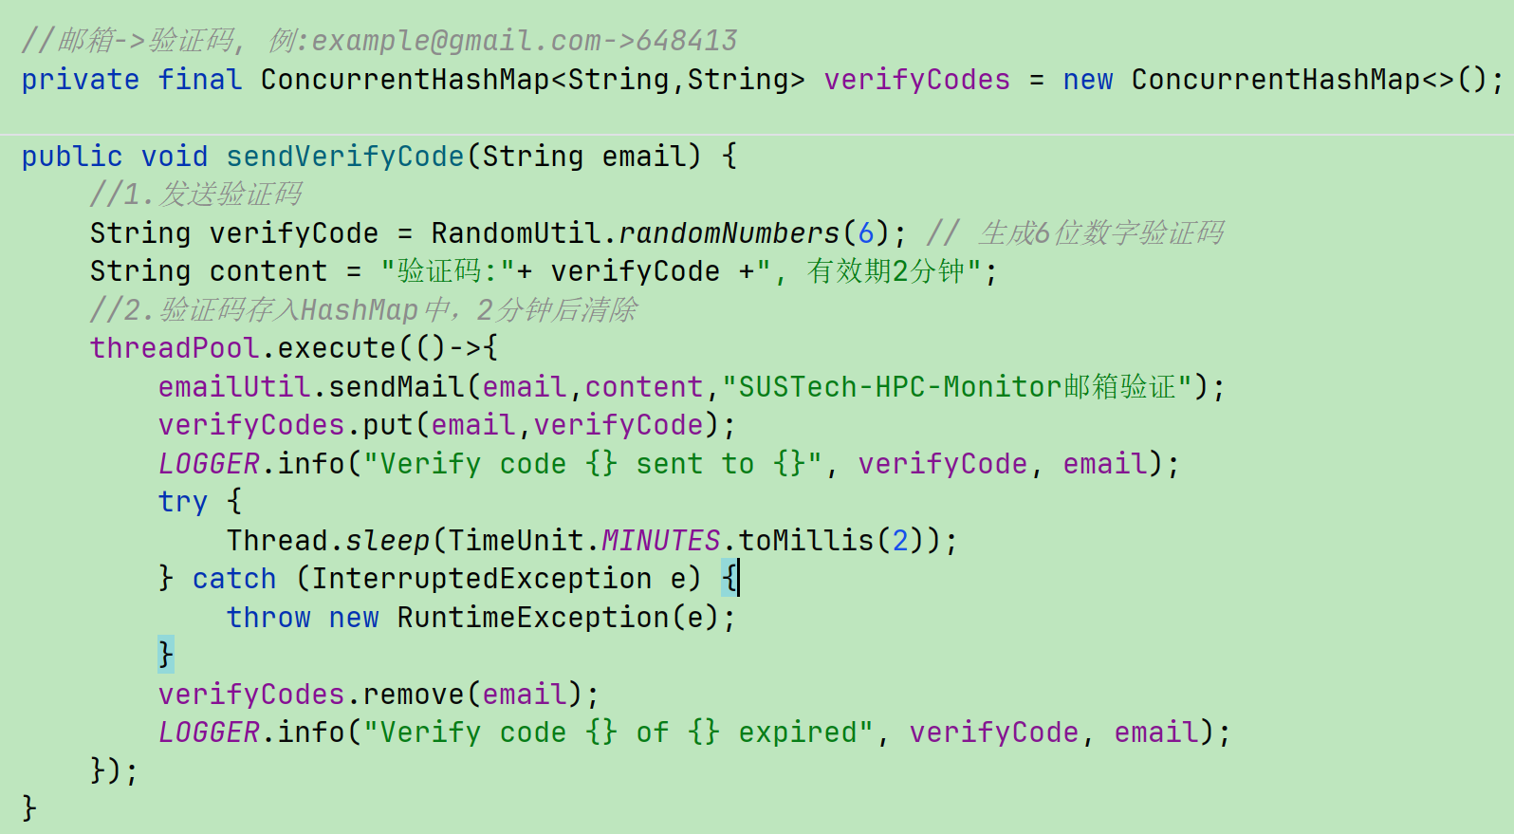
Other Optimizations
CAPTCHA Request Rate Limit
Original

Slide 19
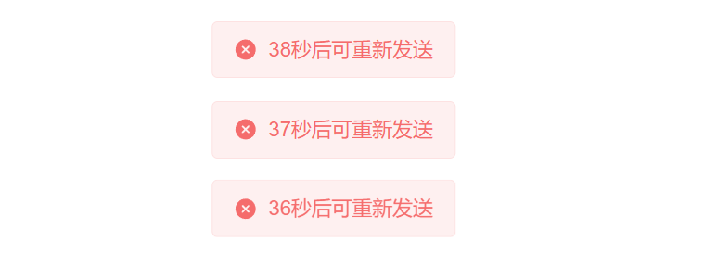
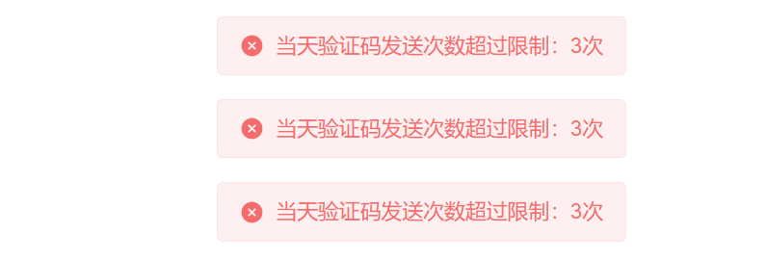
CAPTCHA Request Rate Limit：Redis
Caching Mechanism: Redis is used to store verification codes temporarily.
Expiration Time: The verification codes are automatically expired after a set time (e.g., 10 minutes).
Efficiency: This ensures that the codes are valid only for a limited time, reducing the risk of misuse and enhancing security.
Rate Limiting: Redis is configured to track the number of verification code requests sent to the same email address per day.
Max Requests: A maximum number of allowed requests is set (e.g., 5 emails per day).
Prevention of Abuse: This mechanism helps to prevent email spamming and ensures a smooth user experience.

Slide 20
Prometheus Monitor

Slide 21
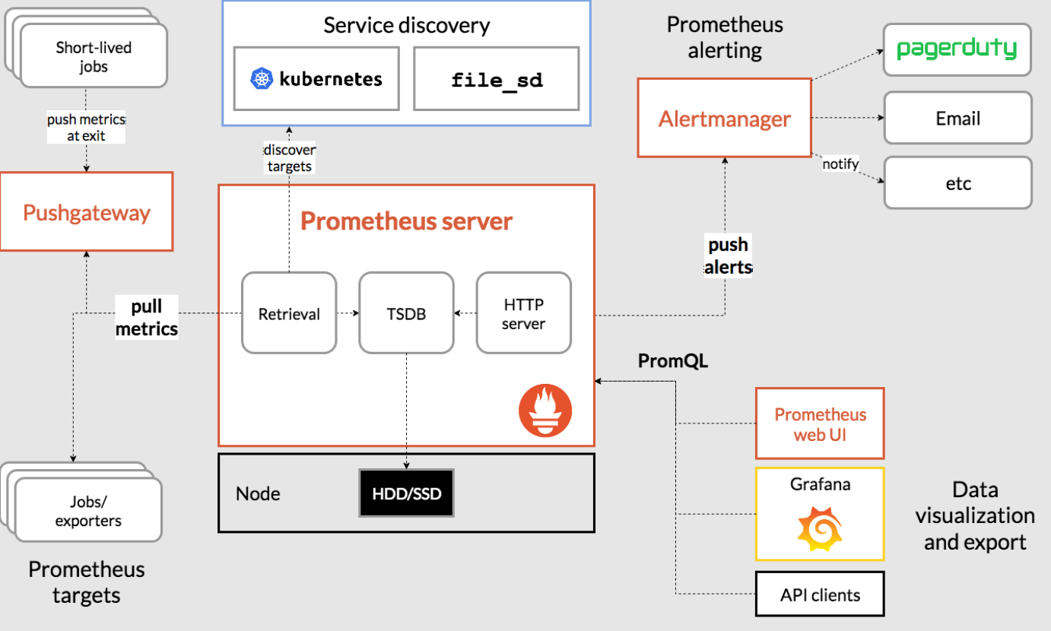
Alertmanager for complex alerts handling

Slide 22
Alertmanager - Centralized Alert Handling in Prometheus
Alertmanager is a component of the Prometheus ecosystem that handles alerts generated by Prometheus based on user-defined PromQL queries.
It acts as the centralized alert handling system, processing and managing the alerts sent from Prometheus.
Alerting Workflow with Webhooks
Prometheus queries metrics with PromQL and detects when thresholds are exceeded, triggering alerts.
Alerts are sent to Alertmanager, which processes and categorizes them based on predefined rules.
Alertmanager sends the processed alerts to external systems via Webhooks.

Slide 23
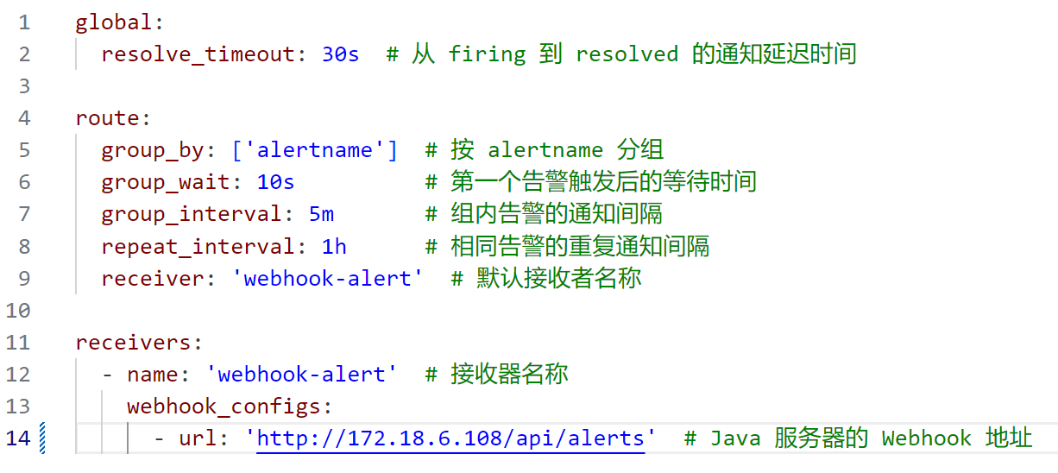
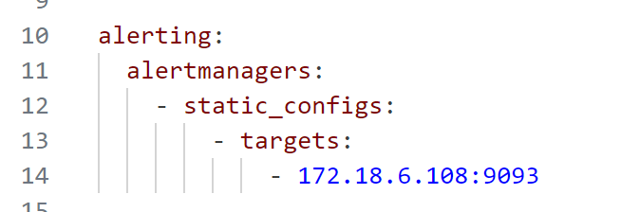
Alertmanager - Centralized Alert Handling in Prometheus
Configuration
Prometheus Configuration

Slide 24
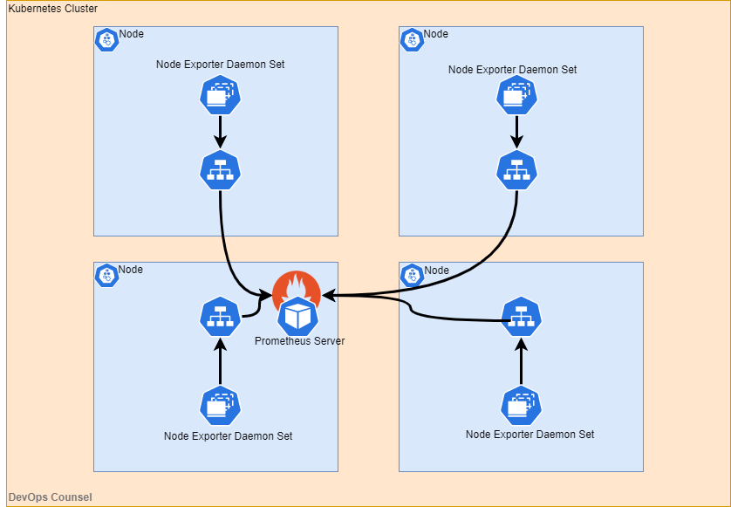
Node Exporter
An open-source component of Prometheus by community
use Node Exporter to scrape software-level metrics
deployed on every compute node and aggregate in Prometheus
utilize TextCollector to scrape custom metrics, including GPU and User details.

Slide 25
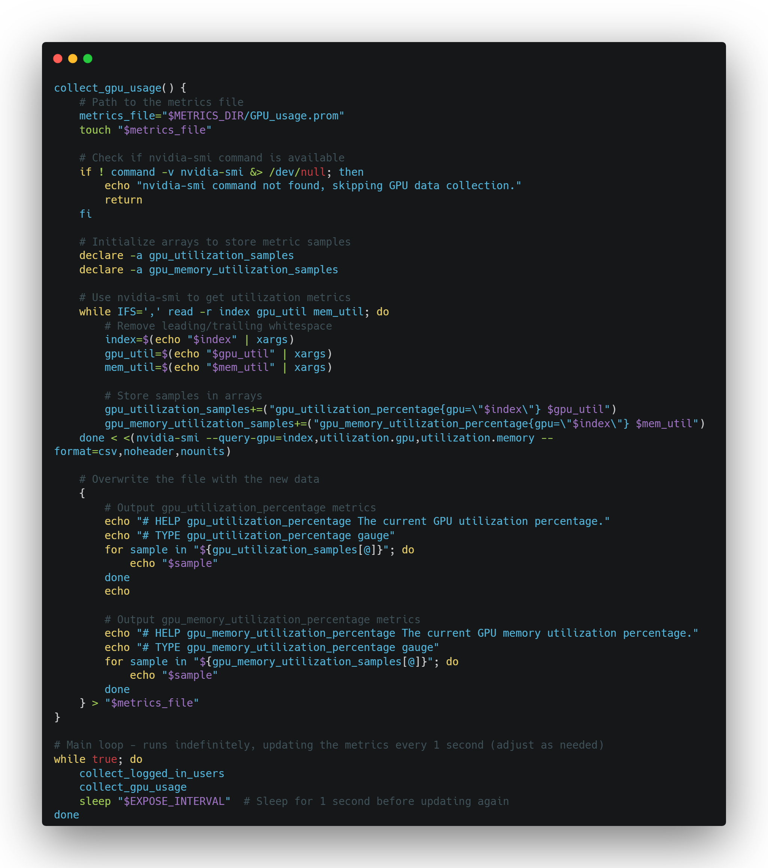
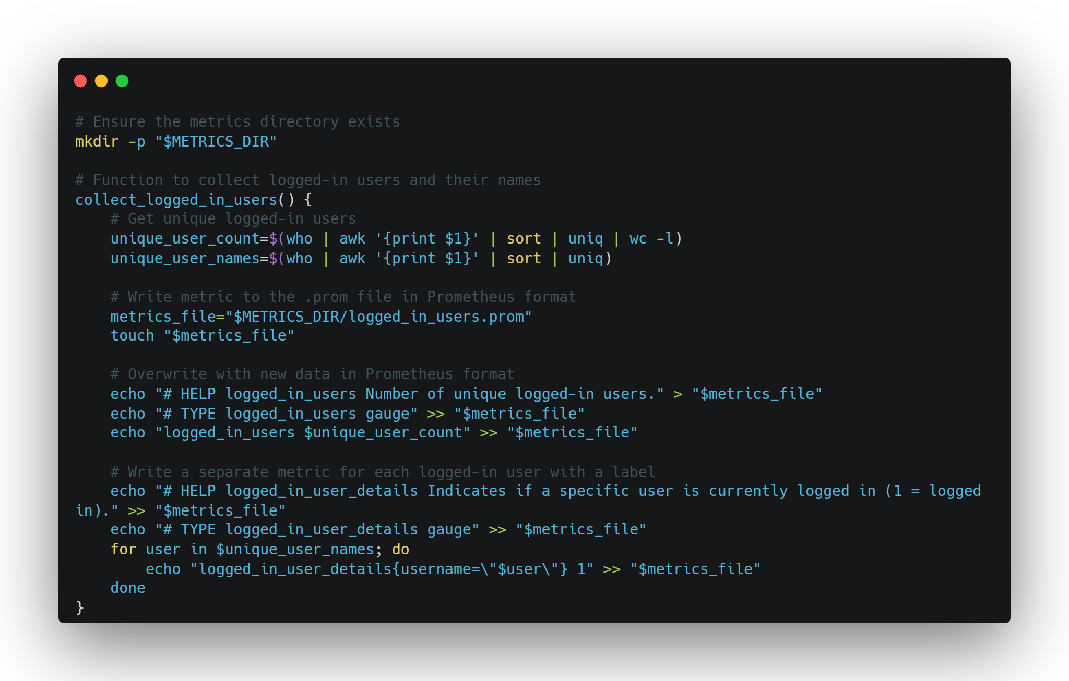
Custom Scripts
script for user info
script for Nvidia GPU info

Slide 26
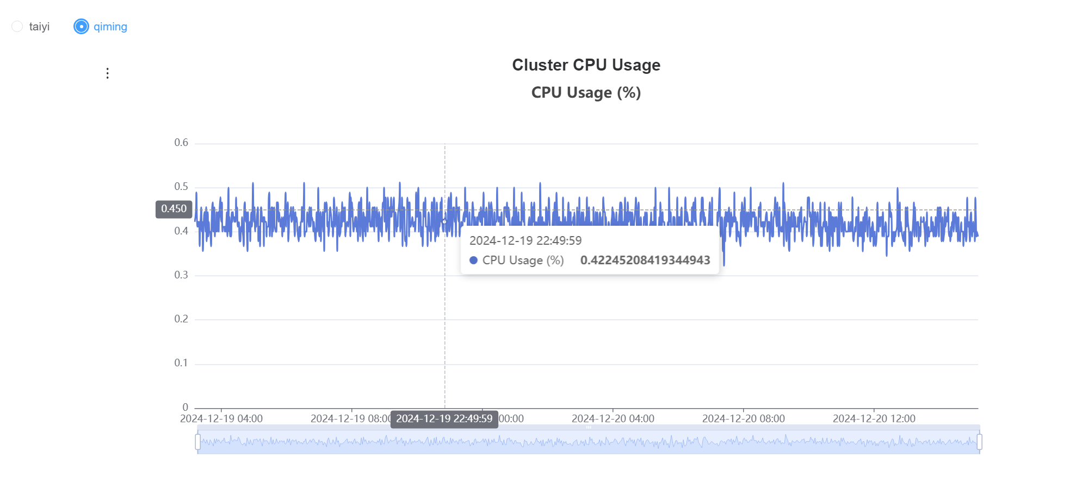
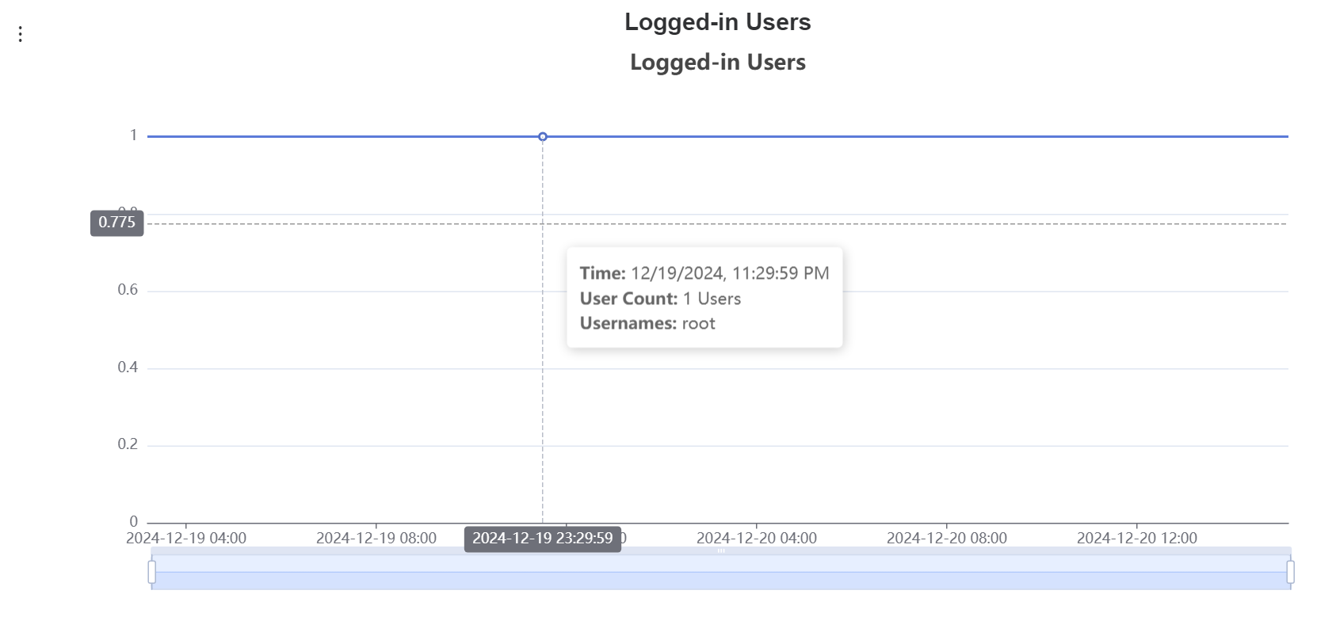
Visualization
use echart.js to display metrics more clearly
allow zooming function
monitor clusters seperately

Slide 27
Other Improvement

