Slide 1
Mechanics of Bitcoin
Part I
Tyler Moore, CS 7403, University of Tulsa
Slides adapted from
Arvind Narayanan, Joseph Bonneau, Edward Felten, Andrew Miller, Princeton University

Slide 2
Recap: Bitcoin consensus
Bitcoin consensus gives us:
Append-only ledger
Decentralized consensus
Miners to validate transactions
assuming a currency exists to motivate miners!
Notes:
But what rules?
Need to clarify what “append-only” means

Slide 3
3.1: Bitcoin transactions

Slide 4
An account-based ledger (not Bitcoin)
time
might need to scan backwards until genesis!
Create 25 coins and credit to Alice_{ASSERTED BY MINERS}
Transfer 17 coins from Alice to Bob_{SIGNED(Alice)}
Transfer 8 coins from Bob to Carol_{SIGNED(Bob)}
Transfer 5 coins from Carol to Alice_{SIGNED(Carol)}
is this valid?
Transfer 15 coins from Alice to David_{SIGNED(Alice)}
SIMPLIFICATION: only one transaction per block

Slide 5
A transaction-based ledger (Bitcoin)
Inputs: Ø
Outputs: 25.0→Alice
1
time
we implement this with hash pointers
change address
Inputs: 1[0]
Outputs: 17.0→Bob, 8.0→Alice
SIGNED(Alice)
2
Inputs: 2[0]
Outputs: 8.0→Carol, 9.0→Bob
SIGNED(Bob)
finite scan to check for validity
3
Inputs: 2[1]
Outputs: 6.0→David, 2.0→Alice
SIGNED(Alice)
4
is this valid?
SIMPLIFICATION: only one transaction per block
Notes:
This is called a “change address”

Slide 6
Merging value
time
Inputs: ...
Outputs: 17.0→Bob, 8.0→Alice
SIGNED(Alice)
1
...
Inputs: 1[1]
Outputs: 6.0→Carol, 2.0→Bob
SIGNED(Carol)
2
...
Inputs: 1[0], 2[1]
Outputs: 19.0→Bob
SIGNED(Bob)
3
SIMPLIFICATION: only one transaction per block

Slide 7
Joint payments
time
Inputs: ...
Outputs: 17.0→Bob, 8.0→Alice
SIGNED(Alice)
1
...
Inputs: 1[1]
Outputs: 6.0→Carol, 2.0→Bob
SIGNED(Carol)
2
...
Inputs: 2[0], 2[1]
Outputs: 8.0→David
SIGNED(Carol), SIGNED(Bob)
3
two signatures!
SIMPLIFICATION: only one transaction per block

Slide 8
The real deal: a Bitcoin transaction
{
"hash":"5a42590fbe0a90ee8e8747244d6c84f0db1a3a24e8f1b95b10c9e050990b8b6b",
"ver":1,
"vin_sz":2,
"vout_sz":1,
"lock_time":0,
"size":404,
"in":[
{
"prev_out":{
"hash":"3be4ac9728a0823cf5e2deb2e86fc0bd2aa503a91d307b42ba76117d79280260",
"n":0
},
"scriptSig":"30440..."
},
{
"prev_out":{
"hash":"7508e6ab259b4df0fd5147bab0c949d81473db4518f81afc5c3f52f91ff6b34e",
"n":0
},
"scriptSig":"3f3a4ce81...."
}
],
"out":[
{
"value":"10.12287097",
"scriptPubKey":"OP_DUP OP_HASH160 69e02e18b5705a05dd6b28ed517716c894b3d42e OP_EQUALVERIFY OP_CHECKSIG"
}
]
}
metadata
input(s)
output(s)

Slide 9
The real deal: transaction metadata
{
"hash":"5a42590...b8b6b",
"ver":1,
"vin_sz":2,
"vout_sz":1,
"lock_time":0,
"size":404,
...
}
transaction hash
housekeeping
“not valid before”
housekeeping

Slide 10
The real deal: transaction inputs
"in":[
{
"prev_out":{
"hash":"3be4...80260",
"n":0
},
"scriptSig":"30440....3f3a4ce81"
},
...
],
previous
transaction
signature
(more inputs)

Slide 11
The real deal: transaction outputs
"out":[
{
"value":"10.12287097",
"scriptPubKey":"OP_DUP OP_HASH160 69e...3d42e OP_EQUALVERIFY OP_CHECKSIG"
},
...
]
output value
recipient address??
more on this soon...
(more outputs)

Slide 12
3.2: Bitcoin scripts

Slide 13
Output “addresses” are really scripts
OP_DUP
OP_HASH160
69e02e18...
OP_EQUALVERIFY OP_CHECKSIG

Slide 14
Input “addresses” are also scripts
30440220...
0467d2c9...
scriptSig
OP_DUP
OP_HASH160
69e02e18...
OP_EQUALVERIFY OP_CHECKSIG
scriptPubKey
TO VERIFY: Concatenated script must execute completely with no errors

Slide 15


Bitcoin scripting language (“Script”)
Design goals
Built for Bitcoin (inspired by Forth)
Simple, compact
Support for cryptography
Stack-based
Limits on time/memory
No looping
I am not impressed
image via Jessie St. Amand

Slide 16
Common Script Operations
OP_DUP | Duplicates the top item on the stack
OP_HASH160 | Hashes twice: first using SHA-256 and then RIPEMD-160
OP_EQUALVERIFY | Returns true if the inputs are equal. Returns false and marks the transaction as invalid if they are unequal
OP_CHECKSIG | Checks that the input signature is a valid signature using the input public key for the hash of the current transaction
OP_CHECKMULTISIG | Checks that the k signatures on the transaction are valid signatures from k of the specified public keys.

Slide 17
Bitcoin script execution example
✓
<pubKeyHash?>
<pubKey>
<pubKeyHash>
<pubKey>
<sig>
true
<sig> <pubKey> OP_DUP OP_HASH160 <pubKeyHash?> OP_EQUALVERIFY OP_CHECKSIG

Slide 18
Bitcoin script instructions
256 opcodes total (15 disabled, 75 reserved)
Arithmetic
If/then
Logic/data handling
Crypto!
  Hashes
  Signature verification
  Multi-signature verification

Slide 19

OP_CHECKMULTISIG
Built-in support for joint signatures
Specify n public keys
Specify t
Verification requires t signatures
BUG ALERT: Extra data value popped from the stack and ignored

Slide 20
3.4: Bitcoin blocks

Slide 21
Bitcoin blocks
Why bundle transactions together?
Single unit of work for miners
Limit length of hash-chain of blocks
  Faster to verify history

Slide 22
Bitcoin block structure
Hash chain of blocks
prev: H( )
prev: H( )
prev: H( )
trans: H( )
trans: H( )
trans: H( )
H( ) H( )
Hash tree (Merkle tree) of transactions in each block
H( ) H( )
H( ) H( )
transaction
transaction
transaction
transaction

Slide 23
The real deal: a Bitcoin block
{
"hash":"00000000000000001aad2...",
"ver":2,
"prev_block":"00000000000000003043...",
"time":1391279636,
"bits":419558700,
"nonce":459459841,
"mrkl_root":"89776...",
"n_tx":354,
"size":181520,
"tx":[
...
],
"mrkl_tree":[
"6bd5eb25...",
...
"89776cdb..."
]
}
block header
transaction data

Slide 24
The real deal: a Bitcoin block header
{
"hash":"00000000000000001aad2...",
"ver":2,
"prev_block":"00000000000000003043...",
"time":1391279636,
"bits":419558700,
"nonce":459459841,
"mrkl_root":"89776...",
...
}
mining puzzle information
hashed during mining
not hashed

Slide 25
The real deal: coinbase transaction
"in":[
{
"prev_out":{
"hash":"000000.....0000000",
"n":4294967295
},
"coinbase":"..."
},
"out":[
{
"value":"25.03371419",
"scriptPubKey":"OPDUP OPHASH160 ... ”
}
Null hash pointer
redeeming nothing
First ever coinbase parameter:
“The Times 03/Jan/2009 Chancellor on brink of second bailout for banks”
arbitrary
block reward
transaction fees

Slide 26
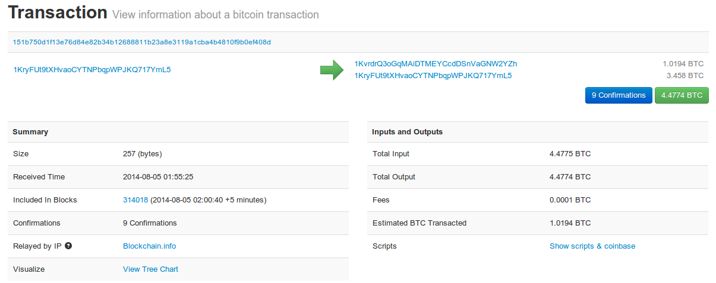
See for yourself!
blockchain.info (and many other sites)

Slide 27
3.5: The Bitcoin network

Slide 28
Bitcoin P2P network
Ad-hoc protocol (runs on TCP port 8333)
Ad-hoc network with random topology
All nodes are equal
New nodes can join at any time
Forget non-responding nodes after 3 hr

Slide 29
Joining the Bitcoin P2P network
5
1
Hello World! I’m ready to Bitcoin!
7
8
getaddr()
getaddr()
1, 7
getaddr()
3
6
2
4
Notes:
No geographic topology
Seed nodes
No formal way of leaving

Slide 30
Transaction propagation (flooding)
Already heard that!
5
1
7
8
A→B
A→B
A→B
New tx!
A→B
3
6
A→B
2
A→B
A→B
A→B
4
A→B
A→B
A→B
Notes:
Transactions are propagated in the “pending transaction pool”

Slide 31
Should I relay a proposed transaction?
Transaction valid with current block chain
(default) script matches a whitelist
  Avoid unusual scripts
Haven’t seen before
  Avoid infinite loops
Doesn’t conflict with others I’ve relayed
  Avoid double-spends
Sanity checks only...
Some nodes may ignore them!

Slide 32
Nodes may differ on transaction pool
New tx!
A→C
5
1
A→C
A→B
A→C
7
A→C
A→C
8
A→C
A→B
A→B
A→B
3
6
2
A→B
A→B
A→B
4
A→B

Slide 33
Race conditions
Transactions or blocks may conflict
Default behavior: accept what you hear first
Network position matters
Miners may implement other logic!

Slide 34
Block propagation nearly identical
Relay a new block when you hear it if:
Block meets the hash target
Block has all valid transactions
  Run all scripts, even if you wouldn’t relay
Block builds on current longest chain
  Avoid forks
Sanity check
Also may be ignored...

Slide 35
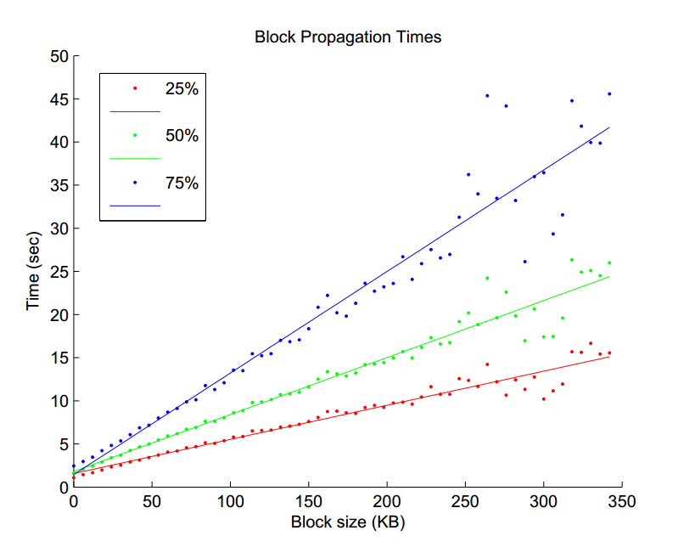
Source: Yonatan Sompolinsky and Aviv Zohar: “Accelerating Bitcoin’s Transaction Processing” 2014

Slide 36
How big is the network?
Impossible to measure exactly
Estimates-up to 1M IP addresses/month
Only about 5-10k “full nodes”
  Permanently connected
  Fully-validate
This number may be dropping!

Slide 37
Fully-validating nodes
Permanently connected
Store entire block chain
Hear and forward every node/transaction

