Slide 1


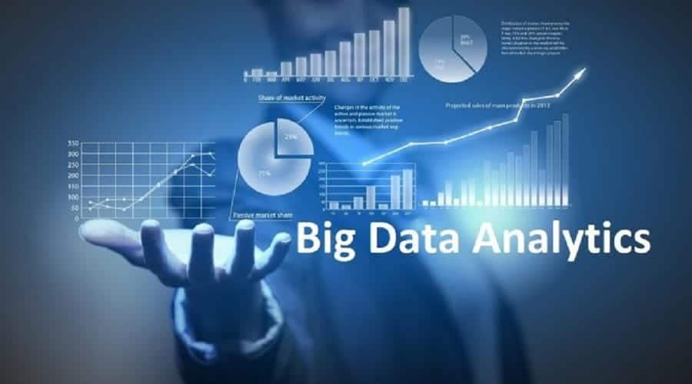
BIG DATA ANALYSIS WITH IBM CLOUD DATABASES

Slide 2
TEAM MEMBERS:
S.SARAVANAN
M.SRINIVASAN
E.SAKTHIKUMAR
K.LOGESHWARAN
S.SIMON DEEPAK

Slide 3
BIG DATA ANALYSIS WITH IBM CLOUD DATABASES :
Big data analytics is the process of collecting, examining, and analyzing large amounts of data to discover market trends, insights, and patterns that can help companies make better business decisions
With big data analytics, you can ultimately fuel better and faster decision-making, modelling and predicting of future outcomes and enhanced business intelligence.
Hydra is a fully-managed open source data warehouse built on Postgres. It's easy to use and designed to scale analytics (OLAP) & hybrid transactional workloads. Our team is excited to announce that Hydra is the fastest Postgres database for analytics.
A cloud database is a database service built and accessed through a cloud computing platform. It serves many of the same functions as a traditional database with the added flexibility of cloud computing.

Slide 4
Services :
The “cloud” is just a set of high-powered servers from one of many providers. They can often view and query large data sets much more quickly than a standard computer could.
IBM Cloud offers over 200 services in its catalog. In this module, we’ll cover eight of the most popular collection of services IBM Cloud has to offer. We’ll start with necessities like databases and move on to emerging technologies like Artificial Intelligence and Blockchain.
Based on the open source cloud platform Cloud Foundry -- developers can use IBM services to create, manage, run and deploy various types of applications for the public cloud, as well as for local or on-premises environments.

Slide 5
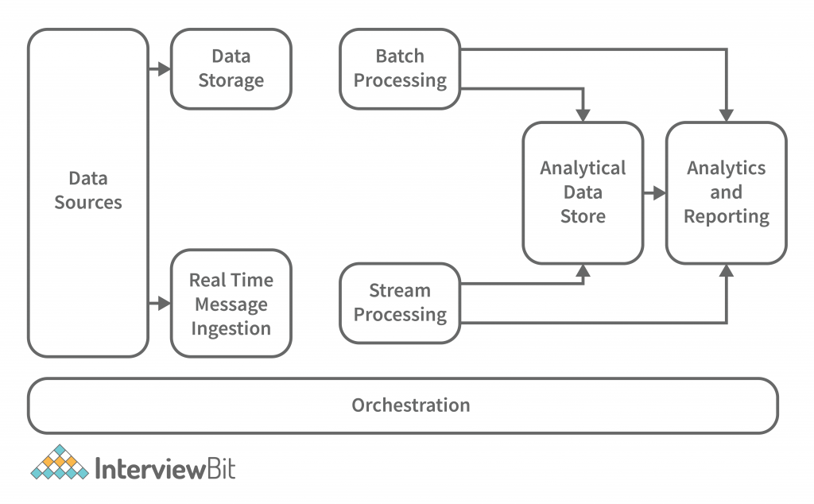
Data management : A cloud database such as IBM Cloudant® enables you to push database access to the farthest edge of the network, such as mobile devices, remote facilities, sensors, and Internet-enabled goods, so you can scale bigger and enable applications to continue run
Hybrid databases create a distributed hybrid data cloud :
Start small, grow big.
Elastically scale on demand.
Clusters can span multiple data centers.
Manage your cloud yourself, or let a provider manage it for you.
Mix and match cloud providers to optimize geographic reach, service level agreements (SLAs), pricing and regulatory requirements.

Slide 6
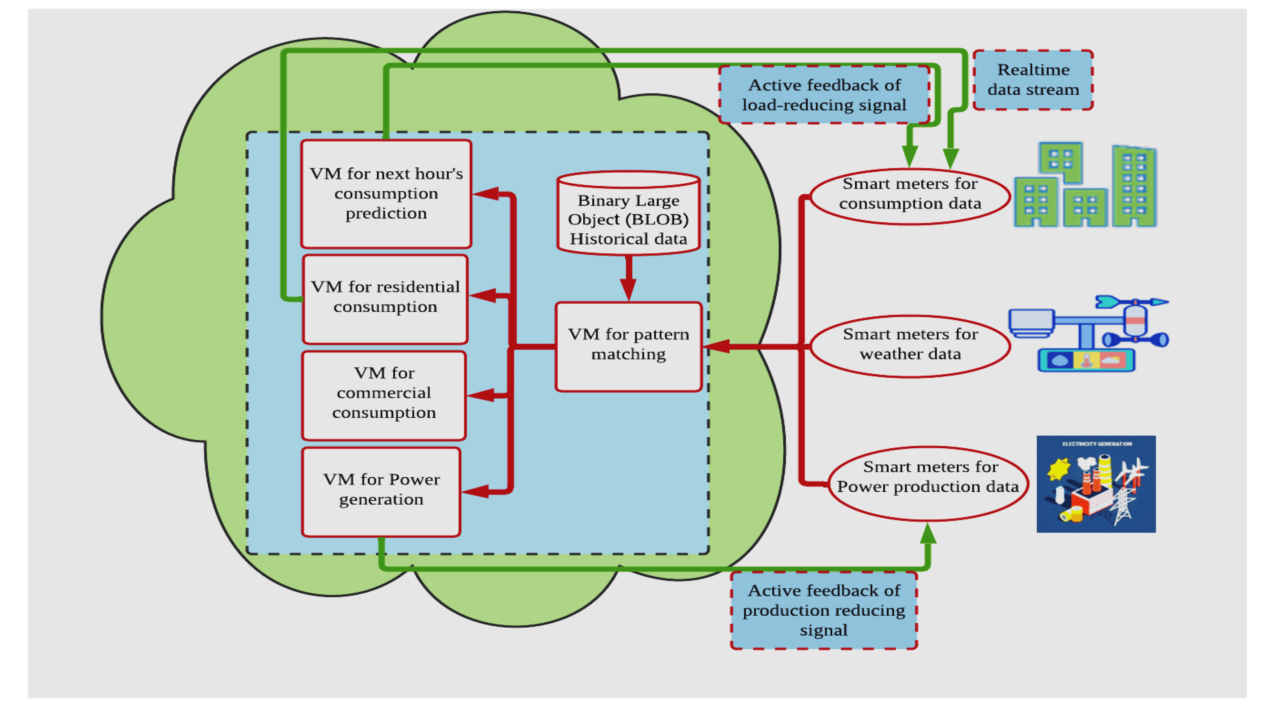
Benefits of Cloud Database :
Cloud databases can collect, deliver, replicate, and push to the edge all your data using the new hybrid cloud concept. Users no longer have to deploy the dependent middleware to deliver database requests anywhere in the world. They can connect applications directly to their database.
For example, financial organizations are embracing the hybrid concept by using the database as a central repository for all their disparate data sources, and then delivering this financial data in JSON format. This data is then distributed to the database as a service and replicated to geographic regions across the world.

Slide 7
CONCLUSION :
A field to analyze and extract information about the big data involved in the business or the data world so that proper conclusions can be made is called big data Analytics. These conclusions can be used to predict the future or to forecast the business. Also, this helps in creating a trend about the past.
And also it helps a business optimize its performance, perform more efficiently, maximize profit, or make more strategically-guided decisions.

