Slide 1
Affinity Propagation
Clustering Algorithm

Slide 2
Introduction
Clustering is an unsupervised machine learning task.
Unsupervised means you will have a dataset that is completely unlabelled.
Grouping of data points are called clustering.

Slide 3
Affinity Propagation
It is a message passing clustering algorithm. Affinity Propagation (AP) is a clustering algorithm that operates by simultaneously considering all data points as potential exemplars and iteratively updating messages between data points to identify exemplars and clusters.

Slide 4
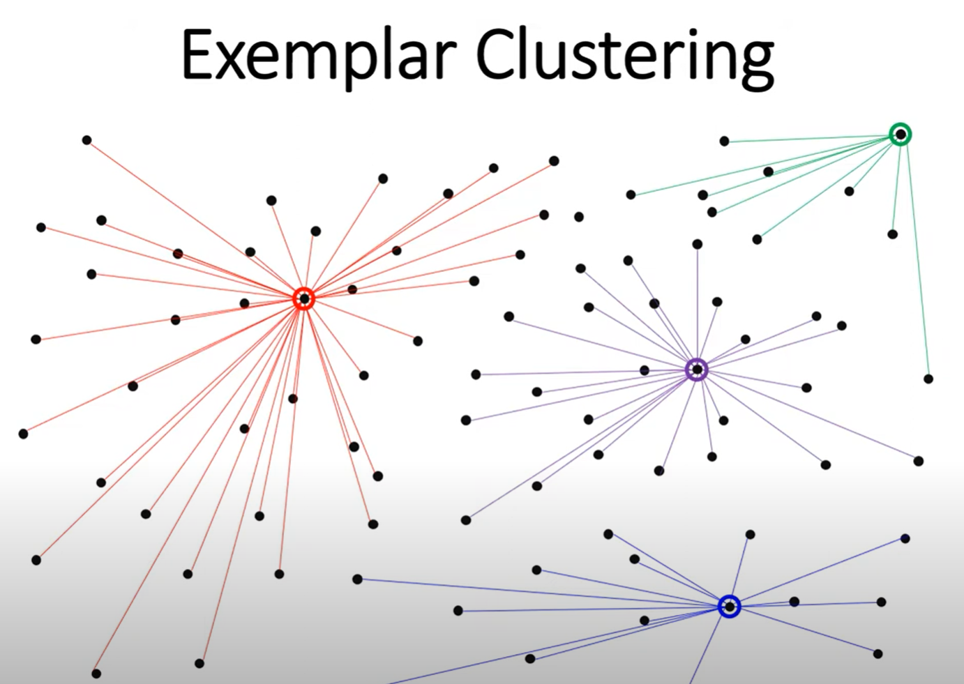
Exemplar Clustering
Selection: In Affinity Propagation, exemplars are selected during the clustering process. Each data point in the dataset is considered as a potential exemplar, and the algorithm determines which data points are most suitable to represent their respective clusters.
Suitability: The suitability of a data point to serve as an exemplar is determined based on various factors, including its similarity to other data points and its ability to capture the overall characteristics of its cluster.
Net Responsibility: In Affinity Propagation, the net responsibility 𝐸(𝑖)E(i) for each data point is computed, which represents the suitability of that data point as an exemplar. Data points with positive net responsibility are typically chosen as exemplars.
Representativeness: Exemplars are expected to be representative of their clusters, meaning they should capture the central tendencies or essential features of the data points within their clusters.
Cluster Assignment: Once exemplars are selected, data points are assigned to clusters based on their similarity to the exemplars. Each data point is assigned to the cluster represented by its nearest exemplar.
Cluster Interpretation: Exemplars play a crucial role in interpreting the clusters generated by the algorithm. They provide insights into the characteristics of each cluster and can be used to describe and analyse the data.

Slide 5
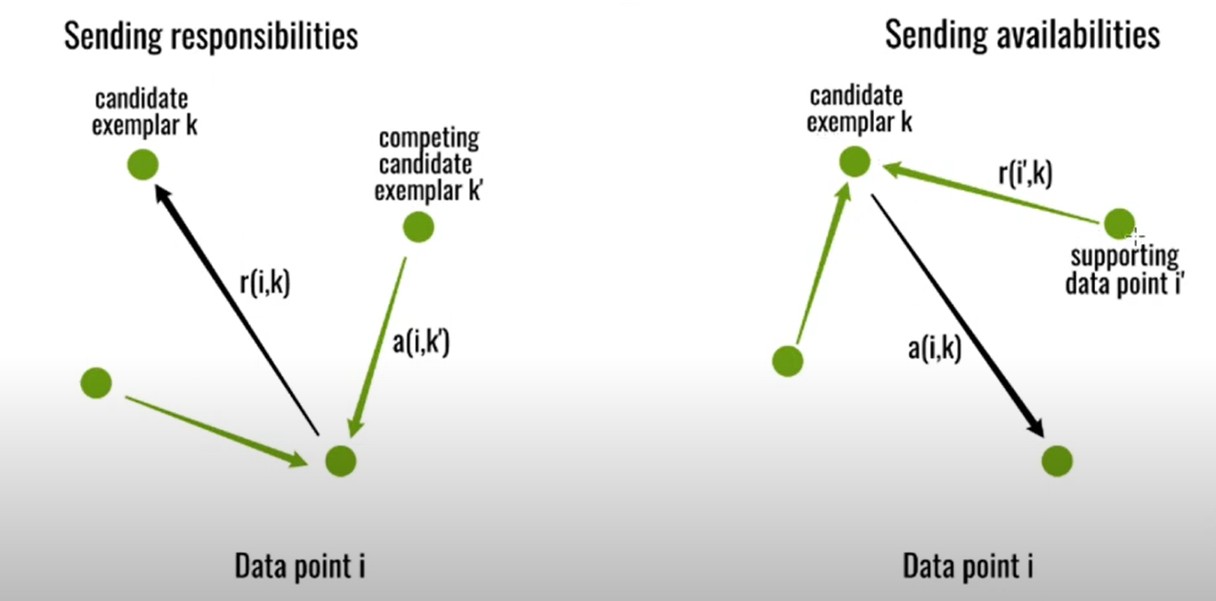
Responsibility matrix 𝑅: 𝑟(𝑖,𝑘) represents the responsibility of data point 𝑖 to select data point 𝑘 as an exemplar.
Availability matrix 𝐴: 𝑎(𝑖,𝑘) represents the availability of data point 𝑘 to serve as an exemplar for data point 𝑖.

Slide 6
Advantage Affinity Propagation clustering algorithm does not need to set the number of clusters. It has advantages on efficiency and accuracy but is not suitable for large-scale data clustering. Affinity Propagation has been applied to various fields, including image and text clustering, gene expression analysis, and network analysis.

Slide 7
Thank you

