Slide 1
BIRCH
Clustering Algorithm

Slide 2
Introduction
Clustering is an unsupervised machine learning task.
Unsupervised means you will have a dataset that is completely unlabelled.
Grouping of data points are called clustering.

Slide 3
Balanced Iterative Reducing and Clustering using Hierarchies
BRICH aims to create a hierarchical clustering of a dataset by iteratively merging clusters until a termination condition is met. The key difference between BRICH and BIRCH lies in how they handle the clusters. BRICH, in addition to maintaining a Clustering Feature (CF) Tree like BIRCH, also constructs a CF-Tree for each cluster. This allows BRICH to maintain the clustering information at different granularities, which facilitates hierarchical clustering.

Slide 4
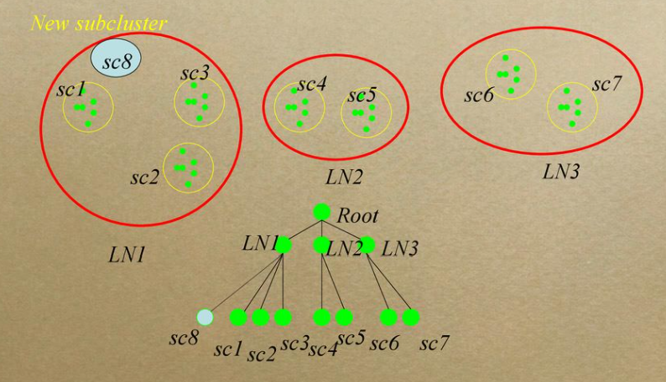
The algorithm operates in two phases:
Clustering Phase:
During this phase, BRICH constructs a Clustering Feature (CF) Tree, which is essentially a hierarchical structure that summarizes the distribution of points in the dataset.
It recursively inserts data points into leaf nodes of the CF-Tree while maintaining certain conditions to ensure balance and compactness of the tree.
When a leaf node exceeds a predefined threshold, it splits to maintain balance.
Hierarchical Clustering Phase:
Once the CF Tree is constructed, BRICH utilizes it to perform hierarchical clustering.
It identifies pairs of clusters to merge based on certain criteria, such as distance or similarity, and merges them into larger clusters.
This process continues until a termination condition is met, such as reaching a desired number of clusters or until further merging doesn't improve the clustering quality significantly.

Slide 5
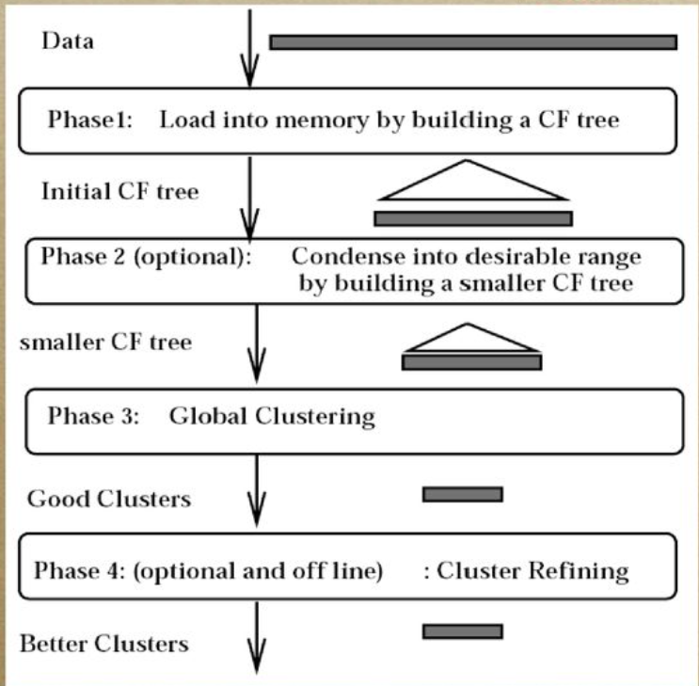

Slide 6
Advantage BRICH is a powerful algorithm for hierarchical clustering of large datasets, providing both efficiency and scalability while producing meaningful hierarchical clustering structures. It can be applied to tasks such as document clustering, customer segmentation, and image clustering. Handles outliers better.

Slide 7
Thank you

