Slide 1
DBSCAN
Clustering Algorithm

Slide 2
Introduction
Clustering is an unsupervised machine learning task.
Unsupervised means you will have a dataset that is completely unlabelled.
Grouping of data points are called clustering.

Slide 3
Density-Based Spatial Clustering of Applications with Noise
It is a density-based clustering algorithm.
It depends on two parameters:
Eps (ε) Neighbourhood: Distance measure that is used to specify the neighbourhood of any data point. If the distance between two data points is less than eps, then those two data points are neighbours.
MinPts: Another parameter is MinPts, which specifies the minimum number of points required to form a dense region. Points with more than MinPts neighbours within distance ε are considered core points.

Slide 4
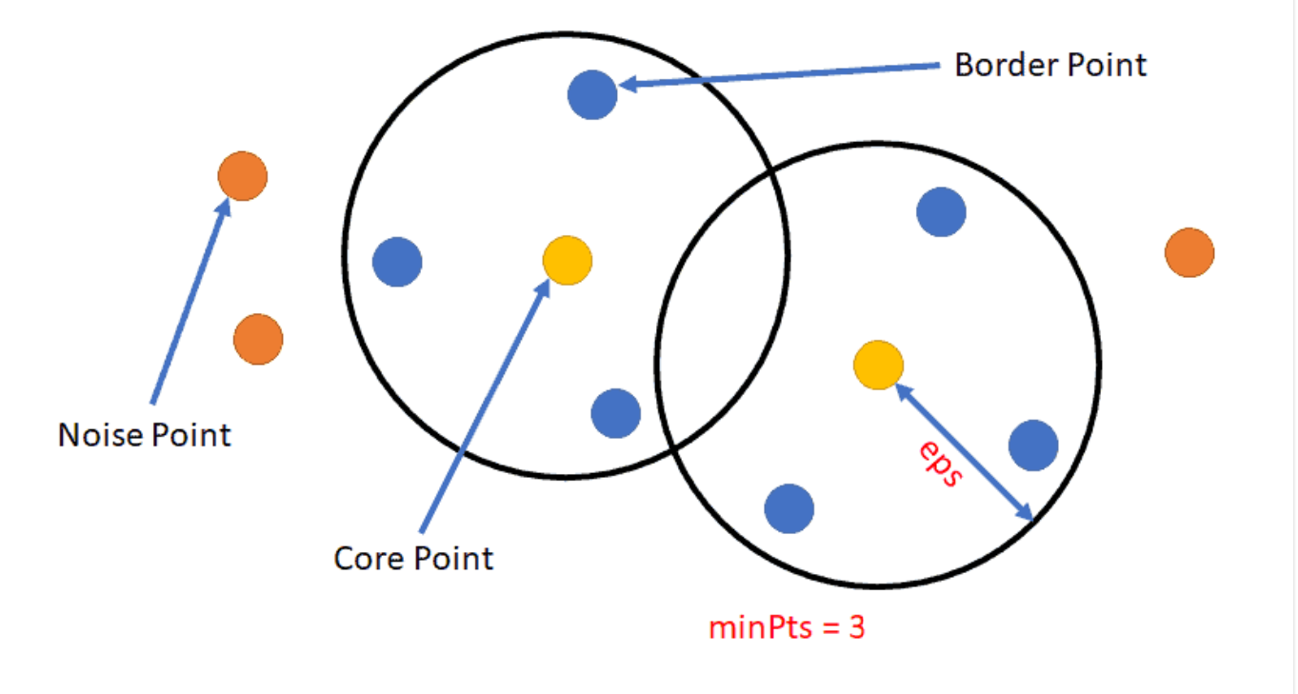
WORKS Based on the Three Points
Core Points:
Core points are those with at least MinPts neighbours (including themselves) within distance ε. These points are at the heart of clusters and typically lie within dense regions.
Border Points:
Border points are not core points themselves but are within the ε neighbourhood of a core point. They belong to the cluster of that core point but do not have enough neighbours to be considered core points themselves.
Noise Points:
Points that are neither core points nor border points are classified as noise points or outliers. These points do not belong to any cluster.

Slide 5
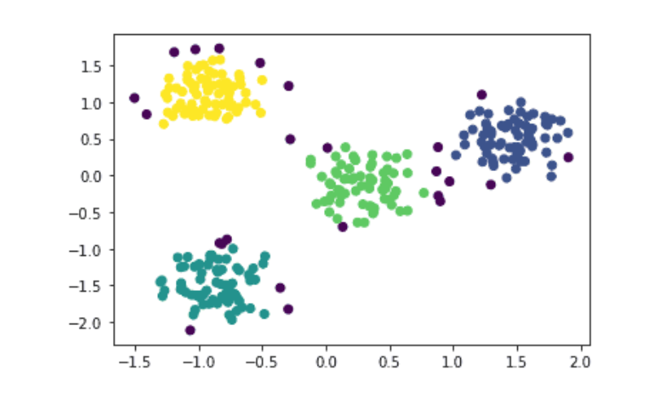
The Scatter Plot

Slide 6
Advantage DBSCAN is particularly useful when dealing with large datasets with complex structures, where traditional clustering algorithms like K-means may struggle. It's a valuable tool for exploratory data analysis and pattern recognition tasks.

Slide 7
Thank you

