Slide 1
GMM
Clustering Algorithm

Slide 2
Introduction
Clustering is an unsupervised machine learning task.
Unsupervised means you will have a dataset that is completely unlabelled.
Grouping of data points are called clustering.

Slide 3
Gaussian Mixture
The Gaussian Mixture Model (GMM) algorithm is a probabilistic model used for clustering and density estimation tasks. It assumes that the data is generated from a mixture of several Gaussian distributions, each characterized by its mean and covariance matrix.

Slide 4
HOW IT WORKS
1. Initialization:
Initialize the parameters of the Gaussian mixture model. This typically involves randomly initializing the means, covariances, and mixing coefficients of the Gaussian components.
2. Expectation-Maximization (EM) Algorithm:
The EM algorithm is used to iteratively estimate the parameters of the Gaussian mixture model.
Expectation Step (E-step): Compute the posterior probabilities (responsibilities) of each data point belonging to each Gaussian component, given the current parameter estimates.
Maximization Step (M-step): Update the parameters (means, covariances, and mixing coefficients) of the Gaussian components based on the computed responsibilities.
3. Convergence:
Iterate the E-step and M-step until convergence criteria are met. Convergence is often determined by the change in log-likelihood or when the parameters stabilize.
4. Model Selection:
Determine the optimal number of Gaussian components for the data. This can be done using techniques such as cross-validation, Bayesian Information Criterion (BIC), or Akaike Information Criterion (AIC).
5. Cluster Assignment:
Once the model has converged, assign each data point to the Gaussian component with the highest posterior probability (responsibility).

Slide 5
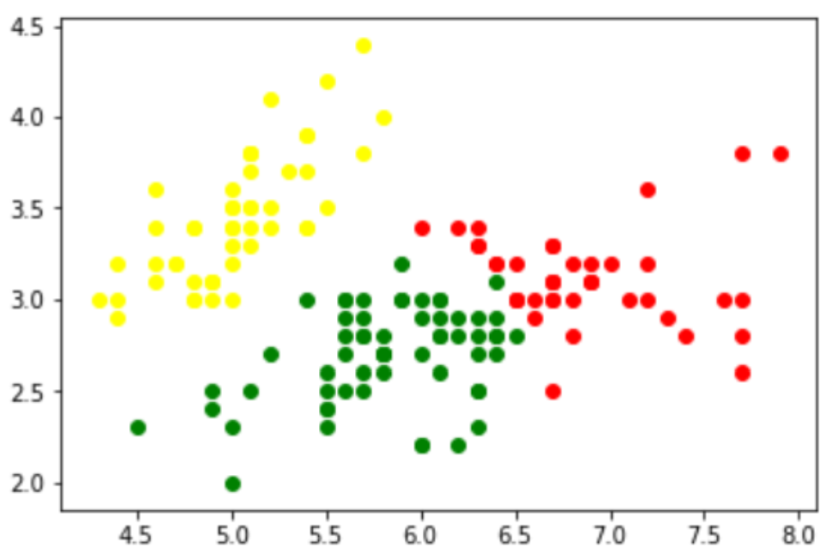
The Scatter Plot

Slide 6
Advantage The Gaussian Mixture Model algorithm is a powerful tool for clustering, density estimation, anomaly detection, and data generation tasks, particularly when the underlying data distribution is complex and composed of multiple Gaussian components.

Slide 7
Thank you

