Slide 1
Mean-shift
Clustering Algorithm

Slide 2
Introduction
Clustering is an unsupervised machine learning task.
Unsupervised means you will have a dataset that is completely unlabelled.
Grouping of data points are called clustering.

Slide 3
Mean-Shift
Mean-shift clustering is an unsupervised machine learning algorithm used to identify clusters within a dataset. It is a density-based clustering method that focuses on finding the regions of high density and iteratively shifting data points towards the highest density of points, hence the name “mean-shift.” The algorithm does not require any prior information about the number of clusters present in the data, making it particularly useful for exploratory data analysis.

Slide 4
HOW IT WORKS
Kernel Density Estimation:
Each data point is considered as a potential cluster center.
A kernel function (typically Gaussian) is applied to each data point, creating a kernel density estimate around it.
Mean Shift:
For each data point, the mean shift vector is computed. This vector points towards a higher density region in the feature space.
The mean shift vector is calculated as the weighted average of the points in the neighbourhood of the current point, with weights determined by the kernel function.
The point is then updated by shifting it towards the mode of the estimated density.
Convergence:
Repeat the mean shift process for each data point until convergence is reached.
Convergence occurs when the mean shift vectors become very small or when the points no longer move significantly.
Cluster Assignment:
After convergence, data points that converge to the same mode are assigned to the same cluster.
Modes that are close together may represent the same cluster.
Parameter Selection:
The Mean Shift algorithm requires the selection of a bandwidth parameter, which determines the size of the neighbourhood used to compute the mean shift vector.
Bandwidth selection can significantly affect the clustering results. It can be chosen manually or using techniques such as cross-validation.

Slide 5
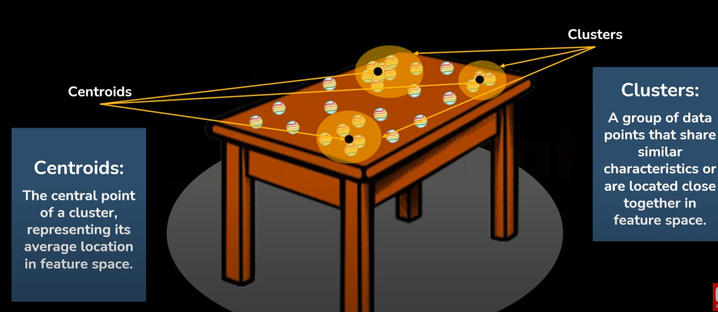

Slide 6
Advantage The Mean Shift algorithm is robust to irregularly shaped clusters and doesn't require prior knowledge of the number of clusters. Emphasize the versatility and effectiveness of the Mean Shift algorithm in clustering and related tasks. Mean Shift is widely used in computer vision for tasks such as image segmentation and object tracking, where it can effectively segment objects based on color or texture similarities. It's also used in other domains like customer segmentation and anomaly detection.

Slide 7
Thank you

