Slide 1
OPTICS
Clustering Algorithm

Slide 2
Introduction
Clustering is an unsupervised machine learning task.
Unsupervised means you will have a dataset that is completely unlabelled.
Grouping of data points are called clustering.

Slide 3
Ordering Points To Identify the Clustering Structure
It is a density-based clustering algorithm.
It depends on two parameters:
Reachability Distance Threshold: It determines the maximum distance between two points for one point to be considered reachable from the other. Influences cluster identification.
MinPts: Another parameter is MinPts, which specifies the minimum number of points required to form a dense region. Points with more than MinPts neighbours within distance ε are considered core points.

Slide 4
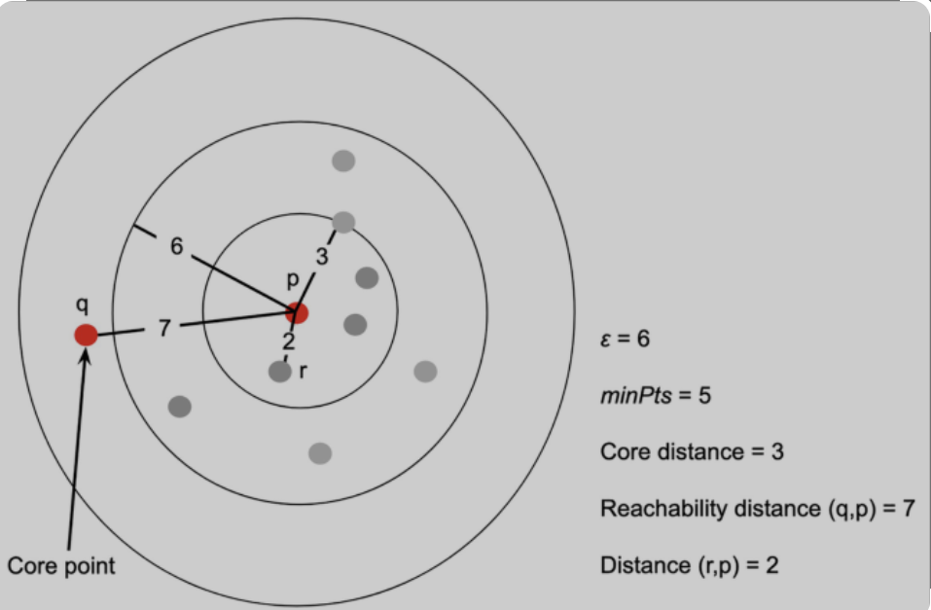
Key Concepts
Reachability Distance:
Measures dissimilarity between points considering distance and local density.
Core Distance:
Distance to the kth nearest neighbour, used to identify core points.
Optics Ordering:
Arranges points based on their reachability distances.

Slide 5
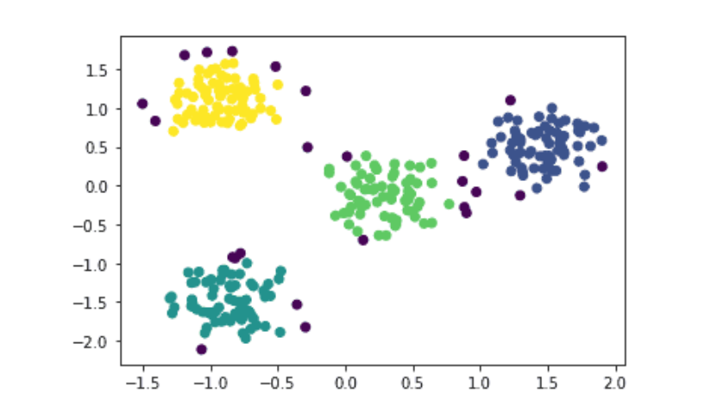
The Scatter Plot

Slide 6
Advantage OPTICS is a powerful clustering algorithm for handling complex datasets. It’s ability to adapt to varying densities and noise makes it valuable in real-world applications. Robust to noise and outliers. .

Slide 7
Thank you

