Slide 1
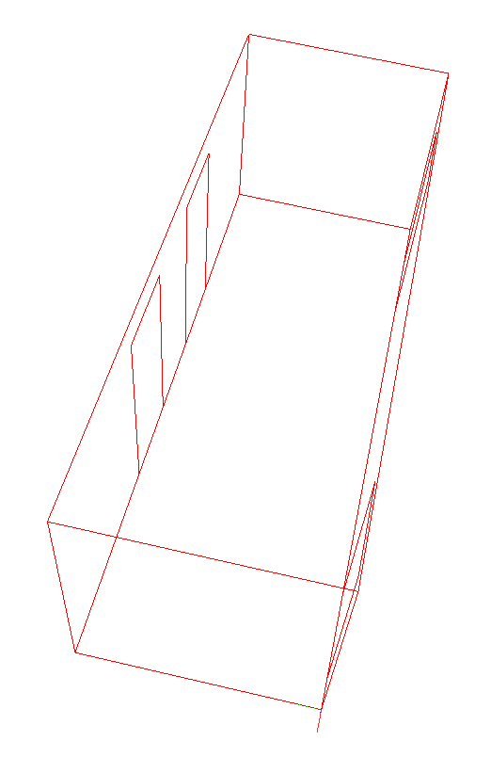
7.8 m
2.9 m
2.8 m

