Slide 1
Revision Information
130930-01/ Sean Yi

Slide 2
ID | 1-1 | Name | State Machine |  | Rev. | 130930-01
▶rPanel-AllegroDog MFC-based GUI program ▶Control Program Real-time control callback
Command
500 Hz
Shared Memory
rPanel-AllegroDog
Shared Memory
Control Program
Status
Status
500 Hz
-GUI
-Send command
-Status monitoring
-Real-time graph
-Real-time control callback
-Device I/O
-CAN communication
Data Sync. Event
500 Hz

Slide 3

ID | 1-1 | Name | State Machine |  | Rev. | 130930-01
▶INIT Just program started Servo off ▶HOMING Servo on Position servo mode enabled Homing process activated After homing the state will transit to READY state automatically Once homing was done, homing process is skipped and will transit to READY state ▶READY Servo on Position servo mode enabled Re-calculate encoder offsets Joints will be controlled to pre-defined position ▶OPERATION Servo on Current servo mode enabled Periodic communication on ▶STOP Emergency stop Servo off Periodic communication off
INIT
Home
Init
HOMING
STOP
Stop
READY
Stop
Enable
OPERATION
Stop

Slide 4
ID | 1-1 | Name | Sub-state Machine (in OPERATION state) |  | Rev. | 130930-01
▶READY ▶HOP ▶WALK ▶
OPERATION
READY
HOP
STOP
WALK

Slide 5
ID | 1-1 | Name | State Machine |  | Rev. | 130930-01
STOP
▶STOP Motors-off(ServoOff();) Deactivate all drivers (“PPE!”)
ENABLE
▶ENABLE CAN-ON (devCAN[0]->on(); devCAN[1]->on();) Activate-Controller (ActivateController(control_pid);)
▶HOME Servo on: Motors On by CAN devices (ServoOn();) ServoOn Controller (ServoOnController(control_pid);) Position servo mode enabled (devCAN->command(CAN_CMD_OPMODE_POSITION, 0, NULL, -1);) Homing process activated: all 12 motors do homing at the same time. (devCAN->command(CAN_CMD_SET_POS_MAX_VELOCITY, 100, NULL, -1);) (devCAN->command(CAN_CMD_HOMING, 0, NULL, -1);)
HOME
READY
▶READY Set CURRENT-mode for all motors in CAN devices: devCAN->command(CAN_CMD_OPMODE_CURRENT, 0, NULL, -1); Set CURRENT-mode for all motors: (devMotor[i]->command(ALLEGRODOGMOTOR_CMD_OPMODE_CUR, 0, NULL, i)) Torque values from Allegrowalk class by Inversekinematic will be sent to motors.
OPERATION: HOP/ WALK
▶HOP/WALK Set CURRENT-mode for all motors in CAN devices: devCAN->command(CAN_CMD_OPMODE_CURRENT, 0, NULL, -1); Set CURRENT-mode for all motors: (devMotor[i]->command(ALLEGRODOGMOTOR_CMD_OPMODE_CUR, 0, NULL, i)) Torque values from Allegrowalk class by Inversekinematic will be sent to motors.

Slide 6
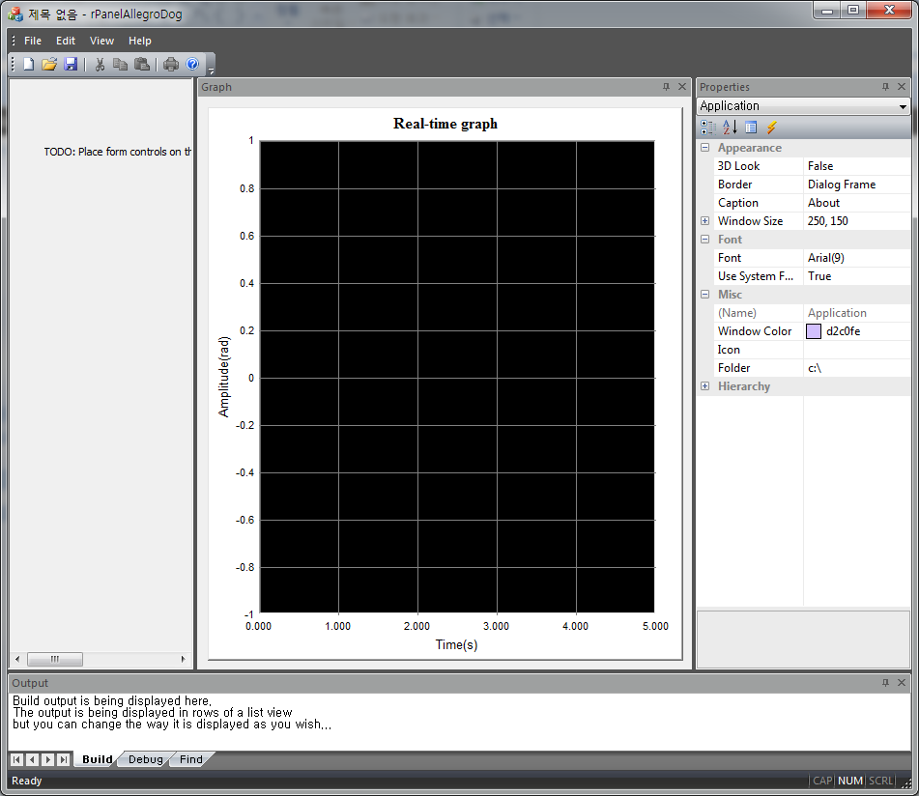
ID | 1-1 | Name | rPanel-AllegroDog |  | Rev. | 130930-01
▶[STOP] button Emergency stop ▶[HOME] button Start homing process ▶[ENABLE] button Enable operation(user defined controller) [READY] button: [HOP] button [WALK] button ▶
STOP
HOME
ENABLE
READY
HOP
WALK

