Slide 1
BANK CHURN PREDICTION
& CUSTOMER RETENTION
RECOMMENDATION SYSTEM
Machine Learning Project
Presented by : Simran (B.Tech CSE (AIML))

Slide 2
PROJECT STATEMENT
Customer churn is a major challenge for banks because losing customers can affect revenue and long-term business growth.
The objective of this project is to:
Predict whether a customer is likely to leave the bank.
Identify customers who are at high risk of churn.
Analyze the factors associated with customer churn.
Provide suitable retention recommendations for high-risk customers.

Slide 3

Project Objectives
Objectives​
Analyze customer banking data.
Perform data cleaning and exploratory data analysis.
Identify patterns related to customer churn.
Build and compare multiple classification models.
Tune the best-performing model.
Predict churn probability and risk level.
Provide customer retention recommendations.
Develop an interactive Streamlit application.

Slide 4
Dataset
Dataset: Bank Customer Churn
10,000 customer records
14 features
Target variable: Exited
Important features:
Credit Score
Geography
Gender
Age
Tenure
Balance
Number of Products
Credit Card
Active Member
Estimated Salary
Target:
0 → Customer stayed
1 → Customer exited
Dropped columns:
RowNumber
CustomerId
Surname

Slide 5
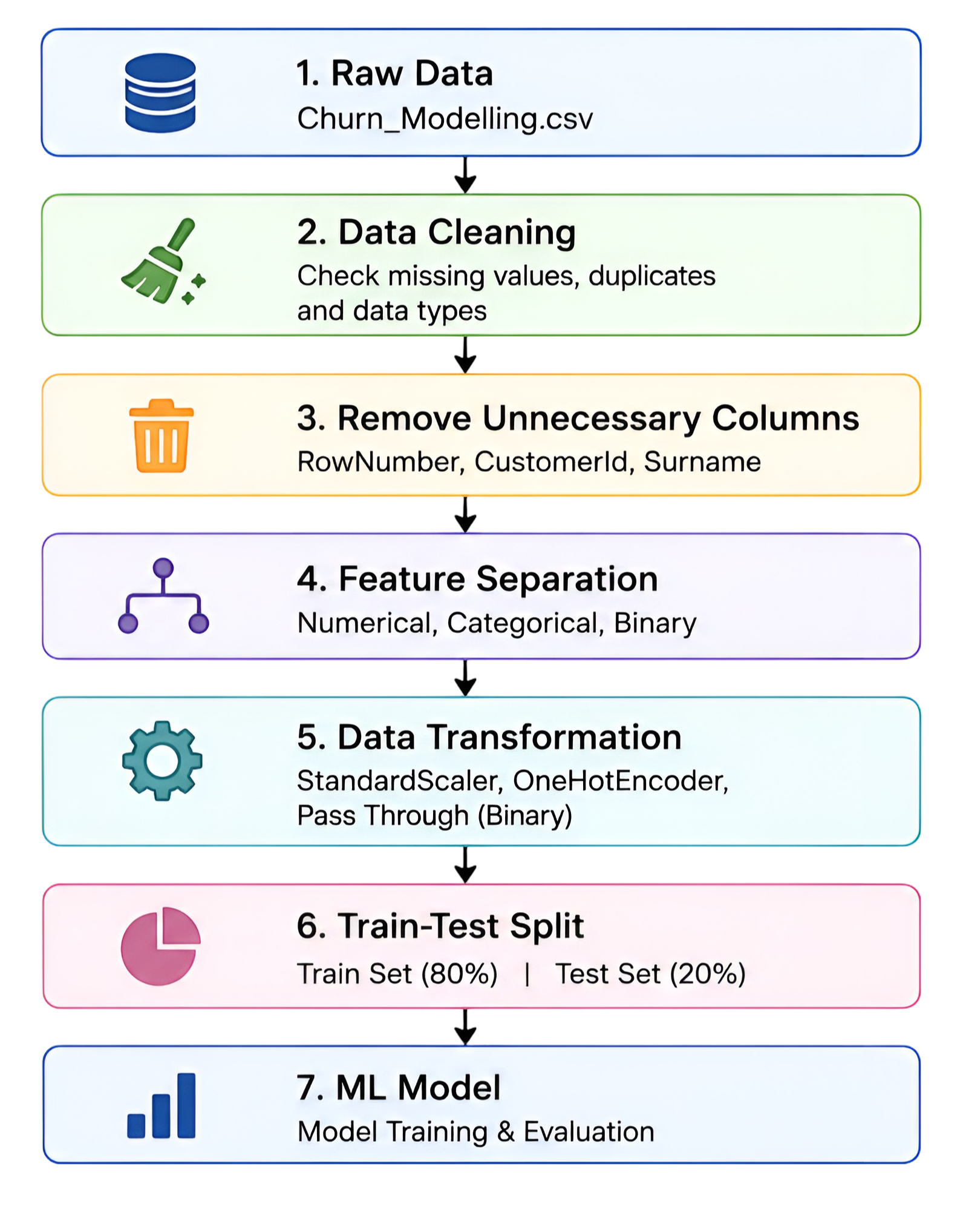
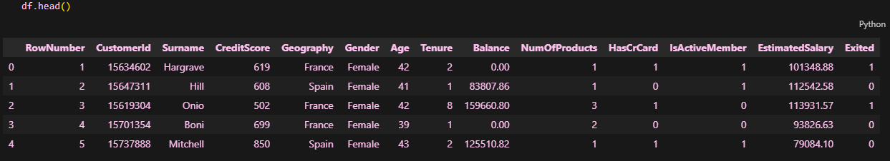
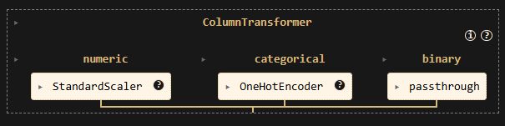
Data Preprocessing
Original Dataset — Before Data Cleaning
✓
✓
ColumnTransformer — Feature Preprocessing
✓
Goal: Convert raw customer data into a clean format suitable for machine learning.

Slide 6
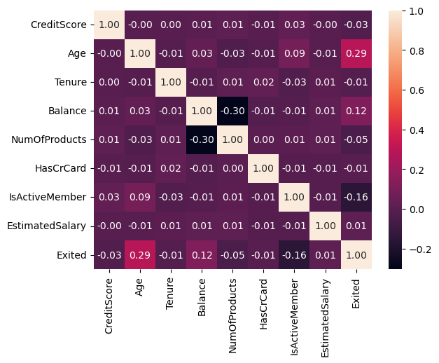
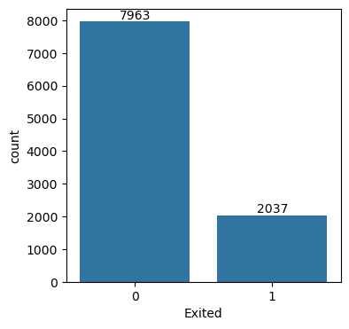
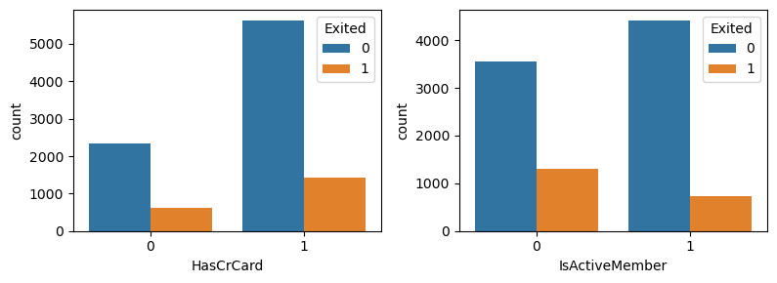
Exploratory Data Analysis
EDA was performed to understand the data and discover patterns related to churn.
Univariate Analysis
Analyzed individual variables to understand their
distributions.
Histograms were used for numerical features.
Count plots were used for categorical and binary features.
Examined the distribution of the target variable Exited.
Bivariate Analysis
Analyzed the relationship between individual features and
customer churn.
Box plots were used for numerical features against Exited.
Count plots were used for categorical and binary features
against Exited.
Multivariate Analysis
Analyzed relationships among multiple numerical features.
A correlation heatmap was used to identify feature
relationships and possible patterns.

Slide 7
Model Building
01
Logistic Regression
Baseline classifier
02
Decision Tree
Non-linear tree model
03
Random Forest
Ensemble model
04
Tuned Random Forest
Optimized final model

Slide 8
Model Comparison
Model
Accuracy
Precision
Recall
F1
Logistic Regression
71.35%
38.72%
70.02%
49.87%
Decision Tree
78.15%
46.36%
46.93%
46.64%
Random Forest
85.70%
77.13%
42.26%
54.60%
BEST OVERALL MODEL
Random Forest

Slide 9
Hyperparameter Tuning & Final Model Results
Hyperparameter Tuning :
Hyperparameter tuning is the process of finding the best settings (hyperparameters) for a machine learning model to improve its performance.
To improve the Random Forest model, I used:
GridSearchCV :
5-Fold Cross Validation
Scoring: Recall
Parameters Tuned
Number of estimators
Maximum tree depth
Minimum samples required for split
Minimum samples required at leaf
The actual search used the following parameter ranges and
5-fold cross-validation with recall as the scoring metric.
Best Parameters
n_estimators = 200
max_depth = 5 min_
samples_split = 10
min_samples_leaf = 2
Final Model Evaluation
Tuned Random Forest
Metric | Score
Accuracy | 79.45%
Precision | 49.68%
Recall | 75.92%
F1 Score | 60.06%
ROC-AUC | 78.14%
Confusion Matrix
Predicted
0 1
Actual
0 1280 313
1 98 309
Key Result :
Recall = 75.92%
The model identifies a large proportion of actual churners.

Slide 10
Churn Prediction System
CUSTOMER INPUT
Credit Score
Age
MODEL OUTPUT
Geography
Balance
CHURN: YES / NO
Products
Active Member
Probability: --%
Has Credit Card
Gender
Risk level
Tenure
Estimated Salary

Slide 11

Retention Recommendation System
Churn Prediction → Risk Level → Recommendation
The system uses churn probability to classify customers into risk categories:
Low Risk: < 40%
Medium Risk: 40–69%
High Risk: ≥ 70%
LOW RISK
Personalized retention offer
Customer engagement call
Loyalty benefits
MEDIUM RISK
Targeted offers
Increased customer engagement
HIGH RISK
Continue regular customer service and engagement

Slide 12
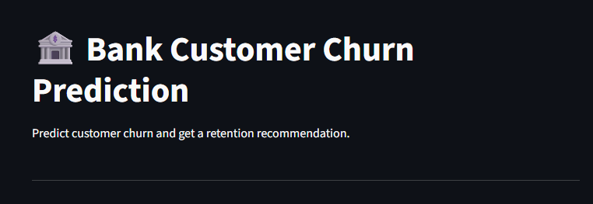
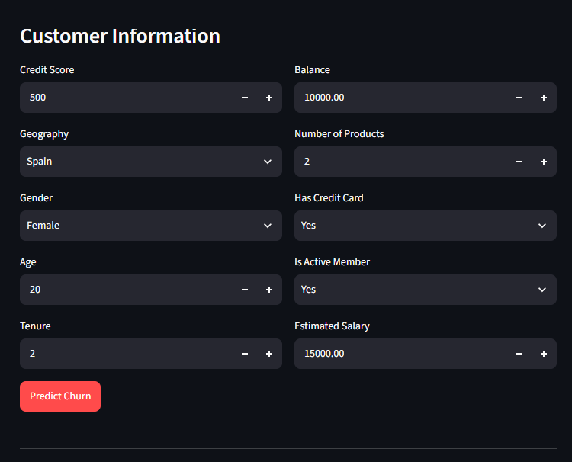
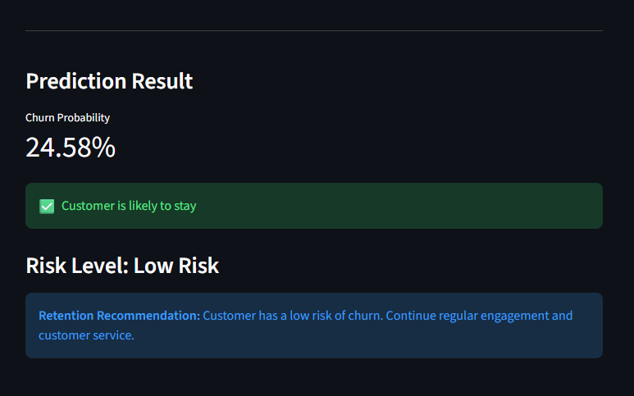
Streamlit Application
Customer Details
↓
Preprocessing Pipeline
↓
Tuned Random Forest
↓
Churn Probability
↓
Risk Level
↓
Retention Recommendation

Slide 13
Results & Conclusion
Conclusion
Developed an end-to-end bank customer churn prediction system.
Performed data cleaning, EDA, preprocessing, model training, and tuning.
Selected Tuned Random Forest as the final model.
Achieved 75% recall and 78% ROC-AUC.
The system focuses on identifying potential churners.
Added a retention recommendation component to support business decision-making.
Developed an interactive Streamlit interface.
Predict → Understand → Act

Slide 14
Future Scope
Real-time banking data
Customer lifetime value
Advanced boosting models
Automated alerts
Cloud deployment
Advanced segmentation

Slide 15
THANK YOU
Bank Churn Prediction & Customer Retention
Recommendation System
Presented by Simran

