Slide 1
Amazon
Logistics Optimization for Delivery Routes

Slide 2
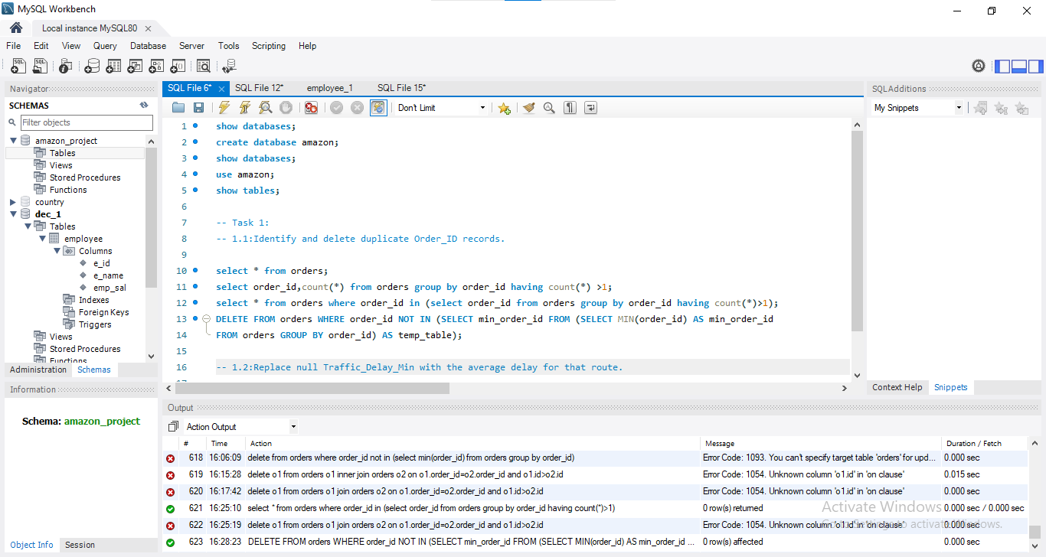
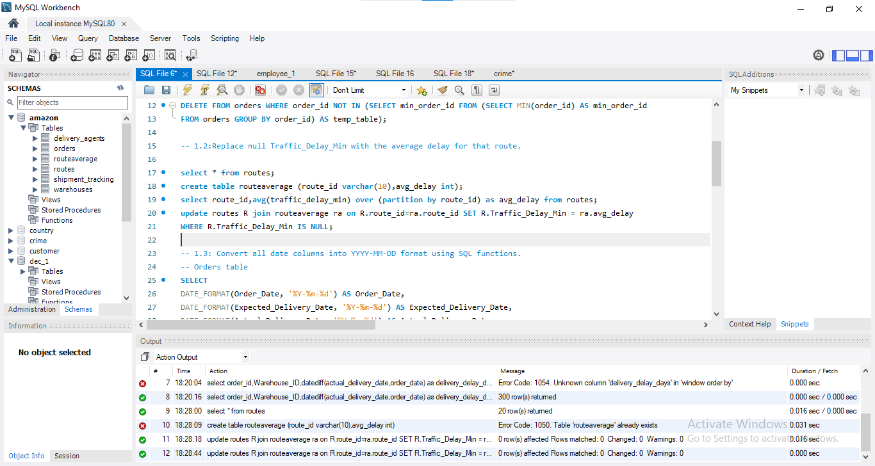
Data Cleaning & Preparation
1.Identify and delete duplicate Order_ID records.
TASK 1:
2.Replace null Traffic_Delay_Min with the average delay for that route.

Slide 3
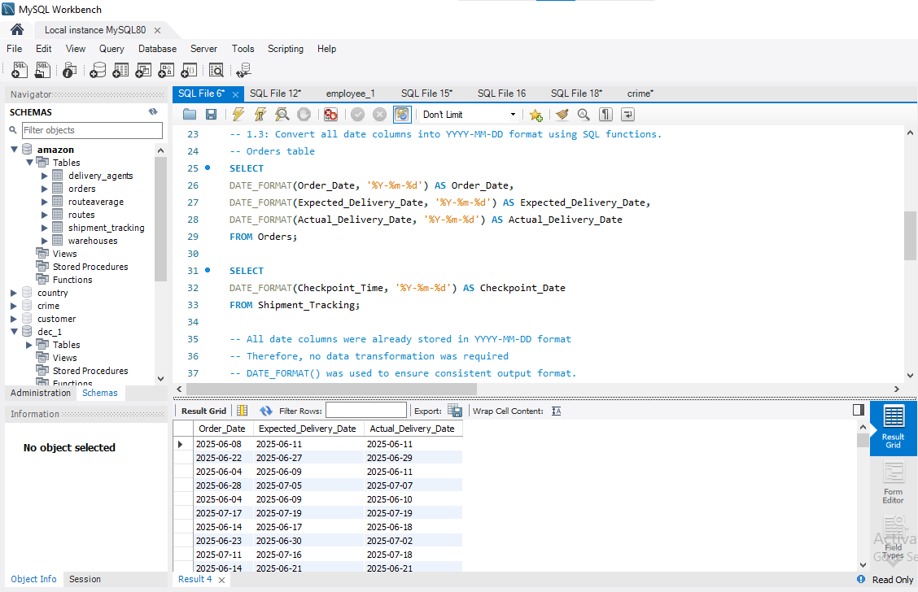
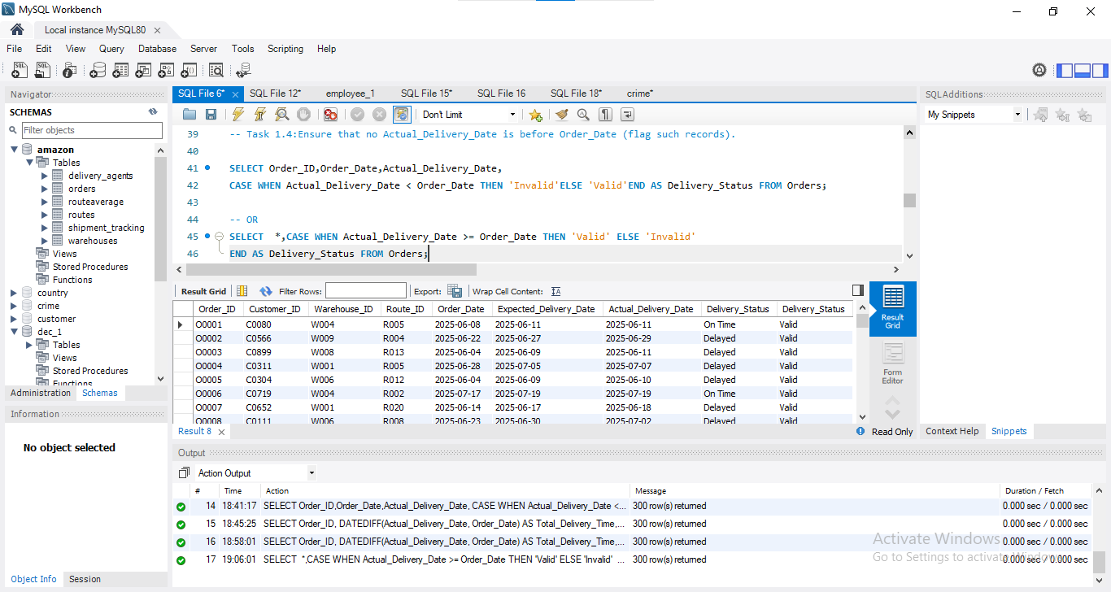
3.Convert all date columns into YYYY-MM-DD format using SQL functions.
All date columns were already stored in YYYY-MM-DD format
Therefore, no data transformation was required
DATE_FORMAT() was used to ensure consistent output format.
4.Ensure that no Actual_Delivery_Date is before Order_Date (flag such records).
We validated delivery dates by comparing Actual_Delivery_Date with Order_Date.
Records where delivery occurred before the order date were flagged as Invalid, as they indicate data inconsistencies.

Slide 4
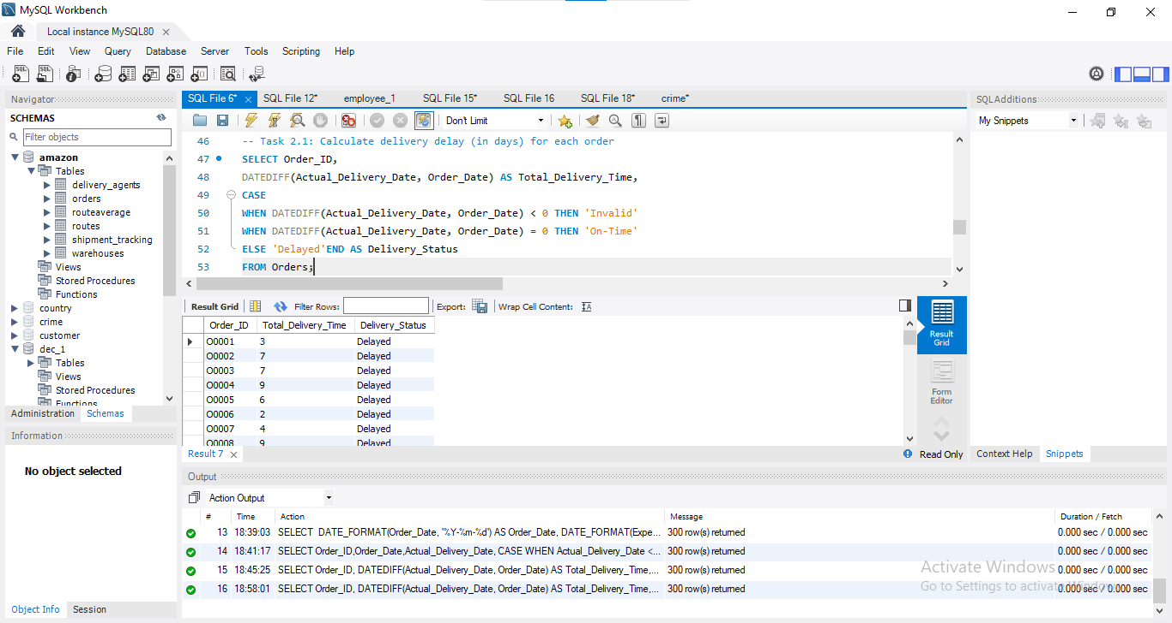
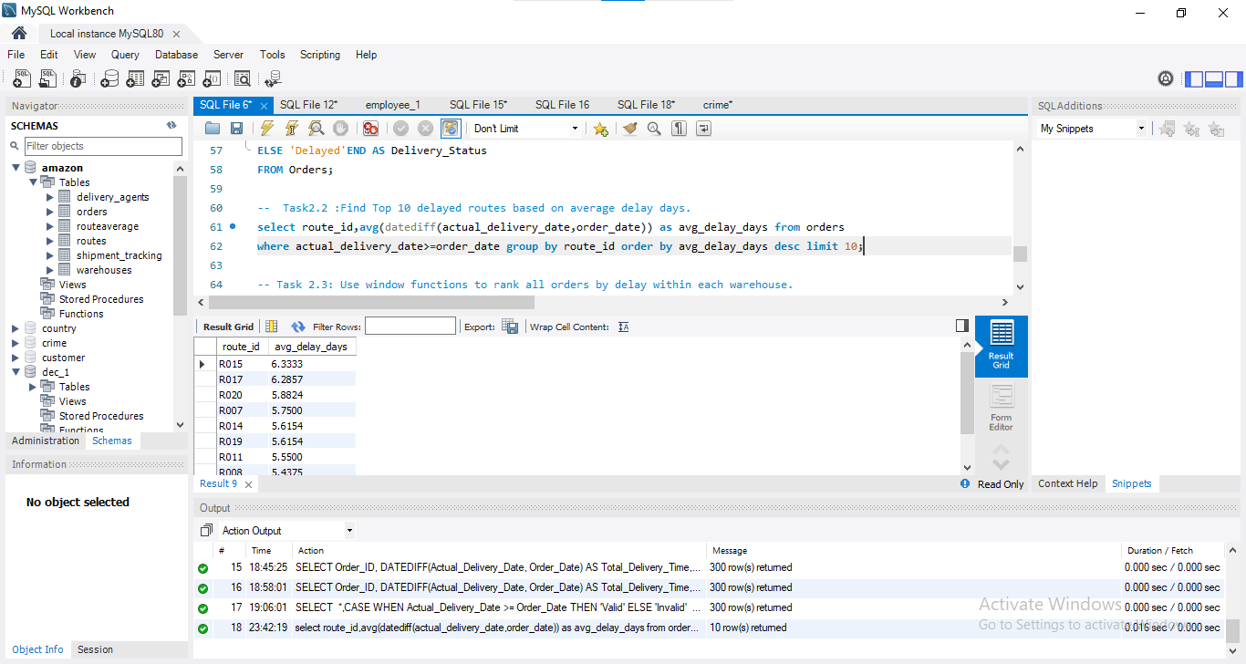
Delivery Delay Analysis
1.Calculate delivery delay (in days) for each orders.
TASK 2:
Delivery delay was calculated using the DATEDIFF() function by subtracting the order date from the actual delivery date. This helps identify delayed, on-time, and invalid deliveries.
2.Find Top 10 delayed routes based on average delay days.
Average delivery delay was calculated for each route using the DATEDIFF() function. Routes were ranked in descending order to identify the top 10 most delayed routes. Invalid records were excluded to ensure accurate analysis.

Slide 5
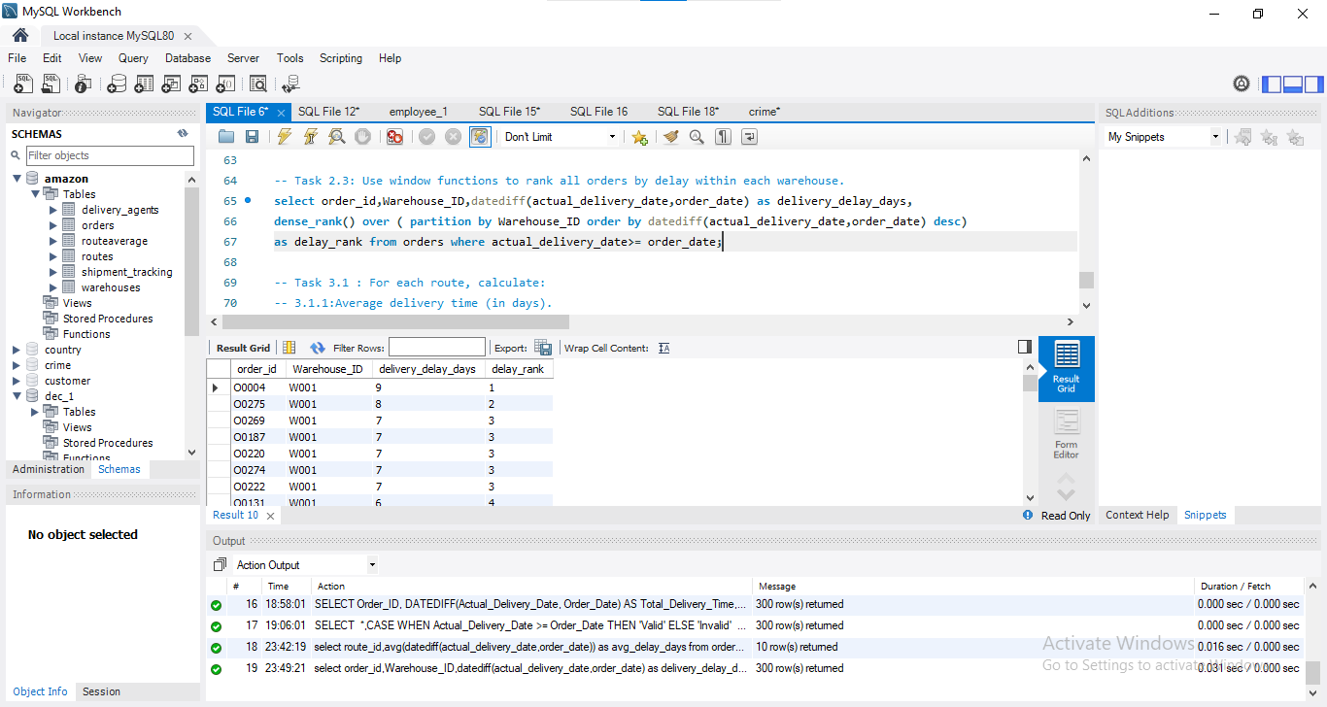
3.Use window functions to rank all orders by delay within each warehouse.
Orders were ranked within each warehouse based on delivery delay using window functions. This helps identify the most delayed orders per warehouse for targeted improvements.

Slide 6
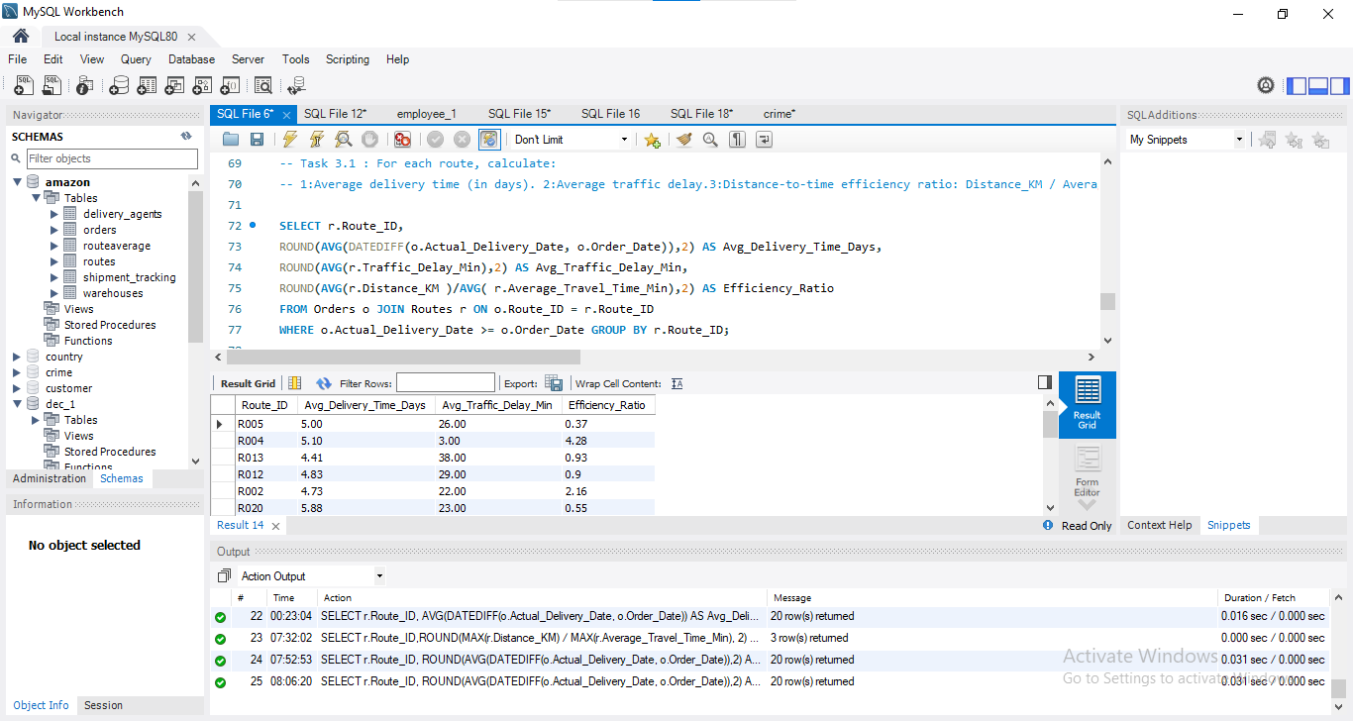
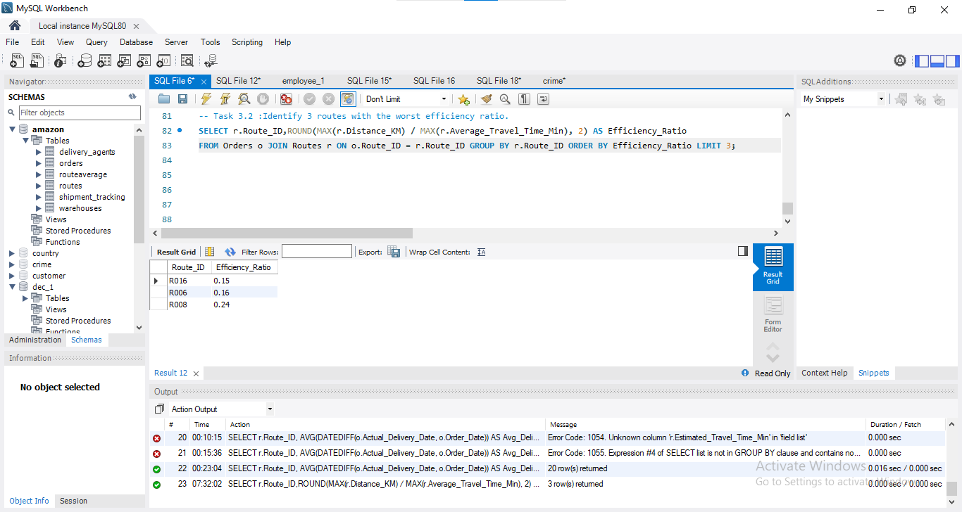
Route Optimization Insights
1.For each route, calculate:
○ Average delivery time (in days).
○ Average traffic delay.
○ Distance-to-time efficiency ratio: Distance_KM / Average_Travel_Time_Min.
Task 3:
2.Identify 3 routes with the worst efficiency ratio.
All route-level metrics were calculated in a single query to provide a consolidated view of performance, enabling easier comparison across routes.

Slide 7
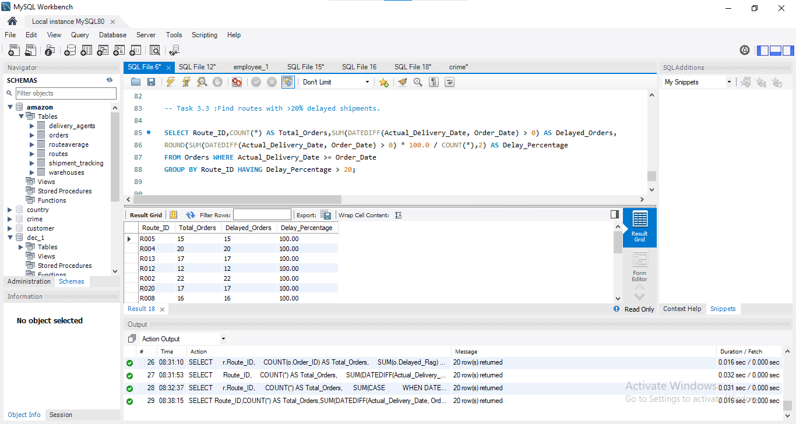
3.Find routes with >20% delayed shipments.
4. Recommend potential routes for optimization.
Optimize routes with low efficiency ratio
Focus on routes with >20% delays
Reduce traffic delays using alternate paths
Improve delivery scheduling (avoid peak hours)
Assign better agents to high-delay routes
Routes with high delays and low efficiency should be prioritized for optimization using better planning and traffic management.

Slide 8
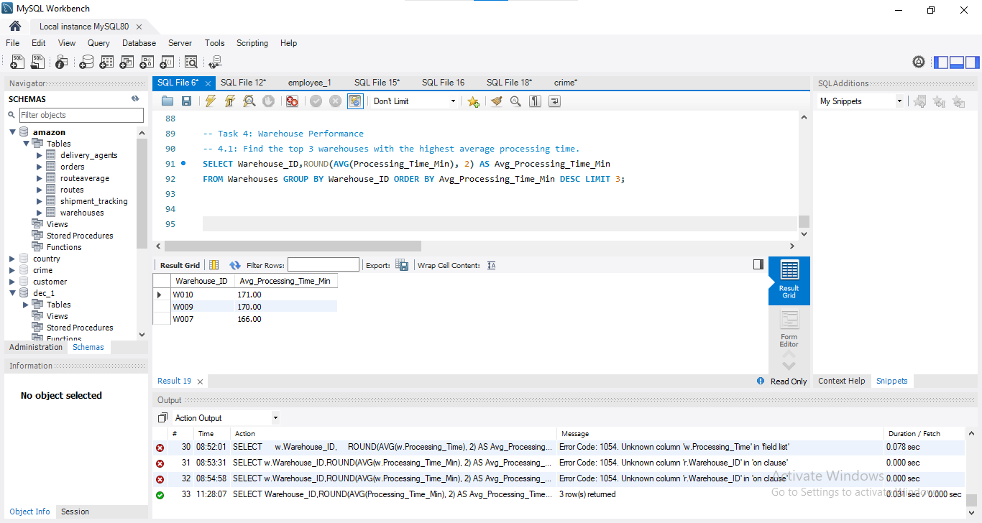
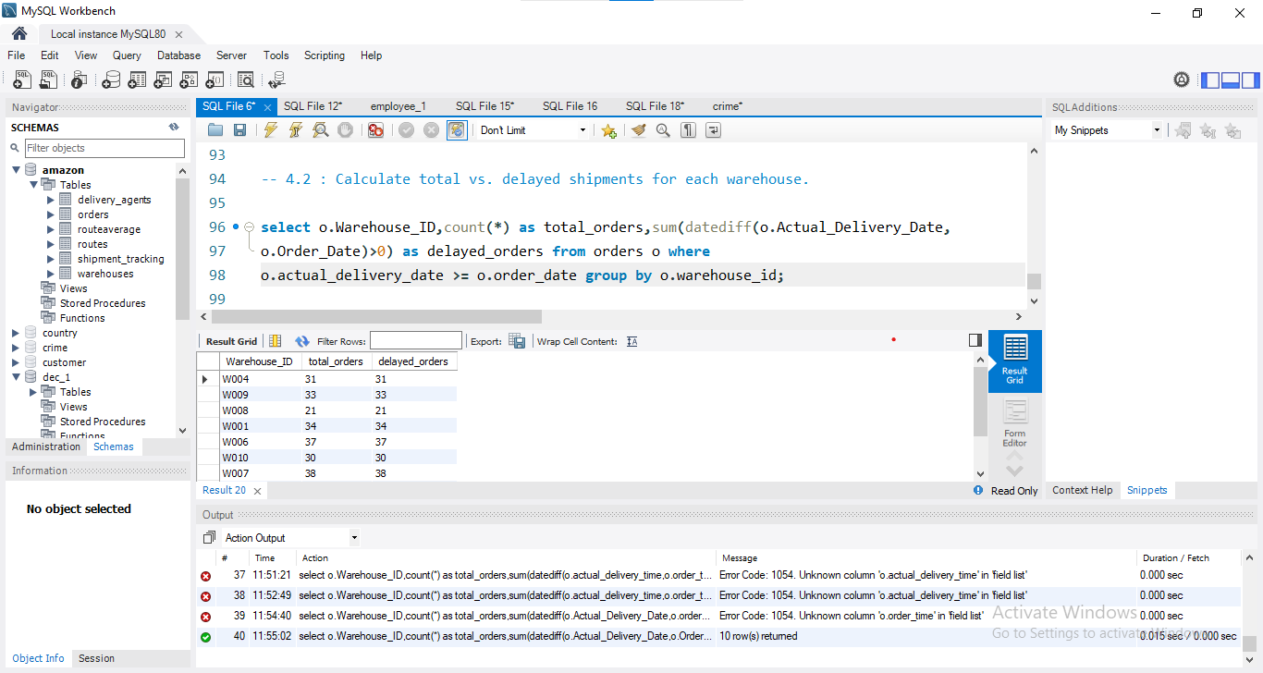
Warehouse Performance
2.Calculate total vs. delayed shipments for each warehouse.
Task 4:
1. Find the top 3 warehouses with the highest average processing time.

Slide 9
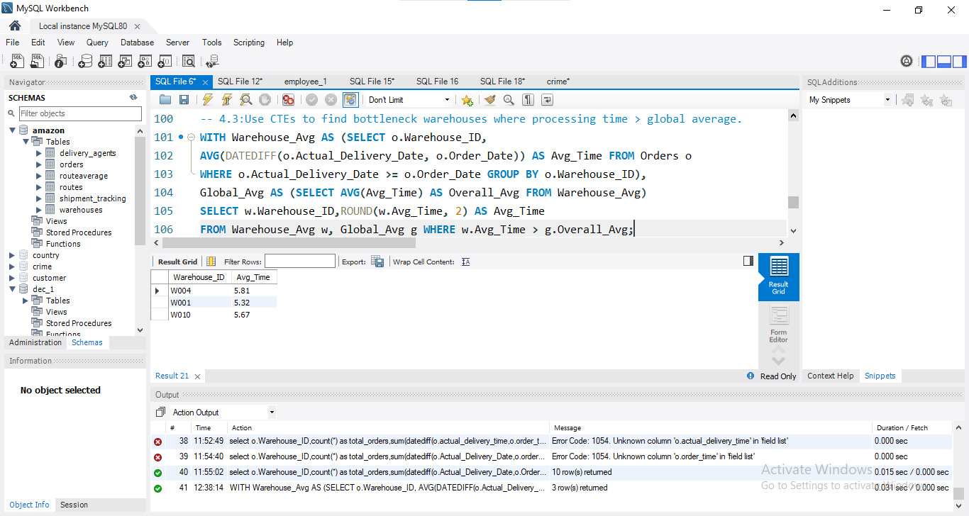
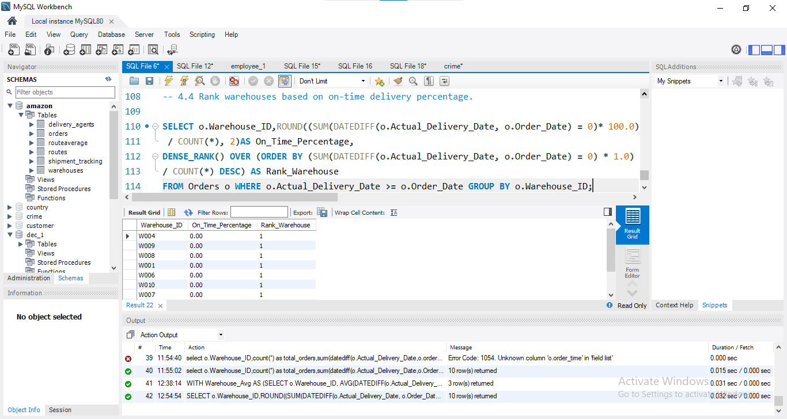
Bottleneck warehouses were identified using a CTE by comparing average delivery time per warehouse with the global average.
4.Rank warehouses based on on-time delivery percentage.
Warehouses were ranked based on on-time delivery percentage using window functions, without joining additional tables since Warehouse_ID was available in the Orders table.
3.Use CTEs to find bottleneck warehouses where processing time > global average.

Slide 10
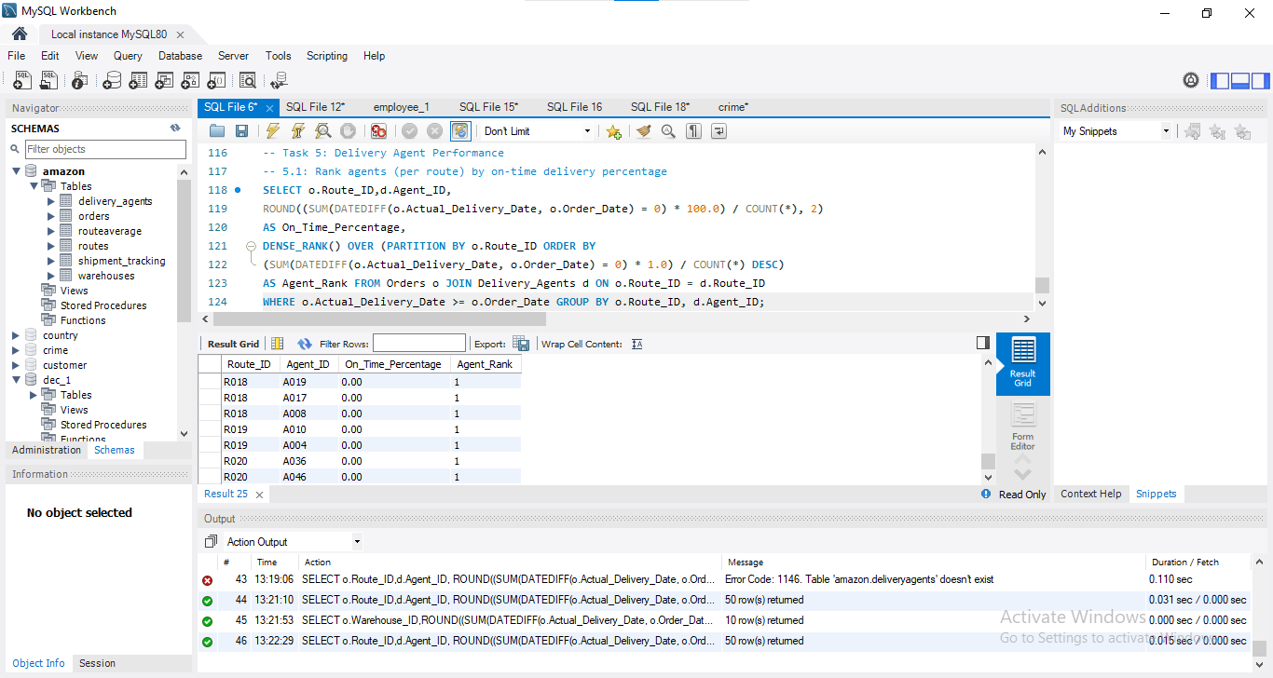
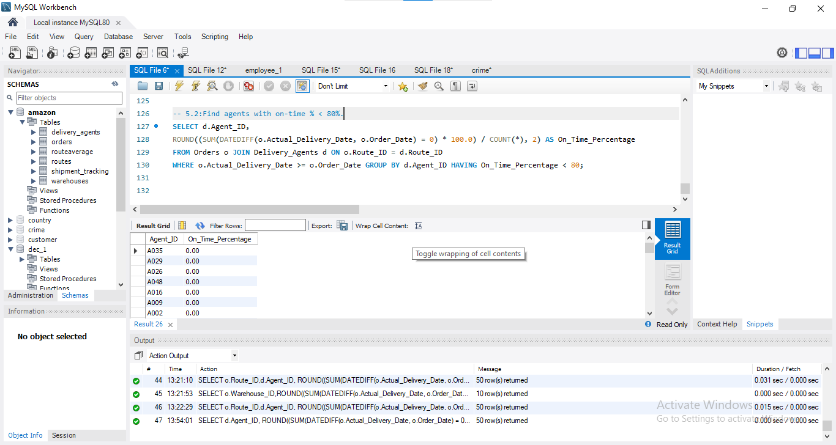
Delivery Agent Performance
1.Rank agents (per route) by on-time delivery percentage
Task 5:
2.Find agents with on-time % < 80%.
Agent performance was evaluated by linking agents to routes and calculating on-time delivery percentage per route.

Slide 11

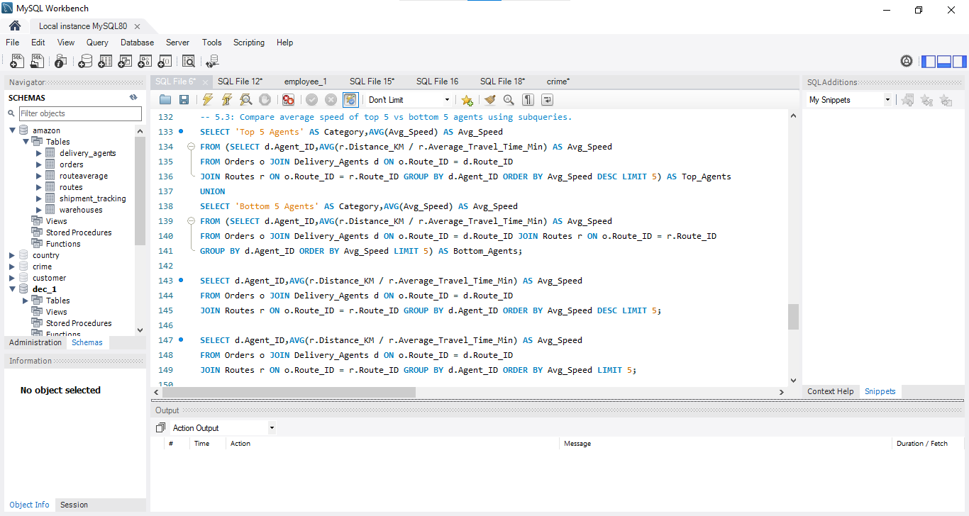
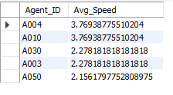
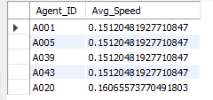
3.Compare average speed of top 5 vs bottom 5 agents using subqueries.
Insight
Top-performing agents are significantly faster than bottom-performing agents, indicating a large performance gap.
🔹 Recommendation
Assign better routes to low-performing agents
Provide training or monitoring
Optimize slow routes
The large variation in speed suggests that route conditions or agent efficiency differ significantly.

Slide 12
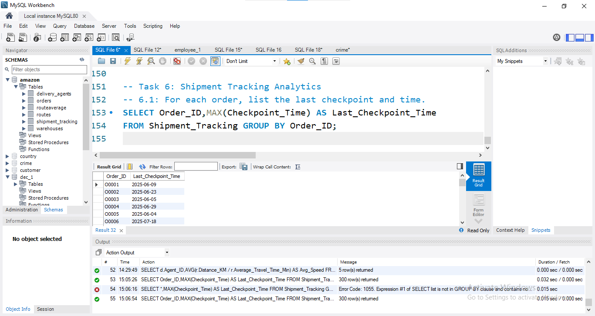
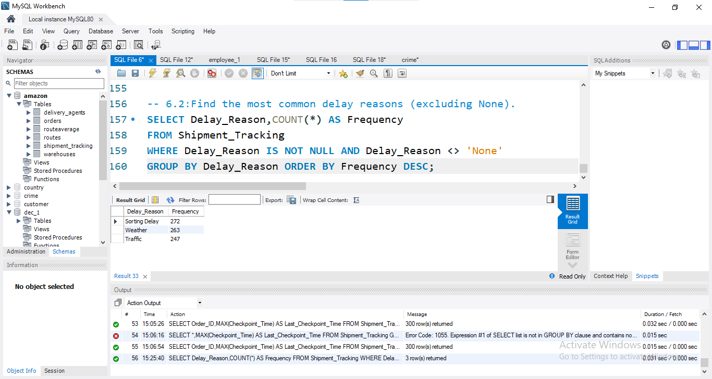
Shipment Tracking Analytics
1.For each order, list the last checkpoint and time.
2.Find the most common delay reasons (excluding None)
Task 6:
The latest checkpoint for each shipment was identified using the maximum checkpoint timestamp.
Null and non-delay values were excluded to accurately identify the most common delay reasons.

Slide 13
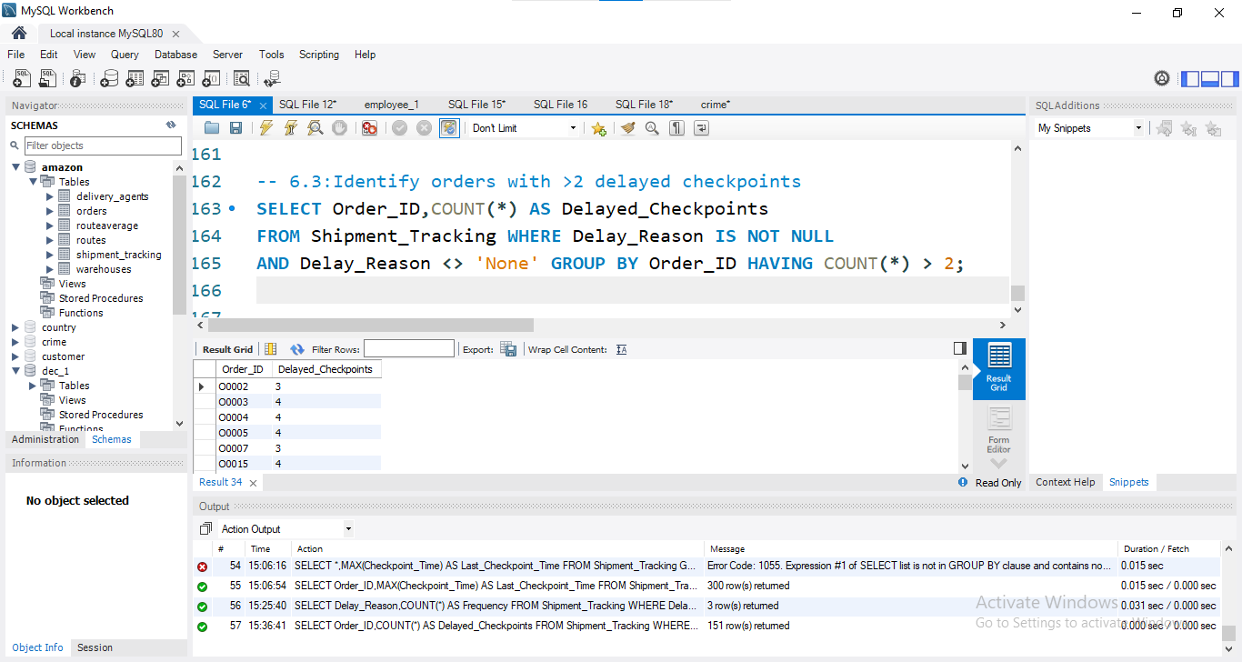
3.Identify orders with >2 delayed checkpoints
Orders with more than two delayed checkpoints were identified to highlight shipments with repeated disruptions.
Identified orders with more than 2 delayed checkpoints
Delay defined as checkpoints with a valid Delay_Reason (excluding ‘None’)
Counted delayed checkpoints for each order
Highlighted shipments with repeated disruptions

Slide 14
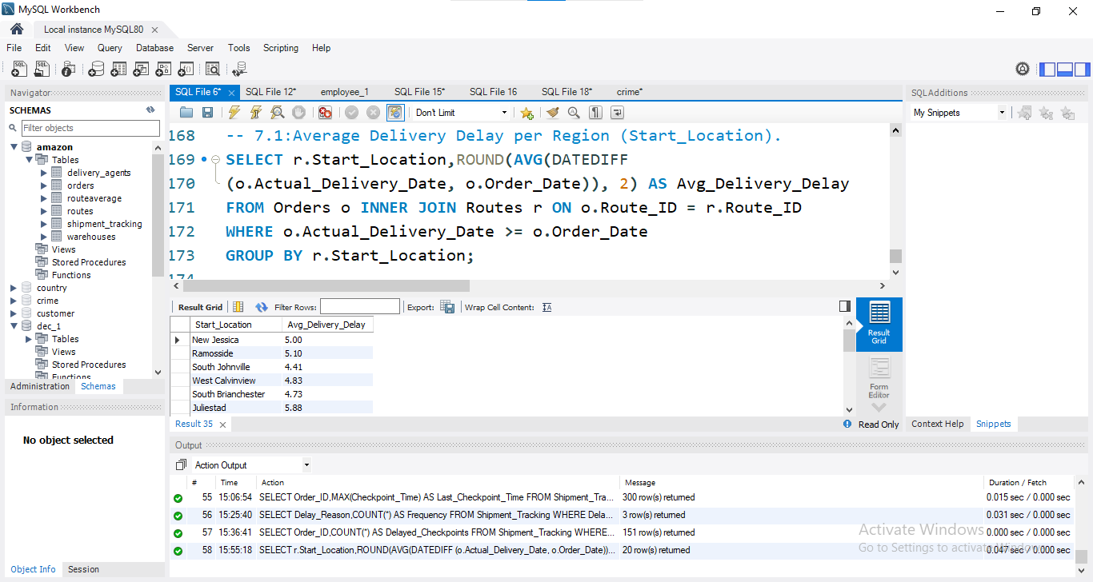
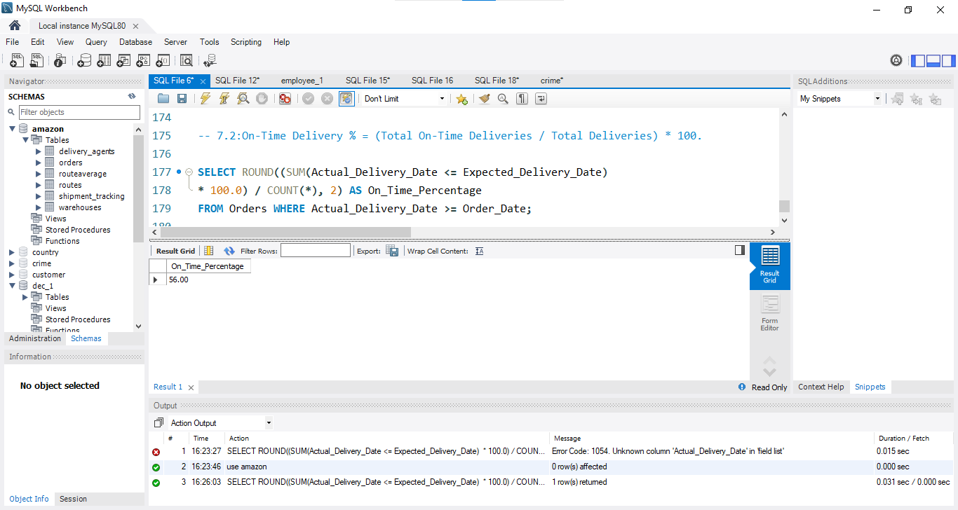
Advanced KPI Reporting
1.Average Delivery Delay per Region (Start_Location).
2.On-Time Delivery % = (Total On-Time Deliveries / Total Deliveries) * 100.
Task 7:
Average delivery delay was calculated per region by joining Orders with Routes to access start location data.
On-time delivery was defined as deliveries completed on or before the expected delivery date.

Slide 15
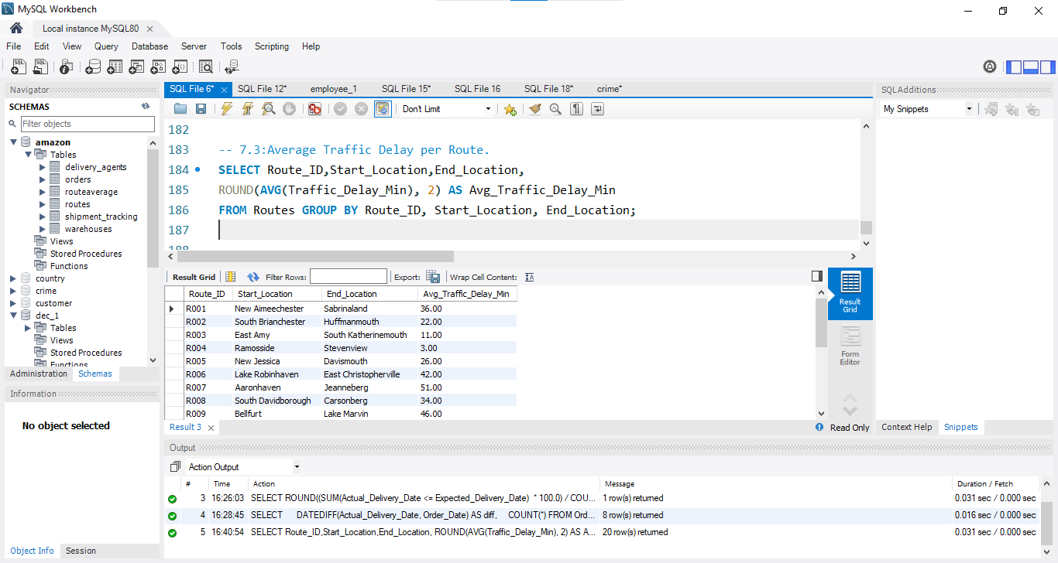
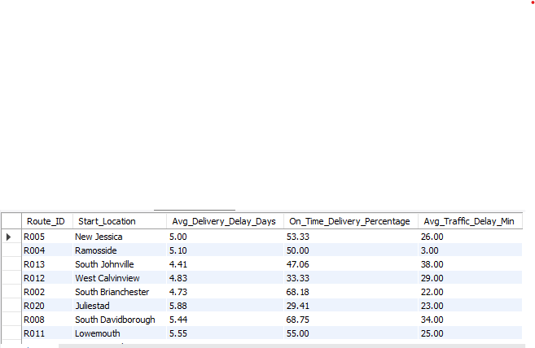
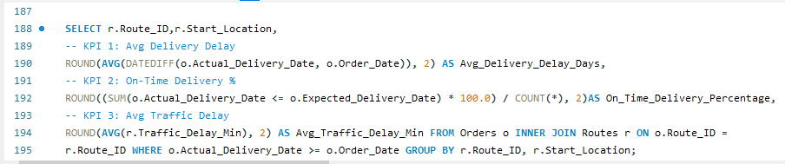
Average traffic delay per route was calculated to analyze route efficiency and identify congestion-prone routes.
3.Average Traffic Delay per Route.
Final Dashboard Query(combined query)
output

Slide 16
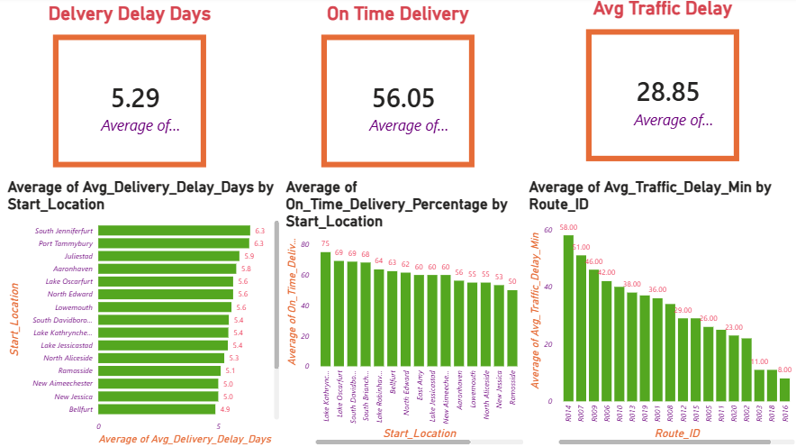
KPIs were visualized using Power BI dashboards to provide interactive insights into delivery performance, traffic delays, and operational efficiency.

