Slide 1
The First Thought
What happens to human thinking when answers become effortless?
Zijian Su

Slide 2
2022 → NOW
I am a young builder learning, researching, and creating inside the GenAI era.
AI moved from task helper to cognitive entry point.
1
Homework
Daily practice and basics
2
Code
Implement and iterate
3
Research
Explore deeper questions
4
Startup Ideas
Seed bold product concepts
5
Daily Life
Plan, decision and navigation

Slide 3
The Language Shift
BEFORE
NOW
"I think the problem might be..."
"What do you think?"
The first move redirected outward — before a personal opinion had formed.
A tentative, personal formation of thought.

Slide 4
AI did not stop me from thinking.
It made not thinking first too convenient.

Slide 5
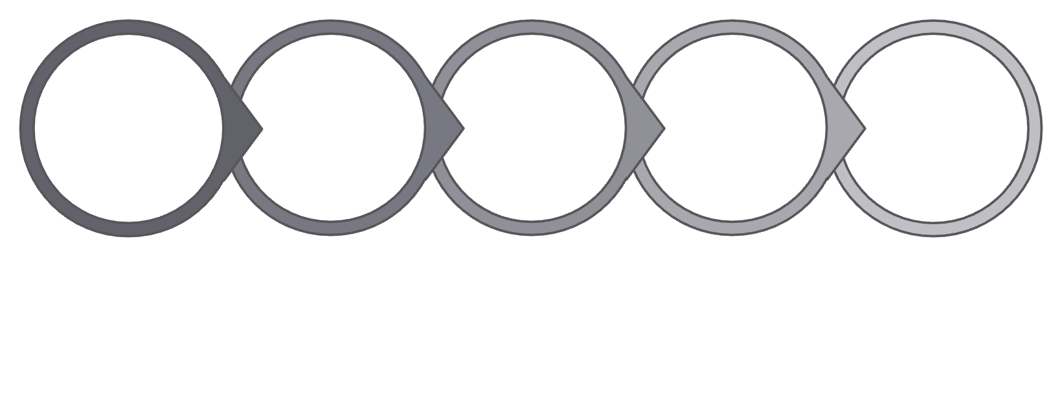

The Missing Step Before the Answer
Before AI
With AI
Observation
Confusion
First Guess
Search & Revision
Answer
Observation
Ask AI
Complete Answer
Wide, messy — and generative.
First Guess — quietly gone.
We still evaluate AI answers. But we often evaluate inside the frame AI created first.

Slide 6
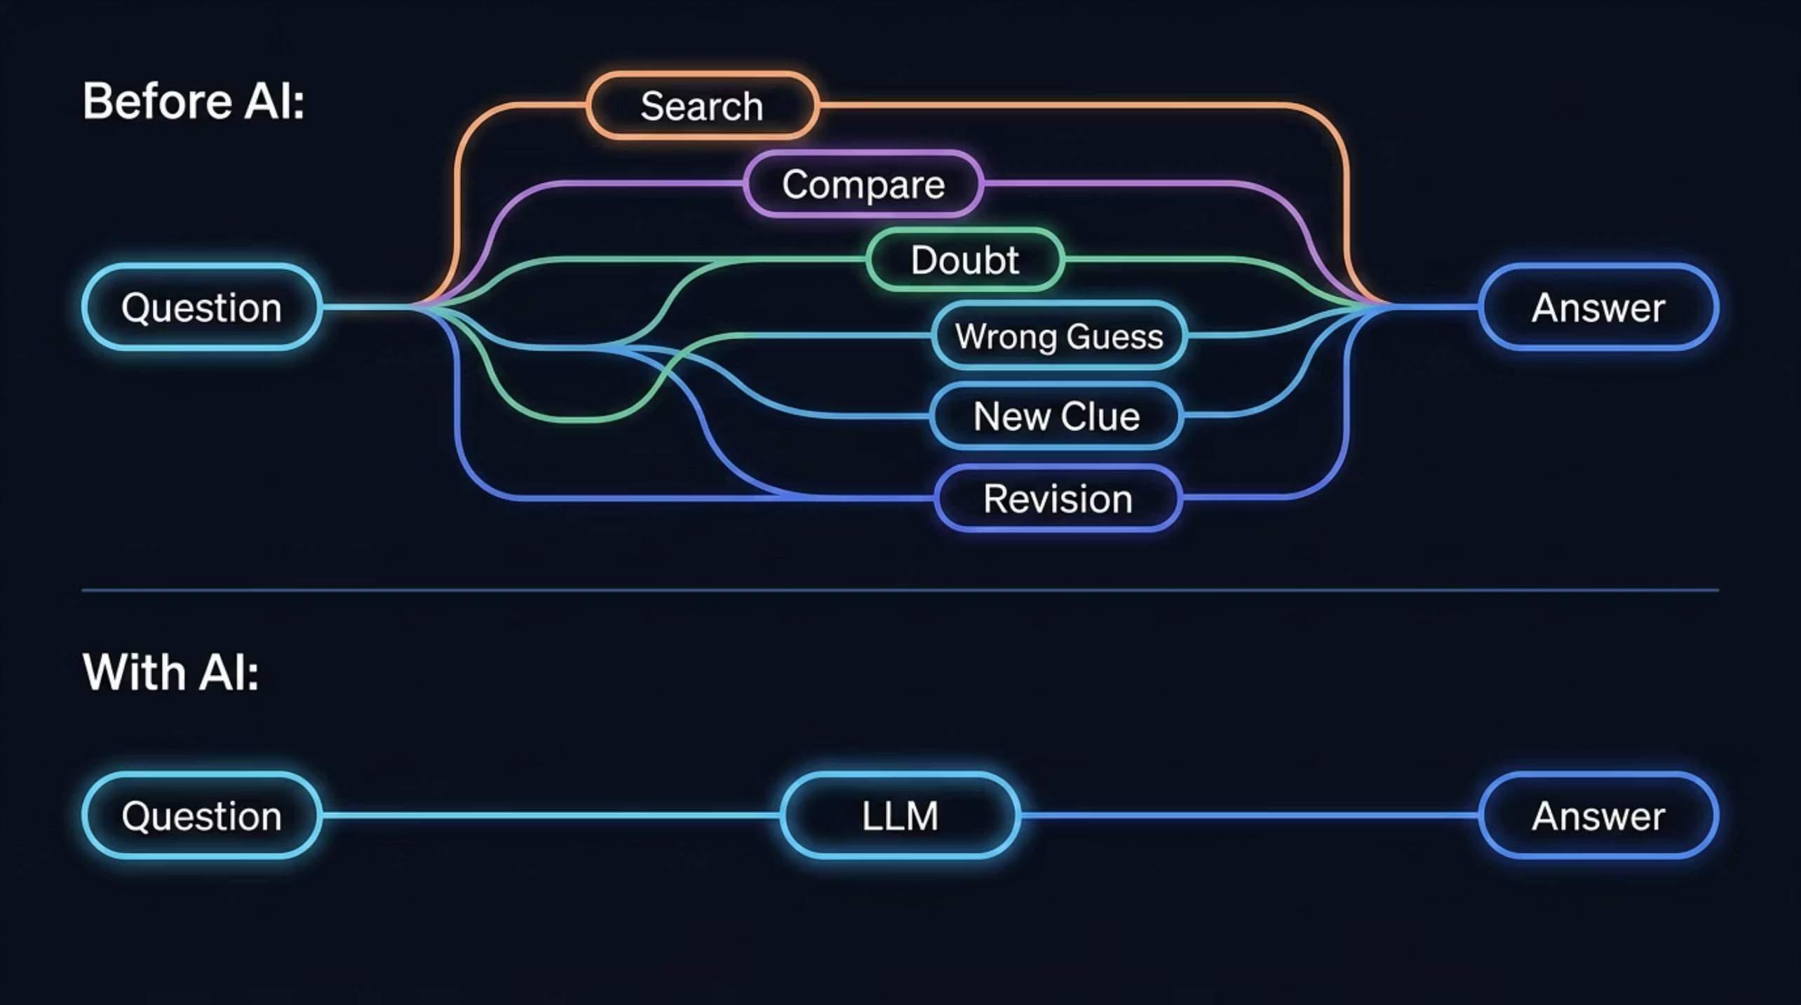
Thinking Compression
The compressed parts — wrong guesses, doubts, detours — may be where original thinking begins.

Slide 7
The First Thought
A first thought is the imperfect explanation we form before seeing an external answer.
It may be wrong. But it gives us a starting point.
Sprout
Seed
A foothold: something personal to build on.
The imperfect first thought, formed before any external answer.
Tree
Branch
Understanding that belongs to you, rooted in your own thinking.
Reasoning extends outward, testing and revising.

Slide 8

This Is Not Only a Personal Feeling
Cognitive Offloading
Automation Bias
Critical Thinking
We outsource memory and calculation. GenAI may let us outsource judgment and reasoning.
A fluent answer can feel complete before we build our own alternative.
Higher trust in AI may reduce the effort users spend critically examining a task.
Research does not prove AI makes people less capable. But it supports the concern that AI changes where cognitive effort happens.

Slide 9
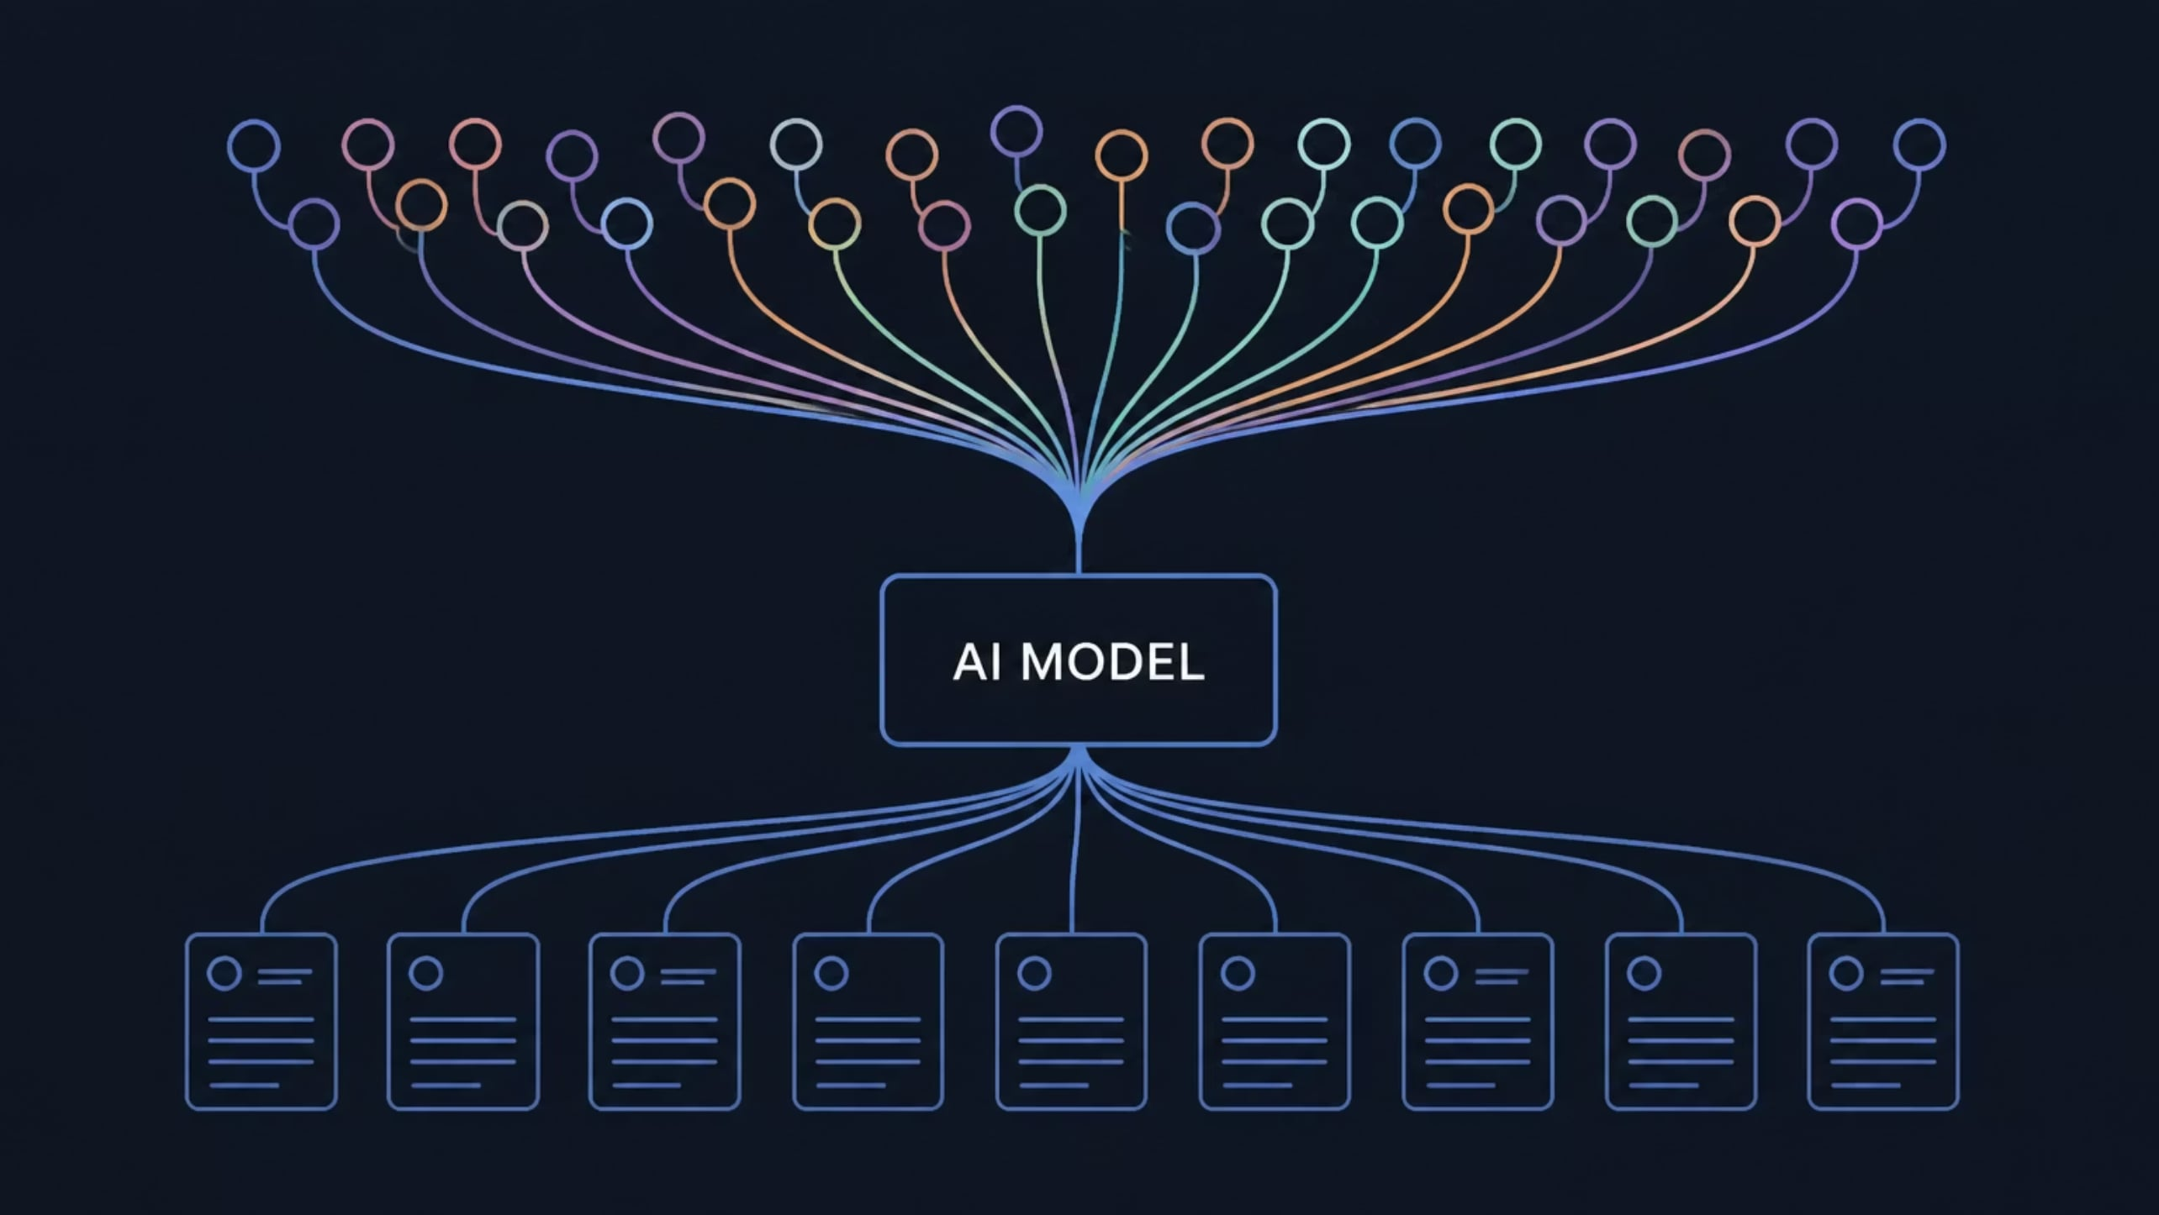
From Individual Habit to Collective Pattern
Different people → Similar models → Similar frames → Similar answers
Innovation needs diverse paths to answers. This is not anti-AI. It is about preserving the cognitive biodiversity that makes new ideas possible.

Slide 10
The Answer Is Not Less AI.
The question is: What should remain human?
01
02
03
Human Starts
AI Expands
Human Decides
Form your own first thought
Deepen, challenge, connect
Own the conclusion
Not human replaced by AI. Human first, AI second.

Slide 11
What I Kept Losing
Fleeting Ideas
Ownership
Evolution
Thoughts disappeared before I could record them.
After long AI conversations, I could not tell which ideas were mine.
I remembered the conclusion, but not how my view had changed.
This is the real reason I built a tool: not to replace thinking, but to preserve the origin and evolution of thought.

Slide 12
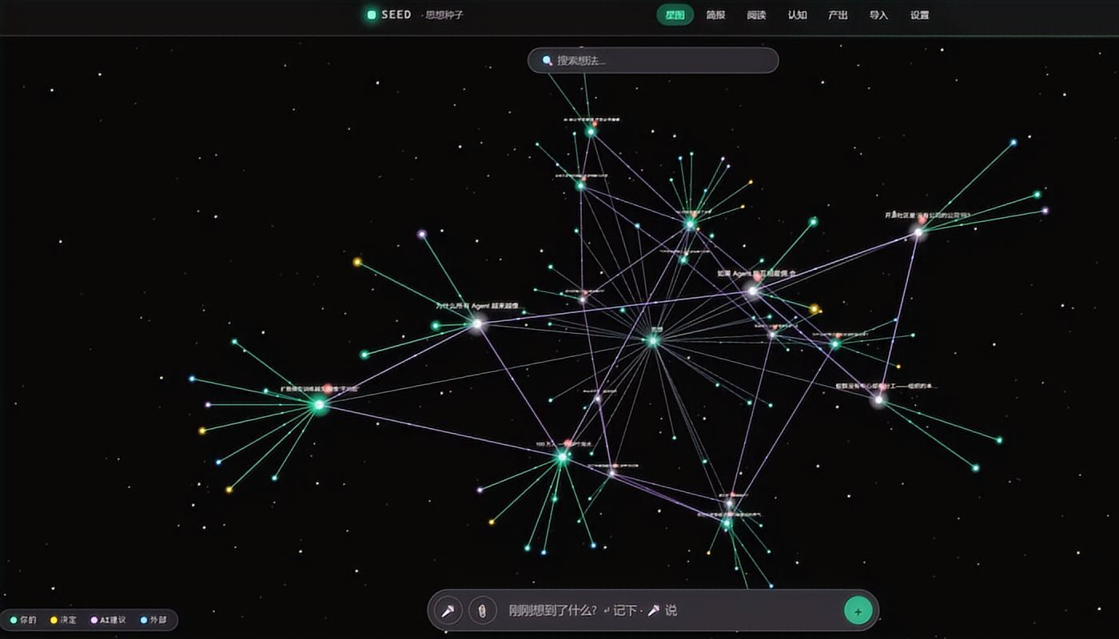
A Personal Prototype
I built a small tool for myself.
Not to replace thinking.
To preserve the moment when a thought begins — before it is overwritten by something more complete.

Slide 13
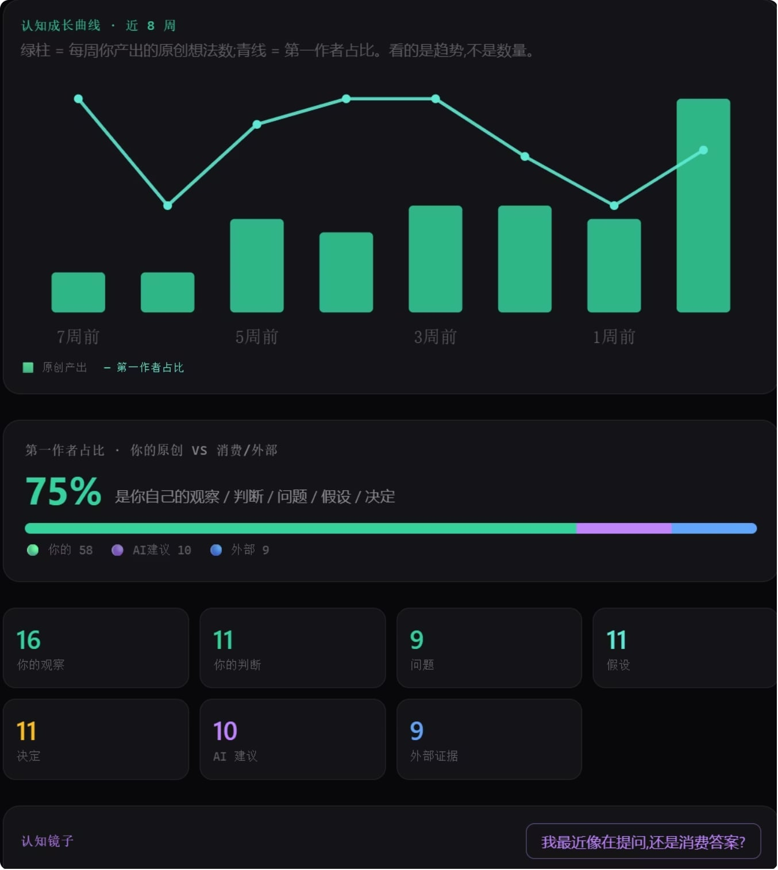


Human First. AI Second.
Not to speed up thinking — to preserve it.
Clarify
Capture
What I actually mean
My original words
Connect
Challenge
Earlier thoughts
One counterexample
Create
Evolve
Turn ideas into work
How my view changes

Slide 14
Creativity begins before the answer.
It begins with a question,
an imperfect first thought,
and a path that is still our own.
The future of AI should not only generate better answers. It should preserve human originality.

