Slide 1
Comprehensive Amazon Sales and Business Analysis
A Deep Dive into Sales Performance, Customer Behavior, and Strategic Insights
Simran

Slide 2
Agenda
Sales Overview
Product Analysis
Fulfillment Analysis
Customer Segmentation
Geographical Analysis
Business Insights
Conclusion and Recommendations

Slide 3
Sales Overview
Key Metrics: Total sales, growth rate, seasonal trends
Total Units Sold: 116616
Number of Orders: 120201
Average Order Value: $649.75
Total Sales: $83628150.71
Growth Rate: 23059.44%

Slide 4
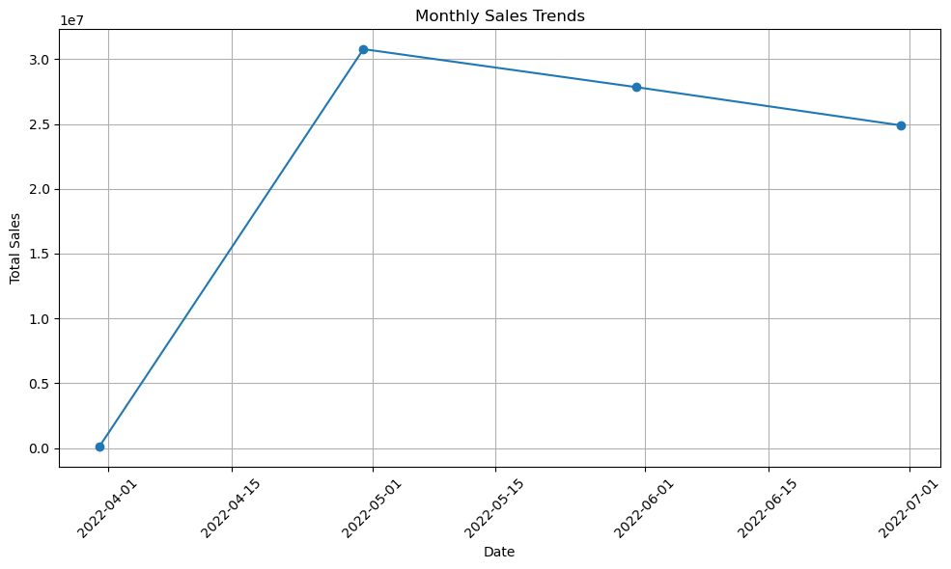
Sales performance over time

Slide 5
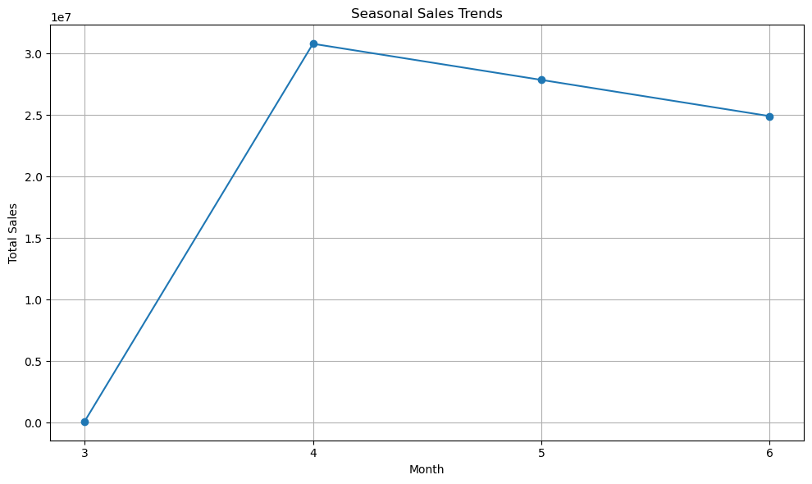
Seasonal sales
Sales Overview and Trends Insight: The analysis revealed patterns in sales over time, highlighting peak sales periods and low seasons.
Recommendations:
Inventory Management: Increase stock levels during peak periods to meet demand and avoid stockouts. Reduce inventory during low seasons to minimize holding costs. Marketing Campaigns: Plan and execute marketing campaigns ahead of peak seasons to capitalize on increased demand. Offer promotions or discounts during low seasons to stimulate sales.

Slide 6
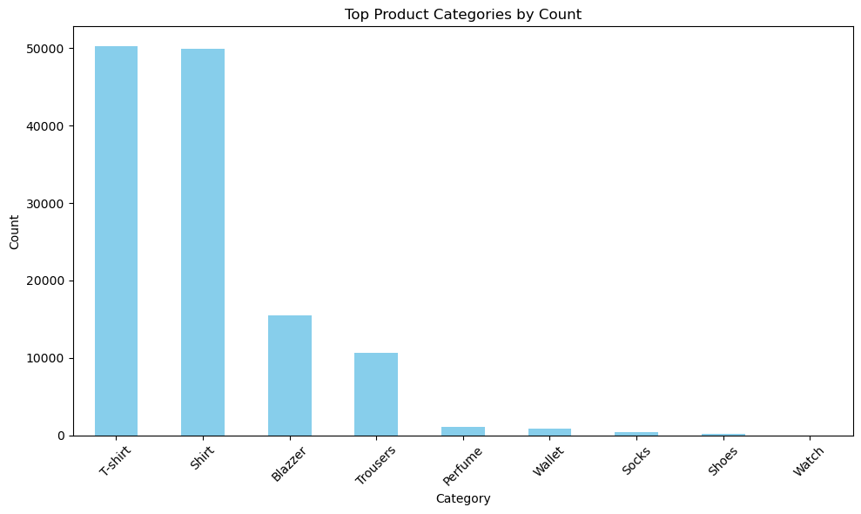
Product Analysis
Distribution of product categories

Slide 7
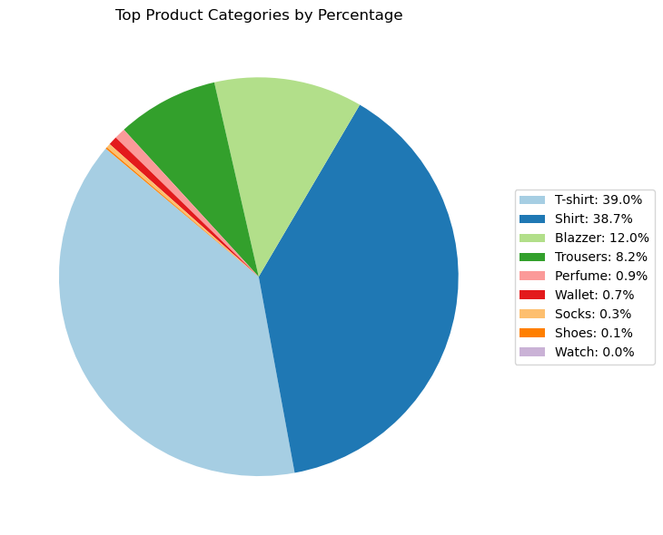
Pie chart of product categories

Slide 8
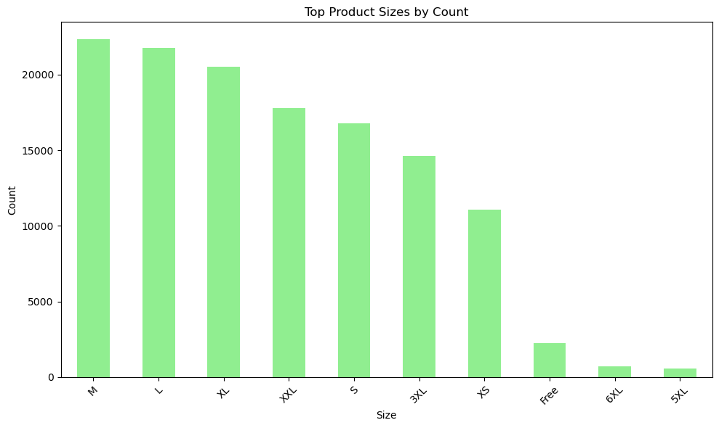
Sizes & Quantities: Popular sizes and quantities sold

Slide 9
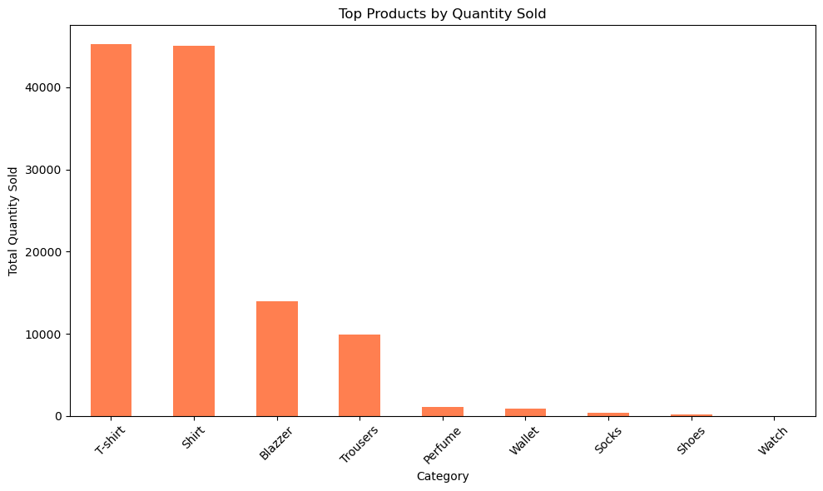
Bar chart of top-selling products
Identification of popular products : Certain product categories, sizes, and quantities are more popular among customers.
Recommendations:
Focus on Popular Products: Prioritize the promotion and availability of popular products to maximize sales. Bundle Offers: Create bundle offers combining popular and less popular products to increase the overall sales volume. Product Expansion: Consider expanding the range of high-demand product categories and sizes.

Slide 10
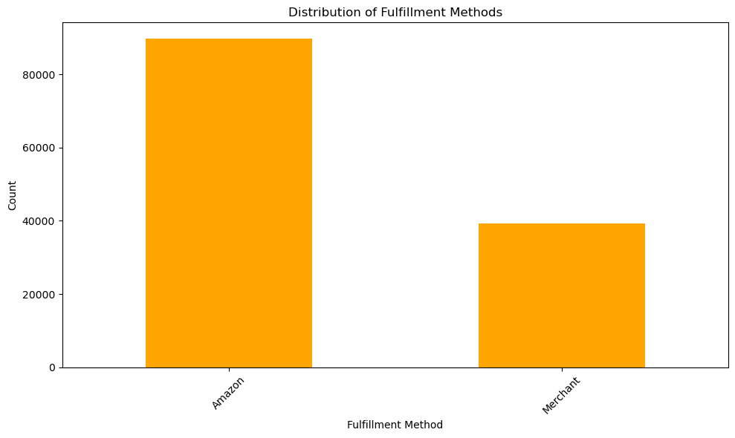
Fulfillment Analysis
Methods: Overview of fulfillment methods used (e.g., in-house, third-party)

Slide 11
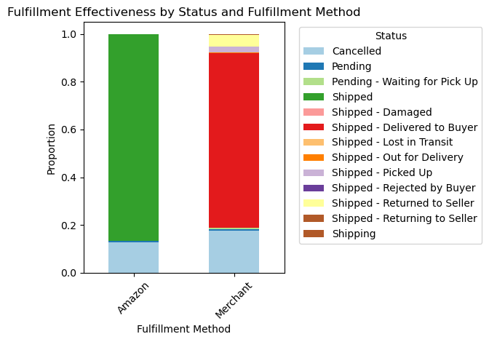
Comparing fulfillment methods

Slide 12
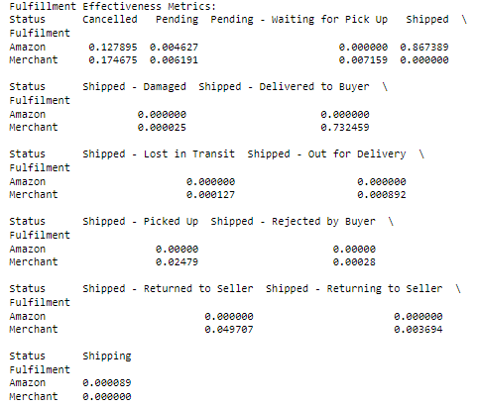
Metrics on delivery time and customer satisfaction
Fulfillment Analysis Insight: Different fulfillment methods vary in their effectiveness in delivering orders.
Recommendations:
Optimize Fulfillment Processes: Streamline fulfillment processes to enhance delivery speed and reliability. Adopt best practices from the most effective fulfillment methods. Partner with Reliable Couriers: Establish partnerships with reliable courier services to improve delivery performance. Monitor Performance: Continuously monitor fulfillment performance metrics to identify and address issues promptly.

Slide 13
Customer Segmentation
Segmentation Factors: Buying behavior, location, and demographics
Cluster
1 | 128881
2 | 43
0 | 17

Slide 14
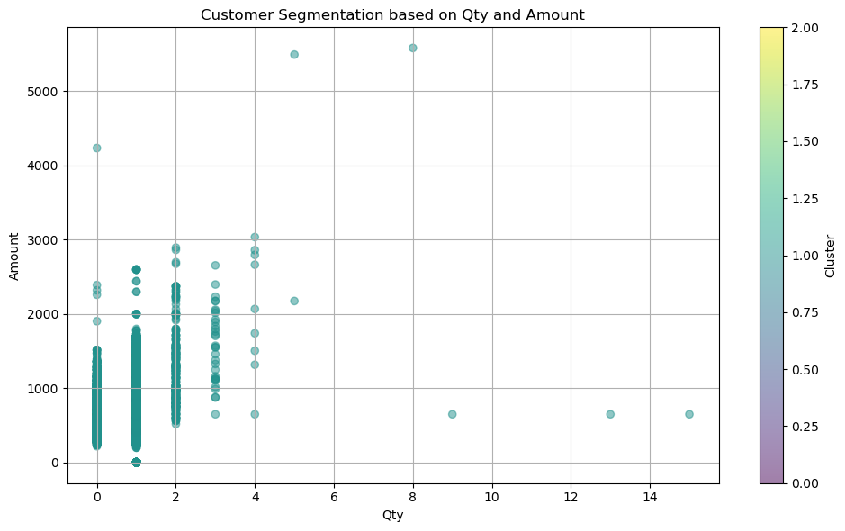
Cluster analysis or scatter plot of customer segments
Insight: Customers can be segmented based on their buying behavior, location, and other relevant factors.
Recommendations: Targeted Marketing: Develop targeted marketing campaigns for different customer segments to increase engagement and conversion rates.
Personalized Offers: Offer personalized promotions and discounts to different customer segments based on their buying behavior.
Location-Based Strategies: Implement location-based strategies such as localized marketing campaigns and region-specific promotions.

Slide 15
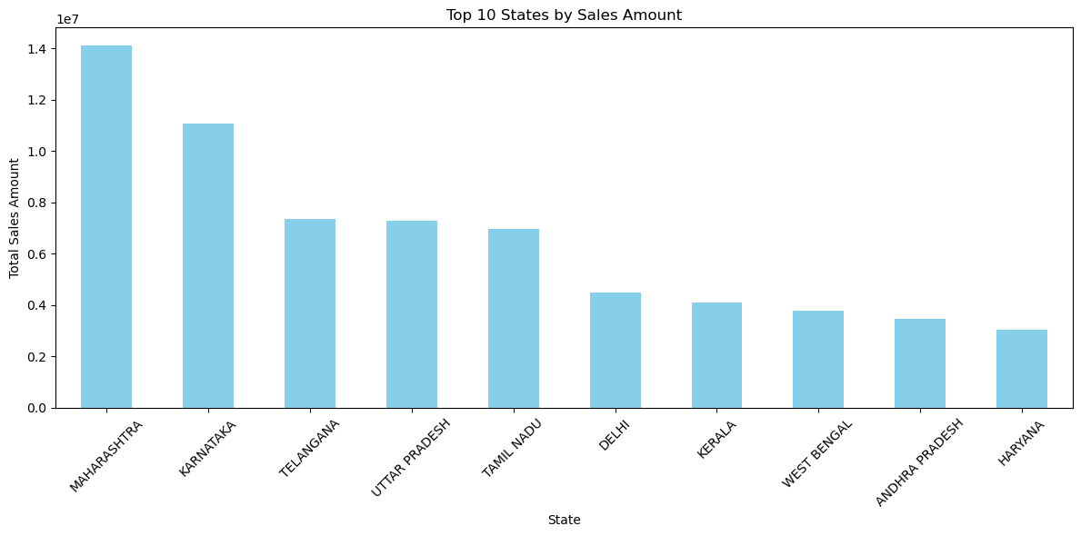
Geographical Analysis
Sales distribution across states

Slide 16
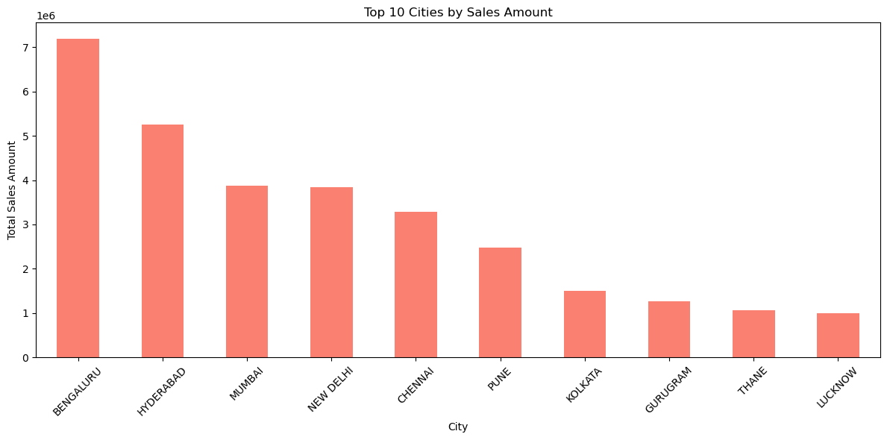
Sales distribution across cities

Slide 17
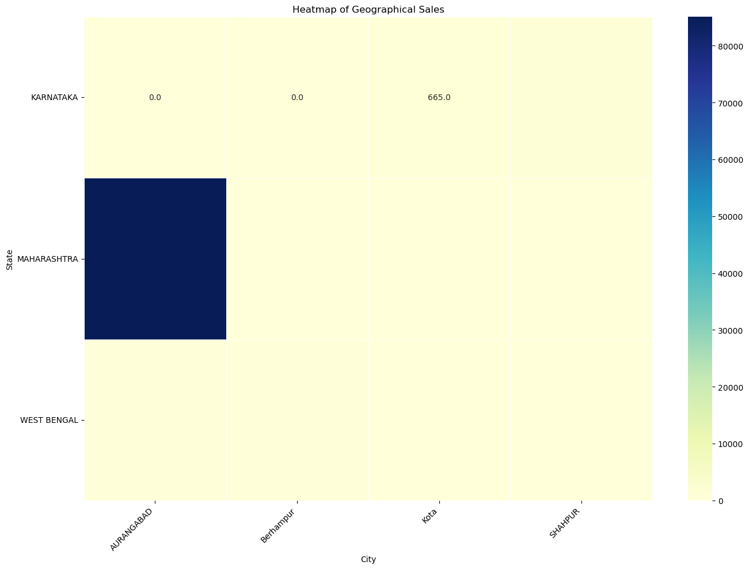
Heatmap of geographical sales
Geographical Analysis Insight: Sales distribution varies significantly across different states and cities.
Recommendations:
Regional Focus: Concentrate marketing efforts and resources on regions with high sales potential. New Markets: Explore opportunities in underperforming regions by understanding local preferences and adapting offerings accordingly. Logistics Optimization: Enhance logistics and distribution networks in high-demand regions to improve delivery times and customer satisfaction.

Slide 18
Business Insights
Key Findings: Summary of key insights from the analysis
Visualization: Highlight significant data points and trends
Actionable Insights: Recommendations for optimizing sales strategies

Slide 19
Recommendations
Customer Satisfaction and Service Insight: Customer satisfaction is crucial for retaining customers and driving repeat purchases.
Customer Feedback: Regularly collect and analyze customer feedback to identify pain points and areas for improvement.
Proactive Support: Provide proactive customer support to resolve issues quickly and effectively.
Enhance User Experience: Continuously improve the user experience across all customer touchpoints, from browsing to post-purchase support.

Slide 20
Inventory Management: Recommendations for better inventory management
Data-Driven Decision Making Insight: Data analytics provides valuable insights for informed decision-making. Recommendations:
Invest in Analytics: Invest in advanced analytics tools and talent to gain deeper insights into customer behavior, sales trends, and operational efficiency. Predictive Analytics: Use predictive analytics to forecast demand, identify emerging trends, and make proactive business decisions. Performance Monitoring: Establish key performance indicators (KPIs) and dashboards to monitor business performance in real-time.

Slide 21
Customer Service: Suggestions to enhance customer satisfaction
Employee Training and Development Insight: Skilled and knowledgeable employees contribute to better customer service and operational efficiency. Recommendations:
Ongoing Training: Provide ongoing training and development opportunities for employees to enhance their skills and knowledge. Employee Empowerment: Empower employees with the tools and information they need to perform their roles effectively. Feedback Loop: Create a feedback loop to capture insights and suggestions from employees to drive continuous improvement.

Slide 22
Conclusion
Summary: Recap of key findings and recommendations. By implementing these insights and recommendations, your business can optimize sales strategies, improve customer satisfaction, and enhance overall business performance. Regularly reviewing and adapting strategies based on data-driven insights will help maintain a competitive edge and achieve sustainable growth.

Slide 23
Thank you for your time
Q&A: Open the floor for any questions

