Slide 1
OneBharat Data Science Internship Assignment
Comprehensive Analysis Report
Simran Kashyap
10 - July - 2024

Slide 2
Introduction
Overview of the Assignment:
- Analysis of three datasets: Bank Statements, Office Supplies Data, Churn Modelling Data.
- Aim to provide insights and recommendations based on data analysis.
Objectives:
- Perform transaction and balance analysis.
- Analyze sales and customer data.
- Model and predict customer churn.

Slide 3
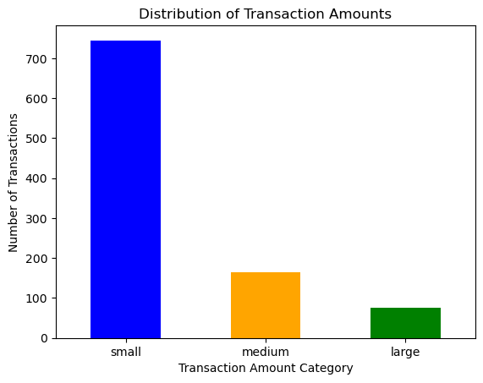
Bank Statements Analysis - Transaction Analysis
Total Number of Transactions: 985
Distribution of Transaction Amounts: Small Transactions: 745 Medium Transactions: 164 Large Transactions: 76

Slide 4
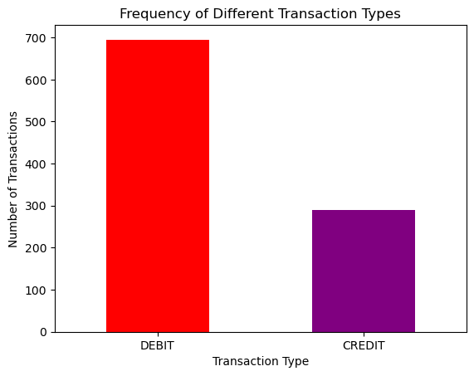
Frequency of Different Transaction Types: Debit Transactions: 695 Credit Transactions: 290

Slide 5
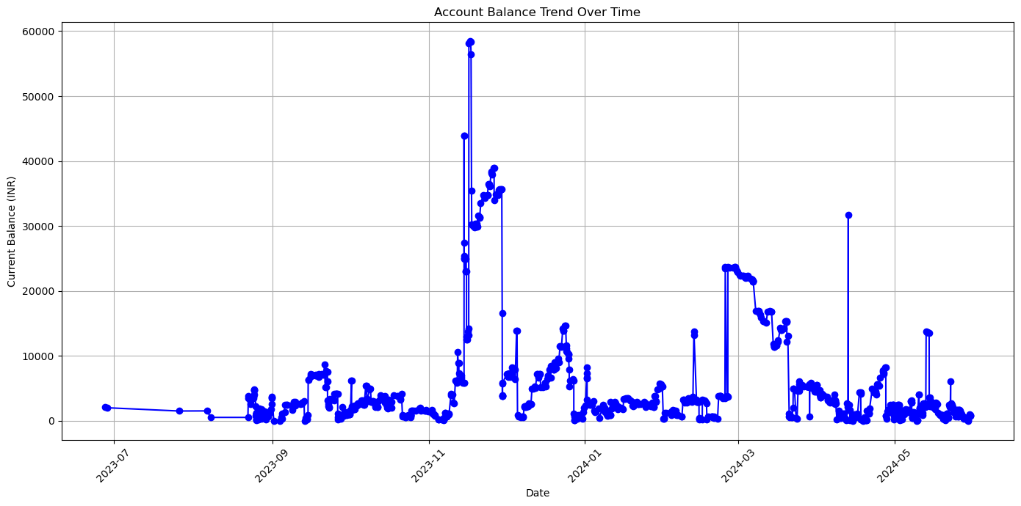
Bank Statements Analysis - Balance Analysis
Trend of Account Balance Over Time: The trend of the account balance over time shows how the balance fluctuates with each transaction. The line plot provides a clear visualization of these fluctuations, making it easy to observe periods of increase or decrease in the account balance. This can be useful for identifying patterns or irregularities in spending or income.

Slide 6
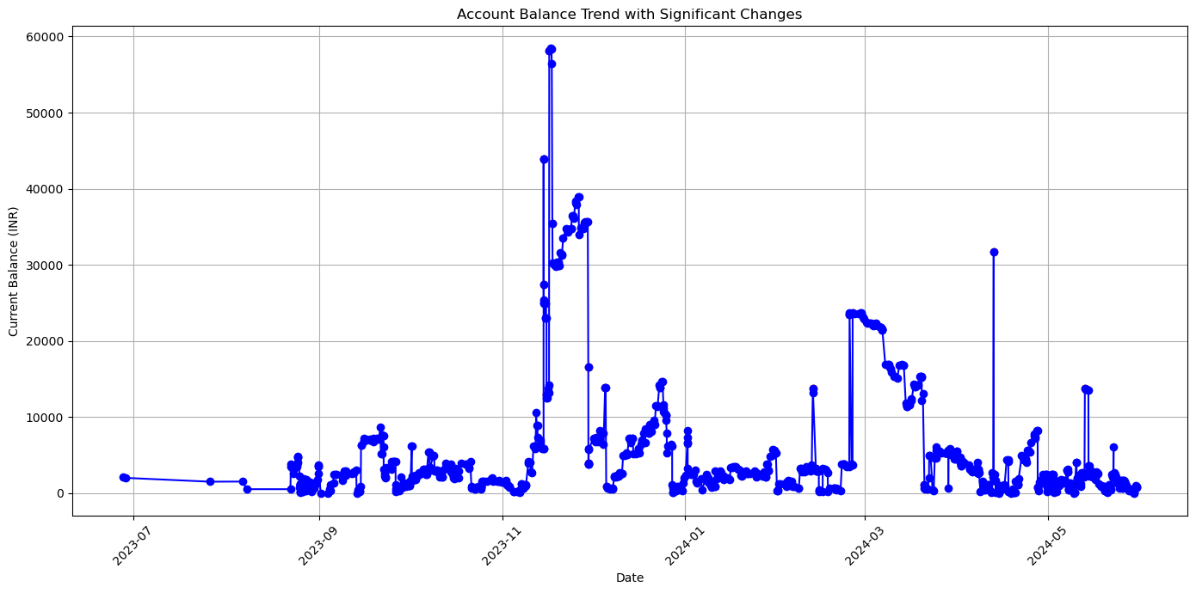
Significant Changes in Account Balance: Significant changes in the account balance are identified based on a threshold defined as 10% of the maximum balance. These changes can indicate major transactions, such as large expenses or income. By plotting these significant changes, we can highlight specific points in time where the account balance experienced substantial variations.

Slide 7
Bank Statements Analysis - Spending Patterns
Main Categories of Expenses:
 | Category | Total Amount
0 | ATM Withdrawal | 1000.010000.02500.0
1 | Other | 100.0170.0500.060.0
2 | UPI Transaction | 1.01200.0140.080.030.02480.01450.0120.01.01.01...

Slide 8
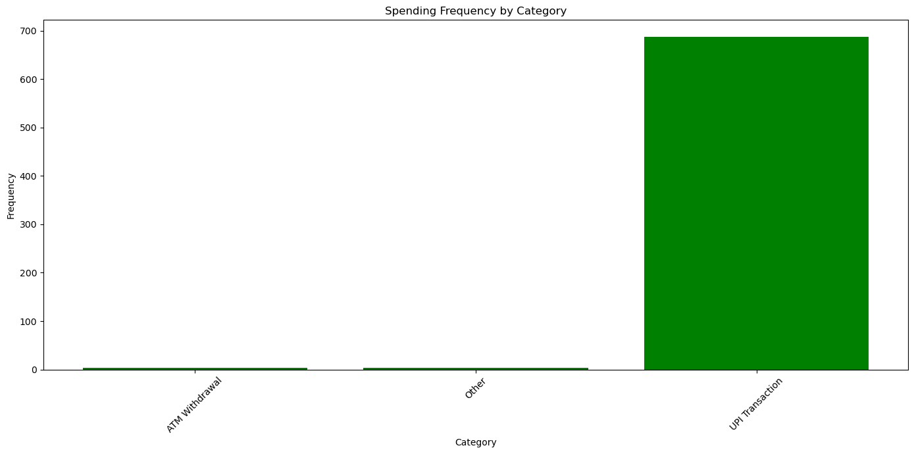
Frequency and Amount of Spending
 | Frequency
0 | 3
1 | 4
2 | 688

Slide 9
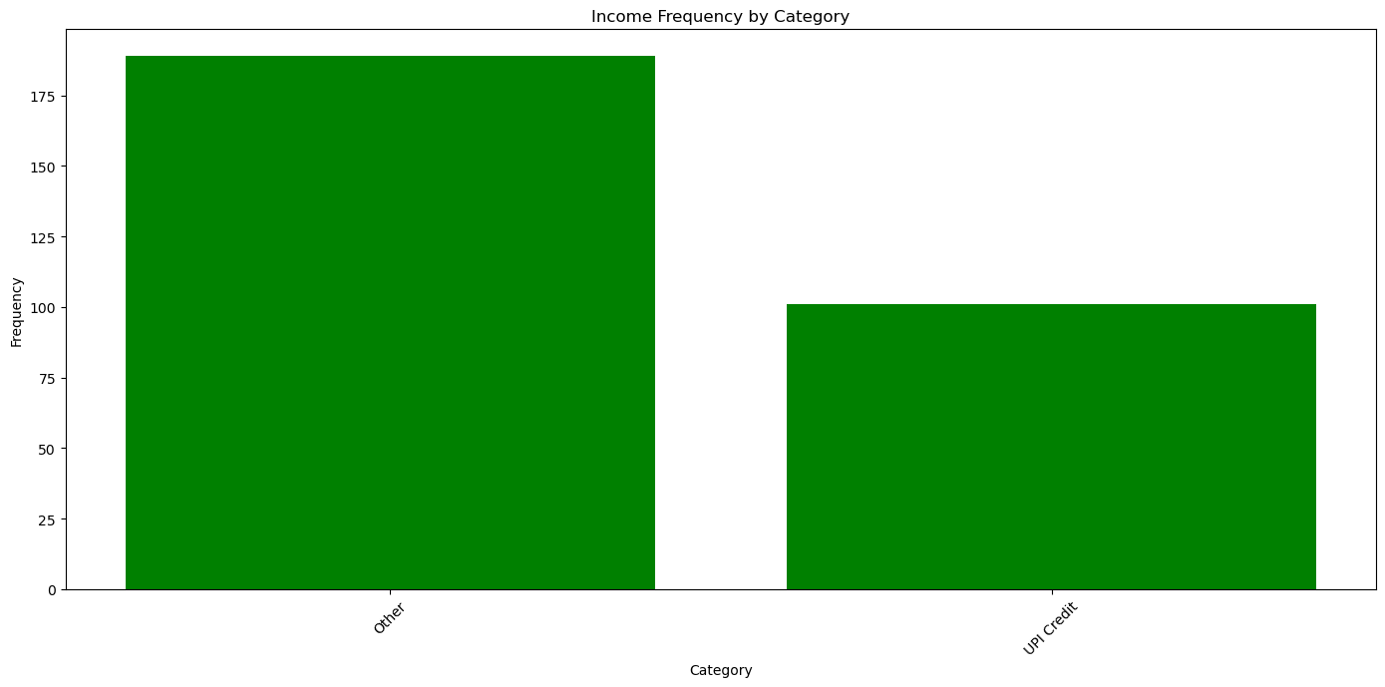
Bank Statements Analysis - Income Analysis
Main Sources of Income
 | Frequency
0 | 189
1 | 101

Slide 10
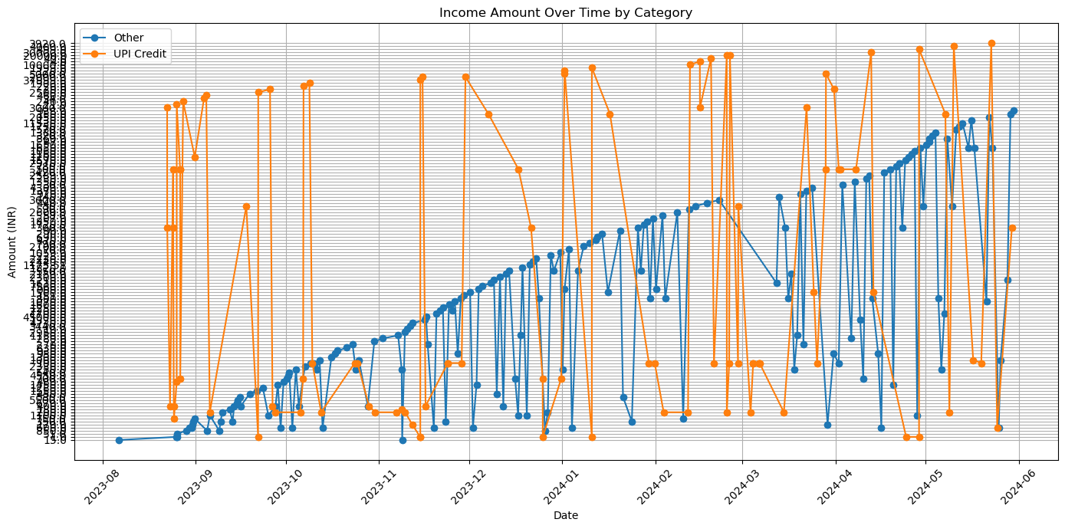
Patterns in Income Timing and Amount
 | Income Category | Total Amount
0 | Other | 15.01.01.051.0850.0600.0600.0170.0350.0750.085...
1 | UPI Credit | 3000.0300.0400.0500.0300.0400.0750.0480.021.05...

Slide 11
Bank Statements Analysis - Alert Generation
Unusual or Suspicious Transactions:
 | Type | Mode | Amount | CurrentBalance | TransactionTimestamp | ValueDate | TxnId | Narration | Reference | Is suspicious
275 | CRE | UPI | 37999.0 | 43892.80 | 18:31 | 2023-11-14 | S65593249 | UPI | NA | T
277 | DEB | UPI | 16500.0 | 27391.80 | 18:49 | 2023-11-14 | S66498670 | UPI | NA | T
285 | DEB | UPI | 10000.0 | 12970.80 | 17:48 | 2023-11-15 | S7201813 | UPI | NA | T
291 | CRE | CASH | 45000.0 | 58180.80 | 15:51 | 2023-11-16 | 00707977 | BY CASH | NA | T
295 | DEB | UPI | 21000.0 | 35400.80 | 16:34 | 2023-11-17 | S82212459 | UPI | NA | T
332 | DEB | UPI | 19000.0 | 16625.80 | 16:15 | 2023-11-29 | S50294642 | UPI | NA | T
333 | DEB | UPI | 12700.0 | 3925.80 | 17:09 | 2023-11-29 | S52850056 | UPI | NA | T

Slide 12
351 | CRE | OTH | 7560.0 | 13925.80 | 07:08 | 2023-12-05 | S85798345 | NEFT | 922020004688715 | T
353 | DEB | UPI | 13000.0 | 865.80 | 15:50 | 2023-12-05 | S8245037 | UPI | NA | T
535 | CRE | UPI | 10000.0 | 13744.81 | 13:22 | 2024-02-12 | S97183279 | UPI | NA | T
537 | DEB | ATM | 10000.0 | 3244.81 | 14:01 | 2024-02-13 | S47446558 | ATM | NA | T
570 | CRE | UPI | 20000.0 | 23483.91 | 18:55 | 2024-02-24 | S58360773 | UPI | NA | T
572 | DEB | UPI | 20000.0 | 3683.91 | 11:08 | 2024-02-25 | S77431539 | UPI | NA | T
576 | CRE | UPI | 20000.0 | 23664.91 | 20:08 | 2024-02-25 | S3167582 | UPI | NA | T
648 | DEB | UPI | 12000.0 | 1119.11 | 18:56 | 2024-03-20 | S75496843 | UPI | NA | T
743 | CRE | UPI | 30000.0 | 31701.21 | 20:47 | 2024-04-12 | S72310155 | UPI | NA | T
744 | DEB | UPI | 30000.0 | 1701.21 | 20:50 | 2024-04-12 | S72445629 | UPI | NA | T
794 | DEB | UPI | 7500.0 | 730.21 | 13:08 | 2024-04-27 | S56538216 | UPI | NA | T
884 | CRE | OTH | 11530.0 | 13704.31 | 06:54 | 2024-05-13 | S48586185 | NEFT | 922020004688715 | T
889 | DEB | UPI | 10000.0 | 3584.31 | 11:51 | 2024-05-14 | S10609765 | UPI | NA | T

Slide 13
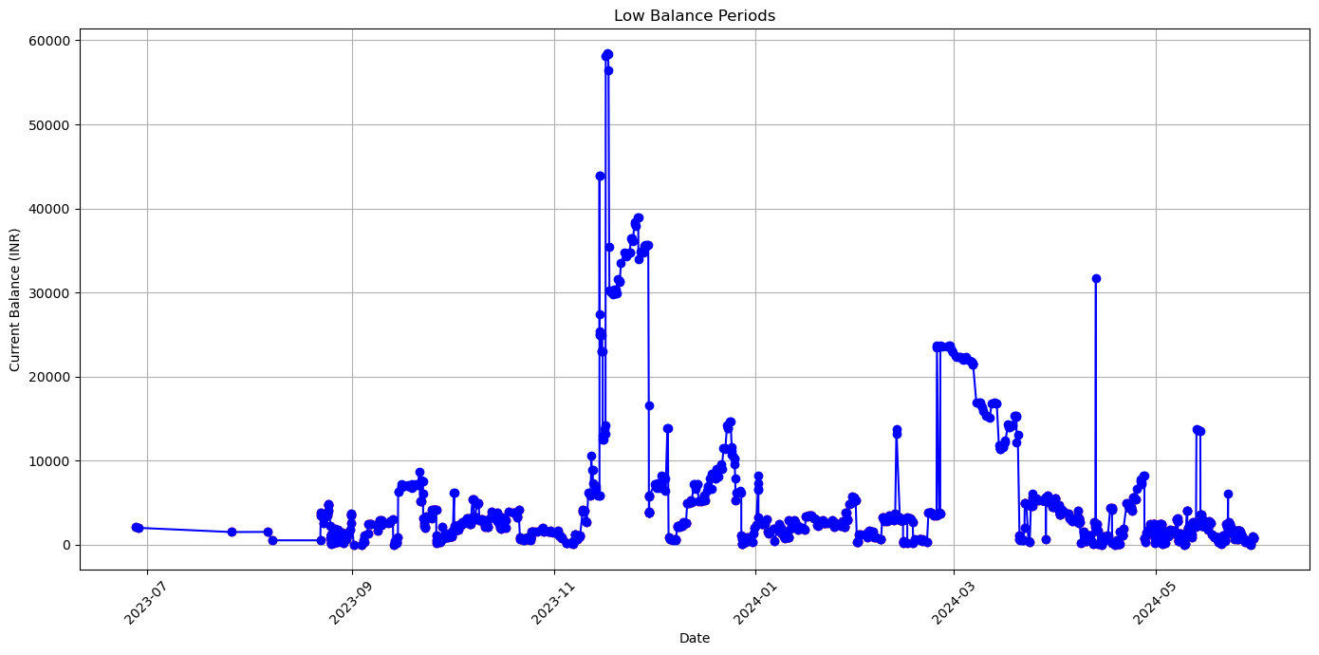
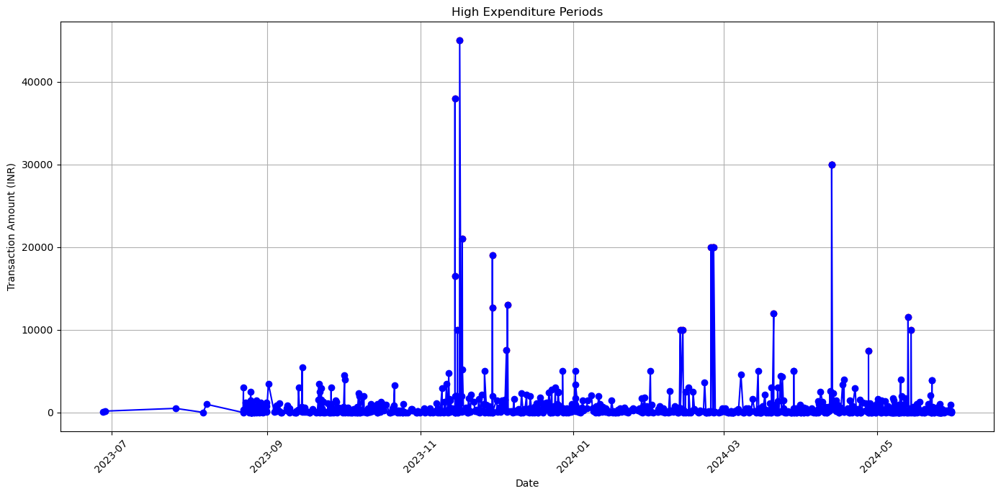
Alerts for Low Balance or High Expenditure Periods

Slide 14
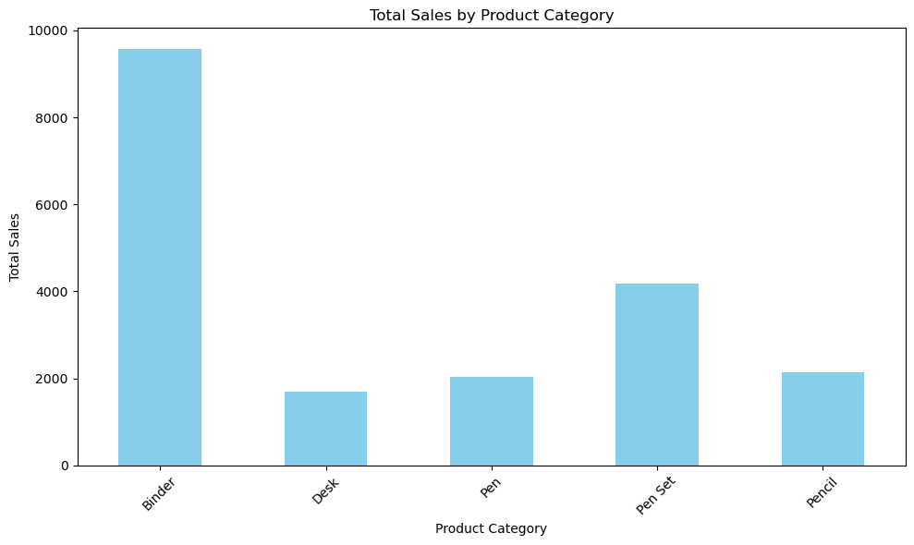
Office Supplies Data Analysis - Sales Analysis
Total Sales for Each Product Category
Item
Binder | 9577.65
Desk | 1700.00
Pen | 2045.22
Pen Set | 4169.87
Pencil | 2135.14

Slide 15
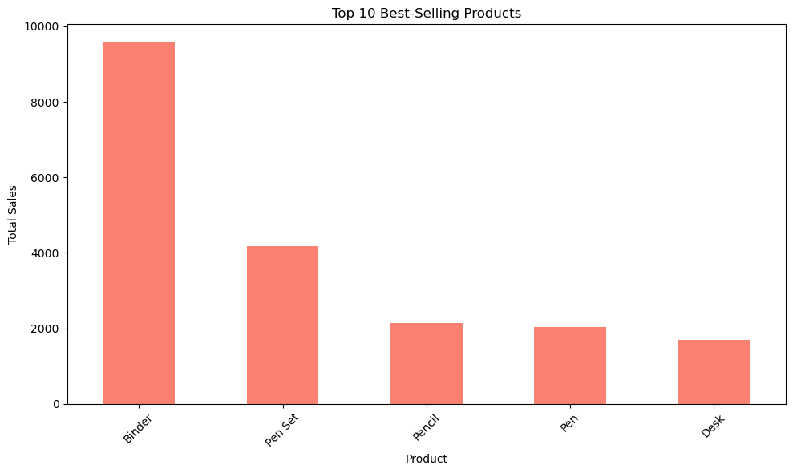
Highest Sales Category: Binder with sales of 9577.65
Top 10 Best-Selling Products:
Item
Binder | 9577.65
Pen Set | 4169.87
Pencil | 2135.14
Pen | 2045.22
Desk | 1700.00

Slide 16
Office Supplies Data Analysis - Customer Analysis
Top 10 Customers by Sales
Rep
Matthew | 3109.44
Susan | 3102.30
Alex | 2812.19
Richard | 2363.04
Bill | 1749.87
Smith | 1641.43
Morgan | 1387.77
James | 1283.61
Thomas | 1203.11
Nick | 536.75

Slide 17
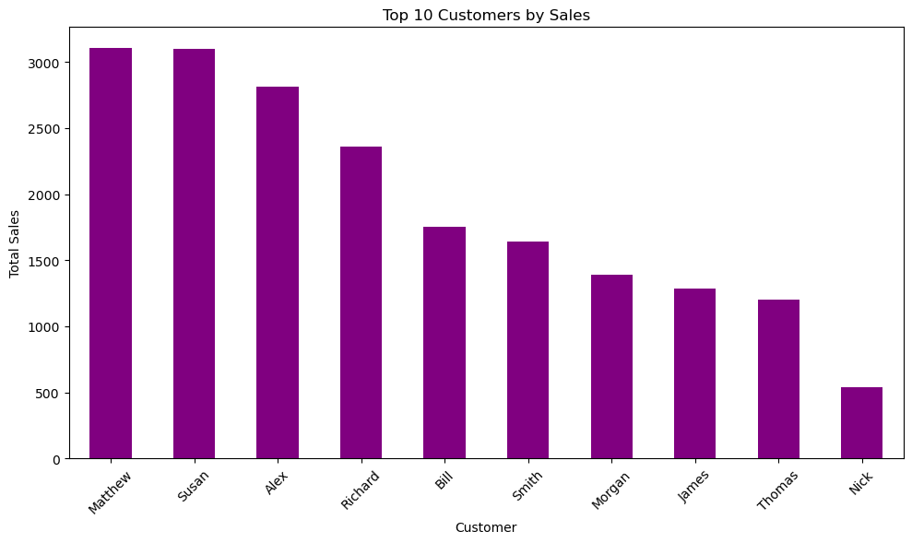

Slide 18
Total Number of Unique Customers: 11
Customer Purchase Frequency
Rep
Richard | 8
Bill | 5
Alex | 5
Matthew | 4
James | 4
Rachel | 4
Morgan | 3
Susan | 3
Smith | 3
Nick | 2
Thomas | 2

Slide 19
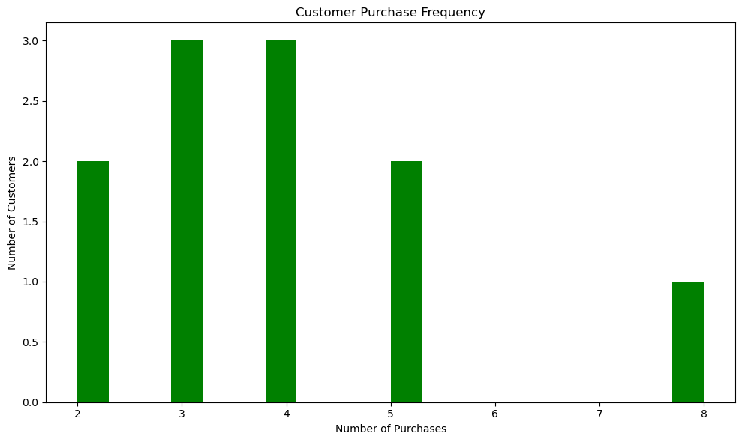

Slide 20
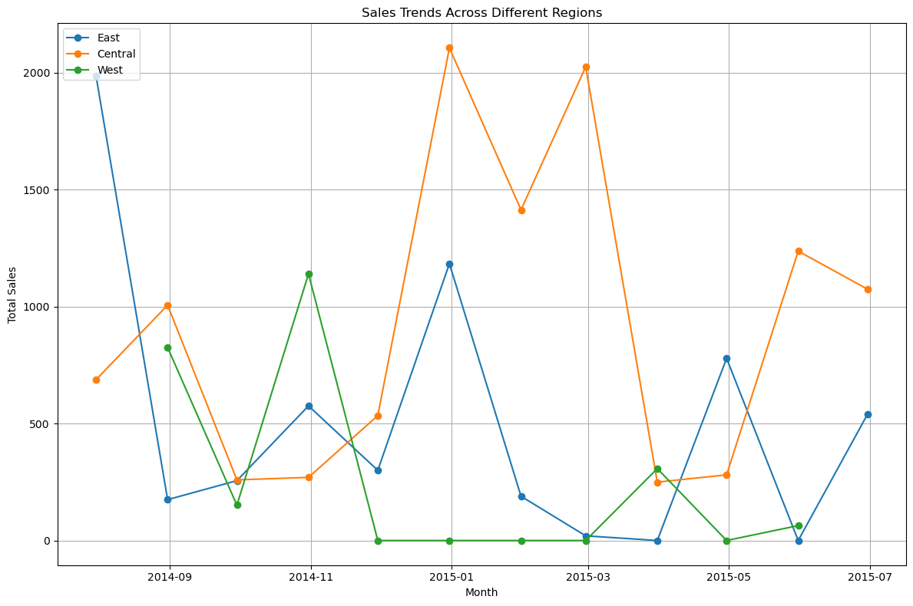
Office Supplies Data Analysis - Time Series Analysis
Monthly Sales Trends

Slide 21
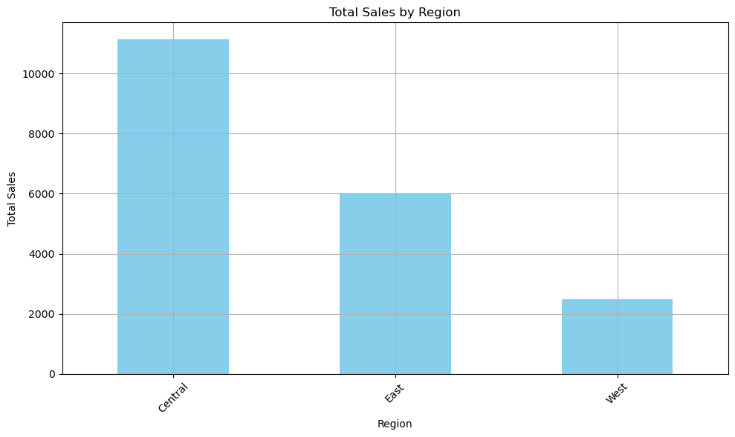
Seasonal Patterns

Slide 22
Office Supplies Data Analysis - Geographical Analysis
Regions Generating Most Sales

Slide 23
Sales Trends Across Different Regions

Slide 24
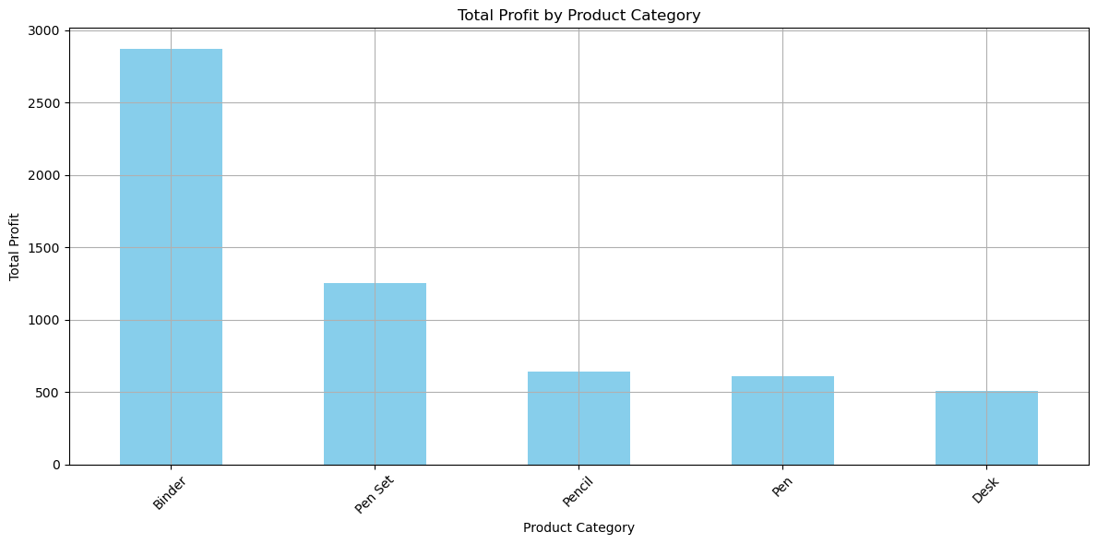
Office Supplies Data Analysis - Profit Analysis
Total Profit for Each Product Category

Slide 25
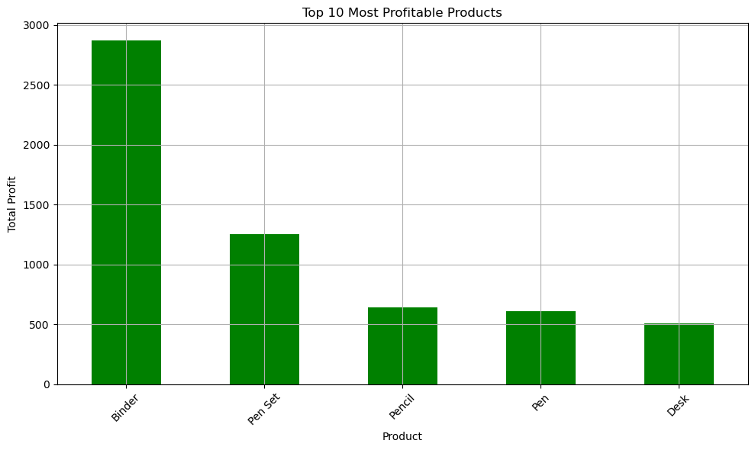
Top 10 Most Profitable Products

Slide 26
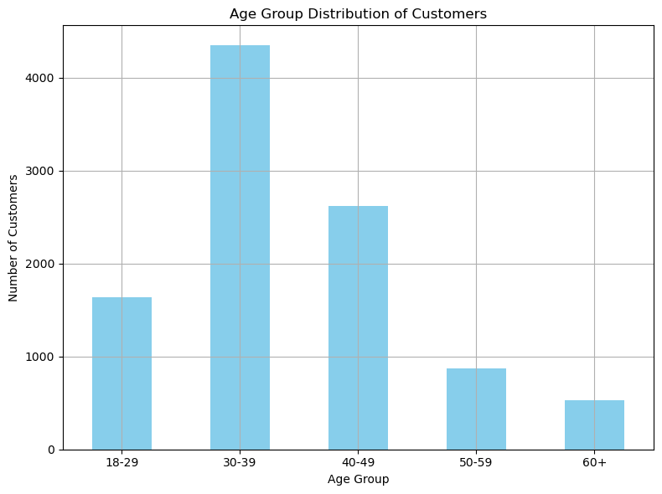
Churn Modelling Data Analysis - Customer Demographics
Distribution Across Age Groups

Slide 27
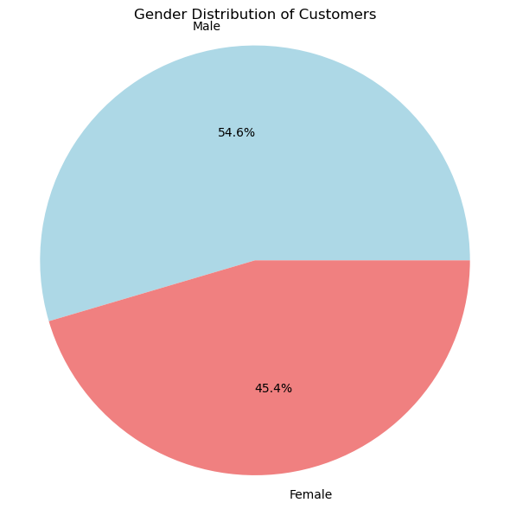
Gender Distribution
Gender
Male | 5457
Female | 4543

Slide 28
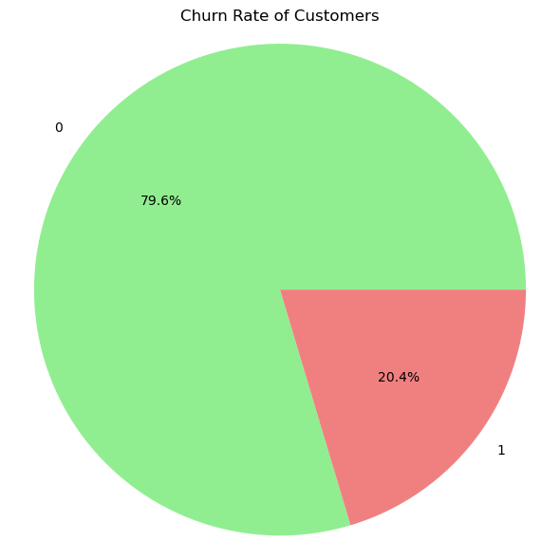
Churn Modelling Data Analysis - Churn Analysis
Percentage of Customers Churned
Churned
0 | 79.63
1 | 20.37

Slide 29
Main Reasons for Churn
Summary of Main Reasons for Churn
Demographic Factors: Age and geographical location significantly impact churn rates.
Financial Stability: Credit score, account balance, and estimated salary are critical indicators.
Engagement with Bank Services: Tenure, number of products, active membership status, and holding a credit card affect churn likelihood.

Slide 30
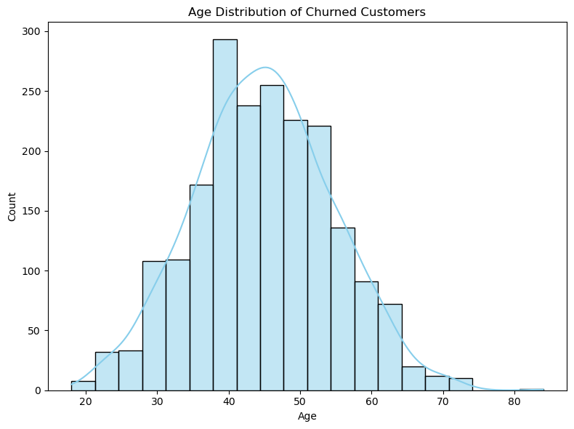
Patterns Among Churned Customers

Slide 31
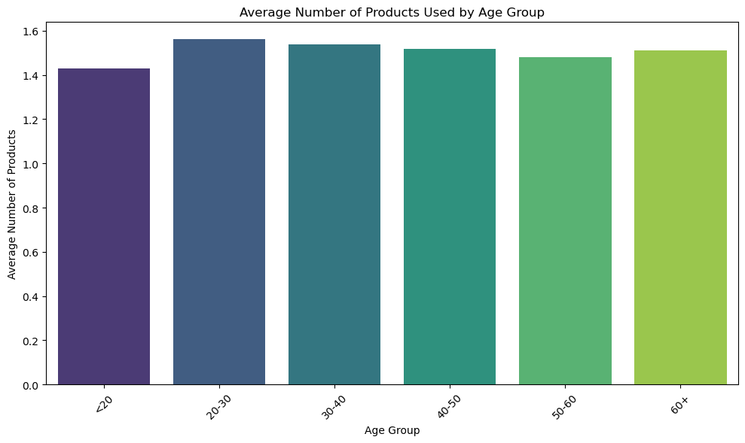
Churn Modelling Data Analysis - Product Usage
Most Commonly Used Products/Services

Slide 32
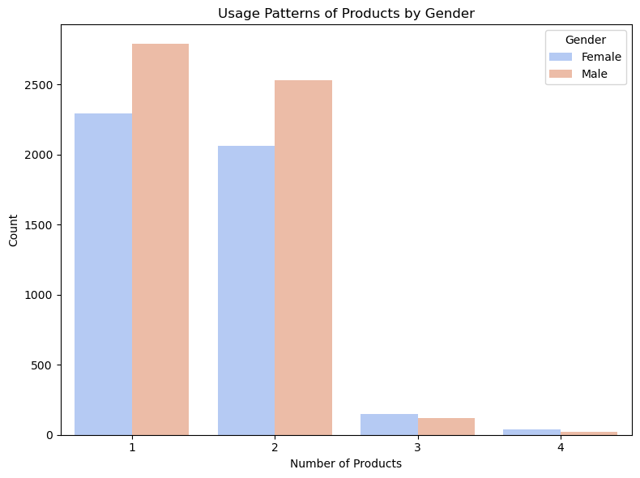
Usage Patterns by Customer Segments

Slide 33
Churn Modelling Data Analysis - Financial Analysis
Average Account Balance: $76485.89

Slide 34
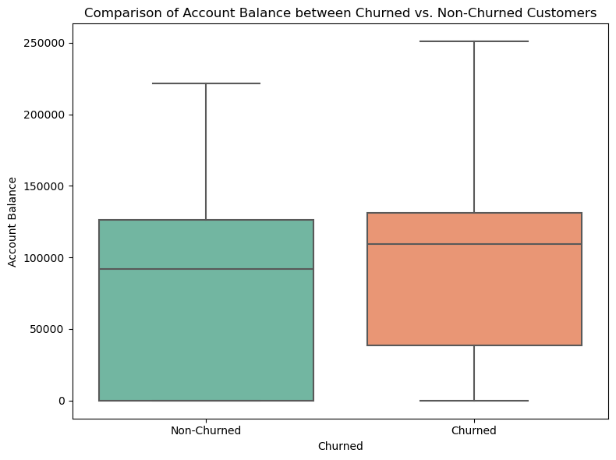
Financial Characteristics of Churned vs. Non-Churned Customers

Slide 35
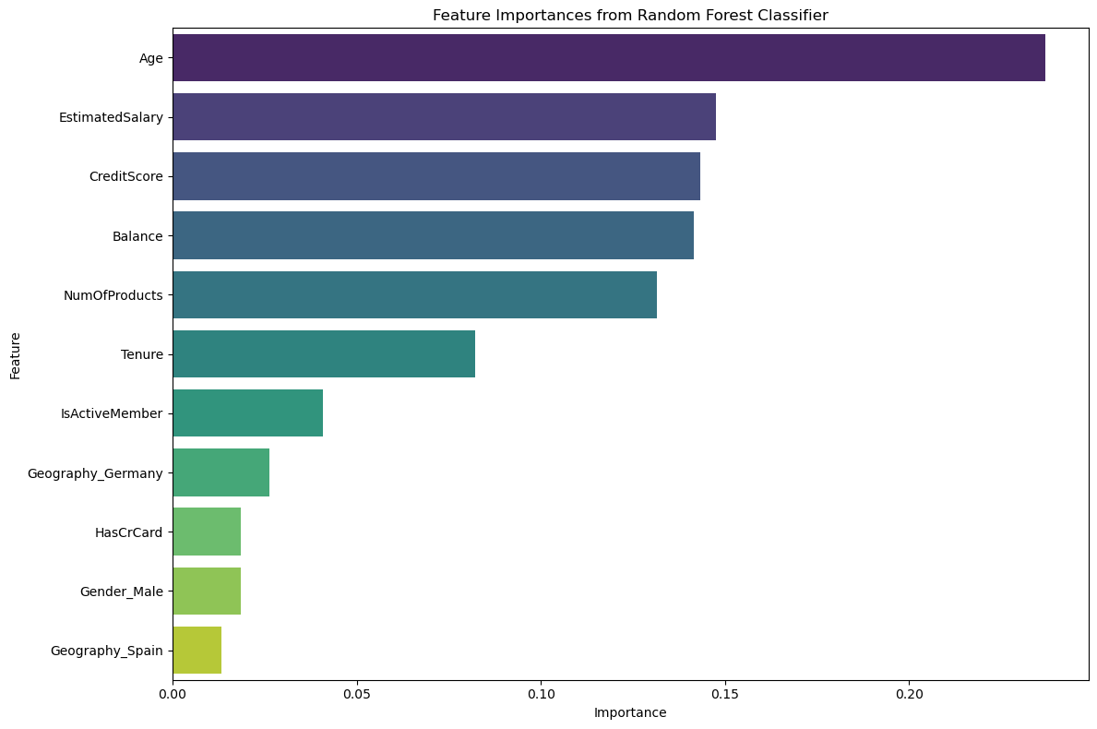
Churn Modelling Data Analysis - Predictive Modeling
Significant Predictors of Customer Churn

Slide 36
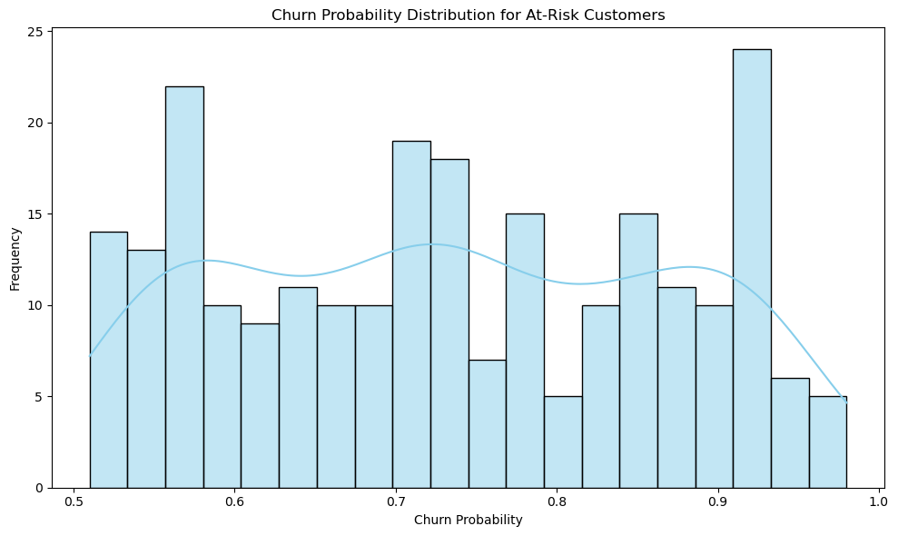
Predictive Model for At-Risk Customers

Slide 37
Thanks

