Slide 1

GAMING SITE
By Simon

Slide 2

ABOUT THE APP
It is a community service website that focuses on helping people to connect and have fun easily.
It is an interactive gaming site for Meetings.

Slide 3
WHAT I USED:
Express js for backend.
mongoDB for database purposes.
Angular Framework for Frontend.
Restful api endpoints to access and use data among the server and UI.
JWT tokens for authentication.
Lazy loading to improve performance by reducing load time for quicker page loading.
Angular material library for UI purposes.

Slide 4
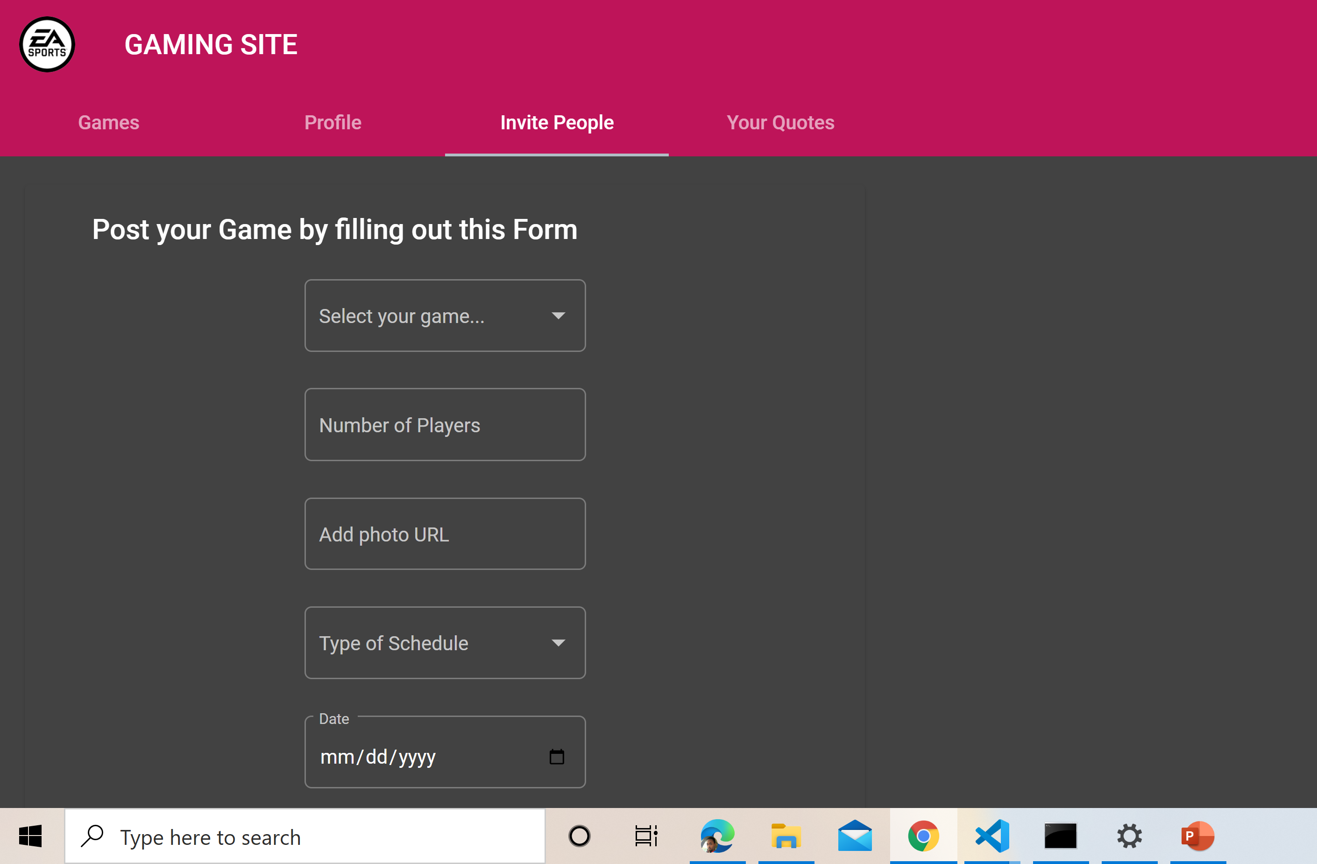
Make schedules in seconds
Create and share game schedules for leagues and tournaments.
User can only create a single game at a time unless the game is removed by the user.

Slide 5
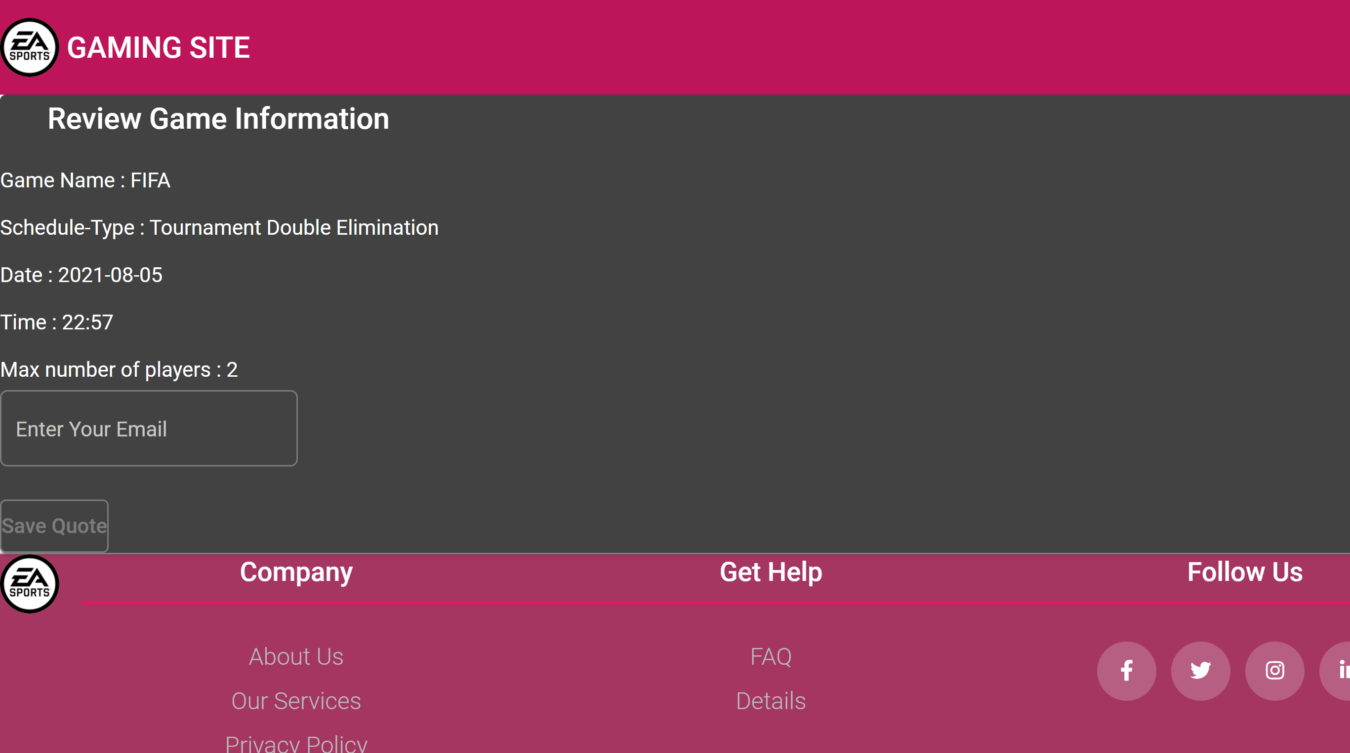
Register players online
Players with active accounts can send a request to reserve a quote to only a specific game.

Slide 6
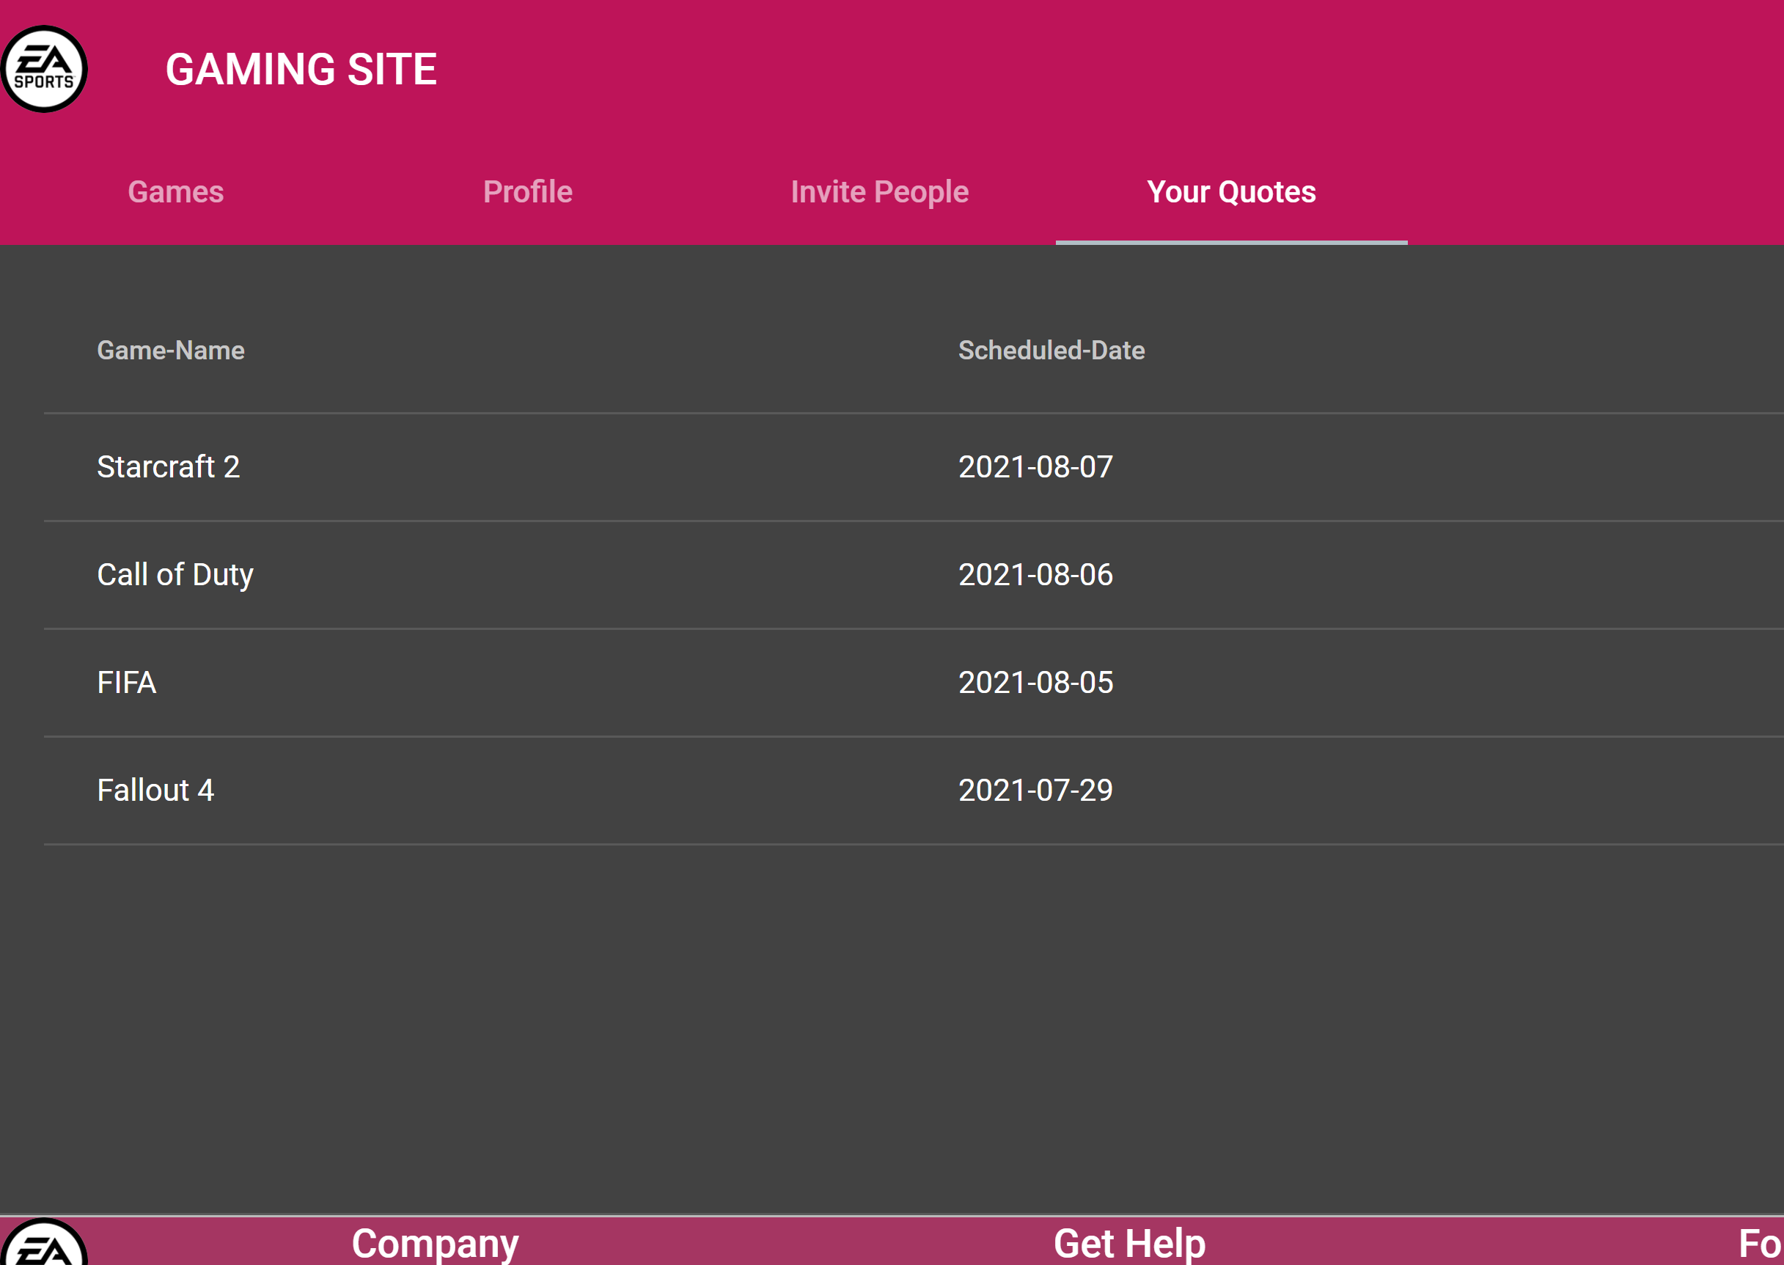
All the reserved quotes for a specific user will be displayed here.

Slide 7
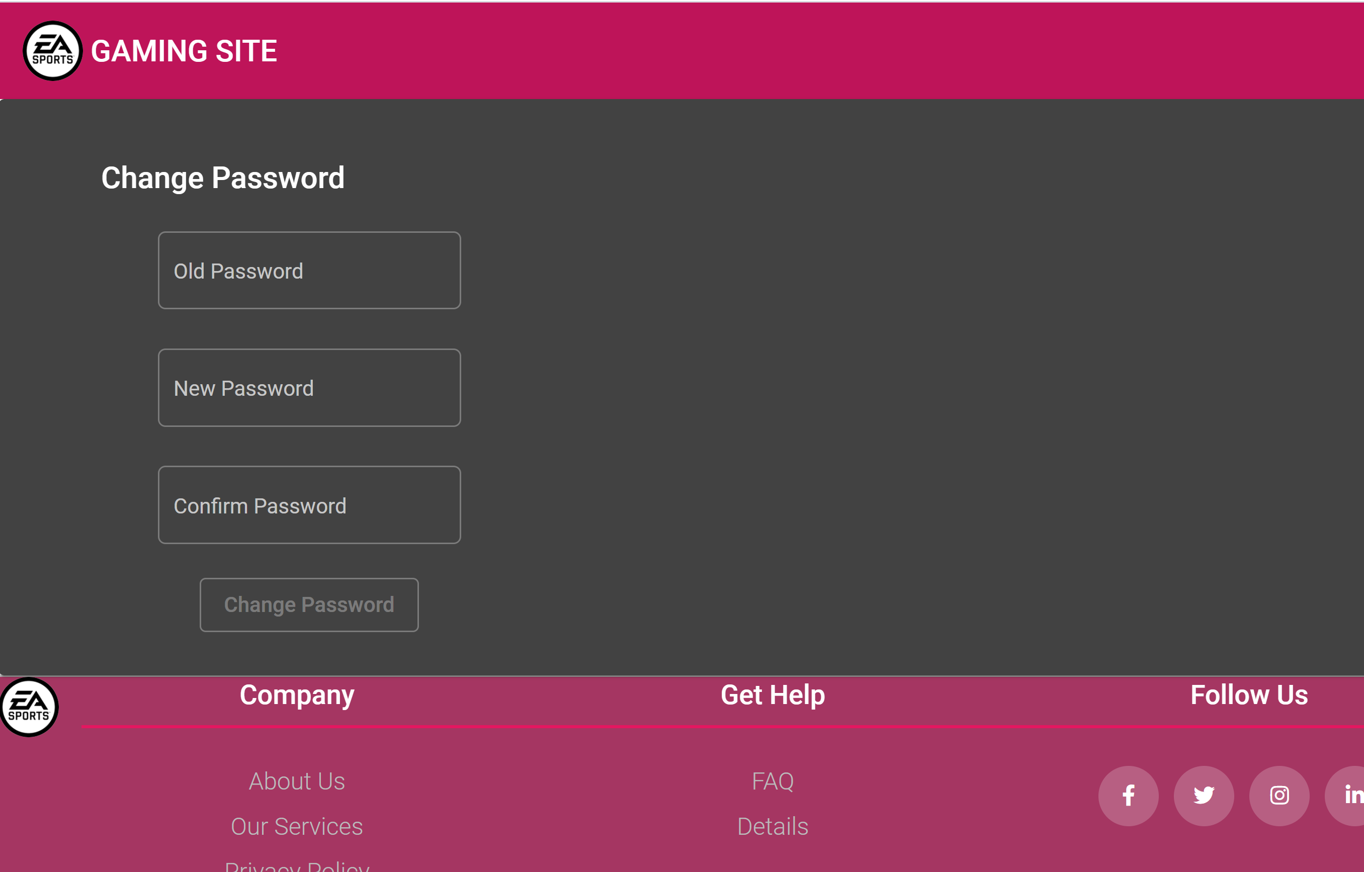
UPDATE PASSWORD
Users are able to see their account profile information and update their password info if they want.

Slide 8
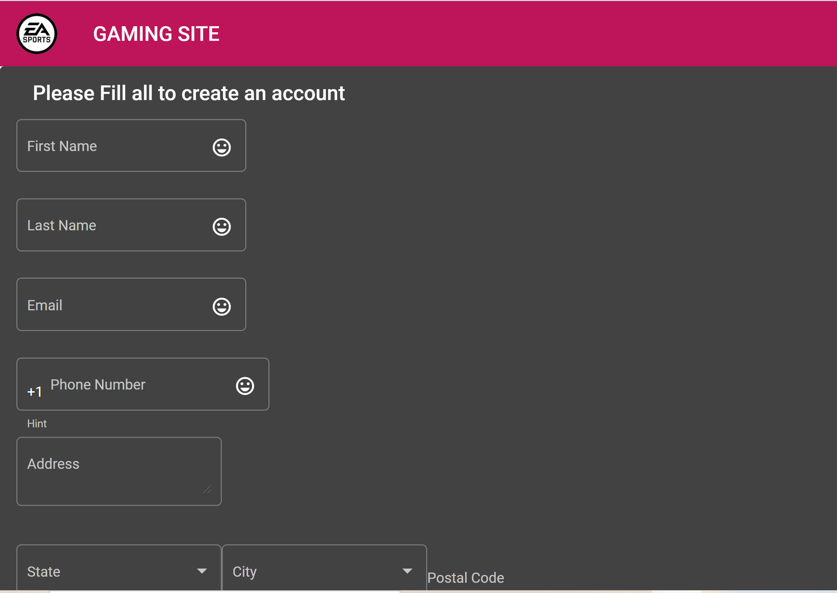
SIGN-UP
Sign-up form to create free account with all fields validated.

Slide 9
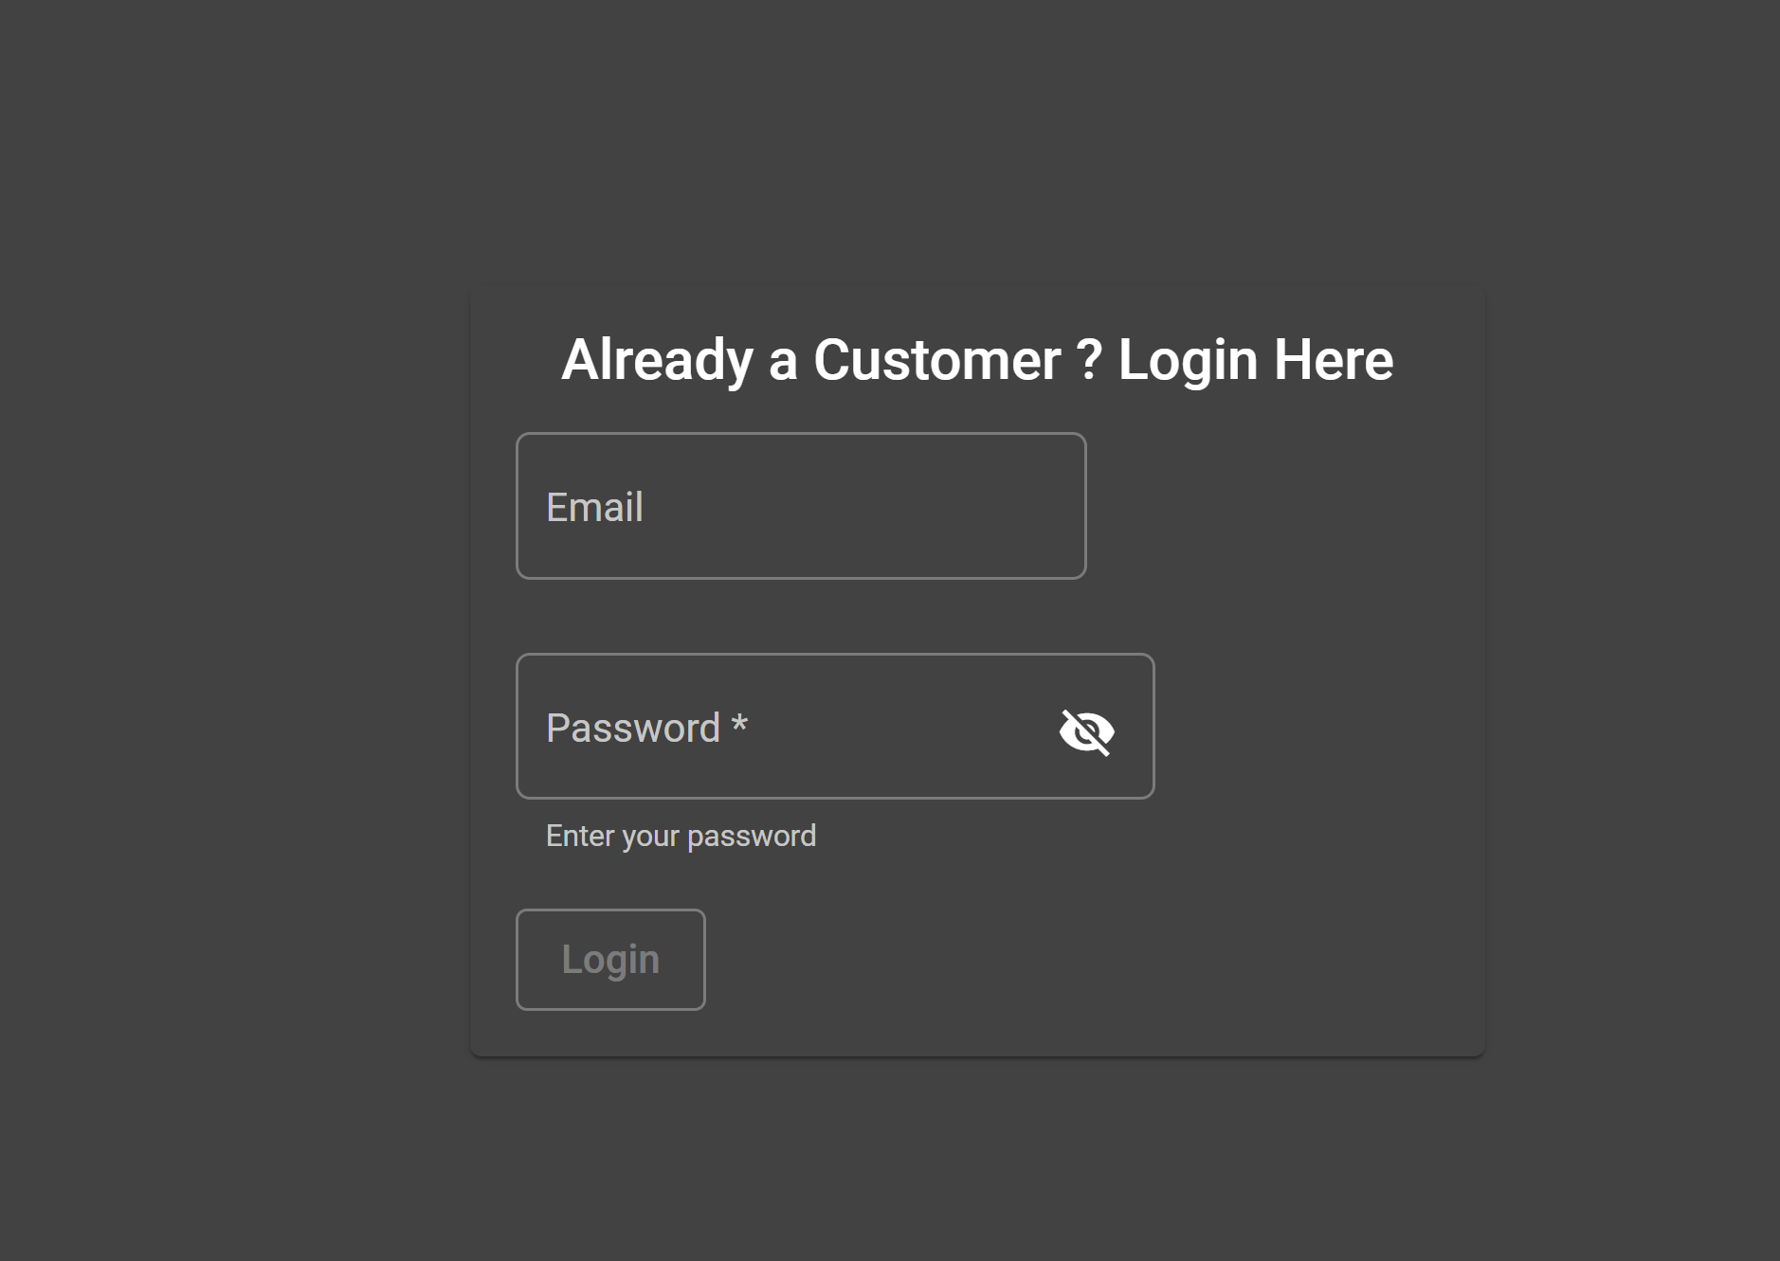
LOGIN FORM
Login form to signin to a users account.

