Slide 1
MARKET ANALYSIS
FOUR CRITERIA. ONE IS A GATE.
Grey rows fail the gate.
Black rows pass the gate.
The gate
Ranking criteria
Country
AI may advise ¹
Market size ²
Savings potential ³
New regulation enforcement ⁴
Total
legal without a lawyer signing
firms with 50 or more staff
on lawyer cost
deadline live, fines starting
of 20
1.
Netherlands
5
4
4
5
18
2.
Sweden
5
3
5
4
17
3.
Germany
2
5
4
4
15
4.
Belgium
5
3
3
3
14
5.
Italy
3
5
2
4
14
6.
Austria
1
3
5
5
14
7.
Denmark
5
2
3
3
13
8.
Finland
5
2
2
3
12
9.
Poland
5
4
1
2
12
Switzerland
outside EU
5
3
5
1
14
1 AI may advise NL wetten.overheid.nl SE riksdagen.se DK retsinformation.dk FI finlex.fi PL sejm.gov.pl BE ejustice.just.fgov.be CH fedlex.admin.ch DE gesetze-im-internet.de, bundesgerichtshof.de IT normattiva.it AT ris.bka.gv.at
2 Market size Eurostat sbs_sc_ovw 2024 ec.europa.eu/eurostat CH bfs.admin.ch 3 Savings potential Eurostat sbs_ovw_act, tps00001 ec.europa.eu/eurostat BE, IT, PL e-justice.europa.eu (2007)
4 New regulation enforcement NL rdi.nl SE riksdagen.se DK retsinformation.dk FI finlex.fi PL sejm.gov.pl DE bsi.bund.de IT gazzettaufficiale.it AT ris.bka.gv.at EU digital-strategy.ec.europa.eu
Notes:
Ten candidate markets, four criteria scored one to five on sourced facts. The first column is the gate: may software give a company its legal answer? Grey rows fail it. Sources: FILES/research-countries.md and FILES/research-legal-*.md.

Slide 2
MARKET ENTRY
GERMANY IS THE GOAL. WHY NOT START THERE?
In Germany an AI adviser may not advise. Start there, and we build a product we can never test.
BUILD
LEARN
EXPAND
ARRIVE
IF WE STARTED IN GERMANY
GATED ADVISER
A lawyer signs every answer.
→
NO PROOF
We never learn if the adviser sells.
→
STUCK
Built for the strictest market. Travels badly.
→
COLD START
No customers, no firm, no references.
GERMANY FIRST
WHAT WE DO INSTEAD
FULL ADVISER
Sold in the Netherlands, where it may speak.
→
PROOF
Companies pay for the software itself.
→
REPEAT
New market, same product. Add a firm and a country pack.
→
GERMANY, AS AN UPGRADE
Dutch customers buy the Germany pack. Same product, German rules, a German firm signs.
OPEN FIRST
Germany's rule generic, rule-based tools are allowed (BGH Smartlaw, 2021). Case-specific advice stays with lawyers. bundesgerichtshof.de
Notes:
Germany is the destination from day one. Starting there would force a gated product before anyone knows whether the ungated one sells. So the full adviser is built and proven where it may speak, and Germany arrives as an upgrade our Dutch customers buy.

Slide 3
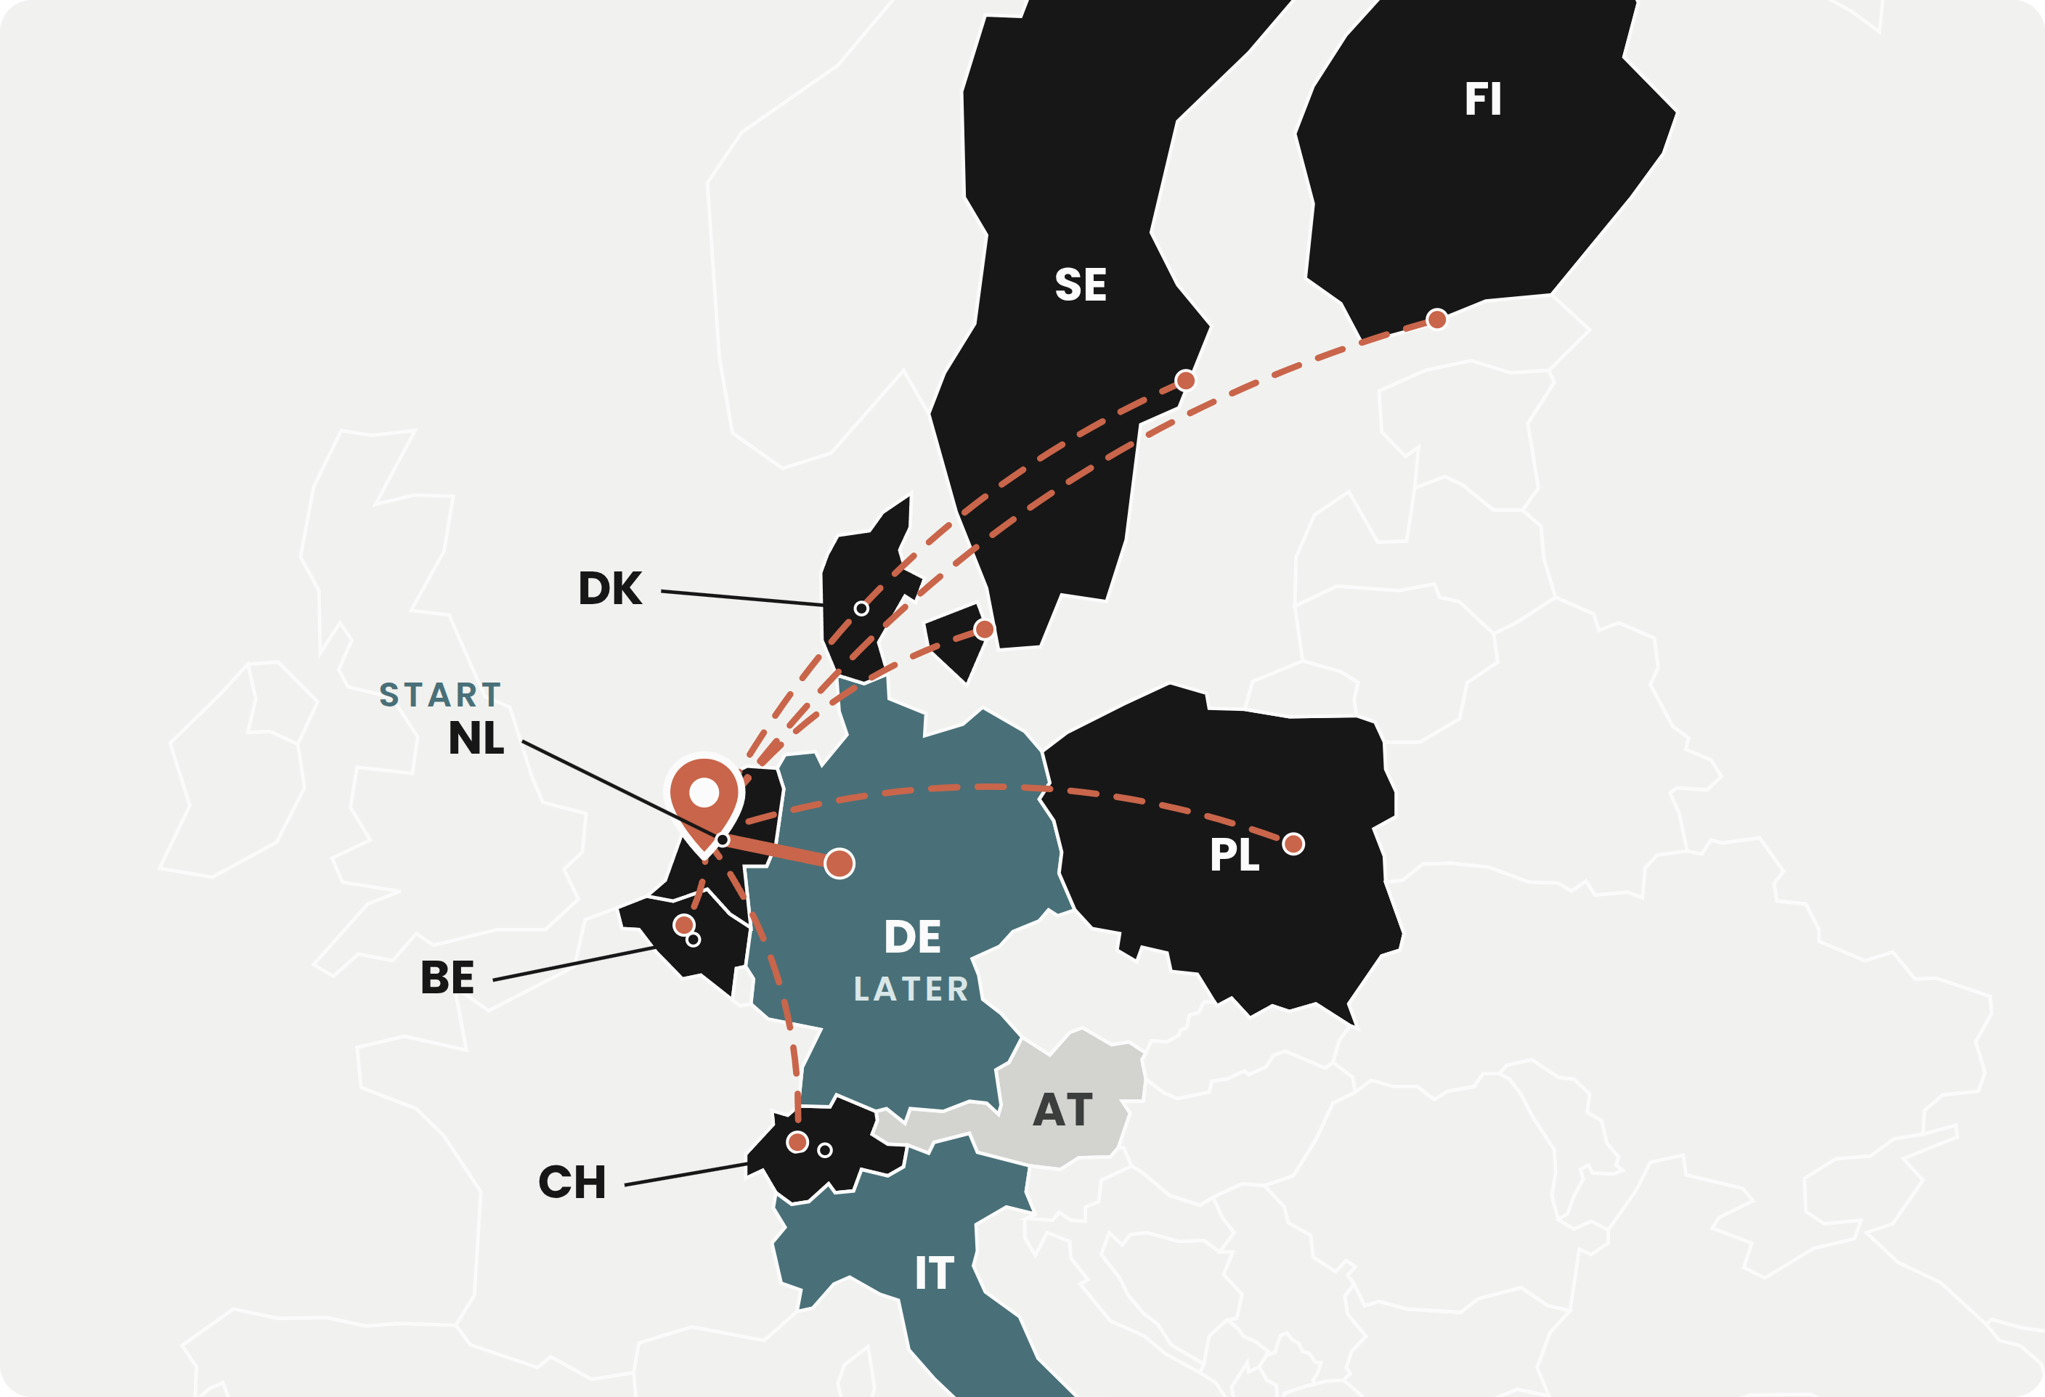
MARKET ENTRY
SO WE START IN THE NETHERLANDS.
Where the adviser may speak, the deadline is live, and the proof is clean.
THE ADVISER MAY SPEAK
LEGAL
Dutch law reserves only the lawyer's title. Software may give a company its answer. In Germany and Austria it may not.
THE DEADLINE IS LIVE
TIMING
NIS2 in force since August 2026. About 8,000 companies in scope, more than half not registered.
COMPANIES PAY FOR SOFTWARE
PROOF
No lawyer is needed to make the sale. So we learn the one thing that matters: does the adviser sell on its own.
Software may advise
Lawyer must sign
Firm-led
Not in the analysis
Our path
Sources wetten.overheid.nl · gesetze-im-internet.de · ris.bka.gv.at · rdi.nl · nctv.nl
Notes:
Only the ten countries from the analysis are coloured. Black: software may advise. Teal: the adviser prepares and a lawyer signs. Grey: firm-led. Orange: our path, the Netherlands first, the open markets next, Germany as the upgrade.

Slide 4
BUSINESS MODEL
ENTER WITH NIS2. GROW WITH EVERY LAW.
One evidence graph. Every new regulation is a module, every new country a pack. The second sale costs almost nothing.
COUNTRY PACKS
Same evidence, another country's rules
from €600
a year, per country
TODAY, WITH LAWYER HOURS
WITH REGULIFT
First law, first country
about €9,800
40 lawyer hours, one-off.
€5,400 a year
Platform plus NIS2, mid-size company.
MODULES
One law at a time
from €1,800
a year, per regulation
Every new law
again €9,800
Same fact-finding again.
+ €1,800
Same evidence, new rules.
NIS2 · ENTRY
AI Act
Cyber Resilience Act
DORA
Data Act
more
Every new country
again €9,800
New firm, new review.
+ €600
Same evidence, new country.
PLATFORM
Evidence graph, adviser, GDPR included
€1,800 to 7,200
a year, by company size
Built once. Every layer above reuses it.
WHY IT MATTERS
Compliance that gets cheaper with every law and every border makes European companies more competitive.
Prices proposed. Companies pay; law firms use the workspace free, sign where the law requires it, no fee per mandate or fee share. Lawyer column illustrative: 40 hours at the German standard rate of €244 (BRAK STAR 2024, beck-aktuell.de); Dutch average €241 (Knab 2026). One NIS2 applicability opinion alone: €3,900 fixed (srd-rechtsanwaelte.de).
Notes:
Prices are proposed, inside the researched ranges. The lawyer column is illustrative: 40 hours at the German standard rate of 244 euro (BRAK STAR 2024). One NIS2 applicability opinion alone sells for 3,900 euro fixed. The country pack at 600 euro is a proposal, a third of a module.

Slide 5


TEAM
WHY US.
We have met this problem at work. Now we build the way out of it.
BUILDS THE PRODUCT
BUILDS THE MARKET
ANDREAS HERZINGER
SIMONE MATTIOLI
Product & engineering
AI & product development
Builds AI integrations for companies: secure connectors, data to LLM, RAG in production. Has seen how compliance turns every integration into a legal question. The evidence graph is his craft.
Customers, partners and discovery. EIT Digital Master School. The first year is interviews, one Dutch firm and two design partners, which is his ground.
WHY WE DO IT
We are a European generation that wants to bring something forward. Cheaper compliance makes Europe's companies more competitive, and we bring the professional experience to make it happen.
Notes:
Founder-problem fit: Andreas builds the kind of system the product is; Simone owns customers and partners, which is what year one needs. Stage: live website, designed collector, researched legal map, legal model under verification, no customer yet, no firm signed.

