Slide 1



Regulift
About
Service
Team
Conclusion
REGULIFT
Page 01

Slide 2



Regulift
About
Service
Team
Conclusion
MARKET PAIN POINTS
COMPLIANCE IS STILL GUESSWORK.
Companies pay to reconstruct facts that already exist in their systems.
TODAY
OUTSIDE-IN
REGULIFT
QUESTIONNAIRES
AI-first compliance: the facts come from your systems, not from questionnaires.
Answers from memory
STALE EVIDENCE
Gaps go unseen
LEGAL OVERHEAD
Next: the inside out framework.
Fact-finding repeats
Page 02

Slide 3

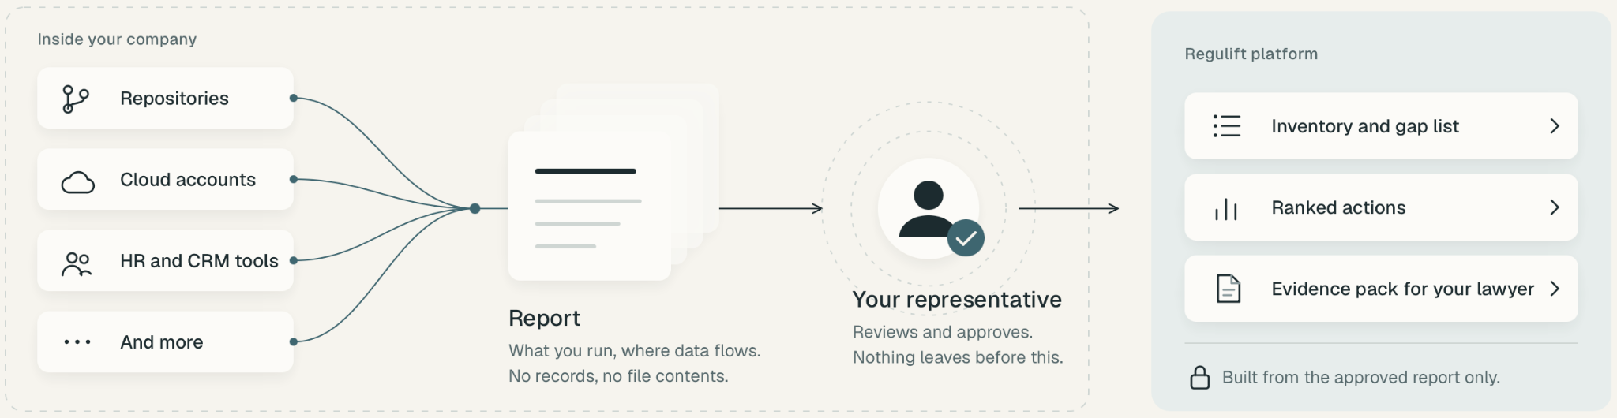
Regulift
About
Service
Team
Conclusion
THE SOLUTION
INSIDE OUT FRAMEWORK
01 DISCOVER
02 APPROVE
03 ACT
Read-only system context
Your representative controls release
Implement Regulift’s recommended fixes
Page 03

Slide 4
Regulift
About
Service
Team
Conclusion
THE SOLUTION
THE COMPLIANCE LOOP
↻
REPEAT UNTIL NO GAPS REMAIN
3
LAW FIRM
COMPANY CONTEXT
Version X
REGULIFT CHECK
Analysis
ASSESS
Product / scope
!
Gaps detected
REVIEW
WHEN CLEAR
Systems
→
Recommended fixes
LEGAL REVIEW
Controls
↻
Reassess
Lawyer validates the
evidence pack
FIX · UPDATE · RECHECK
LEGAL CERTIFICATION
v1
!
Gaps
v2
Improving
v3
No open gaps
When requirements are met
REAL CONTEXT
ONGOING CHECKS
LAWYER-READY
Page 04

Slide 5
Regulift
About
Service
Team
Conclusion
MARKET ANALYSIS
FOUR CRITERIA. ONE IS A GATE.
Grey rows fail the gate.
Black rows pass the gate.
The gate
Ranking criteria
Country
AI may advise ¹
Market size ²
Savings potential ³
New regulation enforcement ⁴
Total
legal without a lawyer signing
firms with 50 or more staff
on lawyer cost
deadline live, fines starting
of 20
1.
Netherlands
5
4
4
5
18
2.
Sweden
5
3
5
4
17
3.
Germany
2
5
4
4
15
4.
Belgium
5
3
3
3
14
5.
Italy
3
5
2
4
14
6.
Austria
1
3
5
5
14
7.
Denmark
5
2
3
3
13
8.
Finland
5
2
2
3
12
9.
Poland
5
4
1
2
12
Switzerland
outside EU
5
3
5
1
14
1 AI may advise NL wetten.overheid.nl SE riksdagen.se DK retsinformation.dk FI finlex.fi PL sejm.gov.pl BE ejustice.just.fgov.be CH fedlex.admin.ch DE gesetze-im-internet.de, bundesgerichtshof.de IT normattiva.it AT ris.bka.gv.at
2 Market size Eurostat sbs_sc_ovw 2024 ec.europa.eu/eurostat CH bfs.admin.ch 3 Savings potential Eurostat sbs_ovw_act, tps00001 ec.europa.eu/eurostat BE, IT, PL e-justice.europa.eu (2007)
4 New regulation enforcement NL rdi.nl SE riksdagen.se DK retsinformation.dk FI finlex.fi PL sejm.gov.pl DE bsi.bund.de IT gazzettaufficiale.it AT ris.bka.gv.at EU digital-strategy.ec.europa.eu
Page 05

Slide 6
Regulift
About
Service
Team
Conclusion
MARKET ENTRY
GERMANY IS THE GOAL. WHY NOT START THERE?
In Germany an AI adviser may not advise. Start there, and we build a product we can never test.
BUILD
LEARN
EXPAND
ARRIVE
IF WE STARTED IN GERMANY
GATED ADVISER
A lawyer signs every answer.
→
NO PROOF
We never learn if the adviser sells.
→
STUCK
Built for the strictest market. Travels badly.
→
COLD START
No customers, no firm, no references.
GERMANY FIRST
WHAT WE DO INSTEAD
FULL ADVISER
Sold in the Netherlands, where it may speak.
→
PROOF
Companies pay for the software itself.
→
REPEAT
New market, same product. Add a firm and a country pack.
→
GERMANY, AS AN UPGRADE
Dutch customers buy the Germany pack. Same product, German rules, a German firm signs.
OPEN FIRST
Germany's rule generic, rule-based tools are allowed (BGH Smartlaw, 2021). Case-specific advice stays with lawyers. bundesgerichtshof.de
Page 06

Slide 7
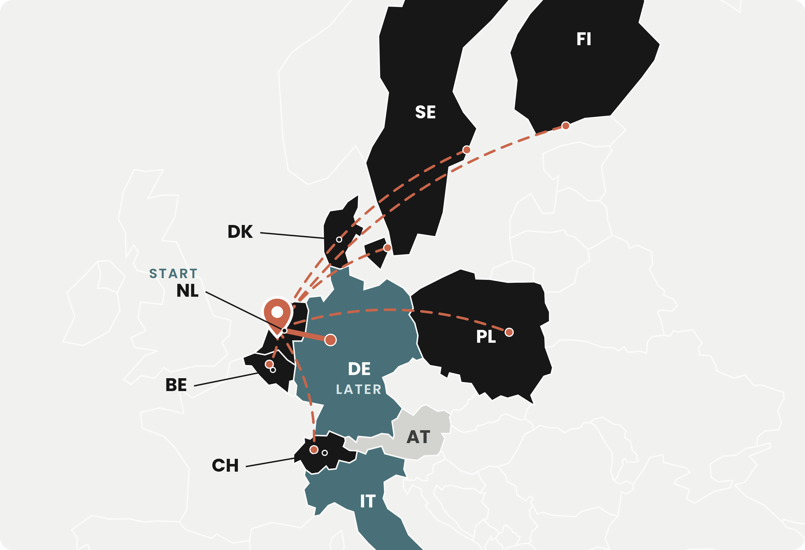
Regulift
About
Service
Team
Conclusion
MARKET ENTRY
SO WE START IN THE NETHERLANDS.
Where the adviser may speak, the deadline is live, and the proof is clean.
THE ADVISER MAY SPEAK
LEGAL
Dutch law reserves only the lawyer's title. Software may give a company its answer. In Germany and Austria it may not.
THE DEADLINE IS LIVE
TIMING
NIS2 in force since August 2026. About 8,000 companies in scope, more than half not registered.
COMPANIES PAY FOR SOFTWARE
PROOF
No lawyer is needed to make the sale. So we learn the one thing that matters: does the adviser sell on its own.
Software may advise
Lawyer must sign
Firm-led
Not in the analysis
Our path
Sources wetten.overheid.nl · gesetze-im-internet.de · ris.bka.gv.at · rdi.nl · nctv.nl
Page 07

Slide 8
Regulift
About
Service
Team
Conclusion
BUSINESS MODEL
ENTER WITH NIS2. GROW WITH EVERY LAW.
One evidence graph. Every new regulation is a module, every new country a pack. The second sale costs almost nothing.
COUNTRY PACKS
Same evidence, another country's rules
from €600
a year, per country
TODAY, WITH LAWYER HOURS
WITH REGULIFT
First law, first country
about €9,800
40 lawyer hours, one-off.
€5,400 a year
Platform plus NIS2, mid-size company.
MODULES
One law at a time
from €1,800
a year, per regulation
Every new law
again €9,800
Same fact-finding again.
+ €1,800
Same evidence, new rules.
NIS2 · ENTRY
AI Act
Cyber Resilience Act
DORA
Data Act
more
Every new country
again €9,800
New firm, new review.
+ €600
Same evidence, new country.
PLATFORM
Evidence graph, adviser, GDPR included
€1,800 to 7,200
a year, by company size
Built once. Every layer above reuses it.
WHY IT MATTERS
Compliance that gets cheaper with every law and every border makes European companies more competitive.
Prices proposed. Companies pay; law firms use the workspace free, sign where the law requires it, no fee per mandate or fee share. Lawyer column illustrative: 40 hours at the German standard rate of €244 (BRAK STAR 2024, beck-aktuell.de); Dutch average €241 (Knab 2026). One NIS2 applicability opinion alone: €3,900 fixed (srd-rechtsanwaelte.de).
Page 08

Slide 9
Regulift
About
Service
Team
Conclusion
NEXT STEPS
WHERE WE STAND.
Plan and validate first. Then build, launch, grow.
NOW
AI ENTREPRENEURS LAB
THEN
THEN
PLAN AND VALIDATE
BUILD
LAUNCH
GROW
Planning the product.
Validating the legal model country by country.
Build the MVP.
Evidence graph, adviser, legal gate.
NIS2 readiness in the Netherlands.
Win customers. Sign law firm partners.
Sweden next.
Germany as a country pack. Every further regulation.
OUR MISSION
Companies spend less on regulation and more on what makes them competitive.
Page 09

Slide 10


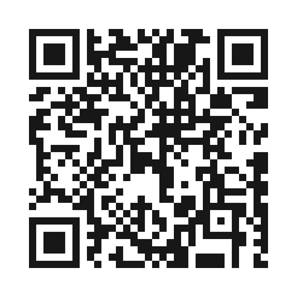
Regulift
About
Service
Team
Conclusion
GET INVOLVED
JOIN EARLY
ACCESS.
MORE DETAILS ONLINE
See how it works.
Explore early access.
SCAN OR VISIT
SIMONE MATTIOLI
simo-hue.github.io/regulift/
ANDREAS HERZINGER
AI & product development
Product & engineering
Page 10

Slide 11

Regulift
About
Service
Team
Conclusion
THANKS
Page 11

