Slide 1



Regulift
About
Service
Team
Conclusion
REGULIFT
Page 01

Slide 2

Regulift
About
Service
Team
Conclusion
MARKET PAIN POINTS
COMPLIANCE IS STILL
GUESSWORK.
Companies pay to reconstruct facts that already exist in their systems.
PAIN 01
PAIN 02
PAIN 03
QUESTIONNAIRES
STALE EVIDENCE
LEGAL OVERHEAD
Answers from memory
Gaps go unseen
Fact-finding repeats
Page 02

Slide 3
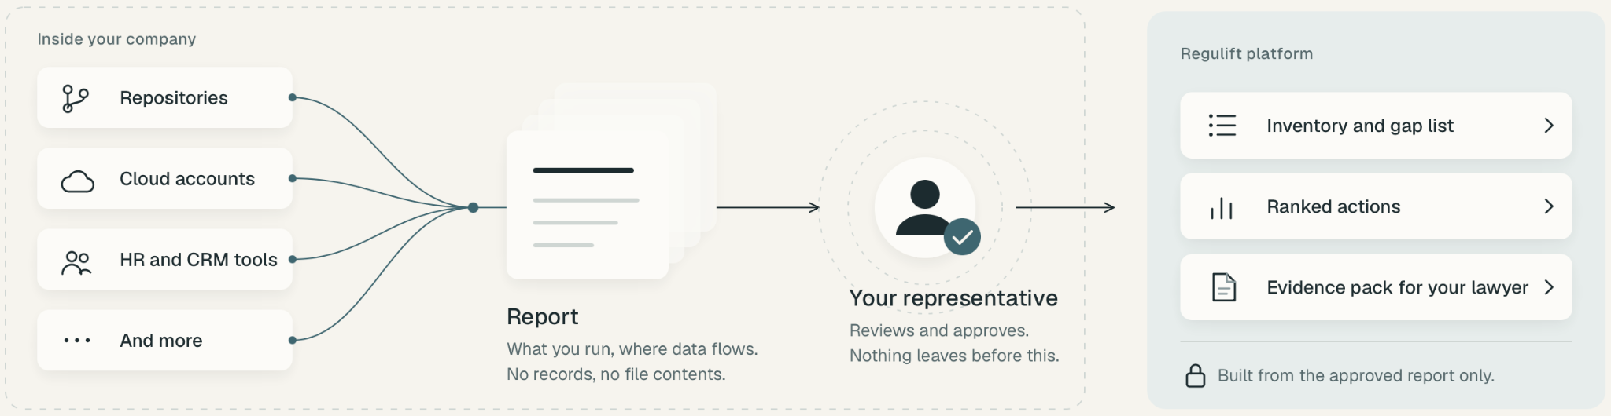
Regulift
About
Service
Team
Conclusion
THE SOLUTION
INSIDE OUT FRAMEWORK
01 DISCOVER
02 APPROVE
03 ACT
Read-only system context
Your representative controls release
Implement Regulift’s recommended fixes
Page 03

Slide 4
Regulift
About
Service
Team
Conclusion
THE SOLUTION
THE COMPLIANCE LOOP
↻
REPEAT UNTIL NO GAPS REMAIN
3
LAW FIRM
COMPANY CONTEXT
Version X
REGULIFT CHECK
Analysis
ASSESS
Product / scope
!
Gaps detected
REVIEW
WHEN CLEAR
Systems
→
Recommended fixes
LEGAL REVIEW
Controls
↻
Reassess
Lawyer validates the
evidence pack
FIX · UPDATE · RECHECK
LEGAL CERTIFICATION
v1
!
Gaps
v2
Improving
v3
No open gaps
When requirements are met
REAL CONTEXT
ONGOING CHECKS
LAWYER-READY
Page 04

Slide 5
Regulift
About
Service
Team
Conclusion
INITIAL PACKAGES
FOUR TO START.
MORE TO COME.
01
02
03
04
AI
NIS2
GDPR
EU AI ACT
DORA
Cybersecurity
Personal data
AI systems
Operational resilience
Page 05

Slide 6


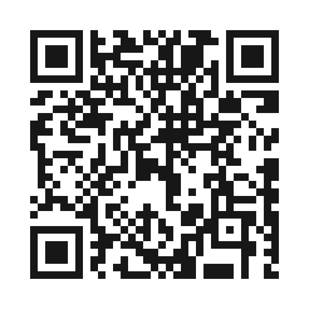
Regulift
About
Service
Team
Conclusion
GET INVOLVED
JOIN EARLY
ACCESS.
MORE DETAILS ONLINE
See how it works.
Explore early access.
SCAN OR VISIT
SIMONE MATTIOLI
simo-hue.github.io/regulift/
ANDREAS HERZINGER
AI & product development
Product & engineering
Page 08

Slide 7

Regulift
About
Service
Team
Conclusion
THANKS
Page 09

