Slide 1


Regulift
About
Service
Team
Conclusion
REGULIFT
Page 01

Slide 2


Regulift
About
Service
Team
Conclusion
THE PROBLEM
COMPLIANCE IS STILL
GUESSWORK.
Companies pay to reconstruct facts that already exist in their systems.
01
02
03
QUESTIONNAIRES
STALE EVIDENCE
LEGAL OVERHEAD
Answers from memory
Gaps go unseen
Fact-finding repeats
Page 02

Slide 3
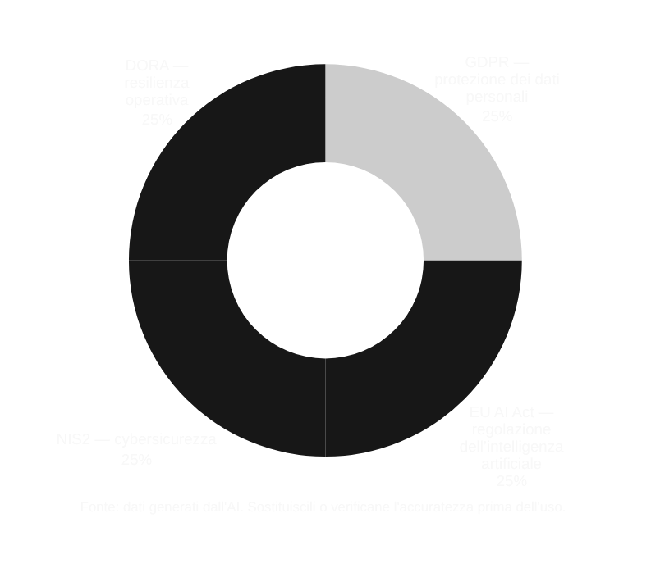
Regulift
About
Service
Team
Conclusion
INITIAL PACKAGES
FOUR TO START.
MORE TO COME.
NIS2
GDPR
Cybersecurity
Personal data
EU AI ACT
DORA
Our first compliance packages.
More regulations will follow.
AI systems
Operational resilience
Page 03

Slide 4
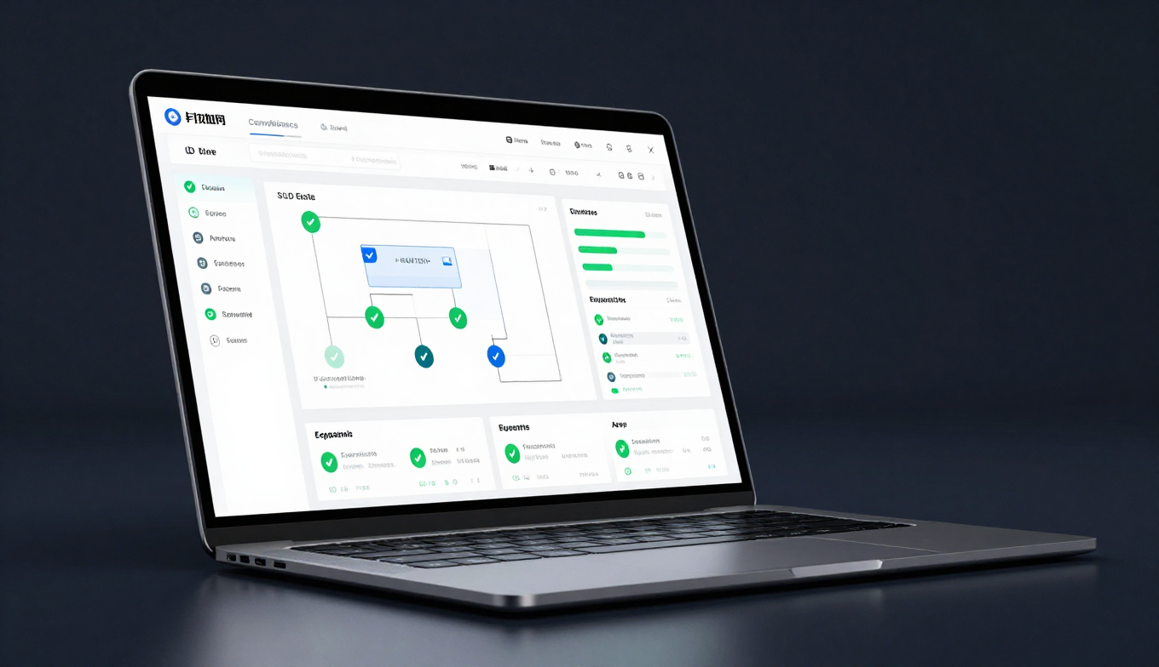
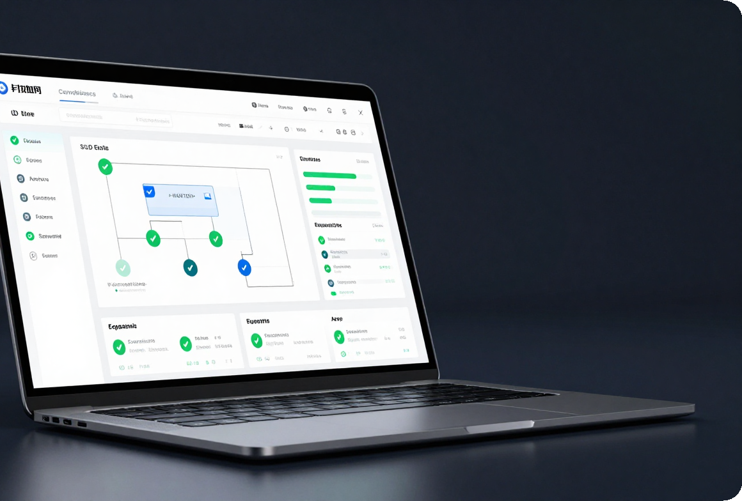
Regulift
About
Service
Team
Conclusion
THE SOLUTION
FROM REAL SYSTEMS
READ-ONLY ACCESS
COMPLIANCE
FROM THE
INSIDE OUT.
REPOSITORIES
CLOUD
HR / CRM
REGULIFT
Real systems → verifiable evidence.
READ-ONLY
Connect to existing tools
EVIDENCE-FIRST
Prioritise real gaps
VERIFIABLE EVIDENCE
✓
Ready for independent legal review
LAWYER-REVIEWED
Independent conclusions
Page 04

Slide 5
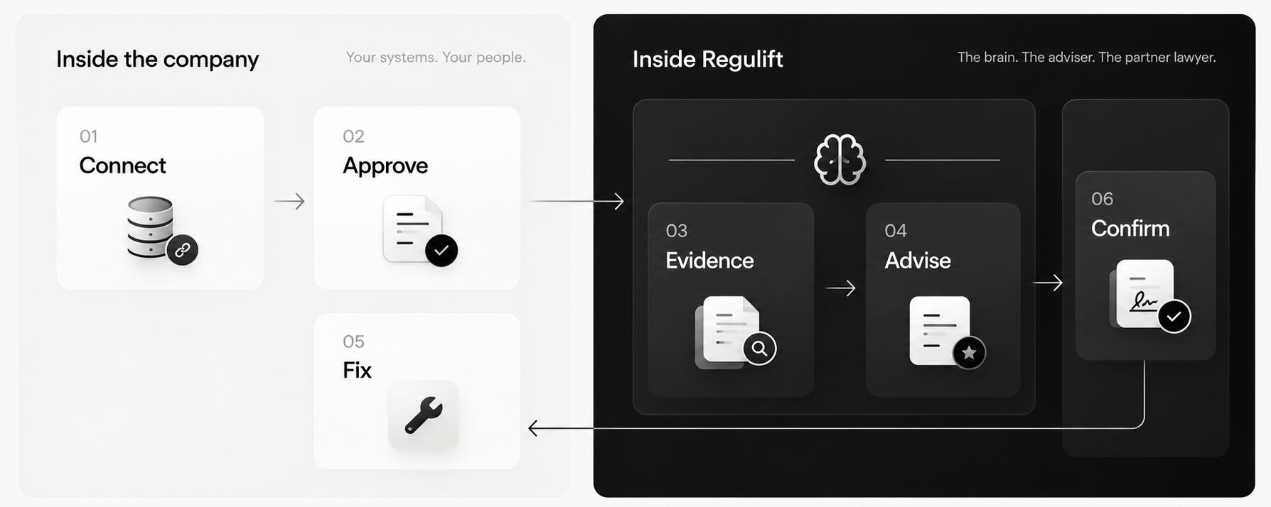

Regulift
About
Service
Team
Conclusion
HOW IT WORKS
FROM CONNECTION TO ACTION.
Company-controlled approval. Evidence-based advice. A clear path to remediation.
Page 05

Slide 6

Regulift
About
Service
Team
Conclusion
Reads. Advises. Loops until a lawyer signs.
Inside the company
Inside Regulift
01
02
report
The brain
Connect
Approve
Read-only. Repositories, cloud, HR, CRM.
One named person releases the context report.
03
04
06
Evidence
Advise
Confirm
05
gaps
Inventory, data flows, evidence graph.
What applies, where you stand, gaps ranked.
The partner lawyer signs in writing.
Fix
evidence
Steps and templates. Upload, re-read, repeat.
Nothing leaves before one person approves
Every answer cites its article and its evidence
A lawyer signs where the law reserves the verdict
Page 06

Slide 7
Regulift
About
Service
Team
Conclusion
DATA PROTECTION
YOUR DATA STAYS. CONTEXT MOVES.
Nothing leaves before your representative approves.
01
02
03
04
READ-ONLY SCAN
→
CONTEXT REPORT
→
HUMAN APPROVAL
→
EVIDENCE PACK
Cloud · repos · HR/CRM
Systems and flows only
Your team decides
Gaps and ranked actions
No records · No file contents · No credentials
Page 07
Notes:
Transferred from old presentation slide 6: Context leaves. Your data stays.
The collector writes a report about what you run and where data flows, never the records themselves. Your representative approves it. Only then does it reach the Regulift platform, which builds the inventory, the gap list and the evidence pack for your lawyer.
Diagram from the Regulift website. The approval step is a product rule, not an option.
Speaker note from original: This answers the first CTO question: what leaves my company. A report about technologies, flows and vendors. No records, no file contents, no credentials, and nothing until one person on their side approves.

Slide 8

Regulift
About
Service
Team
Conclusion
OPERATING PRINCIPLES
CONTROL IS
BUILT IN.
01
Read-only and revocable
02
European infrastructure
03
Independent legal review
You stay in control.
Page 08

Slide 9


Regulift
About
Service
Team
Conclusion
DIFFERENTIATION
FROM ANSWERS TO EVIDENCE.
Questionnaires describe. Systems prove.
TRADITIONAL
ASK
→
CHASE
→
REPEAT
Questionnaires and
manual discovery
REGULIFT
CONNECT
→
VERIFY
→
REUSE
Live evidence and
lawyer review
Page 09

Slide 10
Regulift
About
Service
Team
Conclusion
MARKET OPPORTUNITY
START FOCUSED. SCALE WIDER.
European software SMEs are our entry market.
TAM · GLOBAL
SAM · EU SOFTWARE
SOM · AT / DE / IT
$9.1B
€230M
€17M
GRC software · 2029
23,370 firms · estimate
1,200 target firms · estimate
SAM & SOM use Eurostat company counts × proposed prices; estimates, not forecasts.
Source: Verdantix (2025); Eurostat (2024); Regulift pricing research (2026).
Page 10
Notes:
Transferred from old presentation slide 7: A European market built by regulation.
TAM: global GRC software, $4.98 billion in 2023 to $9.08 billion by 2029 (Verdantix). Security spending overall reaches $240 billion in 2026 (Gartner).
SAM: 23,370 EU software firms with 20 to 249 staff (Eurostat NACE J62, 2024) at our €10,000 average yearly price.
SOM: 1,200 companies by 2029, one percent of the 119,784 firms with 50 or more staff in Austria, Germany and Italy, at €14,000 a year.
SAM and SOM are our estimates from Eurostat counts and our price bands, to validate in pilots.
Sources: Verdantix GRC software forecast, Jan 2025. Gartner, Jul 2025. Eurostat sbs_sc_ovw 2024 (J62 and all sectors, Austria, Germany, Italy). Price bands from the pricing research, Oct 2026.
Speaker note from original: The TAM is a named analyst figure. SAM and SOM are counts times our price, labelled as estimates.

Slide 11
Regulift
About
Service
Team
Conclusion
Four criteria. One is a gate.
The gate
Ranking criteria
Country
Adviser legal ¹
Market size ²
Savings potential ³
Trigger freshness ⁴
Total
software answers directly
firms with 50 or more staff
lawyer prices
NIS2 window, enforcement
of 20
1.
Netherlands
5
4
4
5
18
2.
Sweden
5
3
5
4
17
3.
Germany
2
5
4
4
15
4.
Belgium
5
3
3
3
14
5.
Italy
3
5
2
4
14
6.
Austria
1
3
5
5
14
7.
Denmark
5
2
3
3
13
8.
Finland
5
2
2
3
12
9.
Poland
5
4
1
2
12
Switzerland
outside EU
5
3
5
1
14
1 Adviser legal NL wetten.overheid.nl SE riksdagen.se DK retsinformation.dk FI finlex.fi PL sejm.gov.pl BE ejustice.just.fgov.be CH fedlex.admin.ch DE gesetze-im-internet.de, bundesgerichtshof.de IT normattiva.it AT ris.bka.gv.at
2 Market size Eurostat sbs_sc_ovw 2024 ec.europa.eu/eurostat CH bfs.admin.ch
3 Savings potential Eurostat sbs_ovw_act, tps00001 ec.europa.eu/eurostat BE, IT, PL e-justice.europa.eu (2007)
4 Trigger freshness NL rdi.nl SE riksdagen.se DK retsinformation.dk FI finlex.fi PL sejm.gov.pl DE bsi.bund.de IT gazzettaufficiale.it AT ris.bka.gv.at EU digital-strategy.ec.europa.eu
Page 11

Slide 12
Regulift
About
Service
Team
Conclusion
Enter open. Grow north. Win Germany.
Wedge: NIS2, live in all three markets. Second module: AI Act, from Q1 2027. Base: GDPR.
Seat in Austria, pilots from Budapest
01 Enter
2027, first half
02 Grow
2027, second half
03 Win
2028
Netherlands
Sweden
Germany
adviser legal
adviser legal
adviser gated, firm signs
Trigger
Trigger
Trigger
NIS2 live since 15 Aug 2026. Registration open, about 8,000 entities.
NIS2 live since 15 Jan 2026. One firm for Sweden, Denmark, Finland.
NIS2 live since 6 Dec 2025. 20,141 registered. 80,043 firms with 50 or more staff.
We need
We need
We need
One Dutch firm. 15 interviews. Two design partners.
One Swedish firm. First Expand pack, Netherlands to Sweden.
One German firm. German NIS2 rule set as the second Expand pack.
The path in
1 Arrive with customers
2 Arrive with a firm
3 Then sell, firm-led
1 Netherlands rdi.nl wetten.overheid.nl 2 Sweden riksdagen.se 3 Germany bsi.bund.de bundesgerichtshof.de gesetze-im-internet.de ec.europa.eu/eurostat
Page 12

Slide 13
Regulift
About
Service
Team
Conclusion
BUSINESS MODEL
RECURRING REVENUE. THREE SIMPLE LAYERS.
01 PLATFORM
02 MODULES
03 LAW FIRMS
€3.6K–14.4K
€1.8K–6K
FIXED FEE
per year · GDPR + connectors
per regulation · AI Act, NIS2, DORA, CRA
annual workspace fee · billed separately
Proposed pricing · Firms bill clients directly · No share of legal fees.
Legal framework: BRAO §49b(3); BGH IX ZR 89/23; AT, IT and FR professional rules.
Page 13
Notes:
Transferred from old presentation slide 9: Business model.
Three layers. The company pays a yearly platform fee by size, adds a module per regulation, and picks a partner law firm from a list. The firm bills its own work. Per-framework pricing is the market norm; a fee per legal mandate is unlawful in our first markets, so there is none.
Platform: €3,600 to €14,400/year. 10-49 staff €3,600, 50-249 €7,200, 250-1,000 €14,400. Read-only connectors, context report, inventory, GDPR module and evidence pack.
Modules: €1,800-€6,000 per regulation/year. AI Act, NIS2, DORA, CRA. Each adds its gap list and evidence pack. Mid-sized company with three modules: €14,400 to €18,000. StartComply charges €4,500 per framework; Drata USD 7,500.
Partner law firms: Flat yearly workspace fee; same for every firm, never per mandate. Client chooses firm; firm bills directly. No share of fees in DE, AT, IT, FR (BGH IX ZR 89/23). Firms author rules and confirm in writing.
Sources: Vendr, Feb 2026. Vanta and Drata AWS Marketplace listings and StartComply pricing, Oct 2026. BRAO §49b(3), BGH IX ZR 89/23, ÖRAK RL-BA §47, Italian CDF art. 37, French RIN art. 11.3. Tier prices are our proposal.
Speaker note from original: Mid-tier 9 to 18 thousand euros sits between StartComply at 10,500 for two frameworks and Vanta at 20 to 40 thousand dollars for one framework at this size. Client chooses the firm; firm pays a flat fee. The level of that fee comes from pilot talks.

Slide 14



Regulift
About
Service
Team
Conclusion
TEAM
THE TWO FOUNDERS:
SIMONE MATTIOLI
ANDREAS HERZINGER
AI & product development
Product & engineering
LLM & HPC research
AI integrations
Open-source software
Secure connectors
Page 14

Slide 15


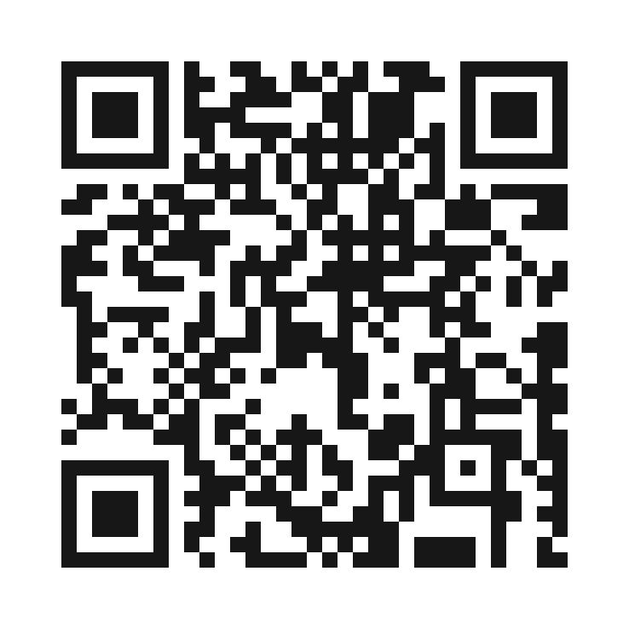
Regulift
About
Service
Team
Conclusion
GET INVOLVED
JOIN EARLY
ACCESS.
MORE DETAILS ONLINE
See how it works.
Explore early access.
SCAN OR VISIT
simo-hue.github.io/regulift/
Page 15

Slide 16

Regulift
About
Service
Team
Conclusion
THANKS
Simone Mattioli :
EIT Digital / 28DGTL
Andreas Herzinger:
EIT Digital / 28DGTL
Page 16

