Slide 1
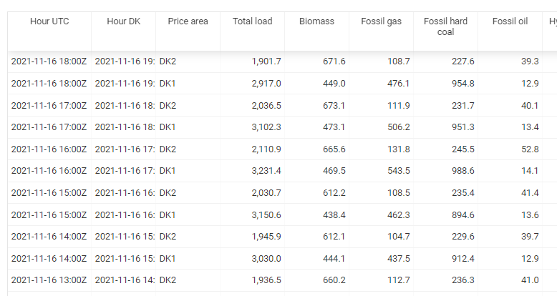
Electricity data for Denmark
Simon Lauridsen and Jakob Jensen
- Data for Danish Price areas DK1 and DK2
4 years on hourly granularity
Production, consumption, flows, carbon dioxide
Prices in DK and neighbouring areas.

Slide 2


Slide 3
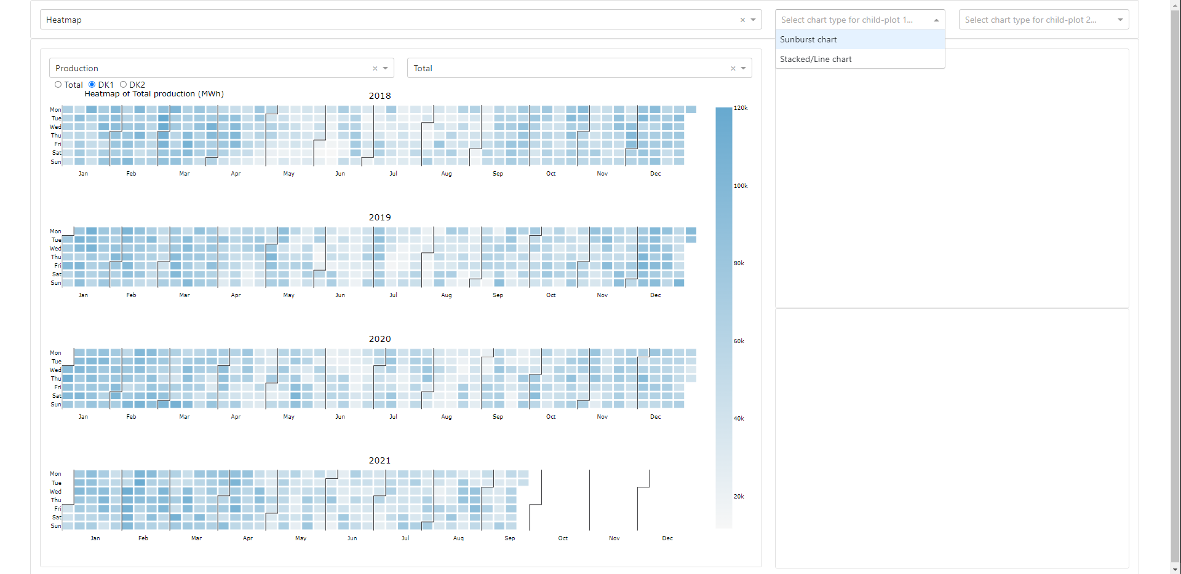

Slide 4
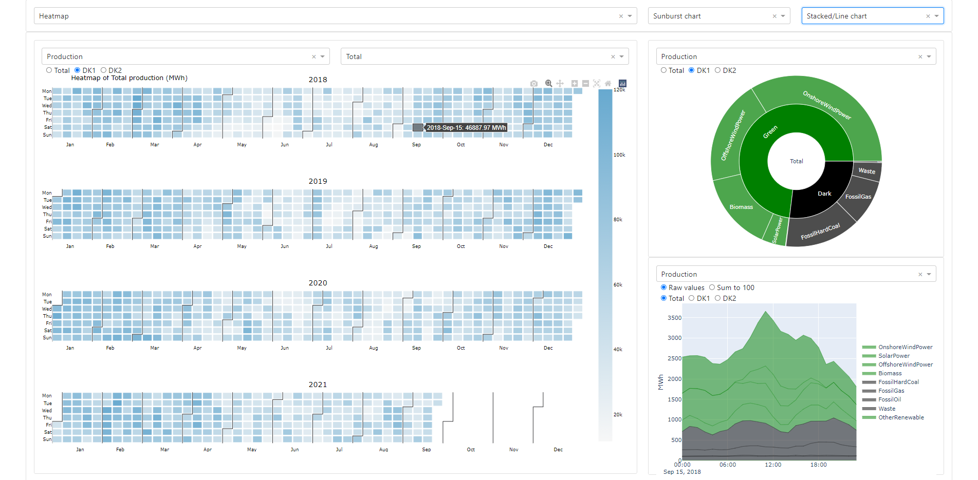



Slide 5
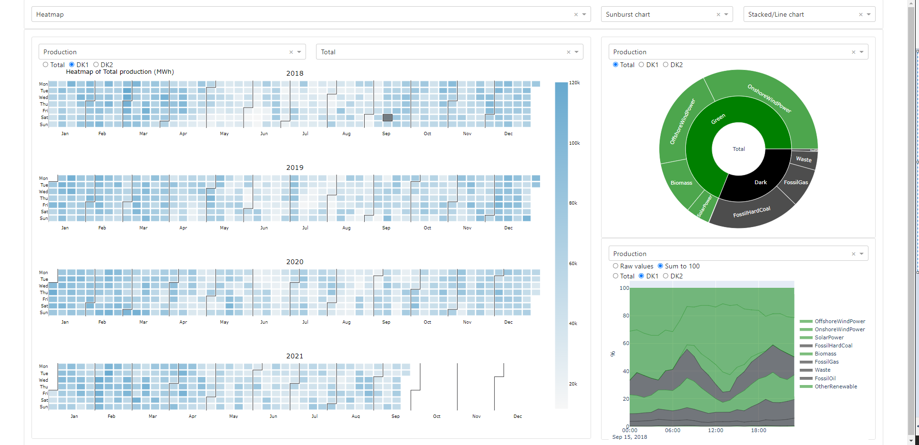



Slide 6
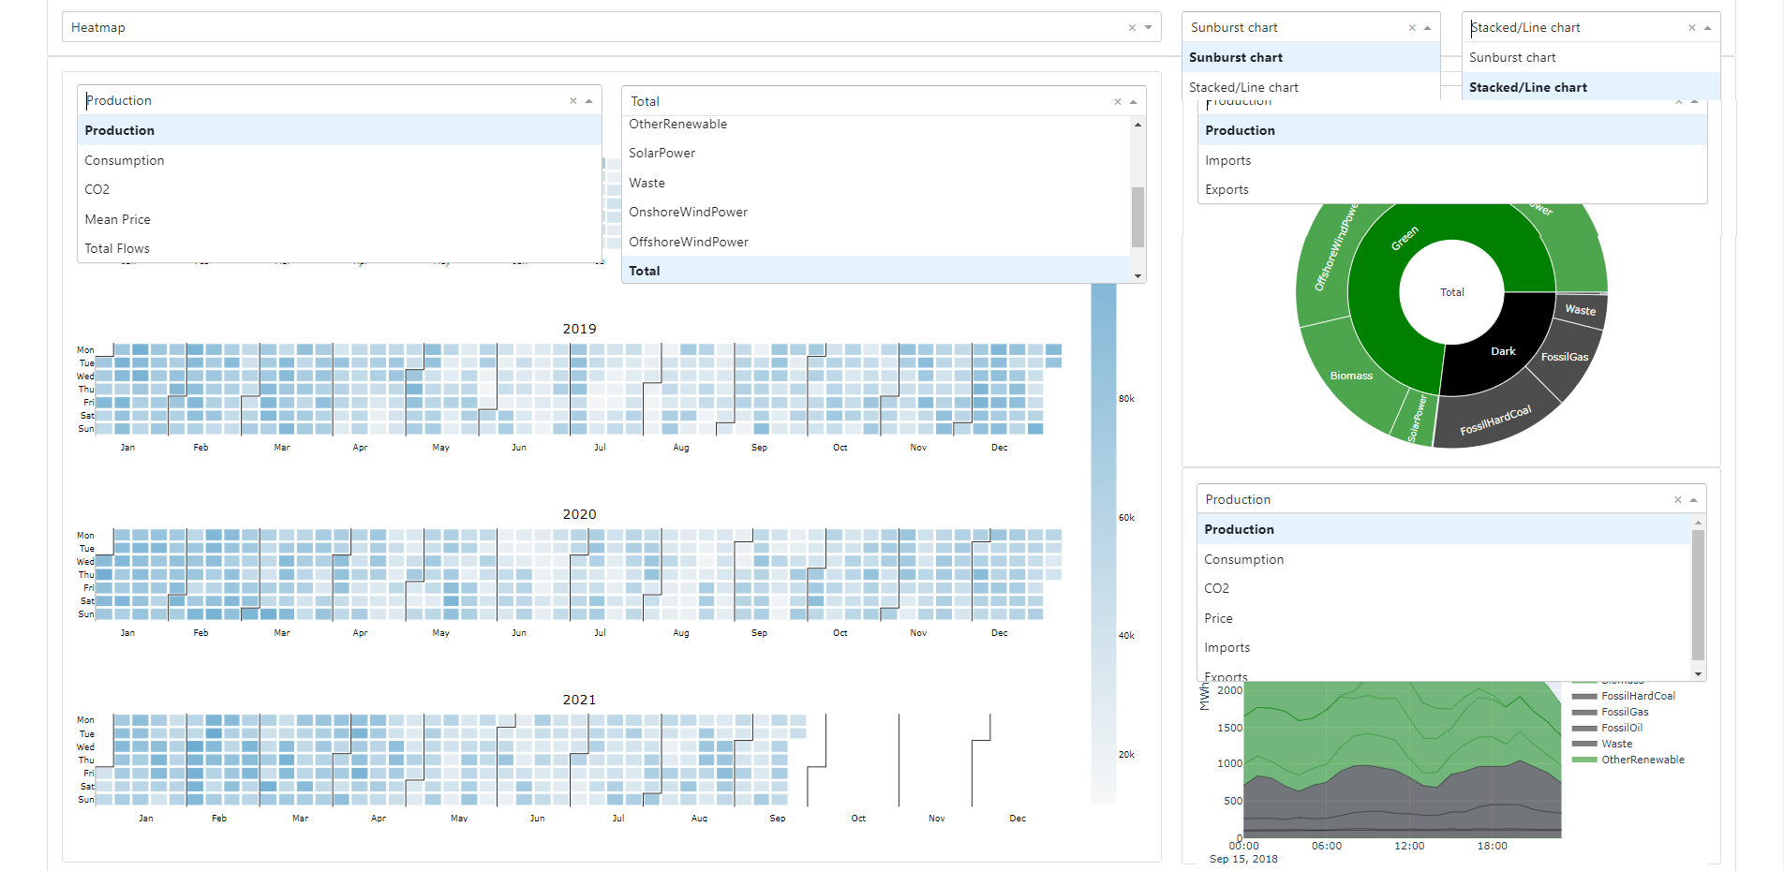


Slide 7
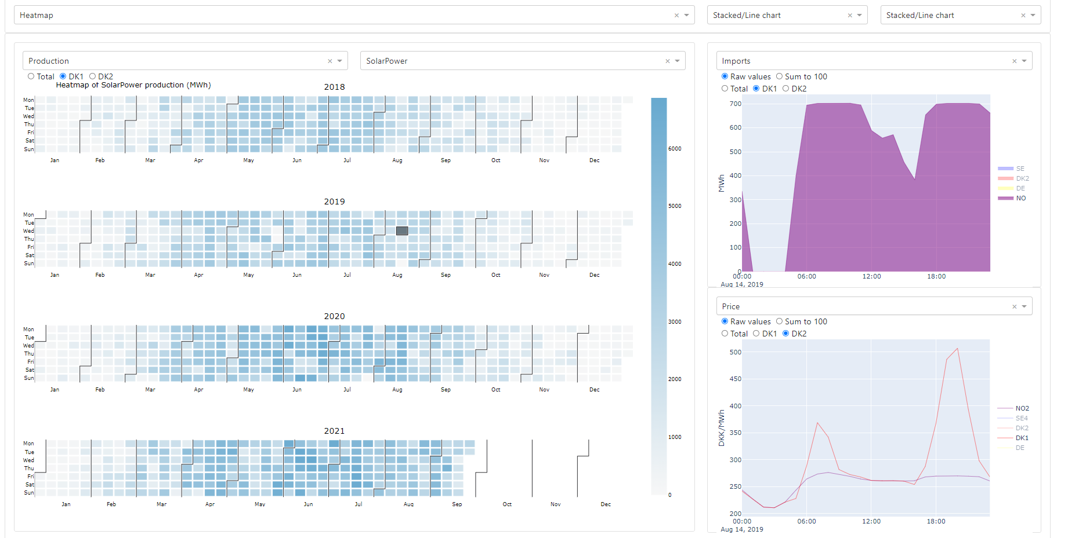

Slide 8
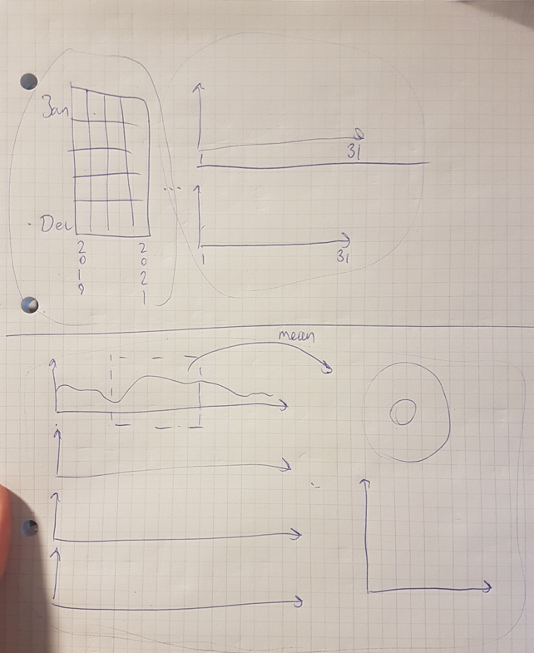
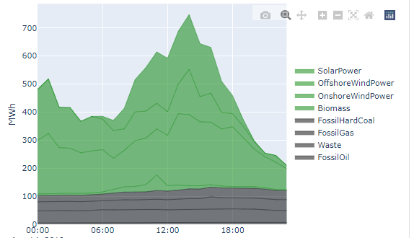
Our questions for you…
COLOR CHOICE IN CHARTS:
Monthly
Time series
instead of
heatmap

