Slide 1
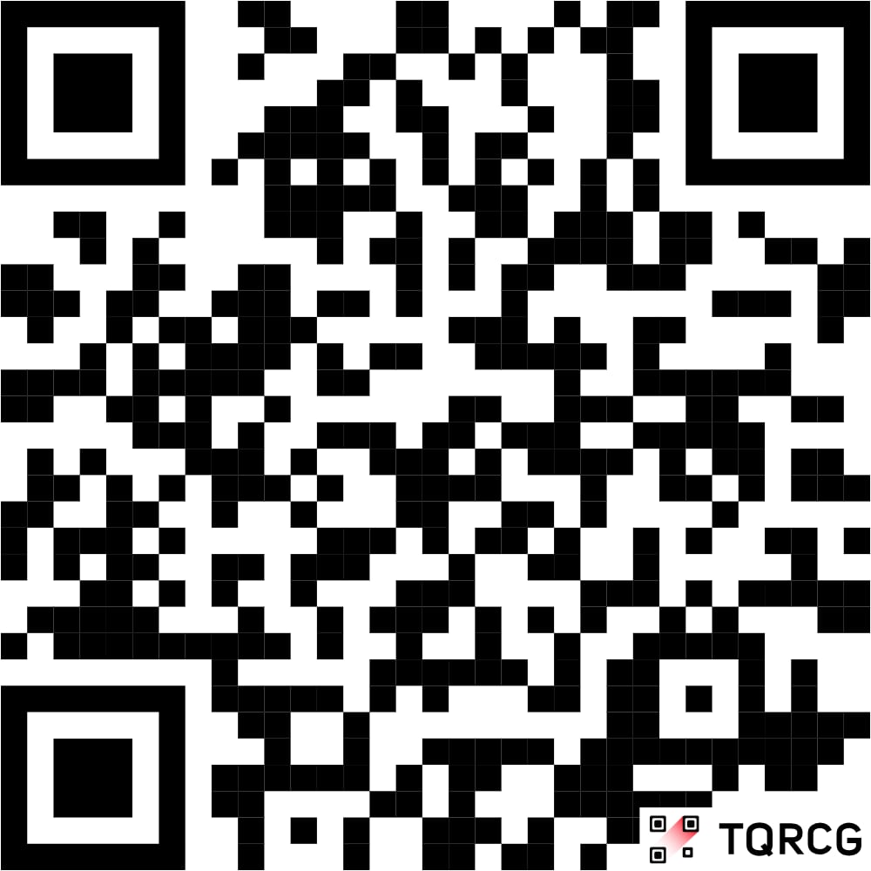

IMADA
ADVENT of CODE
import random
import time
def imada_julefrokost( ):
snacks = [”pepernødder", ”chips"]
drinks = [”sodavand", "øl", ”kaffe"]
music = "Last Christmas"
guests = get_all_students(imada)
while True:
play(music)
for g in guests:
snack = g.choose(snacks)
drink = g.choose(drinks)
print(f"{g.name} grabs some {snack} and sips {drink}!)
# coding challenge
solve(puzzle)
print(f"{g.name} has solved the puzzle!)
1/12 -

