Slide 1

Algorithms and Data Structures
for Medical Informatics
Lesson 14 — Data Structures in Digital Healthcare
EHR/EMR, clinical records, tables, JSON/XML, codes, terminologies and HL7/FHIR
ITS · Medical Informatics
24 September 2026 · 14:30–16:30
Prof. Simone Rancati, PhD
01

Slide 2
LESSON 14
Lesson structure
1. Digital health data
2. EHR and EMR
3. Tables and databases
From clinical work to computable records.
Meaning, scope and data organization.
Patients, encounters, observations and keys.
4. Semi-structured data
5. Codes and terminologies
6. Interoperability
JSON and XML in clinical exchange.
HL7 messages, FHIR resources and APIs.
ICD, SNOMED CT, LOINC and medication codes.
02

Slide 3
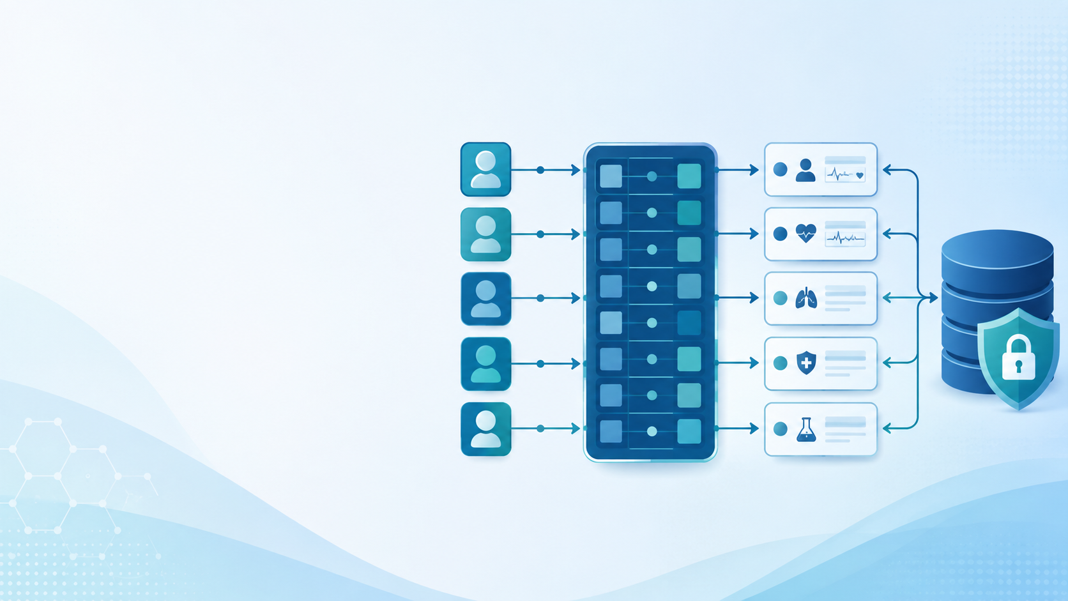
AT THE END OF THE LESSON
Learning objectives
Explain the difference between EMR and EHR in practical terms.
Describe a clinical record as a structured data object.
Interpret core healthcare tables and relationships between them.
Recognize why JSON and XML are used for semi-structured data exchange.
Distinguish diagnostic codes, clinical terminologies and laboratory codes.
Explain the basic idea of HL7/FHIR interoperability.
03

Slide 4
MOTIVATION
Why data structures matter in digital healthcare
Healthcare software does not only store text: it organizes complex clinical events.
The same patient may have diagnoses, visits, laboratory values, medications, images and notes.
Safe clinical algorithms require predictable and well-defined data structures.
Interoperability requires different systems to understand the same data in the same way.
04

Slide 5
DIGITAL HEALTH ECOSYSTEM
Where clinical data come from
Clinical documentation
Orders and procedures
Measurements
medical history
progress notes
discharge letters
laboratory requests
imaging exams
medication orders
vital signs
lab results
wearable sensors
Administrative data
Imaging and signals
External systems
appointments
wards
billing
encounters
DICOM images
ECG and EEG
monitoring streams
pharmacies
regional registries
public health systems
05

Slide 6
CORE CONCEPTS
EMR vs EHR
EMR — Electronic Medical Record
EHR — Electronic Health Record
Usually centered on one organization or provider.
Documents care delivered inside that setting.
Often optimized for local clinical workflows.
Broader longitudinal view of a patient’s health.
Designed to support sharing across systems.
More strongly connected to interoperability.
Teaching point
EMR and EHR are related, but the EHR is usually understood as a broader, more interoperable record.
06

Slide 7
CLINICAL RECORD
A patient record as a nested data structure
patient_record = {
id: 'P001',
demographics: {...},
encounters: [...],
diagnoses: [...],
medications: [...],
observations: [...],
documents: [...]
}
Health data are naturally grouped into sections.
Each section may contain lists of events over time.
Algorithms need predictable fields and stable meanings.
A record is therefore more than a text file: it is a structured object.
07

Slide 8
DATA GRANULARITY
From patient to clinical event
Patient
Encounter
Order
Observation
Document
identity
demographics
visit
admission
test
procedure
result
measurement
note
report
Digital healthcare systems often separate data into entities: patient, encounter, order, observation and document.
08

Slide 9
DATA TYPES
Structured, semi-structured and unstructured clinical data
Structured
Semi-structured
Unstructured
fixed fields
rows and columns
examples: lab table, diagnosis table
flexible nested fields
examples: JSON, XML, FHIR resources
free text or images
examples: clinical notes, reports, scans
A real EHR usually contains all three types at the same time.
09

Slide 10
RELATIONAL THINKING
Clinical data as tables
Many healthcare databases use tables to organize structured data.
Rows represent records, events or observations.
Columns represent attributes with defined types.
Tables are powerful because they support filtering, joining, aggregation and validation.
patient_id
age
sex
ward
P001
67
F
Cardiology
P002
54
M
ER
P003
72
F
Medicine
10

Slide 11
CORE TABLE
The patient table
patient_id
birth_date
sex
region
Primary key
patient_id uniquely identifies each patient.
P001
1959-04-12
F
Lombardy
P002
1972-10-04
M
Lazio
Important
P003
1948-01-28
F
Piedmont
Identifiers must be managed carefully for privacy and linkage.
11

Slide 12
CORE TABLE
The encounter table
encounter_id
patient_id
date
type
Foreign key
patient_id links each encounter to the patient table.
E001
P001
2026-09-10
ER
E002
P001
2026-09-12
Ward
Clinical meaning
E003
P002
2026-09-14
Outpatient
An encounter is a context in which care is delivered.
12

Slide 13
CORE TABLE
The observation table
obs_id
patient_id
code
value
unit
Observation
O001
P001
glucose
110
mg/dL
A measured fact about the patient at a time or in a context.
O002
P001
heart_rate
82
bpm
Key fields
O003
P002
HbA1c
7.2
%
code, value, unit and timestamp are essential.
13

Slide 14
RELATIONAL DATABASES
Connecting tables with keys
Patient
Encounter
Observation
patient_id
age
sex
encounter_id
patient_id
obs_id
patient_id
code
Keys allow the system to reconstruct a longitudinal patient record from multiple specialized tables.
14

Slide 15
TIME IN CLINICAL DATA
Timestamps are part of the structure
Clinical events occur over time and must be ordered correctly.
A measurement without time may be difficult to interpret.
The same value can have different meaning depending on when it was measured.
Time fields support trends, windows, alerts and longitudinal analysis.
Example
2026-09-24 08:15 · glucose = 62 mg/dL
Algorithmic use
detect low value, compute trend, trigger alert
15

Slide 16
SEMI-STRUCTURED DATA
JSON: JavaScript Object Notation
JSON stores data as name–value pairs and nested objects.
It is human-readable and widely used in web APIs.
It is flexible enough to represent complex clinical resources.
Many FHIR resources can be represented in JSON.
{
"patient_id": "P001",
"observation": {
"code": "glucose",
"value": 110,
"unit": "mg/dL"
}
}
16

Slide 17
SEMI-STRUCTURED DATA
XML: Extensible Markup Language
XML represents data using nested tags.
It has been used extensively in document exchange and healthcare messaging.
XML can be very explicit but also verbose.
Some healthcare interoperability standards can be represented in XML.
<Observation>
<PatientId>P001</PatientId>
<Code>glucose</Code>
<Value unit="mg/dL">110</Value>
</Observation>
17

Slide 18
COMPARISON
JSON vs XML in clinical exchange
Aspect
JSON
XML
Style
objects and arrays
nested tags
Readability
compact
explicit but verbose
Common use
APIs and FHIR JSON
messages and documents
Structure
flexible nesting
formal document structure
Teaching point
Both formats solve the same general problem: exchanging structured information between systems.
18

Slide 19
CLINICAL CODING
Why free text is not enough
Humans can understand many ways to write the same concept.
Computers need stable identifiers and controlled meanings.
Codes support search, billing, analytics, decision support and interoperability.
However, codes must be chosen and interpreted carefully.
Text
heart attack
Standardized concept
myocardial infarction
Code
system-specific identifier
19

Slide 20
CLINICAL LANGUAGE
Classification vs terminology
Classification
Terminology
Groups concepts into categories.
Often used for reporting, statistics or reimbursement.
Example: ICD diagnostic categories.
Represents clinical concepts with more detailed meaning.
Often used to encode clinical content.
Example: SNOMED CT concepts.
Key point
Both are important, but they serve different purposes.
20

Slide 21
CODING SYSTEMS
Common examples in healthcare data
ICD
SNOMED CT
LOINC
diagnoses and classification of diseases
clinical terminology for detailed concepts
laboratory tests and clinical observations
Medication codes
Procedure codes
Local codes
drug vocabularies and medication identification
procedures, interventions and activities
site-specific identifiers that may require mapping
21

Slide 22
DIAGNOSTIC CODES
How diagnoses become computable
A diagnosis table usually stores patient ID, encounter context, code and date.
The code system must be specified, not only the code value.
The same text label can map differently depending on the coding system.
Analytics often start by selecting patients with specific diagnosis codes.
patient_id
system
code
date
P001
ICD
E11
2026-09-10
P002
ICD
I10
2026-09-11
22

Slide 23
LABORATORY DATA
Why observation codes and units matter
A laboratory value is not complete without its test identity and unit.
Different laboratories may use different local names.
Standard codes allow systems to understand that two records refer to the same type of test.
Units must be checked because values are not comparable if units differ.
Incomplete
value = 7.2
Better
HbA1c · value = 7.2 · unit = %
Best practice
include code system, code, value, unit and time
23

Slide 24
MEDICATION DATA
A medication order as a structured object
medication_order = {
patient_id: 'P001',
drug_code: '...',
dose: '500 mg',
route: 'oral',
frequency: 'twice daily',
start_date: '2026-09-24'
}
Medication records need multiple fields, not only a drug name.
Dose, route, frequency and time are clinically essential.
Standardized drug identifiers help avoid ambiguity.
24

Slide 25
TERMINOLOGY MAPPING
Local codes and standard codes
Local code
Mapping table
Standard code
GLU_FAST
local lab system
local code → standard code
shared meaning
across systems
Mapping is one of the most important practical tasks in health-data integration.
25

Slide 26
INTEROPERABILITY
The problem: systems must exchange meaning
Hospitals, laboratories, imaging systems and regional platforms may all store data differently.
Interoperability means that systems can exchange and use information correctly.
It requires both technical exchange and semantic agreement.
Standards define how data are structured, transported and interpreted.
26

Slide 27
INTEROPERABILITY STANDARDS
HL7: exchanging healthcare information
HL7 is a family of standards for healthcare data exchange.
Traditional HL7 messages are widely used in hospital integration.
Messages can transmit events such as admissions, discharges, orders and results.
The key idea is to define a common structure for communication between systems.
Example event
new laboratory result
Sender
laboratory information system
Receiver
electronic health record
27

Slide 28
FHIR
Fast Healthcare Interoperability Resources
FHIR organizes healthcare information into modular resources.
A resource is a structured representation of a clinical or administrative concept.
Examples include Patient, Encounter, Observation, Condition and MedicationRequest.
FHIR is often exchanged using modern web technologies and formats such as JSON.
Patient
who the data are about
Observation
measured clinical fact
Condition
diagnosis or clinical problem
MedicationRequest
ordered medication
28

Slide 29
FHIR EXAMPLE
Observation resource: simplified structure
{
"resourceType": "Observation",
"status": "final",
"code": { ... },
"subject": {
"reference": "Patient/P001"
},
"valueQuantity": {
"value": 110,
"unit": "mg/dL"
}
}
The resource declares what kind of object it is.
The subject links the observation to a patient.
The value has both number and unit.
This structure is designed for exchange between systems.
29

Slide 30
DATA INTEGRATION
Mapping EHR tables to FHIR resources
Local EHR table
Mapping logic
FHIR resource
patient_id
lab_code
value
unit
field mapping
code mapping
unit checking
Observation
Patient reference
Interoperability requires transforming local structures into shared structures without losing meaning.
30

Slide 31
DATA QUALITY
Structured data can still be wrong
Missingness
Invalid values
Wrong units
required field absent
negative age or impossible result
mg/dL vs mmol/L
Duplicate records
Coding errors
Time inconsistencies
same observation entered twice
wrong diagnosis or local code
event recorded in wrong order
31

Slide 32
HEALTHCARE DATA STRUCTURES
Privacy and security are part of the design
Clinical data are sensitive and must be protected.
Identifiers should be managed carefully and access should be controlled.
Audit trails record who accessed or modified data.
Data structures should support traceability, not only storage.
32

Slide 33
DESIGN CHECKLIST
Questions before designing a healthcare data structure
What is the entity?
What is the identifier?
What is the time field?
patient, encounter, observation, medication, document
primary key and link to other entities
timestamp, start/end date or episode
Which code system?
What is the unit?
How is it exchanged?
ICD, SNOMED CT, LOINC or local code
especially for measurements and doses
table, JSON, XML, HL7 or FHIR
33

Slide 34
IN-CLASS EXERCISE
Design a clinical observation structure
Design the data structure for a glucose measurement.
Include patient identifier, timestamp, code, value, unit and source device.
Decide whether you would store it in a table, JSON object or FHIR-like resource.
Explain how the structure would support an alert algorithm.
Deliverable
fields + representation
Time
10 minutes
Focus
clinical meaning
34

Slide 35
QUICK QUIZ
Self-check questions
What is the main difference between EMR and EHR?
Why do we need clinical codes?
To make clinical meaning computable.
EHR is broader and more interoperable.
What does JSON represent well?
What is a FHIR resource?
Nested semi-structured data.
A modular healthcare data structure for exchange.
35

Slide 36
CONCLUSION
Take-home messages
Digital healthcare depends on well-designed data structures.
EHR and EMR systems organize patients, encounters, observations, diagnoses, medications and documents.
Tables are essential for structured data; JSON and XML support semi-structured exchange.
Codes and terminologies give clinical concepts computable meaning.
HL7/FHIR interoperability helps different systems exchange healthcare data more consistently.
36

