Slide 1
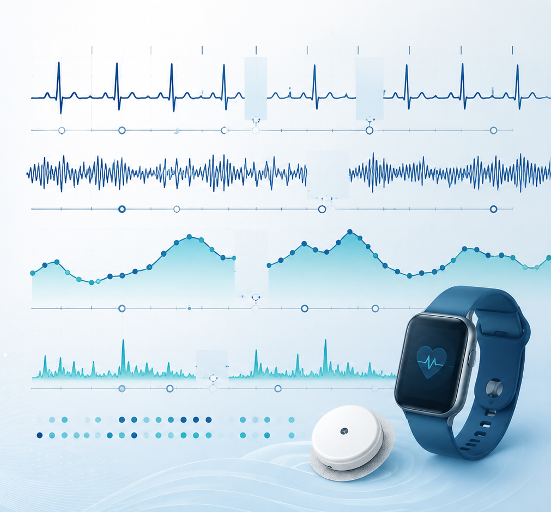
Algorithms and Data Structures
for Medical Informatics
Lesson 15 — Temporal Biomedical Data and Physiological Signals
ECG, EEG, CGM, blood pressure, wearables, timestamps and preprocessing
ITS · Medical Informatics
05 October 2026 · 09:30–11:30
Prof. Simone Rancati, PhD
01

Slide 2
LESSON 15
Lesson structure
1. Why temporal data matter
2. Main physiological signals
3. Time representation
Timestamps, sampling rate and sequences.
Static vs time-dependent biomedical information.
ECG, EEG, CGM, blood pressure and wearables.
4. Common data issues
5. Preprocessing steps
6. Practice
Missing data, noise, irregular sampling.
Resampling, normalization and sliding windows.
Examples, mini-lab and recap.
02

Slide 3

AT THE END OF THE LESSON
Learning objectives
Explain what temporal biomedical data are and why they differ from static data.
Recognize common physiological signals and their main use cases.
Interpret timestamps, sampling frequency and ordered observations.
Describe major issues such as missing data, noise and irregular measurement intervals.
Explain resampling and sliding-window segmentation.
Connect these concepts to biomedical data analysis and machine learning.
03

Slide 4
MOTIVATION
Why temporal data are central in digital health
Many biomedical variables evolve over time rather than remaining fixed.
Clinical interpretation often depends not only on value, but also on trend, rhythm and variability.
A glucose value of 100 mg/dL means something different if it is stable, rising or falling rapidly.
Algorithms for time-dependent data must respect temporal order.
04

Slide 5
STATIC VS TEMPORAL DATA
What changes when time is involved?
Static data
Temporal data
One value or one feature vector per patient.
Examples: sex, genotype, blood type, baseline age.
A sequence of ordered observations.
Examples: ECG waveform, CGM trace, hourly blood pressure, step count.
Key difference
Order matters in temporal data: rearranging the values changes the meaning.
05

Slide 6
CORE CONCEPT
A time series is an ordered sequence of observations
A time series is a collection of measurements indexed by time.
Each observation usually has a timestamp and a value.
Additional channels or variables may be recorded simultaneously.
Time series can be univariate or multivariate.
Example
CGM = [08:00 → 112,
08:05 → 116,
08:10 → 118, ...]
Multivariate example
Wearable = heart rate + steps + sleep + skin temperature
06

Slide 7
TYPES OF BIOMEDICAL TEMPORAL DATA
Common categories
Physiological waveforms
Monitoring streams
Event sequences
ECG, EEG, PPG and respiratory traces.
CGM, blood pressure and oxygen saturation.
Medication administration, alarms and admissions.
Wearable data
Laboratory follow-up
Clinical trajectories
Steps, activity, heart rate and sleep.
Repeated lab measurements over days or months.
Disease course and longitudinal EHR values.
07

Slide 8
SIGNAL EXAMPLE
Electrocardiogram (ECG)
ECG records the electrical activity of the heart over time.
It is typically sampled at high frequency and may contain multiple leads.
Temporal morphology is essential: P wave, QRS complex and T wave.
ECG analysis supports arrhythmia detection, heart-rate estimation and monitoring.
P wave → QRS → T wave
High-frequency waveform
Often multichannel
Clinical rhythm analysis
08

Slide 9
SIGNAL EXAMPLE
Electroencephalogram (EEG)
EEG records electrical activity of the brain from scalp electrodes.
It is highly temporal and often multichannel.
Important applications include seizure detection, sleep analysis and brain-state monitoring.
EEG signals are often noisy and require careful preprocessing.
Many channels
Non-stationary signal
Clinical neuro-monitoring
09

Slide 10
SIGNAL EXAMPLE
Continuous Glucose Monitoring (CGM)
CGM provides repeated glucose measurements, typically every few minutes.
The signal is lower-frequency than ECG or EEG, but still temporal and clinically rich.
Trend, variability and time in range are central concepts.
CGM supports diabetes monitoring, forecasting and decision support.
Typical interval: 5 minutes
Trend matters
Variability matters
Forecasting is common
10

Slide 11
SIGNAL EXAMPLE
Blood pressure and vital-sign monitoring
Blood pressure can be recorded intermittently or continuously.
Vital-sign monitoring may include heart rate, respiratory rate, oxygen saturation and temperature.
In critical care, multiple signals may be acquired simultaneously.
Temporal alignment between channels becomes important.
Intermittent or continuous
Often multivariate
Important in ICU monitoring
11

Slide 12
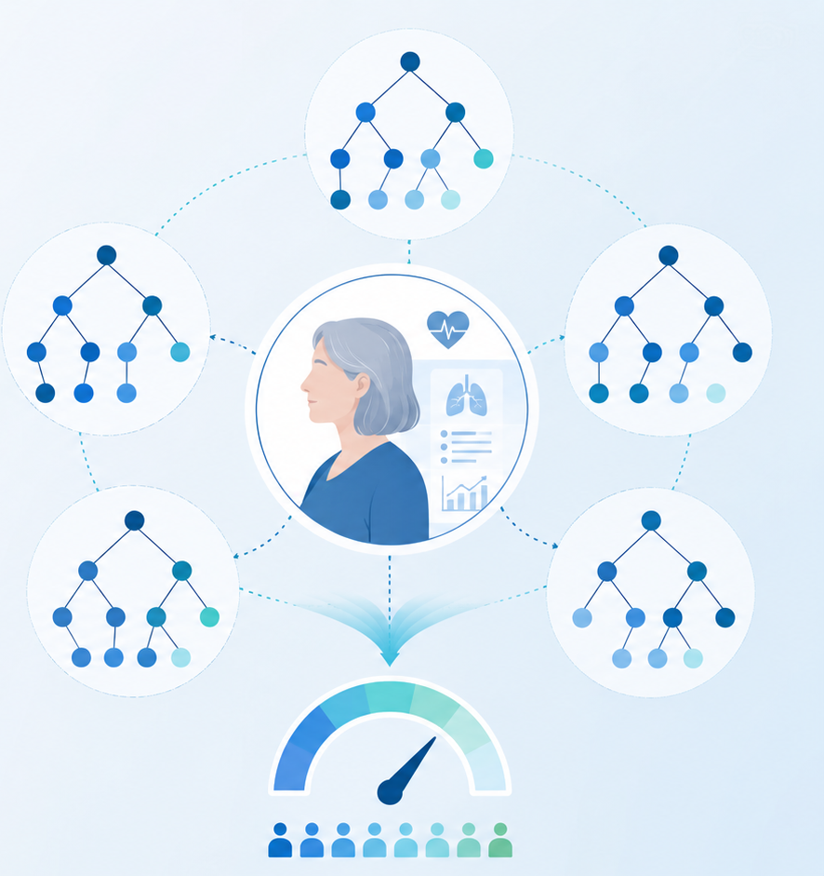
SIGNAL EXAMPLE
Wearable-device data
Wearables generate longitudinal streams such as step count, heart rate, sleep and activity.
These signals are often lower-frequency and more irregular than bedside monitoring.
Wearable data may contain long-term trends, daily cycles and user-behavior effects.
Mobile health and remote monitoring rely heavily on these data.
12

Slide 13
TIME REPRESENTATION
What is a timestamp?
A timestamp indicates when a measurement was acquired.
It may include date, time and sometimes time zone.
Temporal order must be preserved during analysis.
Timestamps allow us to compute intervals, delays and rates.
Example
2026-10-05 09:30:00 → HR = 74 bpm
Why important?
Without time information, the sequence loses meaning.
13

Slide 14
TIME REPRESENTATION
Sampling rate and sampling interval
The sampling rate is how often the signal is acquired.
Equivalent concept: sampling interval = time between consecutive samples.
High-frequency signals such as ECG have short sampling intervals.
Lower-frequency signals such as CGM have longer intervals.
ECG example
250 Hz means 250 samples per second.
CGM example
1 sample every 5 minutes.
14

Slide 15
TIME REPRESENTATION
Regular vs irregular sampling
Regularly sampled
Irregularly sampled
Measurements are collected at fixed intervals.
Example: CGM every 5 minutes.
Intervals change over time.
Example: lab values or wearable data with gaps.
Implication
Irregular sampling complicates direct comparison and model input design.
15

Slide 16
DATA STRUCTURE PERSPECTIVE
How temporal biomedical data are commonly stored
Table with timestamps
Multivariate table
Sequence per patient
timestamp, value, patient_id, device_id
timestamp plus several channels
ordered list or array
Windowed tensor
Event log
Hierarchical format
samples × time × channels
one row per clinical event
patient → visit → sequence
16

Slide 17
COMMON ISSUE
Missing data
Biomedical temporal data often contain missing values.
Causes include sensor dropout, transmission failure, motion artifacts and irregular patient behavior.
Missingness may be isolated, frequent or occur in long gaps.
How we handle missing data can strongly affect downstream analysis.
Sensor dropout
Communication failure
Patient removed device
17

Slide 18
COMMON ISSUE
Noise and artifacts
Signals are often contaminated by noise.
Examples include motion artifacts, electrode displacement and environmental interference.
Noise can distort waveform morphology or create false patterns.
Preprocessing is often required before feature extraction or model training.
Motion artifact
Sensor noise
Baseline drift
18

Slide 19
COMMON ISSUE
Outliers, drift and non-stationarity
Outliers may reflect true acute events or measurement errors.
Signal drift means the baseline changes over time.
Non-stationarity means statistical properties change over time.
Biomedical signals often require local rather than global interpretation.
19

Slide 20
PREPROCESSING
A typical preprocessing pipeline
1. Sort by time
2. Quality check
3. Resample
Ensure temporal order is correct.
Inspect gaps, noise and impossible values.
Map to a common time grid if needed.
4. Handle missingness
5. Normalize
6. Segment
Impute, flag or remove problematic segments.
Scale values when appropriate.
Create windows for analysis or learning.
20

Slide 21
PREPROCESSING
What is resampling?
Resampling means transforming the sequence onto a different time grid.
It is often used to regularize irregular data or harmonize multiple devices.
Downsampling reduces temporal resolution.
Upsampling creates a denser grid and often requires interpolation.
Downsampling
Example: 1 Hz → 1 sample every 10 seconds
Upsampling
Example: irregular measurements → regular 5-minute grid
21

Slide 22
PREPROCESSING
Why resampling may be needed
Some algorithms expect equally spaced time points.
Multiple channels may have different original sampling rates.
Common time grids simplify comparison and integration.
Resampling must be done carefully to avoid distortion.
22

Slide 23
PREPROCESSING
Handling missing data in time series
Deletion
Forward fill
Remove segments or records with too much missingness.
Propagate the last observed value.
Interpolation
Masking
Estimate missing values between observations.
Keep an explicit indicator of missingness.
Model-based imputation
Use a more advanced predictive strategy.
23

Slide 24
PREPROCESSING
Normalization and scaling
Temporal biomedical variables may have very different numeric ranges.
Scaling can make optimization more stable for machine-learning models.
Common strategies include z-score normalization and min-max scaling.
In medical data, interpretability and unit awareness should not be lost.
24

Slide 25
SEGMENTATION
What is a sliding window?
A sliding window extracts short consecutive segments from a longer time series.
Each window contains a fixed number of time points.
Windows can overlap or not overlap.
Sliding windows are common for feature extraction and supervised learning.
Window length
How much history is included?
Stride
How far the window moves each time
25

Slide 26
SEGMENTATION
Why sliding windows are useful
Feature extraction
Prediction
Mean, variability, peaks and derived metrics.
Use past samples to predict future outcomes.
Classification
Standardization
Detect events such as arrhythmias or seizures.
Convert long variable-length streams into uniform samples.
26

Slide 27
WINDOW DESIGN
Important choices in temporal segmentation
Window length: short windows capture local detail; long windows capture broader context.
Stride: smaller stride creates more overlap and more training samples.
Prediction horizon: how far into the future the target refers to.
Labeling strategy: how each window is assigned a class or target.
27

Slide 28
BIOMEDICAL EXAMPLE
ECG windows for arrhythmia detection
A long ECG signal is split into shorter windows.
Each window may be labeled as normal rhythm or abnormal rhythm.
Features or deep-learning models can then analyze each segment.
Window size influences how much rhythm context is visible.
Input
Continuous ECG waveform
Processing
Segment into fixed windows
Output
Window-level rhythm label
28

Slide 29
BIOMEDICAL EXAMPLE
CGM windows for glucose forecasting
Past CGM values can be used as model input windows.
The target may be the glucose value 15, 30 or 60 minutes ahead.
Additional channels such as insulin or meals may be included.
Temporal preprocessing is essential for reliable forecasting.
History window
e.g., past 60 minutes
Prediction target
e.g., glucose in 30 minutes
29

Slide 30
BIOMEDICAL EXAMPLE
Wearable data for activity and health monitoring
Windows of wearable data may support activity recognition, sleep staging or anomaly detection.
Signals may include accelerometry, heart rate and temperature.
Daily cycles and user-specific patterns are often important.
Temporal context improves interpretation compared with isolated measurements.
30

Slide 31
MACHINE-LEARNING PERSPECTIVE
How temporal data differ from tabular data
Tabular view
Temporal view
Rows are often independent samples.
Column order usually does not imply time.
Observations are ordered and often dependent.
Patterns over time are fundamental.
Implication
Temporal models must respect sequence structure and often leverage history.
31

Slide 32
PRACTICAL CAUTIONS
Important challenges in temporal biomedical analysis
Label leakage
Patient variability
Future information must not enter the input window.
Signals differ across individuals and contexts.
Alignment
Data quality
Multiple channels may not be perfectly synchronized.
Artifacts and missingness can bias analysis.
Interpretability
Clinical meaning should remain central.
32

Slide 33
IN-CLASS EXERCISE
Identify the right temporal-data concepts
1. An ECG sampled 250 times per second: what does the sampling rate mean?
2. A CGM device misses data for 30 minutes: what issue is this?
3. A model uses the past 12 glucose measurements to predict the next one: what is the window concept?
4. A wearable records at irregular intervals: what challenge does this introduce?
For each case, name the correct temporal-data concept.
33

Slide 34
MINI-LAB PROMPT
Design a preprocessing workflow for CGM or ECG
Choose one signal: CGM or ECG.
Describe the likely sampling pattern and common data problems.
Propose preprocessing steps in the correct order.
Explain whether resampling and sliding windows are needed.
State one potential modeling task for the processed data.
Deliverable
workflow + rationale
Time
10 minutes
Focus
clear sequence of steps
34

Slide 35
QUICK QUIZ
Self-check questions
What is a timestamp?
What is resampling?
A marker indicating when a measurement was recorded.
Mapping a signal onto a new time grid.
What is a sliding window?
Why is missing data important in biomedical time series?
A fixed-length segment extracted from a longer sequence.
Because it can distort interpretation and model performance.
35

Slide 36
CONCLUSION
Take-home messages
Temporal biomedical data are sequences in which order, timing and dynamics matter.
Common examples include ECG, EEG, CGM, blood-pressure monitoring and wearable signals.
Timestamps, sampling rate and regularity are foundational concepts.
Missingness, noise and irregular sampling are common practical challenges.
Resampling and sliding windows are key preprocessing tools for analysis and machine learning.
36

