Slide 1
Algorithms and Data Structures
for Medical Informatics
LIST
Lesson 7 — Lists, stacks and queues: emergency waiting lists and triage workflows
QUEUE
ITS · Medical Informatics
17 September 2026 · 14:30–16:30
Prof: Simone Rancati, PhD
Contact: simone.rancati01@universitadipavia.it
STACK
01
Notes:
Speaker notes:
Open by connecting the lecture to hospital workflows. Explain that lists, stacks and queues are simple structures, but they are the basis of many real systems: waiting lists, alarms, worklists, undo operations and data streams.

Slide 2
LESSON STRUCTURE
Today’s learning path
1. Lists
Main teaching question
Ordered collections and basic operations.
How do we choose the right linear data structure for a healthcare workflow?
2. Linked organization
Dynamic data and references.
3. Stacks
LIFO behavior and clinical examples.
4. Queues
5. Triage case study
FIFO behavior and waiting lists.
Priority-based queues in emergency care.
02
Notes:
Speaker notes:
Use this slide to frame the lesson. Students should understand that lists, stacks and queues are different ways of organizing linear information.

Slide 3

AT THE END OF THE LESSON
Learning objectives
• Define lists, stacks and queues as linear data structures.
• Explain the difference between LIFO and FIFO behavior.
• Select an appropriate structure for common healthcare workflows.
• Write simple pseudocode using append, insert, remove, push, pop, enqueue and dequeue.
• Explain why emergency triage requires priority rules beyond a simple queue.
03
Notes:
Speaker notes:
Read the objectives slowly. Tell students that the goal is not memorizing names, but understanding when each structure is appropriate.

Slide 4
MOTIVATION
Why linear structures matter in medical informatics
• Many healthcare processes are sequential: patients arrive, measurements are collected, tasks are completed and alerts are generated.
• The order of processing can affect fairness, efficiency and safety.
• Lists, stacks and queues are simple abstractions that appear inside larger software systems.
• A hospital system often combines these structures with databases, user interfaces and rules.
Examples in practice
• Emergency waiting lists
• Laboratory worklists
• Medication administration tasks
• Wearable sensor buffers
04
Notes:
Speaker notes:
Connect the topic to familiar workflows: a waiting room, laboratory worklist, sensor data stream and clinical alerts.

Slide 5
FIRST CONCEPT
Linear data structures
What “linear” means
Biomedical interpretation
• Elements are organized one after another.
• There is usually a first element and a last element.
• We can traverse the structure in sequence.
• Order is part of the meaning of the data.
• Patient arrivals over time.
• Glucose measurements during a day.
• ECG samples captured by a device.
• Tasks waiting for a clinician.
05
Notes:
Speaker notes:
Define linearity using examples from students’ everyday experience before moving to formal operations.

Slide 6
ABSTRACTION
Abstract data type vs implementation
• An abstract data type defines what operations are allowed and what behavior they must have.
• An implementation defines how the structure is actually stored in memory or in a program.
• The same abstract structure can be implemented in different ways.
• We first reason about behavior, then about performance.
Key idea
• Behavior first
• Implementation second
• Performance depends on implementation
06
Notes:
Speaker notes:
This distinction is important. A queue is a behavior: enqueue at the back and dequeue from the front. The implementation may be an array, linked list or database table.

Slide 7
LISTS
What is a list?
A list stores an ordered collection of elements
P001
P014
P032
P041
P055
index: 0 1 2 3 4
• The order of elements is meaningful.
• We can traverse the list from the first element to the last.
• Depending on the implementation, access and insertion costs may differ.
• In healthcare, a list may represent appointments, measurements or tasks.
07
Notes:
Speaker notes:
Introduce a list as an ordered collection. Use the patient IDs as a concrete example.

Slide 8
LIST OPERATIONS
Basic operations on lists
Operation
Meaning
Healthcare example
append(x)
Add x at the end
Add a new appointment to the daily list
insert(i, x)
Add x at position i
Insert an urgent follow-up before another visit
remove(x)
Delete an element
Remove a cancelled exam
get(i)
Access position i
Read the third measurement
traverse
Visit elements in order
Compute mean heart rate from all values
08
Notes:
Speaker notes:
Walk through each operation. Ask students which operations are common in appointment scheduling.

Slide 9
IMPLEMENTATION CHOICE
Array-based list vs linked list
Array-based list
Linked list
• Elements are stored in contiguous positions.
• Fast access by index.
• Insertion in the middle may require shifting elements.
• Useful when random access is frequent.
• Elements are stored as nodes connected by references.
• Efficient insertion when the position is known.
• Accessing the k-th element requires traversal.
• Useful for teaching dynamic organization.
09
Notes:
Speaker notes:
Do not make this too technical. The key is to link implementation to operations: access, insertion and deletion.

Slide 10
BIOMEDICAL EXAMPLE
A patient list as a data structure
• A clinic may maintain a list of patients scheduled for the day.
• The order may represent appointment time, arrival time or priority.
• Adding, removing and reordering patients are data-structure operations.
• The same clinical workflow can be represented in several different ways.
Discussion prompt
• What does “first” mean?
• Arrival order?
• Appointment time?
• Clinical priority?
10
Notes:
Speaker notes:
Use this slide to explain why the meaning of order matters. A list ordered by appointment time is different from a list ordered by urgency.

Slide 11
LINKED ORGANIZATION
A linked list representation
Linked list: each element contains data and a reference to the next element
data: P001
data: P014
data: P032
data: P041
next
next
next
null
• Elements do not need to be stored in consecutive memory locations.
• Insertion can be efficient when we already know the position.
• Random access is slower because we must follow references step by step.
• This structure is useful for understanding dynamic data organization.
11
Notes:
Speaker notes:
Show how nodes are connected. Make sure students understand that the next field is not clinical data; it is structural information.

Slide 12
PSEUDOCODE
Traversing a list of glucose values
Algorithm CountLowValues(glucose_values)
Input: list of glucose values
Output: number of low values
count_low ← 0
FOR each value IN glucose_values DO
IF value < 70 THEN
count_low ← count_low + 1
END IF
END FOR
RETURN count_low
• The algorithm visits every value once.
• The list provides the repeated measurements.
• The variable count_low stores intermediate state.
• This pattern appears in signal processing and dataset analysis.
12
Notes:
Speaker notes:
Trace the algorithm with a short example: [92, 68, 110, 64]. Ask students to update count_low step by step.

Slide 13
INSERTION AND DELETION
What changes when the list changes?
• Adding an element at the end is usually conceptually simple.
• Inserting in the middle requires preserving the intended order.
• Deleting an element requires deciding what happens to the surrounding elements.
• In clinical systems, insert/delete operations should be logged and auditable.
Example
• Cancelled exam
• New urgent visit
• Duplicated record
• Wrong patient removed
13
Notes:
Speaker notes:
Use medical safety as the professional angle. Changing a clinical list is not only a programming action; it may affect workflow and accountability.

Slide 14
EFFICIENCY OVERVIEW
Typical cost of common list operations
Operation
Array-based list
Linked list
Interpretation
Access by index
Fast
Slow
Arrays are good for reading position i
Append at end
Often fast
Fast if tail known
Good for sensor values arriving over time
Insert in middle
May be slow
Can be fast if node known
Depends on whether we must search first
Delete element
May be slow
Can be fast if node known
Real cost includes finding the element
Traverse all
Linear
Linear
Every element must be visited
14
Notes:
Speaker notes:
Keep this slide qualitative. Detailed Big-O has already been introduced, but here the focus is operational intuition.

Slide 15
COMMON MISCONCEPTION
Lists are not always the right structure
• A list is flexible, but flexibility does not automatically mean optimal design.
• If we always process the newest item first, we need stack behavior.
• If we always process the oldest item first, we need queue behavior.
• If we process the most urgent item first, we need priority behavior.
Design principle
• Choose the structure that matches the workflow rule.
15
Notes:
Speaker notes:
This slide prepares the transition to stacks and queues. Emphasize behavior, not vocabulary.

Slide 16
STACKS
The stack abstraction
Stack: Last In, First Out (LIFO)
• Only the top element is directly accessible.
• The most recent item is processed first.
• Stacks are useful for reversible or nested operations.
POP returns
the top item
Newest action
ECG review
Lab review
PUSH adds
a new top item
Medication check
Oldest task
16
Notes:
Speaker notes:
Introduce stack behavior using LIFO. Make sure students can explain why the top element is special.

Slide 17
STACK OPERATIONS
Stack operations and behavior
Operation
Meaning
Result
push(x)
Add x to the top
x becomes the next item to remove
pop()
Remove and return the top item
The most recent item is processed first
peek()
Read the top item without removing it
Useful before deciding what to do
is_empty()
Check whether the stack has no elements
Prevents invalid pop operations
17
Notes:
Speaker notes:
Explain that stack operations are intentionally restricted. That restriction makes behavior predictable.

Slide 18
STACK EXAMPLES
Where stacks appear in healthcare software
• Undo history in a clinical annotation tool: the most recent action is undone first.
• Nested clinical forms: the most recently opened form may be closed first.
• Backtracking in rule-based decision pathways.
• Parsing structured health messages or configuration files.
Important warning
• A stack is usually not fair for patient waiting lists.
18
Notes:
Speaker notes:
Give a simple example: if a clinician changes three annotations, the undo stack should reverse the last change first.

Slide 19
PSEUDOCODE
Stack example: undo last annotation
Algorithm UndoLastAnnotation(stack)
Input: stack of previous actions
Output: restored previous state
IF stack.is_empty() THEN
RETURN "nothing_to_undo"
END IF
last_action ← stack.pop()
restore_state_before(last_action)
RETURN "undo_completed"
• The algorithm must check whether the stack is empty.
• The last action is the first action reversed.
• This is LIFO behavior.
• The same idea appears in many user interfaces.
19
Notes:
Speaker notes:
Emphasize the empty-stack case. It is a simple but important edge case.

Slide 20
STACK LIMITATIONS
Why a stack is not a waiting room
• If patients are stored in a stack, the last patient to arrive would be the first served.
• That behavior is usually inappropriate for a standard waiting list.
• Stacks are useful when recency is the correct rule.
• Healthcare workflows often require FIFO or priority-based behavior instead.
Check understanding
• LIFO = newest first
• FIFO = oldest first
20
Notes:
Speaker notes:
Use a small thought experiment: three patients arrive at 9:00, 9:05 and 9:10. A stack serves 9:10 first. Ask whether that is acceptable.

Slide 21
QUEUES
The queue abstraction
Queue: First In, First Out (FIFO)
P1
P2
P3
P4
P5
ENQUEUE
new arrival
DEQUEUE
served first
• The first patient who entered the queue is the first to leave it.
• Queues are natural for waiting lists, scheduled tasks and buffered messages.
• Real emergency care often needs priority rules, not only FIFO.
21
Notes:
Speaker notes:
Introduce queue behavior with FIFO. Make sure students can identify front and back of the queue.

Slide 22
QUEUE OPERATIONS
Queue operations and behavior
Operation
Meaning
Healthcare example
enqueue(x)
Add x at the back
New patient joins a waiting list
dequeue()
Remove and return the front item
Next patient is called
front()
Read the next item without removing it
Check who will be served next
is_empty()
Check if the queue has no elements
Avoid calling a missing patient
22
Notes:
Speaker notes:
Use the waiting list example throughout the table. This makes FIFO intuitive.

Slide 23
QUEUE EXAMPLES
Where queues appear in health systems
• Patient waiting lists in outpatient clinics.
• Laboratory samples waiting for analysis.
• Messages waiting to be processed by an integration engine.
• Device measurements buffered before storage.
• Clinical alerts waiting for review by a team.
Key idea
• A queue represents controlled waiting.
23
Notes:
Speaker notes:
Make students see queues beyond the hospital waiting room. Queues are also present in data pipelines and interoperability systems.

Slide 24
PSEUDOCODE
Queue example: call next patient
Algorithm CallNextPatient(waiting_queue)
Input: queue of waiting patients
Output: selected patient or message
IF waiting_queue.is_empty() THEN
RETURN "no_patient_waiting"
END IF
patient ← waiting_queue.dequeue()
RETURN patient
• The first patient in the queue is selected.
• The selected patient is removed from the queue.
• The algorithm must handle an empty queue.
• The logic is simple because FIFO behavior is well defined.
24
Notes:
Speaker notes:
Trace this with a queue containing P001, P014 and P032. Ask which patient is returned first.

Slide 25
CASE STUDY
Emergency Department waiting list and triage
Arrival
Triage
Queue
Care
vital signs + symptoms
assign priority
wait by priority
clinical evaluation
High priority: immediate
Medium priority: soon
Low priority: standard
A triage system is not a simple FIFO queue. It is a queue combined with priority rules.
25
Notes:
Speaker notes:
Explain the difference between administrative order and clinical priority. The triage case will be the main applied example.

Slide 26
FIFO VS PRIORITY
When a simple queue is not enough
Simple FIFO queue
Priority-based queue
• Serves patients in arrival order.
• Easy to understand and implement.
• Fair when all items have similar urgency.
• Not appropriate when urgency differs strongly.
• Serves higher-priority patients first.
• Patients with equal priority may follow FIFO order.
• Requires a priority score or category.
• Better matches triage logic.
26
Notes:
Speaker notes:
This slide is important for medical informatics. Queue behavior must match clinical rules, not only computer convenience.

Slide 27
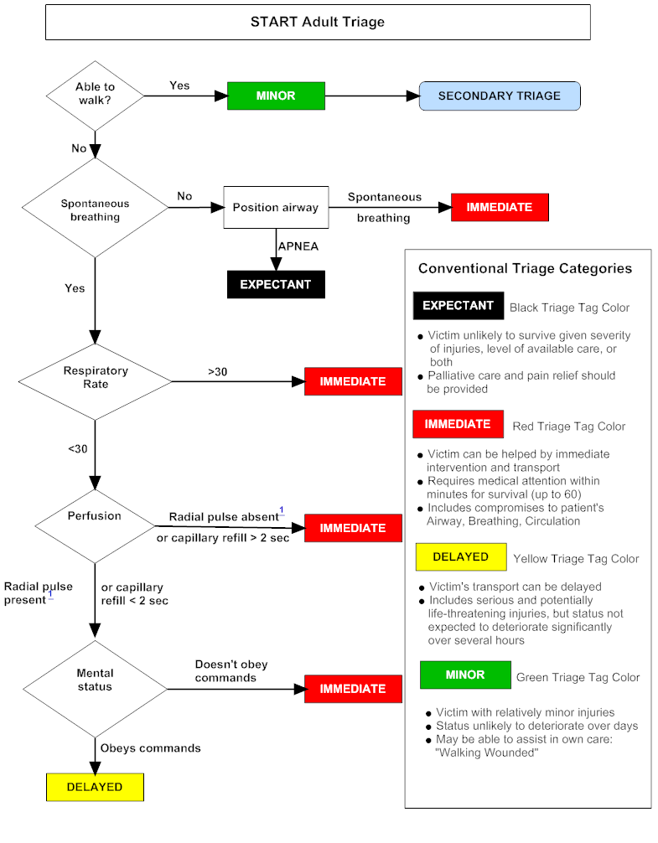
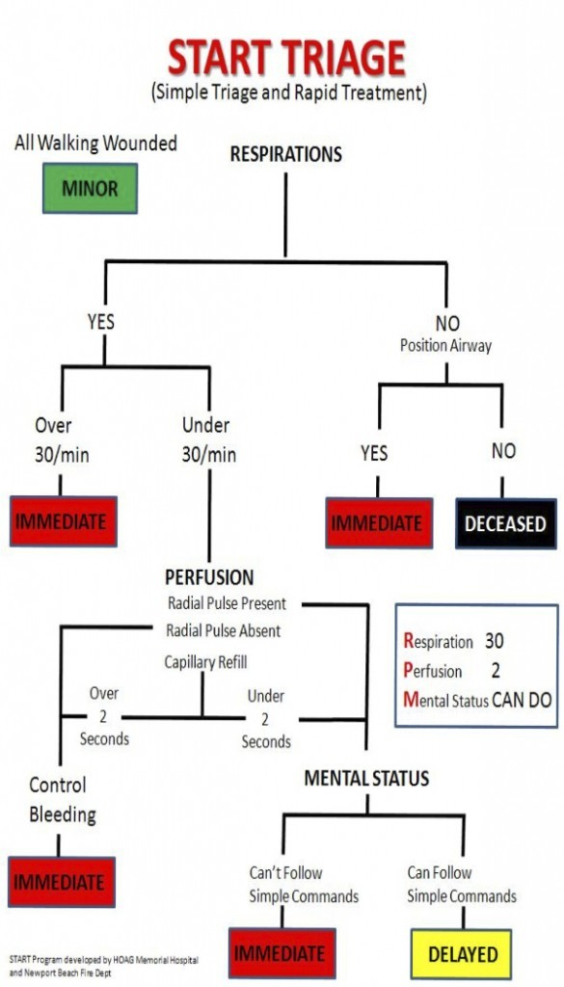
TRIAGE ALGORITHM
From patient data to a priority queue
27
Notes:
Speaker notes:
Use this visible flowchart to explain how conditions determine priority and then determine queue position.

Slide 28
PRIORITY QUEUE
Implementation options for priority-based processing
Implementation
Insertion
Removing highest priority
When it may be used
Unsorted list
Simple
Search required
Small educational examples
Sorted list
Insert in right position
Front is ready
Moderate lists, easy to inspect
Heap
Efficient priority operations
Efficient
Large-scale systems
Database query
Depends on index
Depends on query/order
Real hospital applications
28
Notes:
Speaker notes:
Keep heap introduction brief. The full tree/heap topic can be connected to the previous or next lessons.

Slide 29
CLINICAL DESIGN
Queue rules must be explicit
• What information determines priority?
• How are ties handled within the same priority level?
• Can a patient move to a higher priority while waiting?
• Who is allowed to modify the priority?
• What must be logged for accountability?
Tie-breaking example
• Priority first
• Arrival time second
• Clinical reassessment can update position
29
Notes:
Speaker notes:
This slide adds professional discipline. A data structure is not enough; the organization must also define the rule and governance.

Slide 30
VARIANTS
Deque and circular buffer
• A deque allows insertion and removal at both ends.
• A circular buffer reuses a fixed-size memory area for streaming data.
• Wearable sensors often need buffers because data arrive continuously.
• These variants show how linear structures adapt to practical constraints.
Biomedical example
• Keep the last N ECG samples
• Store recent glucose readings
• Process streaming sensor packets
30
Notes:
Speaker notes:
Use circular buffer as a bridge to time-series signals: a device may keep only the most recent measurements.

Slide 31
COMMON ERRORS
Typical mistakes and how to prevent them
Mistake
Why it matters
Prevention
Pop from empty stack
No valid item exists
Check is_empty() first
Dequeue from empty queue
No patient/task to process
Return a safe message
Wrong order rule
Workflow becomes unfair or unsafe
Define FIFO, LIFO or priority explicitly
Ignoring ties
Same-priority cases become inconsistent
Specify tie-breaking rule
No audit trail
Clinical changes cannot be reviewed
Log insertion, removal and priority changes
31
Notes:
Speaker notes:
Use these errors as a checklist for robust algorithm design in healthcare.

Slide 32
COMBINED EXAMPLE
Priority insertion using simple rules
Algorithm AddPatient(patient, queue)
Input: patient record and priority queue
Output: updated queue
priority ← compute_priority(patient)
patient.priority ← priority
Insert patient after all patients
with higher priority and after
patients with the same priority
who arrived earlier
RETURN queue
• This is a simplified priority queue algorithm.
• Higher priority is considered before arrival time.
• Arrival time is used to break ties.
• The rule must be documented and testable.
32
Notes:
Speaker notes:
Explain that this is not optimized code. It is a clear specification of the intended behavior.

Slide 33
CLASSROOM ACTIVITY
Design the Emergency Department data structure
• You receive five patients with arrival time, symptoms and vital signs.
• Assign each patient to high, medium or low priority using explicit rules.
• Choose whether to use a list, stack, queue or priority queue.
• Write pseudocode for adding a new patient.
• Explain how ties are handled.
Suggested timing
• 8 minutes group work
• 5 minutes discussion
• 2 minutes synthesis
33
Notes:
Speaker notes:
Run this activity in pairs or small groups. The output should be pseudocode and a short explanation, not a full program.

Slide 34
MINI-LAB PROMPT
Implement or simulate a waiting list
• Create a small list of patient records.
• Add at least one new patient.
• Remove the next patient to be served.
• Compare what changes when the structure is a queue instead of a stack.
• Extend the solution with a simple priority field.
Assessment criteria
• Correct operations
• Clear rule
• Edge cases handled
• Biomedical interpretation
34
Notes:
Speaker notes:
This can be assigned as homework or completed in class using pseudocode or Python-like code.

Slide 35

LESSON SYNTHESIS
Key takeaways
• Lists store ordered collections and support flexible traversal and modification.
• Stacks use LIFO behavior: the most recent item is processed first.
• Queues use FIFO behavior: the earliest item is processed first.
• Emergency triage usually requires priority-based processing, not a simple FIFO queue.
• In medical informatics, choosing a data structure is also choosing a workflow rule.
35
Notes:
Speaker notes:
Close by returning to the main question: how do we choose the right structure for a healthcare workflow?

Slide 36
NEXT LESSON
Looking ahead
• We will move from linear structures to hierarchical structures.
• Trees help represent decisions, priorities, taxonomies and search spaces.
• Heaps provide an efficient way to implement priority queues.
• The Emergency Department triage example will connect naturally to priority queues and heaps.
36
Notes:
Speaker notes:
Prepare students for the next topic. Emphasize continuity: queues lead naturally to priority queues, and priority queues lead to heaps.

