Slide 1



Algorithms and Data Structures
for Medical Informatics
Lesson 3 — Algorithm efficiency, memory usage and computational complexity
ITS · Medical Informatics
15 September 2026 · 09:30–11:30
Prof: Simone Rancati, PhD
Contact: simone.rancati01@universitadipavia.it
Notes:
Open by explaining that the previous lessons introduced algorithms as precise procedures. This lesson introduces a second question: not only does an algorithm work, but how well does it scale when healthcare data grow?

Slide 2
LESSON STRUCTURE
Today’s learning path
1. Efficiency
2. Big-O notation
3. Main classes
4. Biomedical scale
Time and memory as resources.
How we describe growth.
O(1), O(log n), O(n), O(n²).
From patients to CGM time series.
By the end of the lesson, students should be able to estimate how an algorithm behaves as input size grows and explain why complexity matters in real medical informatics systems.
Main teaching question
Why does the same algorithm feel “instant” on 100 patients and unusable on millions of measurements?
02
Notes:
Use this slide as the contract for the two-hour session. Emphasize that complexity is not an abstract mathematical topic: it is about making systems usable at clinical scale.

Slide 3

AT THE END OF THE LESSON
Learning objectives
• Explain efficiency in terms of time and memory consumption.
• Distinguish exact running time from asymptotic growth.
• Interpret Big-O notation as a description of scalability.
• Recognize common complexity classes: O(1), O(log n), O(n) and O(n²).
• Estimate the complexity of simple biomedical algorithms.
• Connect algorithmic choices to clinical datasets such as patient registries and CGM signals.
03
Notes:
Read the objectives slowly. Ask students to keep the word “scale” in mind throughout the lesson.

Slide 4

MOTIVATION
Why efficiency matters in medical informatics
• Hospitals process data continuously: admissions, laboratory tests, prescriptions, medical images and device streams.
• A correct algorithm may still be unusable if it is too slow or consumes too much memory.
• A method that works for one patient may fail when applied to an entire hospital or regional database.
• Understanding complexity helps us choose appropriate data structures and algorithms before implementation.
Efficiency is not only about speed. It affects usability, cost, energy consumption, latency and sometimes patient safety.
04
Notes:
Give practical examples: opening a patient record, computing daily glucose metrics, sorting a waiting list.

Slide 5
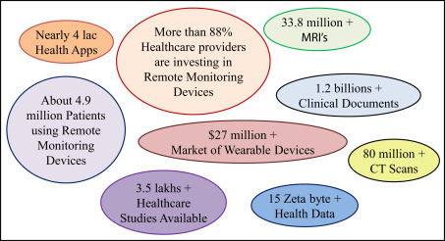
CLINICAL DATA AT SCALE
From 100 patients to millions of CGM values
Scenario | Approximate input size | What the algorithm must do
Small classroom example | 100 patient records | Search, filter or compute a simple statistic.
Clinic registry | 10,000 patient records | Repeated queries and reporting.
CGM for one patient | ≈ 288 values/day at 5-minute sampling | Scan, summarize and detect events.
CGM for 1,000 patients/month | Millions of values | Efficient storage, processing and validation.
A linear scan over 100 values is trivial. A repeated linear scan over millions of values may become a bottleneck.
05
Notes:
Use the CGM example because it is intuitive: measurements every few minutes produce large volumes quickly.

Slide 6
CORE CONCEPT
What does “efficient” mean?
An algorithm is efficient when it solves the intended problem using a reasonable amount of computational resources.
Time efficiency
Memory efficiency
Scalability
How the number of operations grows when the input becomes larger.
How much storage the algorithm needs during execution.
Whether the algorithm remains usable when data volume increases.
Important distinction
We are not usually interested in the exact number of milliseconds on one computer. We are interested in how the required work grows as the input size n grows.
06
Notes:
Make clear that efficiency is relative to input size and context. A slower but more clinically interpretable algorithm may still be preferred in some settings.

Slide 7
RESOURCE 1
Time complexity
Time complexity describes how the number of elementary operations grows as a function of input size n.
Input size n
Elementary operation
Growth pattern
Number of values, records, pixels, samples or nodes processed by the algorithm.
A basic step such as comparison, assignment, arithmetic or lookup.
The key question is whether operations grow slowly or rapidly as n increases.
FOR each glucose value IN patient_cgm:
IF glucose < 70:
count = count + 1
If the list has n glucose values, this algorithm checks each value once → O(n).
07
Notes:
Introduce n as a variable representing input size. Keep it concrete: number of CGM samples, patients, images.

Slide 8
RESOURCE 2
Memory complexity
• Memory complexity describes how much additional storage an algorithm needs as input size grows.
• Some algorithms process data in-place and require very little extra memory.
• Other algorithms create copies, temporary arrays, matrices or model representations.
• In medical informatics, memory becomes important for images, waveforms and longitudinal records.
Data type | Typical representation | Memory concern
CGM signal | Array of timestamp-value pairs | Long duration and many patients.
ECG waveform | High-frequency time series | Many samples per second.
MRI/CT volume | 3D tensor | Large multidimensional arrays.
Patient registry | Table or database | Many rows and fields.
A fast algorithm can still fail if it does not fit in memory.
08
Notes:
Mention that memory is also related to hardware costs and deployment constraints.

Slide 9
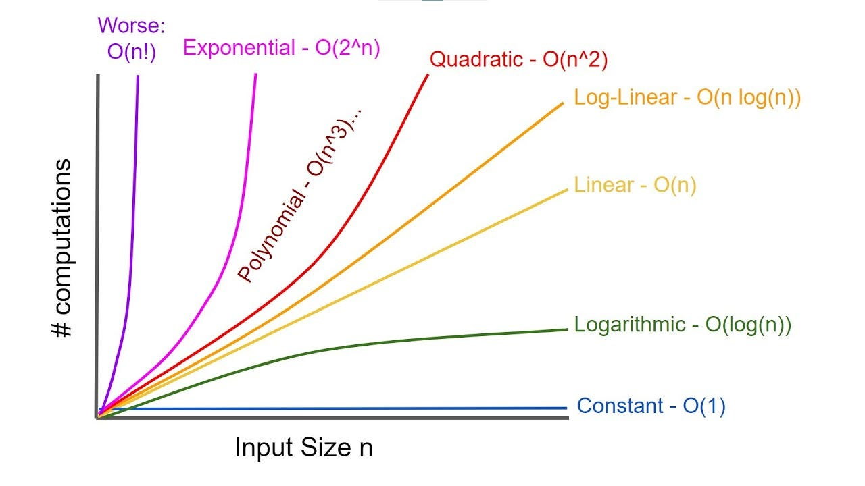
ASYMPTOTIC THINKING
Big-O notation: the main idea
Big-O notation describes an upper-bound growth trend: how the required work increases when the input becomes large.
It ignores constants
10n and 100n are both O(n): both grow linearly.
It focuses on large n
Big-O is mainly about what happens when data volume becomes large.
It supports comparison
It helps us compare algorithm families independently of a specific machine.
09
Notes:
Use the chart to show that differences become dramatic at scale. Avoid too much mathematical detail in this introductory lesson.

Slide 10
BIG-O INTERPRETATION
Exact runtime is not the same as complexity
Question | Exact runtime answer | Complexity answer
How long did it take today? | 0.3 seconds on this laptop | Not enough information about scalability.
How does it grow with more data? | Need multiple measurements | O(1), O(log n), O(n), O(n²), ...
What if hardware changes? | Time may change | Growth class usually remains informative.
What if data grow 100x? | Runtime may become too high | Complexity predicts risk.
Big-O does not predict the exact clock time. It predicts how the work scales.
For healthcare systems, the scaling trend often matters more than a single benchmark.
10
Notes:
Students often confuse runtime and complexity. Give the example of a fast laptop versus an old workstation: exact time changes, growth pattern remains.

Slide 11
COMPLEXITY CLASS
O(1): constant time
An operation is O(1) when its running time does not depend on the number of items in the input.
Example
Healthcare example
Why useful
Read the latest heart rate value from a variable.
Retrieve the value stored in latest_glucose.
Constant-time access is essential for real-time alerts.
IF latest_glucose < 70:
alert = true
The algorithm performs a fixed number of operations whether the hospital has 100 or 1,000,000 other records.
11
Notes:
Clarify that O(1) does not mean zero time. It means the time is bounded by a constant with respect to n.

Slide 12
COMPLEXITY CLASS
O(n): linear time
An algorithm is O(n) when the required work grows proportionally to the number of input items.
count_low = 0
FOR value IN glucose_values:
IF value < 70:
count_low = count_low + 1
RETURN count_low
If the list has n measurements, the loop visits n measurements → O(n).
Biomedical examples
• Scan all CGM values for hypoglycemia.
• Compute mean heart rate.
• Filter all patients older than 65.
12
Notes:
Linear algorithms are often acceptable if data are processed once. The problem appears when linear scans are repeated many times unnecessarily.

Slide 13
COMPLEXITY CLASS
O(log n): logarithmic time
An algorithm is O(log n) when each step reduces the remaining search space by a constant fraction, often by half.
Typical example
Clinical example
Key idea
Binary search in a sorted list.
Find a time interval in a sorted list of timestamped measurements.
Do not inspect every item; discard many candidates at once.
Number of items | Approximate binary-search steps
1,000 | ≈ 10
1,000,000 | ≈ 20
1,000,000,000 | ≈ 30
Logarithmic growth is very slow. This is why sorted data and indexes are powerful.
13
Notes:
Emphasize that O(log n) usually requires structure: sorted arrays, trees or indexes. It is not automatic.

Slide 14
COMPLEXITY CLASS
O(n²): quadratic time
An algorithm is O(n²) when the amount of work grows roughly with the square of the input size.
n patients | Pairwise comparisons n²
100 | 10,000
1,000 | 1,000,000
10,000 | 100,000,000
FOR each patient_a IN patients:
FOR each patient_b IN patients:
compare(patient_a, patient_b)
A nested loop over the same dataset often produces quadratic behavior.
Quadratic algorithms can become impractical very quickly in cohort analysis and similarity search.
14
Notes:
Give examples: comparing every patient to every other patient, computing all pairwise similarities.

Slide 15
GROWTH RATES
Comparing the main complexity classes
Input size n | O(1) | O(log n) | O(n) | O(n²)
10 | 1 | ≈3 | 10 | 100
1,000 | 1 | ≈10 | 1,000 | 1,000,000
1,000,000 | 1 | ≈20 | 1,000,000 | 10¹²
Complexity classes are about growth, not about clinical importance or model quality.
Rule of thumb: when n becomes large, the growth class dominates constant details.
15
Notes:
Use this as the key Big-O synthesis slide. Walk through the table slowly.

Slide 16
DATA STRUCTURES CONNECTION
Typical operations and their cost
Operation | Naive structure | Improved structure | Typical complexity
Get latest measurement | Variable/list end | Variable/list end | O(1)
Find patient by ID | Unsorted list | Dictionary/hash table | O(n) → O(1) average
Find value in sorted sequence | Linear scan | Binary search | O(n) → O(log n)
Compare all patient pairs | Nested loops | Indexing/approximate methods | O(n²) may be reduced
Process all signal samples | List/array | Streaming/windowed processing | O(n), with lower memory
The same problem can have very different complexity depending on how the data are stored.
16
Notes:
This slide prepares students for the upcoming lessons on arrays, dictionaries, trees and graphs.

Slide 17
BIOMEDICAL CASE STUDY
Continuous Glucose Monitoring data scale
A CGM sensor often generates one measurement every few minutes. Over weeks or months, a single patient becomes a non-trivial time series.
Time horizon | 5-minute samples | Algorithmic implication
1 day | ≈288 values | Easy to scan once.
14 days | ≈4,032 values | Windowing and summaries become useful.
90 days | ≈25,920 values | Memory and preprocessing matter.
1,000 patients × 90 days | ≈25.9 million values | Scalable pipelines are required.
The algorithmic question changes from “can I compute it?” to “can I compute it repeatedly, reliably and at scale?”
17
Notes:
Use this slide to connect complexity to a familiar biomedical signal.

Slide 18
WORKED EXAMPLE
Counting hypoglycemic measurements
Algorithm CountLowGlucose(values)
Input: list of glucose values
Output: number of values below 70 mg/dL
count = 0
FOR each value IN values:
IF value < 70:
count = count + 1
RETURN count
Correctness
Returns the number of values satisfying the low-glucose condition.
Time complexity
Each value is inspected exactly once → O(n).
Memory complexity
Only one counter is stored → O(1) additional memory.
This is a good algorithm: simple, transparent, linear and memory-light.
18
Notes:
Make students distinguish time complexity O(n) from additional memory complexity O(1).

Slide 19
DATA STRUCTURE CHOICE
Patient lookup: list vs dictionary
Task: retrieve a patient record from a patient identifier.
Unsorted list
Dictionary / hash table
Search patient IDs one by one until the correct record is found. Worst case: inspect all records → O(n).
Use patient_id as a key and directly retrieve the associated record. Average case: O(1).
patients_list = [record1, record2, record3, ...]
# linear search
patients_by_id = {"P001": record1, "P002": record2}
# direct lookup by key
In medical systems, fast lookup is essential because patient records are accessed repeatedly.
19
Notes:
This slide connects directly to hash tables in later lessons.

Slide 20

PRACTICAL CONTEXT
Sorting and prioritization in healthcare
• Sorting organizes data according to a rule: time, severity, risk score, admission date or laboratory value.
• Naive sorting algorithms may be simple to understand but inefficient for large datasets.
• Priority queues can support triage-like workflows where the next item is selected by urgency, not arrival order.
• Algorithmic efficiency matters when the queue is updated continuously.
A triage system should not repeatedly re-sort everything if only one new patient arrives.
20
Notes:
Avoid going deep into priority queues here; use it as motivation for later data structures.

Slide 21
COMMON PITFALL
Nested loops and pairwise comparisons
n | n² comparisons | Interpretation
100 | 10,000 | Usually manageable
5,000 | 25,000,000 | May require optimization
100,000 | 10,000,000,000 | Often infeasible without a new strategy
FOR each patient_a IN patients:
FOR each patient_b IN patients:
similarity = compare(patient_a, patient_b)
store(similarity)
This pattern is common in biomedical analytics: clustering, similarity search, duplicate detection or cohort matching.
Before coding nested loops, ask: do we really need every pair?
21
Notes:
This is one of the most important practical slides. Students will often write nested loops instinctively.

Slide 22

MEMORY AT SCALE
Large biomedical objects require different thinking
Object | Why memory grows | Typical strategy
Longitudinal records | Many repeated measurements per patient | Process by windows or streams.
Medical images | Millions of pixels or voxels | Use batches, compression or tiling.
Pairwise matrix | n × n similarities | Avoid materializing full matrix when possible.
Deep learning tensors | Large intermediate activations | Control batch size and precision.
Memory complexity becomes visible when the algorithm creates new data structures proportional to n or n².
Professional habit: estimate memory before running large biomedical pipelines.
22
Notes:
Mention that running out of memory is common in biomedical imaging and large tabular datasets.

Slide 23
COMBINED DESIGN
Algorithms and data structures work together
The complexity of a solution depends on both the procedure and the representation of data.
Problem
Data structure
Algorithm
Find a patient record quickly.
Dictionary keyed by patient ID.
Lookup by key and return record.
Changing the data structure can change the complexity without changing the clinical task.
This is why the course studies algorithms and data structures together.
23
Notes:
This slide states the course philosophy explicitly.

Slide 24
CASE STUDY
Daily report over a hospital registry
Task: every morning, compute how many patients had at least one abnormal glucose value during the previous day.
Naive strategy
Better strategy
Scalable strategy
For every report request, scan all historical values for every patient.
Process only yesterday’s data and update a summary table.
Precompute daily features during data ingestion.
Design choice | Likely effect
Repeated full scan | Slow as history grows.
Daily summaries | Faster reports and lower memory load.
Incremental update | Suitable for routine operations.
24
Notes:
Emphasize that many production systems rely on precomputed summaries and indexes rather than repeated raw scans.

Slide 25
TWO DIFFERENT QUESTIONS
Correctness and efficiency
Correctness
Efficiency
Does the algorithm return the expected output for every valid input?
Example: are glucose values classified according to the stated thresholds?
How many resources does it use as input size grows?
Example: can it process millions of CGM values in a reasonable time?
A correct algorithm can be inefficient. An efficient algorithm can be clinically wrong if the specification is wrong.
In professional medical informatics, we need both.
25
Notes:
This reinforces lesson 1 and adds the new dimension of scalability.

Slide 26
METHOD
How to estimate complexity from pseudocode
Pattern in pseudocode | Typical complexity | Explanation
Fixed number of operations | O(1) | Does not depend on input size.
One loop over n items | O(n) | Each item is visited once.
Binary search or repeated halving | O(log n) | Remaining search space shrinks rapidly.
Nested loop over same n items | O(n²) | For each item, many other items are processed.
Creating a list of n results | O(n) memory | Additional storage grows with input size.
Step 1: identify input size n. Step 2: count how many times the main work is repeated.
26
Notes:
This slide gives students a practical heuristic. It is not a proof method, but it is useful at this level.

Slide 27
CLASSROOM EXERCISE
Identify the complexity class
For each task, estimate the time complexity and explain your reasoning.
Task | Input size n | Likely complexity
Read latest glucose value | Number of stored values | ?
Scan all CGM values to compute maximum | Number of values | ?
Binary search a sorted timestamp list | Number of timestamps | ?
Compare every patient with every other patient | Number of patients | ?
Find patient by ID in a dictionary | Number of patients | ?
5 minutes individual work + 5 minutes discussion in pairs.
Do not just write the answer. Write the reason.
27
Notes:
Let students reason before showing answers. Ask them to justify n.

Slide 28
CLASSROOM EXERCISE
Suggested answers and reasoning
Task | Complexity | Reason
Read latest glucose value | O(1) | Fixed direct access to one stored value.
Scan all CGM values | O(n) | Each value must be inspected once.
Binary search timestamps | O(log n) | Each step halves the search range.
Compare all patient pairs | O(n²) | Nested comparisons among patients.
Lookup by dictionary key | O(1) average | Hash table maps key directly to record.
When giving complexity, always define what n represents.
28
Notes:
Stress that “n” is not always the number of patients: it may be values, pixels, timestamps or nodes.

Slide 29
MINI-LAB
Count abnormal CGM readings
Design pseudocode for the following task:
Input: a list of glucose values for one patient.
Output: count_low, count_high and total_abnormal.
• Low: value < 70 mg/dL.
• High: value > 180 mg/dL.
• Use one loop if possible.
• State the time complexity and memory complexity.
• Add one sentence about missing values.
Expected design: one pass over the list → O(n) time, O(1) additional memory.
29
Notes:
This can be used as a paper exercise or in Python if students are ready.

Slide 30
MINI-LAB
Optimize patient lookup
A hospital stores patient records. The system must frequently retrieve records by patient ID.
Version A
Version B
Store all records in a list and scan the list every time an ID is requested.
Store records in a dictionary using patient ID as key.
• Which version scales better?
• What is the expected time complexity of each lookup?
• What extra structure must be maintained?
• Why can this matter in a hospital information system?
30
Notes:
This is a discussion activity designed to connect complexity with data-structure choice.

Slide 31
COMMON MISCONCEPTIONS
What Big-O does and does not say
Misconception | Correction
O(1) means instant. | It means constant with respect to n, not zero time.
O(n) is always bad. | Linear scans are often acceptable and sometimes necessary.
Big-O gives exact runtime. | It describes growth, not clock time.
Only programmers need complexity. | Anyone designing data pipelines or clinical algorithms needs scalability reasoning.
More complex algorithms are always better. | Simplicity, transparency and context also matter.
Complexity is a decision-support tool for engineering, not a replacement for domain reasoning.
31
Notes:
Use this slide to prevent over-simplified thinking.

Slide 32

PROFESSIONAL PRACTICE
Algorithmic habits for healthcare data
• Define the input size n before estimating complexity.
• Separate correctness testing from efficiency evaluation.
• Test algorithms on small examples, boundary cases and realistic dataset sizes.
• Prefer transparent solutions unless there is a clear reason for more complex designs.
• Choose data structures that match the most frequent operations.
• Document assumptions, units and missing-data handling.
In medical informatics, scalability and reliability are part of responsible system design.
32
Notes:
This slide translates the technical content into professional behavior for ITS students.

Slide 33
LESSON SYNTHESIS
Key takeaways
• Efficiency concerns the resources required by an algorithm, mainly time and memory.
• Big-O notation describes how resource usage grows as input size n becomes large.
• O(1), O(log n), O(n) and O(n²) represent very different scalability profiles.
• The same biomedical task can have different complexity depending on the chosen data structure.
• CGM, ECG, imaging and hospital records make scalability a practical concern, not a theoretical detail.
• A useful medical informatics algorithm should be correct, transparent and scalable enough for its intended context.
The central lesson: always ask how the algorithm behaves when the data grow.
33
Notes:
Use this slide to recap and to ask students for one example of each complexity class.

Slide 34
NEXT STEP
Preparation for the next lesson
In the next lesson, we will study arrays, vectors, matrices and strings: the data structures used to represent signals, tables, images and biological sequences.
Before next class
Short exercise
Reflection question
Review the meaning of input size n and Big-O notation.
Find one healthcare example of O(1), O(n) and O(n²).
Which data structure would you use for repeated CGM measurements?
End of Lesson 3
34
Notes:
Close by linking complexity to the next structural topic: arrays and matrices.

