Slide 1
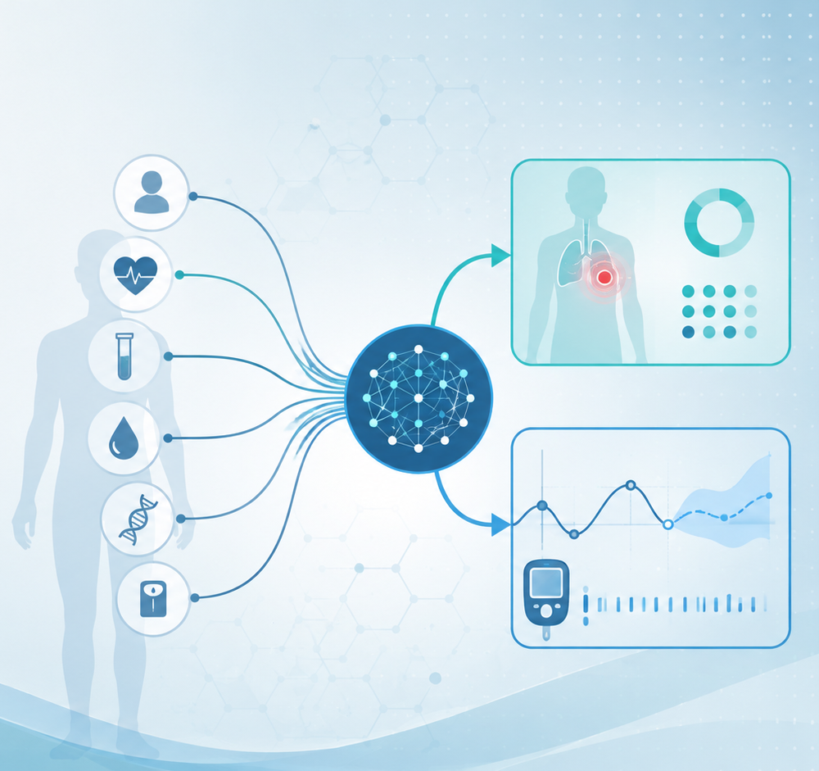
Algorithms and Data Structures
for Medical Informatics
Lesson 17 — Introduction to Machine Learning
as an Algorithm
Datasets, samples, features, targets, training, models and inference
ITS · Medical Informatics
08 October 2026 · 14:30–16:30
Prof. Simone Rancati, PhD
01

Slide 2
LESSON 17
Lesson structure
1. What ML changes
2. Dataset vocabulary
3. Training process
From explicit rules to learning patterns from data.
Sample, feature, target and label.
How the model learns from examples.
4. Inference process
5. Biomedical examples
6. Practice
How trained models produce predictions.
Diagnosis, prognosis and forecasting.
Mini-lab, quiz and recap.
02

Slide 3
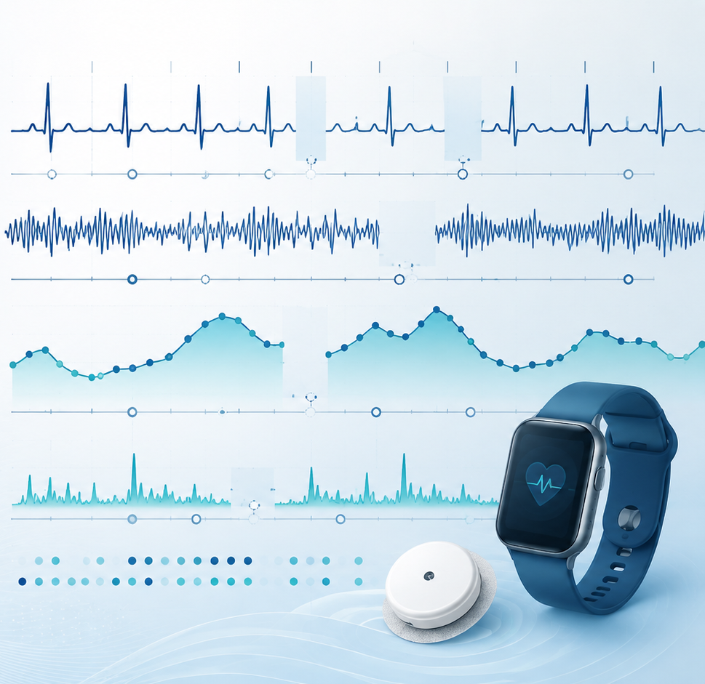
AT THE END OF THE LESSON
Learning objectives
Explain why machine learning can be viewed as an algorithmic approach.
Distinguish dataset, sample, feature, target and label.
Describe the difference between training and inference.
Explain what a model learns during training.
Connect diagnostic and predictive clinical tasks to supervised learning.
Recognize common risks such as overfitting, data leakage and biased data.
03

Slide 4
MOTIVATION
Why introduce Machine Learning in a course on algorithms?
Machine learning is not separate from algorithms: it is a family of algorithms that learn from data.
Traditional algorithms apply explicitly written rules.
Machine-learning algorithms infer useful patterns from examples.
In medicine, this can support diagnosis, risk prediction, image analysis and time-series forecasting.
04

Slide 5
CORE IDEA
Traditional algorithms vs Machine Learning
Traditional algorithm
Machine Learning
Human writes explicit rules.
Rules + data produce the output.
Example: if glucose < 70 → hypoglycemia.
The algorithm learns rules from examples.
Data + known answers produce a model.
The model predicts answers for new cases.
Key message
Machine learning changes how the algorithm is constructed: it is learned rather than manually written.
05

Slide 6
MACHINE LEARNING PIPELINE
From biomedical data to prediction
Biomedical data
Dataset
Training
Model
Inference
patients, signals, images
samples × features
learn model parameters
pattern encoded by algorithm
prediction on new data
A machine-learning system is still an algorithmic pipeline with inputs, operations and outputs.
06

Slide 7
DATASET VOCABULARY
What is a dataset?
A dataset is a structured collection of examples used for analysis or learning.
In supervised learning, each example usually contains input information and a known target.
In medical informatics, one example may be one patient, one image, one signal window or one visit.
The dataset design determines what the model can learn.
Dataset = rows of samples × columns of features
07

Slide 8
DATASET VOCABULARY
What is a sample?
A sample is one individual example in the dataset.
For a tabular clinical dataset, a sample may be one patient.
For image analysis, a sample may be one radiological image.
For time series, a sample may be one sliding window of ECG or CGM data.
Patient sample
Age, BMI, glucose, blood pressure, diagnosis
Image sample
One chest X-ray with label
Signal sample
One ECG segment or CGM window
08

Slide 9
DATASET VOCABULARY
What is a feature?
A feature is an input variable used by the model.
Features describe each sample numerically or categorically.
Examples include age, BMI, heart rate, glucose variability or image-derived values.
Feature quality strongly influences model quality.
Demographic
age, sex
Clinical
blood pressure, diagnosis
Laboratory
HbA1c, creatinine
Signal-derived
mean HR, glucose trend
09

Slide 10
DATASET VOCABULARY
What is a target?
The target is the output the model is trained to predict.
In classification, the target is a class label.
In regression, the target is a continuous value.
The target must be defined carefully because it determines the clinical question.
Classification target
disease present vs absent
Regression target
future glucose value
Risk prediction target
hospital readmission within 30 days
10

Slide 11
DATASET VOCABULARY
Target, label and outcome
Target
Label
The variable we want to predict.
General term used in supervised learning.
Can be categorical or continuous.
Often used for classification targets.
Example: normal vs abnormal ECG.
Must be reliable and consistently assigned.
Clinical caution
The model cannot learn a reliable task if the labels are noisy or poorly defined.
11

Slide 12
TABULAR EXAMPLE
Patient dataset for diabetes-risk prediction
Rows = patients
Columns = features + target
Each row is one patient sample.
Rows should be independent enough for evaluation.
Age, BMI, glucose and blood pressure are features.
Future diabetes diagnosis is the target.
features → model input; target → expected answer during training
12

Slide 13
LEARNING SETTING
Supervised learning
Supervised learning uses examples with known targets.
The model learns a mapping from inputs to outputs.
This is the most common starting point for clinical prediction tasks.
Examples include diagnosis classification, risk prediction and outcome forecasting.
Input X
patient features, image, signal window
Target y
diagnosis, outcome, future value
Goal
learn f(X) ≈ y
13

Slide 14
TASK TYPES
Classification vs regression
Classification
Regression
Predicts a category or class.
Examples: disease/no disease, normal/abnormal, risk group.
Predicts a continuous value.
Examples: future glucose, length of stay, biomarker value.
Key message
The target type determines the learning task and the evaluation metrics.
14

Slide 15
TRAINING
What happens during training?
Training is the phase in which the algorithm learns from examples.
The model receives inputs and known targets.
It adjusts internal parameters to reduce prediction errors.
The result is a trained model that can be used on new cases.
Inputs
X
Known targets
y
Learning algorithm
updates parameters
Trained model
ready for inference
15

Slide 16
TRAINING
Prediction error and loss function
A loss function measures how wrong the model prediction is during training.
The learning algorithm tries to minimize this loss.
For classification, the loss compares predicted probabilities with true labels.
For regression, the loss compares predicted values with observed values.
Prediction
model says: risk = 0.82
True target
patient outcome = positive
Loss
numerical penalty for the error
16

Slide 17
MODEL
What is a machine-learning model?
A model is the learned mathematical object used to make predictions.
It may be simple, such as a linear model, or complex, such as a neural network.
The model stores patterns learned from training data.
A model is not the same as the dataset: it is learned from the dataset.
17

Slide 18
MODEL
Parameters and hyperparameters
Parameters
Hyperparameters
Values learned from the data.
Examples: weights of a linear model or neural network.
Changed during training.
Choices set before training.
Examples: number of trees, learning rate, model depth.
Chosen by design or validation.
Practical message
Good machine learning requires both learning and careful design choices.
18

Slide 19
INFERENCE
What happens after training?
Inference is the phase in which a trained model is applied to new data.
The target is unknown at the moment of prediction.
The model outputs a predicted class, value or probability.
Clinical use should always consider uncertainty, validation and context.
New patient
features only
Trained model
learned patterns
Prediction
risk / diagnosis / value
19

Slide 20
TRAINING VS INFERENCE
Two different phases
Training
Inference
Uses examples with known targets.
Learns model parameters.
Usually performed offline or periodically.
Uses new examples without known targets.
Applies the trained model.
Produces predictions for decision support.
Key distinction
During training the answer is known; during inference the answer is what we want to predict.
20

Slide 21
EVALUATION IDEA
Why we split data
A model must be evaluated on data not used for training.
Training performance alone can be overly optimistic.
A test set simulates future unseen cases.
In medicine, validation must reflect the intended clinical use.
Training set
used to learn
Validation set
used to tune choices
Test set
used for final evaluation
21

Slide 22
CORE RISK
Overfitting
Overfitting occurs when a model learns the training data too specifically.
The model may perform very well during training but poorly on new patients.
This is especially dangerous in small biomedical datasets.
Evaluation on independent data is essential.
Training performance
Very high
New-patient performance
Low or unstable
Interpretation
Model memorized noise
22

Slide 23
CORE RISK
Data leakage
Data leakage occurs when information from the future or from the test set contaminates training.
It can make model performance look unrealistically good.
In clinical datasets, leakage can occur through duplicated patients, future lab values or preprocessing done before splitting.
Leakage prevention is part of correct algorithm design.
23

Slide 24
BIOMEDICAL EXAMPLE
Diagnosis as a classification problem
The input is a set of patient features, image features or signal features.
The target is a diagnostic category.
The model learns patterns associated with each category.
The output may be a predicted class and a probability score.
Input
symptoms + labs + imaging
Target
disease present / absent
Output
predicted diagnosis
24

Slide 25
BIOMEDICAL EXAMPLE
Prognosis and risk prediction
Prognostic models estimate what may happen in the future.
Examples include readmission risk, complication risk or disease progression.
The time horizon must be defined clearly.
A prediction is clinically meaningful only when the target is well defined.
25

Slide 26
BIOMEDICAL EXAMPLE
Forecasting as a regression problem
Forecasting predicts a future continuous value.
Example: use past CGM values to predict glucose 30 minutes ahead.
The input is a temporal window.
The target is a future measurement.
Input window
glucose from the last hour
Model
learns temporal pattern
Output
glucose in 30 minutes
26

Slide 27
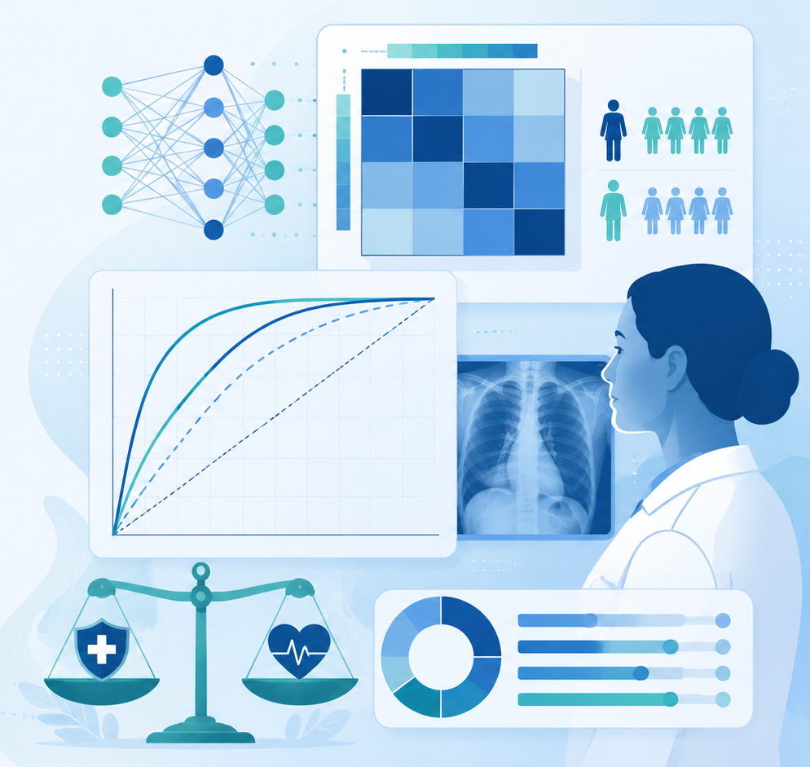
BIOMEDICAL EXAMPLE
Medical-image classification
A medical image can be a sample in a machine-learning dataset.
Features may be manually extracted or learned automatically by deep-learning models.
The target can be normal/abnormal, disease class or risk category.
This connects image matrices and tensors to predictive algorithms.
27

Slide 28
CLINICAL ML WORKFLOW
A complete supervised-learning pipeline
Define question
Build dataset
Split data
What should be predicted?
Samples, features, target
Train / validation / test
Train model
Evaluate
Deploy cautiously
Learn from examples
Measure generalization
Use with monitoring
28

Slide 29
EXAMPLES OF ML ALGORITHMS
Different algorithms, same supervised-learning idea
k-Nearest Neighbors
Decision Tree
Random Forest
predict from similar examples
learn branching rules
combine many trees
Logistic Regression
Support Vector Machine
Neural Network
predict probability
separate classes with a boundary
learn layered representations
29

Slide 30
INPUT TYPES
Machine learning depends on the data structure
Tabular data
Images
Signals
patient × feature matrix
height × width × channel tensors
time × channel sequences
Text
Genomics
Graphs
token sequences
nucleotide strings or encoded matrices
nodes, edges and features
30

Slide 31
EVALUATION PREVIEW
How do we know whether the model works?
Evaluation metrics depend on the task type.
Classification may use accuracy, sensitivity, specificity, precision, recall or AUC.
Regression may use MAE, RMSE or R².
In healthcare, clinical meaning is as important as numerical performance.
31

Slide 32
CLINICAL CAUTION
A prediction is not automatically a decision
Machine-learning models produce predictions, not clinical truth.
Predictions should be interpreted in context.
Clinical workflow, uncertainty, bias and safety must be considered.
A useful model should support human decision-making rather than replace clinical reasoning.
32

Slide 33
COMMON PITFALLS
What can go wrong?
Poor target definition
Small dataset
The model learns the wrong clinical question.
High risk of unstable results.
Class imbalance
Data leakage
Rare conditions may be poorly detected.
Unrealistically high performance.
Bias
Model may work poorly for underrepresented groups.
33

Slide 34
IN-CLASS EXERCISE
Define an ML task
Choose one biomedical problem: diagnosis, risk prediction or forecasting.
Define the sample: what is one example?
Define the features: what information is used as input?
Define the target: what should the model predict?
State whether the task is classification or regression.
Discussion focus
Expected outcome
sample, features, target, task type
clear supervised-learning formulation
34

Slide 35
QUICK QUIZ
Self-check questions
What is a feature?
What is a target?
An input variable used by the model.
The output the model should predict.
What is training?
What is inference?
Learning from examples with known answers.
Using the trained model on new data.
35

Slide 36
CONCLUSION
Take-home messages
Machine learning is an algorithmic approach that learns patterns from data.
A supervised dataset contains samples, features and targets.
Training learns a model; inference applies the trained model to new data.
Diagnosis, prognosis and forecasting can be framed as machine-learning tasks.
Correct task definition, evaluation and data quality are essential in medical informatics.
36

