Slide 1
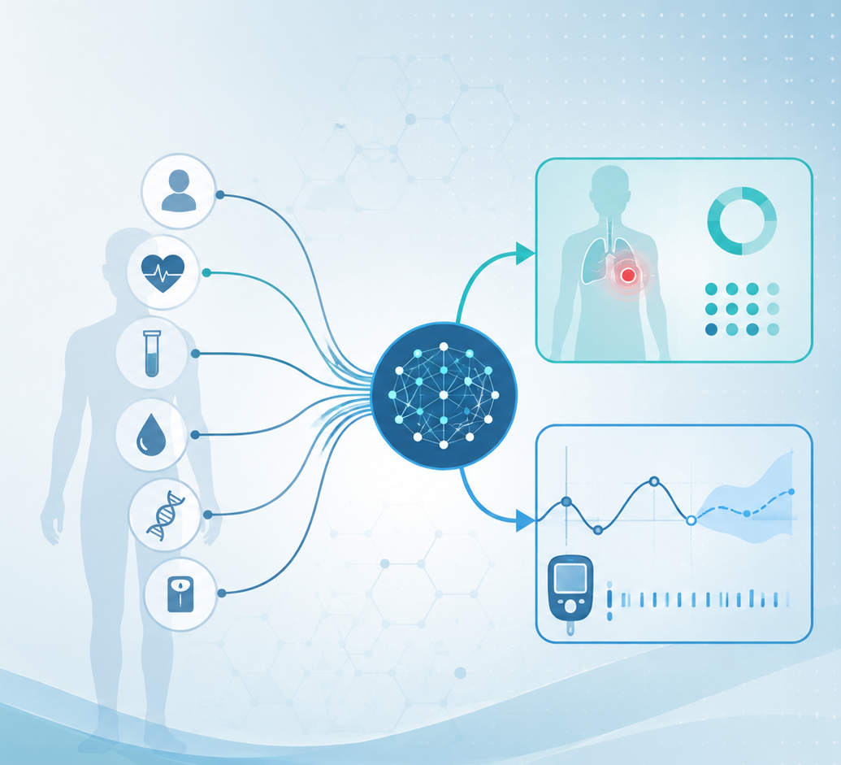
Algorithms and Data Structures
for Medical Informatics
Lesson 18 — Supervised Machine Learning: Classification and Regression
k-Nearest Neighbors, Linear Regression and Logistic Regression
ITS · Medical Informatics
08 October 2026 · 14:30–16:30
Prof. Simone Rancati, PhD
01

Slide 2
LESSON 18
Lesson structure
1. Supervised learning recap
2. Two task families
3. k-NN
Classification and regression.
Instance-based learning for class and value prediction.
From labeled examples to predictions.
4. Linear models
5. Biomedical examples
6. Practice
Linear regression and logistic regression.
Sick/healthy classification and glucose prediction.
Metrics, exercises and recap.
02

Slide 3

AT THE END OF THE LESSON
Learning objectives
Distinguish classification from regression.
Explain how supervised learning uses labeled data.
Describe the intuition and workflow of k-nearest neighbors.
Explain the role of linear regression in continuous prediction.
Explain the role of logistic regression in binary classification.
Connect these algorithms to biomedical use cases such as diagnosis and glucose prediction.
03

Slide 4
RECAP
What is supervised machine learning?
In supervised learning, the algorithm learns from examples that already contain the correct answer.
Each training example includes input information (features) and an output label or value (target).
The objective is to learn a rule that generalizes to new unseen cases.
Many diagnostic and predictive biomedical tasks can be framed this way.
04

Slide 5
CORE TERMINOLOGY
Dataset, sample, features and target
Dataset
Sample
Features
Collection of examples used for modeling.
One observation, for example one patient.
Input variables such as age, glucose, BMI or biomarkers.
Target
Model
Inference
What we want to predict.
The learned mapping from features to target.
Applying the trained model to new data.
05

Slide 6
PIPELINE
A simple supervised-learning workflow
Data
Training
Model
Inference
Output
samples + labels
fit algorithm
learned rule
predict new case
class/value
The same general workflow applies to many algorithms, even though the training procedure differs.
06

Slide 7
DATA SPLITTING
Training, validation and test sets
Training set: used to learn the model parameters.
Validation set: used to tune settings and compare candidate models.
Test set: used for final unbiased evaluation.
Keeping these roles separate helps estimate generalization.
Training
Validation
Test
largest split
final check
model choice
07

Slide 8
TWO MAJOR PROBLEM TYPES
Classification vs regression
Classification
Regression
Predicts a category or class.
Examples: sick vs healthy, benign vs malignant.
ù
Key distinction
Classification chooses among categories; regression estimates a continuous quantity.
08

Slide 9
CLASSIFICATION
What does a classifier produce?
A class label, such as positive / negative or healthy / diseased.
Often also a score or probability expressing model confidence.
Binary classification has two classes; multiclass classification has more than two.
Clinical decision support often uses classification.
Binary example
Diabetes complication: yes / no
Probability example
P(disease) = 0.82
09

Slide 10
REGRESSION
What does a regressor produce?
A continuous numeric estimate rather than a category.
Examples include predicted glucose, creatinine level or time to discharge.
The output may take many possible values on a scale.
The predicted value can later be interpreted clinically.
Example
Predicted glucose in 30 min = 142 mg/dL
Interpretation
Useful for anticipation and decision support
10

Slide 11
ALGORITHM FAMILY
Instance-based learning: k-nearest neighbors
k-NN is a simple supervised-learning algorithm.
It stores the training examples instead of learning an explicit global equation.
For a new case, it looks for the most similar training samples.
The prediction depends on the neighbors and the chosen value of k.
11

Slide 12
K-NN INTUITION
The new case is predicted from nearby cases
Similarity is usually computed as a distance in feature space.
Nearby patients are assumed to have similar outcomes.
For classification, the majority class among neighbors is used.
For regression, the average neighbor value is used.
new patient
12

Slide 13
K-NN WORKFLOW
Main steps of the algorithm
Step 1
Step 2
Choose k, the number of neighbors.
Compute the distance from the new case to all training samples.
Step 3
Step 4
Select the k closest neighbors.
Aggregate their labels or values to produce the prediction.
13

Slide 14
K-NN FOR CLASSIFICATION
Example: sick or healthy
Suppose the features are fasting glucose and BMI.
A new patient is placed in the same feature space as the training patients.
If most nearby patients are sick, the new patient is classified as sick.
This is a local, example-driven prediction.
k = 3 example
neighbors: Sick, Sick, Healthy
Prediction
Majority vote → Sick
14

Slide 15
K-NN FOR REGRESSION
Example: glucose prediction
Now suppose the target is a numeric value such as glucose in 30 minutes.
The algorithm finds the most similar past windows or patients.
It then averages the neighbors’ target values.
The result is a continuous prediction.
Neighbor values
138, 142, 146 mg/dL
Prediction
Average ≈ 142 mg/dL
15

Slide 16
K-NN DESIGN CHOICES
Important practical considerations
Choice of k
Distance metric
Small k is sensitive; large k is smoother.
Euclidean distance is common, but not the only option.
Feature scaling
Prediction speed
Variables should often be normalized.
k-NN can be slow at inference because it compares with many stored samples.
16

Slide 17
ALGORITHM FAMILY
Linear regression
Linear regression is a classical algorithm for regression problems.
It models the target as a weighted sum of the input features.
Each feature contributes linearly through a coefficient.
It is simple, interpretable and widely used.
17

Slide 18
LINEAR REGRESSION INTUITION
A line or hyperplane fits the data
With one feature, the model corresponds to a line.
With multiple features, the same idea generalizes to a higher-dimensional hyperplane.
The coefficients quantify how the prediction changes when a feature changes.
The intercept is the baseline prediction.
y = b0 + b1·x1 + b2·x2 + ... + bp·xp
Example:
future glucose = baseline + effect of current glucose + effect of insulin + effect of meal
18

Slide 19
LINEAR REGRESSION TRAINING
How are the coefficients chosen?
Training tries to find coefficients that make predictions close to the observed targets.
A common objective is minimizing the sum of squared errors.
The fitted line balances all training points rather than memorizing them.
After training, the model can predict the target for a new sample.
19

Slide 20
BIOMEDICAL EXAMPLE
Linear regression for future glucose prediction
Features may include current glucose, recent trend, carbohydrates and insulin.
The target may be glucose 30 minutes in the future.
The model estimates how these inputs combine to influence the future value.
This frames glucose forecasting as a regression problem.
current glucose = 128
trend = rising
insulin = 1.5 U
Input example
Target example
glucose in 30 min = 144
20

Slide 21
ALGORITHM FAMILY
Logistic regression
Despite its name, logistic regression is mainly used for classification, especially binary classification.
It predicts the probability that a sample belongs to a class.
The final class is obtained by applying a threshold to the probability.
It is one of the most important baseline classifiers in medicine and beyond.
21

Slide 22
LOGISTIC REGRESSION INTUITION
From linear score to probability
The model first computes a weighted linear combination of the features.
This score is then transformed into a probability between 0 and 1.
A sigmoid function is commonly used for this transformation.
The output can be interpreted as estimated class probability.
P(class=1) = sigmoid(b0 + b1·x1 + ... + bp·xp)
22

Slide 23
LOGISTIC REGRESSION OUTPUT
Why probabilities are useful
A probability provides more information than a hard class label alone.
For example, 0.51 and 0.95 may lead to the same class, but confidence differs greatly.
In healthcare, thresholds may be adjusted according to the clinical context.
Probability estimates can support risk-based decisions.
Example
P(disease) = 0.78
If threshold = 0.50
Predicted class = disease
23

Slide 24
BIOMEDICAL EXAMPLE
Logistic regression for sick/healthy classification
Features may include symptoms, lab values, age and vital signs.
The target is whether the patient belongs to the sick class or the healthy class.
The model estimates the probability of disease based on the features.
This is a standard binary classification setting.
Features
fever, CRP, heart rate, age
Target
sick / healthy
24

Slide 25
COMPARISON
k-NN vs linear regression vs logistic regression
Algorithm
Main task
Idea
Typical biomedical example
k-NN
class or value
use nearest samples
patient similarity
Linear regression
numeric value
fit linear relationship
future glucose
Logistic regression
class probability
fit logistic classifier
disease diagnosis
25

Slide 26
EVALUATION
Common metrics for classification
Accuracy
Sensitivity / Recall
Specificity
Proportion of correct predictions.
Ability to detect positives.
Ability to detect negatives.
Precision
AUROC
Confusion matrix
Among predicted positives, how many are truly positive?
Ranking ability across thresholds.
Counts of TP, TN, FP and FN.
26

Slide 27
EVALUATION
Common metrics for regression
MAE
RMSE
R²
Average absolute error.
Square-root of the mean squared error.
How much variance is explained.
Residuals
Calibration
Clinical usefulness
Observed minus predicted values.
Are predicted values systematically biased?
Is the error acceptable for the application?
27

Slide 28
PREPROCESSING
Why input preparation matters
Missing values may need imputation or explicit handling.
Categorical variables may require encoding.
Feature scaling is especially important for distance-based methods such as k-NN.
Good preprocessing improves both performance and interpretability.
28

Slide 29
GENERALIZATION
Overfitting and underfitting
Underfitting
Overfitting
Model is too simple.
It misses important patterns.
Both training and test performance are poor.
Model learns training noise too closely.
Training performance is high, but generalization is poor.
Validation and test performance reveal the issue.
Goal
Find a model that captures signal but generalizes to new biomedical cases.
29

Slide 30
BIOMEDICAL CASE STUDY
Sick vs healthy as a classification problem
Each patient is described by features such as symptoms, laboratory values and vital signs.
The target is categorical: sick or healthy.
Possible algorithms include k-NN and logistic regression.
The output can support triage, screening or preliminary risk stratification.
30

Slide 31
BIOMEDICAL CASE STUDY
Future glucose as a regression problem
Each sample may represent a patient or a recent time window of CGM and related variables.
The target is a future glucose value.
Possible algorithms include k-NN regression and linear regression.
The predicted value can support anticipation of hypo- or hyperglycemia.
31

Slide 32
INTERPRETABILITY
Why simple models are still important in medicine
Simple models are often easier to explain to clinicians and students.
Linear regression and logistic regression provide interpretable coefficients.
k-NN can be explained through similarity to known cases.
Interpretability is especially valuable in high-stakes settings.
32

Slide 33
COMMON PITFALLS
Important cautions
Data leakage
Imbalance
Future or target-related information must not enter the features.
In classification, rare classes may require special attention.
Scaling issues
Misinterpreting probabilities
Unscaled variables can distort k-NN distances.
A probability is not a guarantee.
Ignoring clinical context
Good metrics do not automatically mean clinical usefulness.
33

Slide 34
IN-CLASS EXERCISE
Choose the right task and algorithm
1. Predict whether a patient has pneumonia from clinical features.
2. Predict glucose 30 minutes ahead from recent CGM values.
3. Estimate hospital length of stay from admission data.
4. Predict whether a skin lesion is benign or malignant.
For each task, decide whether it is classification or regression, and suggest a suitable algorithm.
34

Slide 35
QUICK QUIZ
Self-check questions
Which algorithm predicts from nearby examples?
Which of today’s models is mainly used for continuous targets?
k-nearest neighbors
Linear regression
Which of today’s models is mainly used for binary classification?
Is future glucose prediction classification or regression?
Logistic regression
Regression
35

Slide 36
CONCLUSION
Take-home messages
Supervised learning uses labeled data to learn predictive rules.
Classification predicts categories, whereas regression predicts continuous values.
k-NN is a similarity-based method that works for both task types.
Linear regression is a core method for numeric prediction, and logistic regression is a core method for binary classification.
These algorithms are directly relevant to biomedical tasks such as disease classification and glucose prediction.
36

