Slide 1
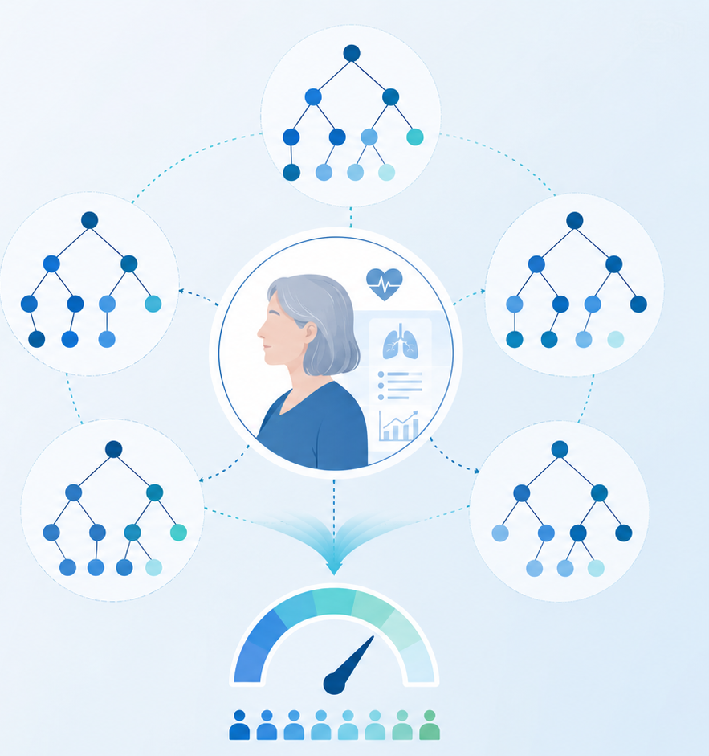
Algorithms and Data Structures
for Medical Informatics
Lesson 19 — Decision Trees, Random Forest and Ensemble Algorithms
Clinical risk trees, bagging and interpretability of decisions
ITS · Medical Informatics
09 October 2026 · 11:30–13:30
Prof. Simone Rancati, PhD
01

Slide 2
LESSON 19
Lesson structure
1. Tree-based learning
2. Decision trees
3. Tree growth and control
Decision rules as a predictive algorithm.
Splits, nodes, leaves and clinical pathways.
Impurity, depth, pruning and overfitting.
4. Random forest
5. Ensemble logic
6. Practice
Bagging and aggregation of many trees.
Why multiple models can improve performance.
Interpretation, exercises and recap.
02

Slide 3

AT THE END OF THE LESSON
Learning objectives
Explain how a decision tree makes predictions through sequential splits.
Distinguish root nodes, internal nodes, branches and leaves.
Understand why trees are interpretable and useful in clinical settings.
Explain why a single tree may overfit and how pruning can help.
Describe how random forests work and why they often perform better than a single tree.
Understand the general idea behind ensemble algorithms.
03

Slide 4
MOTIVATION
Why tree-based algorithms are important in medicine
Healthcare decisions are often naturally expressed as a sequence of if–then rules.
Tree-based models resemble this reasoning style.
They can handle nonlinear relationships and interactions between variables.
Their structure is intuitive and often easier to explain to students and clinicians.
04

Slide 5
RECAP
Where decision trees fit in supervised learning
Input
Task
Model form
A dataset with features and a target.
Classification or regression.
A hierarchy of decisions.
Output
Strength
Limitation
A class label, probability or numeric value.
High interpretability.
Single trees can be unstable or overfit.
05

Slide 6
DECISION TREE BASICS
What is a decision tree?
A decision tree is a supervised-learning model that makes predictions through a sequence of rules.
Each internal node asks a question about one feature.
Each branch corresponds to one possible answer.
Each terminal node, called a leaf, stores the prediction.
Age > 65?
SpO₂ < 92%?
CRP > 10?
Low risk
High risk
Moderate
High risk
06

Slide 7
DECISION TREE STRUCTURE
Root, nodes, branches and leaves
Root node
Internal node
The first split, applied to all samples.
A decision point based on a feature.
Branch
Leaf
One route depending on the answer to the split.
Final output region of the tree.
Path
A complete sequence of decisions from root to leaf.
07

Slide 8
INTUITION
A clinical decision path example
Suppose the task is to predict clinical risk.
The tree may first split by age, then by oxygen saturation, then by inflammatory markers.
Following the branches leads to a final risk category.
This mirrors rule-based clinical reasoning.
Age > 65?
SpO₂ < 92%?
CRP > 10?
Low risk
High risk
Moderate
High risk
08

Slide 9
CLASSIFICATION TREES
How a tree predicts a class
For classification, each leaf corresponds to a class or a class distribution.
The algorithm sends the new sample through the tree according to the split rules.
When it reaches a leaf, the leaf determines the predicted class.
The leaf may also provide estimated class probabilities.
09

Slide 10
REGRESSION TREES
How a tree predicts a numeric value
Decision trees can also solve regression problems.
In a regression tree, each leaf contains a numeric prediction.
For example, a leaf may predict future glucose or length of stay.
Thus tree-based models work for both categorical and continuous targets.
10

Slide 11
BUILDING THE TREE
What makes a good split?
At each node, the algorithm tries candidate questions based on the available features.
A good split should separate the data into more homogeneous groups.
The exact criterion depends on whether the task is classification or regression.
The algorithm repeats this process recursively.
11

Slide 12
SPLIT QUALITY
Impurity in classification trees
A node is pure if most or all samples inside it belong to the same class.
Impurity measures how mixed the classes are within a node.
Common impurity criteria include Gini impurity and entropy.
The tree prefers splits that reduce impurity.
High impurity
mixed sick and healthy cases
Low impurity
mostly one class
12

Slide 13
SPLIT QUALITY
Error reduction in regression trees
In regression, the goal is not class purity but reduction of prediction error.
The algorithm prefers splits that produce groups with more similar target values.
This often corresponds to reducing variance within each child node.
The final leaves then contain more coherent numeric predictions.
13

Slide 14
TREE GROWTH
How the algorithm expands the structure
Start
Search
Split
Repeat
Stop
All training samples are in the root node.
Evaluate candidate features and thresholds.
Choose the best rule and create child nodes.
Apply the same process to each child.
End when a stopping rule is reached.
14

Slide 15
STOPPING RULES
When does a tree stop growing?
Maximum depth
Minimum samples per node
Limit the number of levels.
Do not split tiny groups.
Minimum gain
Pure leaves
Split only if the improvement is large enough.
Stop if the node is already homogeneous.
15

Slide 16
MODEL BEHAVIOR
Why a single tree may overfit
If allowed to grow without constraints, a decision tree can become very complex.
It may learn idiosyncrasies of the training data rather than general patterns.
This produces excellent training performance but weaker generalization.
Controlling tree complexity is therefore essential.
16

Slide 17
CONTROLLING COMPLEXITY
Pruning
Pruning means simplifying a tree after or during training.
Some branches that add little value are removed.
A smaller tree is often easier to interpret and may generalize better.
Pruning is one way to balance interpretability and performance.
Before pruning
large, detailed, potentially overfit
After pruning
simpler and more robust
17

Slide 18
INTERPRETABILITY
Why decision trees are easy to explain
Each prediction follows an explicit path of decisions.
The model can be visualized as a flowchart-like structure.
Clinicians can inspect which features drive the decision.
This transparency makes trees attractive in educational and clinical contexts.
18

Slide 19
CLINICAL EXAMPLE
Decision tree for clinical risk stratification
A tree can be trained to assign low, moderate or high clinical risk.
Features may include age, oxygen saturation, blood pressure, lab markers and comorbidities.
The learned structure shows one possible triage-like logic.
The exact thresholds come from the training data.
Age > 65?
SpO₂ < 92%?
CRP > 10?
Low risk
High risk
Moderate
High risk
19

Slide 20
LIMITATIONS OF A SINGLE TREE
Strengths and weaknesses
Strengths
Weaknesses
Highly interpretable
Handles nonlinear patterns
Works with mixed types of features
Can overfit easily
Can be unstable: small data changes may alter the tree
May have lower predictive power than ensembles
Takeaway
A single tree is transparent, but not always the best predictor.
20

Slide 21
FROM ONE MODEL TO MANY
What is an ensemble algorithm?
An ensemble combines the predictions of multiple models.
The idea is that a group of models can be more accurate and robust than a single one.
Different ensemble methods use different strategies to create diversity among models.
Random forest is one of the most important ensemble methods.
21

Slide 22
ENSEMBLE LOGIC
Why many trees can outperform one tree
Individual trees may make different mistakes.
Aggregating them can reduce variance and improve stability.
If each tree captures part of the signal, the combined decision is often more reliable.
This is the core intuition behind random forests.
22

Slide 23
RANDOM FOREST
What is a random forest?
A random forest is an ensemble of many decision trees.
Each tree is trained on a slightly different version of the data.
During prediction, the forest aggregates the outputs of all trees.
This usually improves performance and robustness.
23

Slide 24
RANDOM FOREST WORKFLOW
Main idea in four steps
Step 1
Step 2
Create multiple bootstrap samples from the training data.
Train one tree on each sample.
Step 3
Step 4
At each split, consider only a random subset of features.
Aggregate the predictions of all trees.
24

Slide 25
BAGGING
Bootstrap aggregation
Bagging means training multiple models on resampled versions of the training data.
Each bootstrap sample is created by sampling with replacement.
This introduces variation across the trees.
Aggregation over many trees reduces instability.
Bootstrap
sample with replacement
Aggregation
combine predictions
25

Slide 26
RANDOMNESS IN THE FOREST
Why random feature subsets are used
If all trees looked at the same strongest feature all the time, they would become too similar.
Random subsets of features encourage diversity across trees.
Greater diversity often improves the benefit of aggregation.
This is one of the defining ideas of random forests.
26

Slide 27
PREDICTION AGGREGATION
How the forest makes the final decision
Classification forest
Regression forest
Each tree votes for a class.
The majority vote becomes the prediction.
Each tree outputs a number.
The final prediction is often the average.
Aggregation rule
Voting for classes, averaging for continuous values.
27

Slide 28
PERFORMANCE PERSPECTIVE
Why random forests are often strong baselines
They often handle structured tabular biomedical data very well.
They capture nonlinear effects and interactions automatically.
They are less prone to overfitting than a single deep tree.
They usually require less feature engineering than simpler linear models.
28

Slide 29
INTERPRETABILITY TRADE-OFF
Single tree vs random forest
Single decision tree
Random forest
Easy to visualize and explain
One explicit path per prediction
Potentially less stable and less accurate
Often more accurate and robust
Harder to explain as a single flowchart
Interpretation often uses feature importance and summaries
Trade-off
Better performance often comes at the cost of reduced direct interpretability.
29

Slide 30
FEATURE IMPORTANCE
A useful interpretation tool for forests
Random forests can provide estimates of which features are most influential.
Feature importance does not fully explain one single prediction, but it summarizes global relevance.
In clinical data, this can help highlight which variables drive the model most strongly.
Interpretation should still be done carefully.
Example important features
Age
SpO₂
CRP
Comorbidity score
30

Slide 31
OTHER ENSEMBLE IDEAS
Beyond random forest
Bagging
Boosting
Combine many resampled models.
Build models sequentially to correct previous errors.
Voting ensembles
Stacking
Aggregate different model types.
Use a meta-model to combine base models.
For this course, the key message is that combining models is a powerful algorithmic strategy.
31

Slide 32
BIOMEDICAL EXAMPLE
Random forest for clinical risk prediction
Suppose we want to predict whether a patient is at high clinical risk.
Each tree in the forest sees a slightly different sample of patients and features.
The final risk classification is based on the aggregate vote.
This can yield stronger predictive performance than a single risk tree.
32

Slide 33
COMMON PITFALLS
Important cautions
Over-interpretation
Instability
A learned threshold is not the same as a clinical rule.
Single trees may change with small changes in data.
Bias in data
Black-box drift
Garbage in, garbage out still applies.
Large ensembles are harder to inspect directly.
Clinical validation
Strong predictive performance is not enough without proper evaluation.
33

Slide 34
IN-CLASS EXERCISE
Which model would you choose?
1. You need a simple, explainable risk algorithm for teaching purposes.
2. You want stronger predictive performance on tabular clinical data.
3. You need to explain one full decision path to a student.
4. You want to reduce instability from one single tree.
For each scenario, decide whether a single tree or a random forest is more appropriate, and explain why.
34

Slide 35
QUICK QUIZ
Self-check questions
What does a leaf represent in a decision tree?
Why can a single tree overfit?
Because it can grow too complex and memorize the training data.
The final prediction.
What is the core idea of a random forest?
Why are single trees often considered interpretable?
Train many diverse trees and aggregate them.
Because the full decision path can be inspected.
35

Slide 36
CONCLUSION
Take-home messages
Decision trees make predictions through explicit sequences of if–then rules.
They are attractive in medicine because they are intuitive and interpretable.
However, a single tree may overfit and be unstable.
Random forests improve robustness and performance by combining many diverse trees.
Ensemble algorithms show that combining multiple models is a powerful predictive strategy.
36

