Slide 1
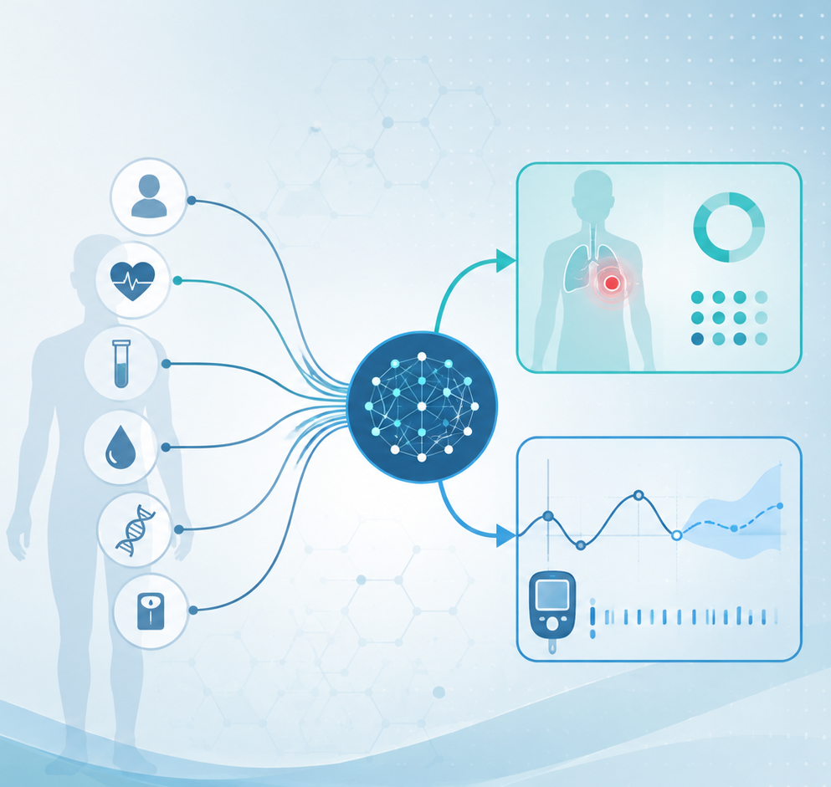
Algorithms and Data Structures
for Medical Informatics
Lesson 21 — Deep Learning and Neural Networks
Artificial neurons, layers, activations, loss, gradient descent and backpropagation
ITS · Medical Informatics
16 October 2026 · 11:30–13:30
Prof. Simone Rancati, PhD
01

Slide 2
LESSON 21
Lesson structure
1. From ML to DL
2. Artificial neuron
3. Network architecture
Why neural networks are different.
Inputs, weights, bias and activation.
Layers and forward propagation.
4. Learning
5. Practical training
6. Biomedical applications
Loss, gradient descent and backpropagation.
Epochs, batches, learning rate and overfitting.
Images, signals and clinical prediction.
02

Slide 3

AT THE END OF THE LESSON
Learning objectives
Explain the structure of an artificial neuron.
Describe how layers combine neurons into a neural network.
Understand why activation functions introduce nonlinearity.
Explain the purpose of a loss function.
Describe gradient descent and backpropagation intuitively.
Connect neural-network training to biomedical prediction problems.
03

Slide 4
MOTIVATION
Why deep learning?
Traditional machine learning often relies on manually chosen features.
Deep learning can learn useful internal representations directly from raw or minimally processed data.
This is powerful for complex inputs such as images, waveforms and long sequences.
The price is greater computational cost and usually lower direct interpretability.
04

Slide 5
BIG PICTURE
Machine learning vs deep learning
Traditional ML
Deep learning
Human-designed features are often important.
Model may be relatively shallow.
Examples: logistic regression, random forest.
Multiple representation-learning layers.
Can learn complex features automatically.
Examples: CNNs, recurrent networks, Transformers.
Key idea
Deep learning is still machine learning: it learns a predictive function from data.
05

Slide 6
ARTIFICIAL NEURON
The basic computational unit
An artificial neuron receives one or more input values.
Each input is multiplied by a learnable weight.
A bias term is added.
An activation function transforms the resulting score.
x₁
x₂
Σ
f
output
x₃
06

Slide 7
ARTIFICIAL NEURON
Weights and bias
Weights determine how strongly each input influences the neuron.
Positive and negative weights can push the output in different directions.
The bias shifts the neuron's response.
Weights and biases are the parameters learned during training.
Weighted sum
z = w₁x₁ + w₂x₂ + ... + wₙxₙ + b
The neuron combines its inputs before activation.
07

Slide 8
ARTIFICIAL NEURON
Why activation functions are needed
Without activation functions, stacking many linear layers would still behave like one linear transformation.
Activation functions introduce nonlinearity.
Nonlinearity allows the network to represent complex patterns.
Different activation functions are useful in different parts of a network.
08

Slide 9
ACTIVATION FUNCTIONS
Three common examples
ReLU
Sigmoid
Softmax
max(0, z)
Common in hidden layers.
maps values to 0–1
Useful for binary output probabilities.
converts several scores into class probabilities
Useful for multiclass output.
09

Slide 10
NETWORK ARCHITECTURE
From one neuron to many layers
A neural network organizes neurons into layers.
The input layer receives the original features.
Hidden layers transform the representation step by step.
The output layer produces the final prediction.
Input layer
Hidden layer
Output
10

Slide 11
NETWORK ARCHITECTURE
What is a hidden layer?
A hidden layer is located between input and output.
Its neurons create new intermediate representations.
Early layers may learn simple patterns; later layers may combine them into more complex patterns.
The word hidden simply means that these values are internal to the model.
11

Slide 12
NETWORK ARCHITECTURE
What does 'deep' mean?
A network is called deep when it contains multiple hidden layers.
Depth gives the model multiple stages of representation learning.
More depth can increase expressive power.
But deeper models are not automatically better: they also require more data, computation and careful training.
12

Slide 13
FORWARD PROPAGATION
How a network makes one prediction
1
Input
A patient feature vector, image or signal enters the network.
2
Hidden layers
Each layer computes weighted sums and activations.
3
Output layer
The final layer produces a score, probability or number.
4
Prediction
The network output is interpreted for the task.
13

Slide 14
FORWARD PROPAGATION
Classification output example
For binary classification, the network may output one probability.
Example: P(pneumonia) = 0.84.
A decision threshold converts the probability into a class.
For multiclass classification, the output layer may provide one probability per class.
Network output
P(disease) = 0.84
Threshold = 0.50
Predicted class = disease
14

Slide 15
FORWARD PROPAGATION
Regression output example
For regression, the output layer produces a numeric value.
Example: predicted glucose in 30 minutes = 147 mg/dL.
The final layer often uses a linear output rather than a probability activation.
Training adjusts parameters to reduce the error in this numeric prediction.
Input
Recent CGM + insulin + meal information
Output
147 mg/dL
15

Slide 16
LEARNING
The model needs a way to measure error
After a prediction, the network compares its output with the correct target.
A loss function converts the prediction error into a single number.
Lower loss means the predictions are closer to what we want.
Training tries to reduce this loss.
16

Slide 17
LOSS FUNCTIONS
Loss depends on the task
Regression
Binary classification
Multiclass classification
Mean Squared Error (MSE)
Penalizes large numeric errors.
Binary Cross-Entropy
Penalizes incorrect probabilities.
Cross-Entropy
Compares predicted class distribution with the true class.
17

Slide 18
LOSS INTUITION
Prediction → loss
Prediction
True label
Loss
P(disease) = 0.30
Disease = 1
High because prediction is poor
The loss is the signal that tells the network how well or badly it is currently performing.
18

Slide 19
OPTIMIZATION
Gradient descent: the basic idea
Imagine the loss as a landscape with hills and valleys.
The current model parameters correspond to one point on this landscape.
The gradient tells us the direction of steepest increase.
Gradient descent moves parameters in the opposite direction to reduce loss.
Loss landscape (conceptual)
Move toward lower loss
19

Slide 20
OPTIMIZATION
Learning rate
The learning rate controls how large each parameter update is.
Too small: learning may be very slow.
Too large: the optimizer may overshoot good solutions or become unstable.
Choosing a suitable learning rate is one of the most important training decisions.
Small learning rate
slow but cautious steps
Large learning rate
fast but potentially unstable
20

Slide 21
TRAINING
How do we know which parameter to change?
A neural network may contain thousands or millions of weights.
Each weight influences the final prediction through many intermediate computations.
We need an efficient way to determine how each weight affected the loss.
Backpropagation provides this information.
21

Slide 22
BACKPROPAGATION
Intuitive view
First, the network performs a forward pass and computes the loss.
Then the error signal is propagated backward from the output toward earlier layers.
The algorithm calculates how sensitive the loss is to each parameter.
These gradients are then used by the optimizer to update the weights.
Input
Prediction
Gradients
Loss
Forward → error → backward
22

Slide 23
BACKPROPAGATION
The chain rule — intuition, not derivation
A weight affects the loss through a chain of intermediate operations.
The chain rule allows us to combine these local effects.
Backpropagation reuses intermediate calculations efficiently.
The result is a gradient for every trainable parameter.
Mental model
Ask: if this weight changed slightly, how would the final loss change?
23

Slide 24
TRAINING LOOP
The core learning cycle
Forward pass
Loss
Backpropagation
Update
Compute predictions.
Measure prediction error.
Compute gradients.
Gradient descent changes weights.
Repeat this cycle many times until the model parameters produce useful predictions.
24

Slide 25
PRACTICAL TRAINING
Epochs
One epoch means one complete pass through the training dataset.
Neural networks are usually trained for multiple epochs.
Early epochs often produce rapid improvement.
Too many epochs can lead to overfitting if validation performance starts to worsen.
25

Slide 26
PRACTICAL TRAINING
Batches and mini-batches
Large datasets are usually not processed all at once.
A batch is a subset of training samples used for one gradient update.
Mini-batch training is computationally efficient and works well on GPUs.
Batch size affects memory use and optimization behavior.
Dataset
10,000 examples
Batch size
32 examples per update
26

Slide 27
PRACTICAL TRAINING
Parameters vs hyperparameters
Parameters
Hyperparameters
Learned automatically from data.
Examples: weights and biases.
Chosen by the practitioner.
Examples: learning rate, batch size, number of layers.
Training
The optimizer learns parameters while we tune hyperparameters.
27

Slide 28
GENERALIZATION
Overfitting in neural networks
Neural networks can have very high capacity.
They may memorize training-specific patterns if data are limited or training is excessive.
Training loss may continue to fall while validation loss starts to rise.
Monitoring validation performance is therefore essential.
Training loss
continues decreasing
Validation loss
starts increasing
28

Slide 29
GENERALIZATION
Regularization ideas
Early stopping
Weight decay
Stop when validation performance stops improving.
Discourage excessively large weights.
Dropout
Data augmentation
Randomly deactivate some units during training.
Create useful variations of training examples.
29

Slide 30
COMPUTATIONAL PERSPECTIVE
Why GPUs are important
Neural networks perform many matrix and tensor operations.
GPUs are designed to execute large numbers of parallel operations efficiently.
Training deep networks is therefore often much faster on GPUs than on standard CPUs.
This hardware advantage helped enable modern deep learning.
30

Slide 31
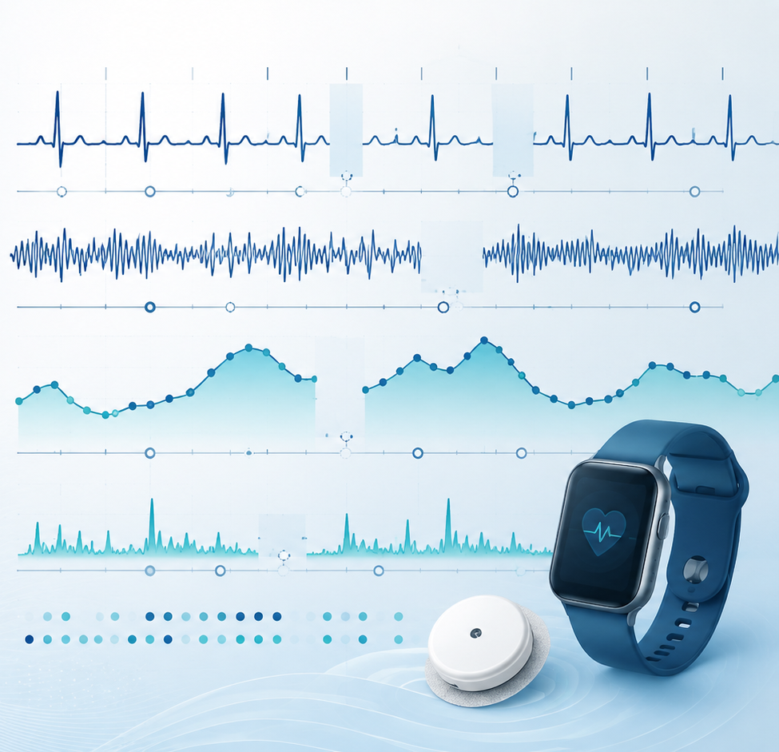
BIOMEDICAL APPLICATION
Medical images
Deep learning can learn features directly from images such as X-rays, CT scans, MRI and pathology slides.
Convolutional neural networks are especially suited to spatial data.
The model may learn edges, shapes, textures and higher-level structures automatically.
Applications include classification, segmentation and detection.
31

Slide 32
BIOMEDICAL APPLICATION
Physiological signals and time series
Neural networks can process ECG, EEG, CGM and wearable signals.
Temporal architectures can learn local patterns and long-range dependencies.
Tasks include arrhythmia classification, seizure detection and glucose forecasting.
The input may be a time window rather than one static row.
32

Slide 33
BIOMEDICAL APPLICATION
Clinical tabular data
Neural networks can also be trained on patient tables containing demographics, laboratory values and measurements.
However, deep learning is not automatically superior to classical machine learning on every tabular dataset.
Dataset size, feature quality and task complexity matter.
A strong baseline comparison remains essential.
33

Slide 34
INTERPRETABILITY
A major challenge in medicine
Deep networks contain many interacting parameters and internal representations.
This can make individual decisions harder to explain than a small decision tree or linear model.
Explainability methods can provide partial insight into influential inputs or regions.
Interpretability, validation and clinical context remain critical in high-stakes applications.
34

Slide 35
COMMON PITFALLS
Important cautions
More layers ≠ better
Training loss ≠ test performance
Depth must match the problem and data.
Generalization must be evaluated separately.
Probability ≠ certainty
Data quality matters
Outputs require careful interpretation and calibration.
Bias and noise can be learned by the network.
Compute is not validation
A large model still needs rigorous evaluation.
35

Slide 36
IN-CLASS EXERCISE
Follow one training iteration
A neural network predicts P(disease) = 0.25 for a patient whose true label is disease.
1. Is the loss likely to be high or low?
2. What happens during backpropagation?
3. What does gradient descent do with the computed gradients?
4. After many useful updates, what should happen to the prediction and loss?
36

Slide 37
QUICK QUIZ
Self-check questions
What does an activation function add to a network?
What does the loss function measure?
How wrong the current prediction is
Nonlinearity
What does gradient descent change?
What does backpropagation compute?
Weights and biases
Gradients of the loss with respect to parameters
37

Slide 38
CONCLUSION
Take-home messages
An artificial neuron combines weighted inputs, a bias and an activation function.
Neural networks organize many neurons into layers that learn increasingly useful representations.
The forward pass produces predictions, and the loss function measures their error.
Backpropagation computes gradients, while gradient descent uses them to update the parameters.
Training is an iterative process involving epochs, mini-batches and hyperparameters.
Deep learning is powerful for complex biomedical data, but it still requires careful evaluation and interpretation.
38

