Slide 1
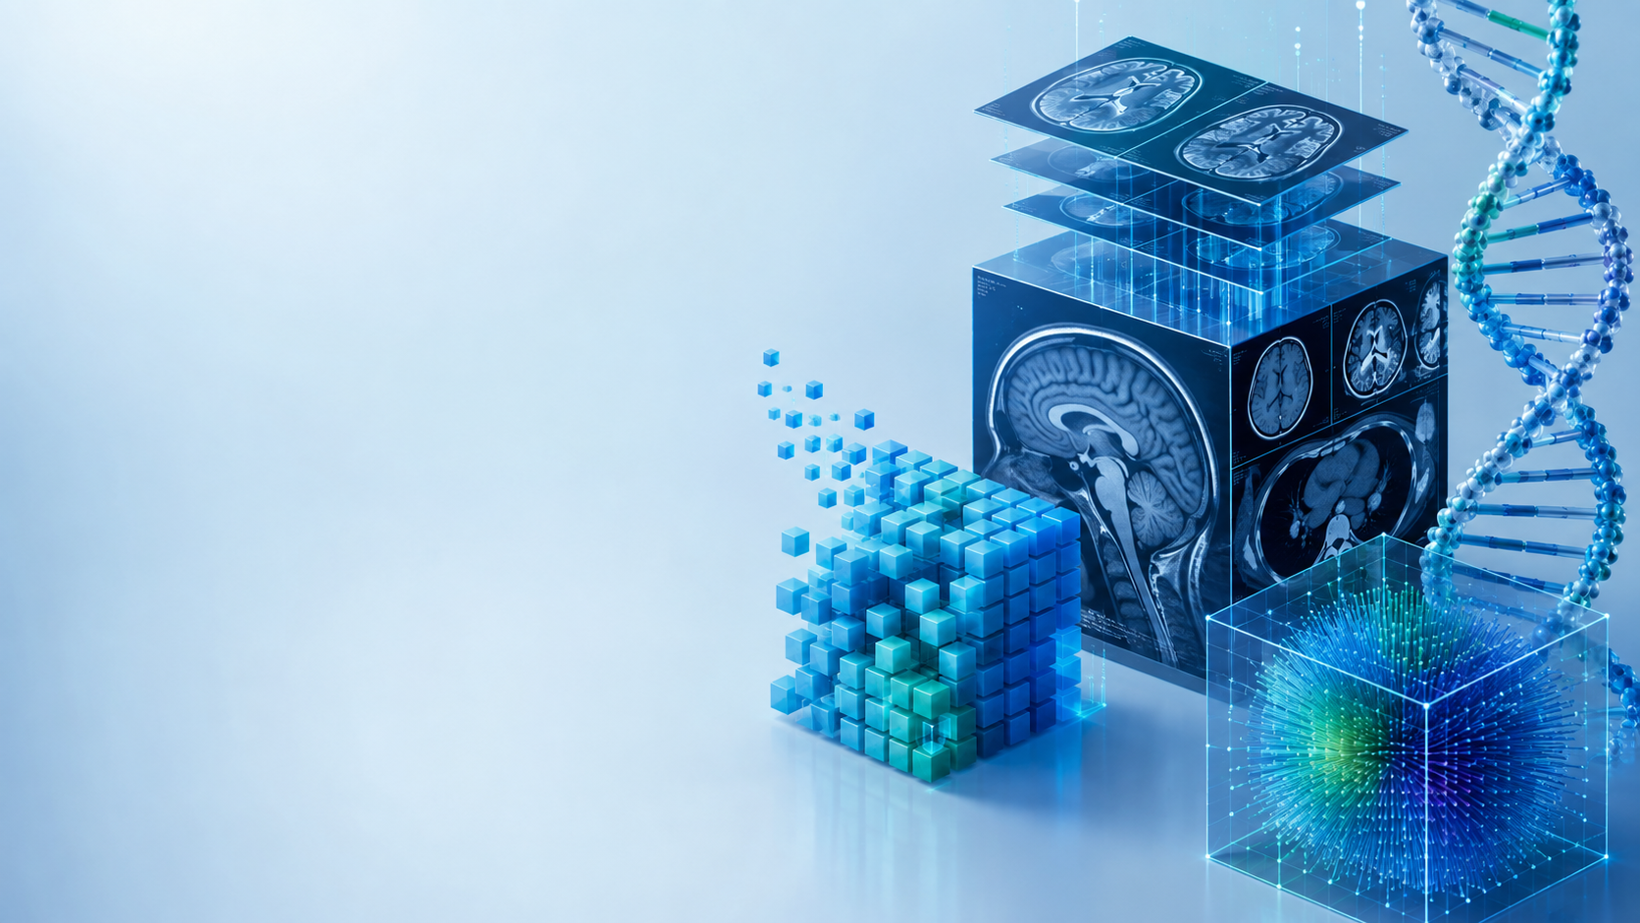
Algorithms and Data Structures
for Medical Informatics
Lesson 22 — CNNs, Sequential Models and Transformers in Biomedicine
Radiology images, ECG/CGM time series, clinical text and biomedical sequences
ITS · Medical Informatics
20 October 2026 · 14:30–16:30
Prof. Simone Rancati, PhD
01

Slide 2
LESSON 22
Lesson structure
1. Why architecture matters
2. CNNs
3. Sequential models
Different data structures need different models.
Spatial pattern learning for medical images.
RNN, LSTM and GRU for time-dependent signals.
4. Transformers
5. Biomedical applications
6. Model selection
Attention-based modeling of text, signals and sequences.
Radiology, ECG, CGM and clinical notes.
Match architecture to data and task.
02

Slide 3
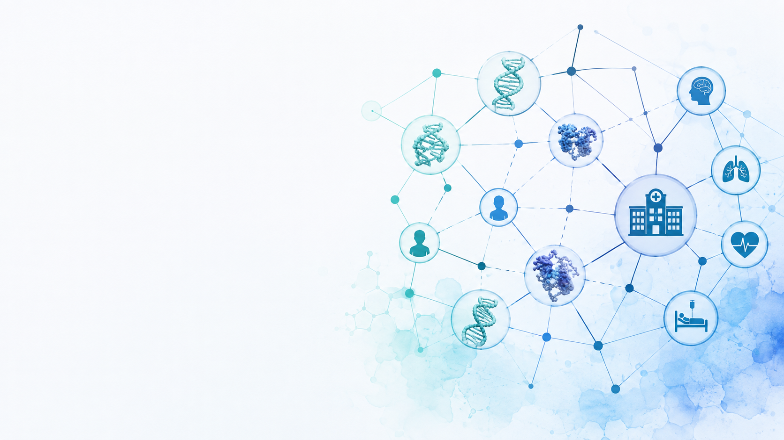
AT THE END OF THE LESSON
Learning objectives
Explain why CNNs are well suited to spatial image data.
Understand the basic idea of convolution, filters and feature maps.
Describe recurrent and gated models for sequential biomedical signals.
Explain self-attention and the core Transformer intuition.
Connect model architecture to radiographs, ECG, CGM, clinical text and biological sequences.
Compare strengths and limitations of the main architecture families.
03

Slide 4
BIG PICTURE
The structure of the data guides the architecture
Images
Time series
Spatial neighborhoods matter.
Temporal order and history matter.
Text
DNA / proteins
Relationships among words and context matter.
Long-range sequence dependencies may matter.
04

Slide 5
ARCHITECTURE MAP
Which family is often used for which data?
Data type
Common architecture
Biomedical example
2D image
CNN
Chest X-ray classification
1D signal
1D CNN / RNN / Transformer
ECG arrhythmia detection
Time series
RNN / LSTM / Transformer
CGM forecasting
Clinical text
Transformer
Clinical note classification
DNA / protein sequence
CNN / Transformer
Sequence prediction
05

Slide 6
CNNS
Why convolutional neural networks for images?
Medical images contain local spatial patterns: edges, textures, shapes and anatomical structures.
CNNs use small filters that scan across the image.
The same filter is reused at many locations.
This makes CNNs efficient at detecting patterns regardless of where they appear.
Conv
filters
X-ray
image
Feature
maps
Class
score
06

Slide 7
CNN BUILDING BLOCK
Convolution
A convolutional filter is a small matrix of learnable weights.
It moves across the input image.
At each position, the filter computes a local weighted combination.
The output forms a feature map.
Image patch
Filter
3 × 3 weights
Output
3 × 3 pixels
1 value
07

Slide 8
CNN BUILDING BLOCK
Feature maps
Different filters learn to respond to different patterns.
Early filters may detect simple edges or intensity changes.
Deeper filters can combine these responses into more complex structures.
A CNN therefore builds a hierarchy of spatial features.
08

Slide 9
CNN BUILDING BLOCK
Pooling and spatial compression
Pooling reduces the spatial size of feature maps.
It keeps important information while decreasing computation.
Max pooling keeps the strongest local activation.
Modern CNNs may also use strided convolutions instead of explicit pooling.
Before pooling
large feature map
After pooling
smaller spatial representation
09

Slide 10
CNN PIPELINE
From radiograph to prediction
Image
Convolution
Feature hierarchy
Classifier
Chest X-ray
Learn local patterns
Combine simple patterns
Produce disease probability
The network learns both the image representation and the final prediction rule.
10

Slide 11
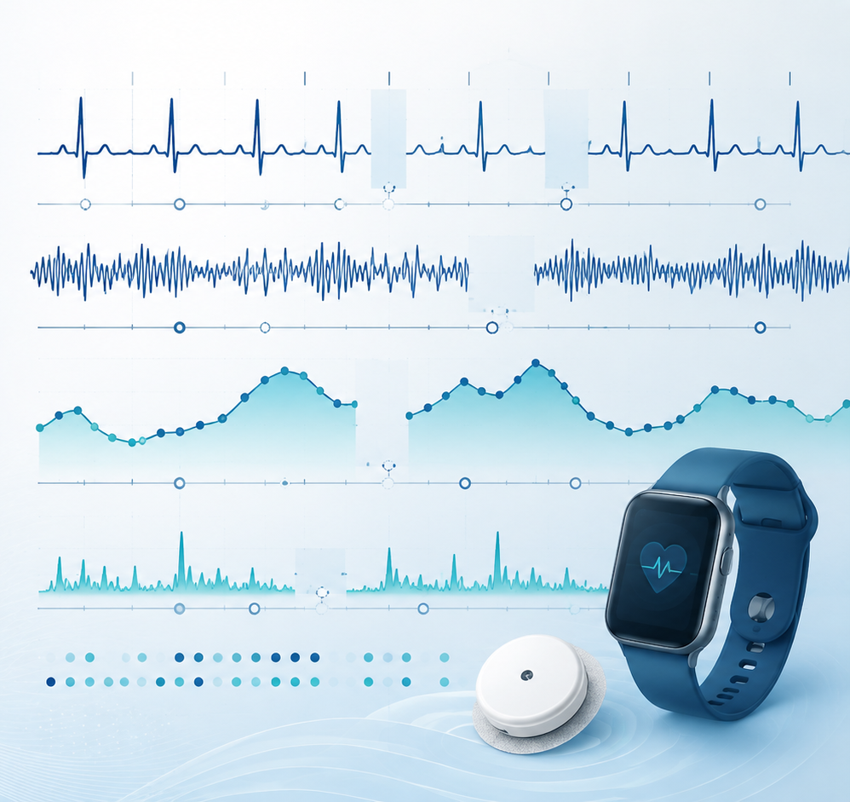
BIOMEDICAL APPLICATION
CNN for chest X-ray classification
Input: a 2D radiograph.
Task: classify findings such as normal vs abnormal, or detect specific pathologies.
CNN layers learn spatial features directly from the image.
The final layer outputs one or more class probabilities.
11

Slide 12
BEYOND CLASSIFICATION
Other CNN tasks in medical imaging
Segmentation
Detection
Assign a class to each pixel or voxel.
Locate lesions or anatomical structures.
Regression
Representation learning
Estimate quantities from images.
Extract useful image embeddings for later models.
12

Slide 13
SEQUENTIAL MODELS
Why sequences need temporal context
In ECG and CGM data, the meaning of one sample depends on surrounding samples.
Temporal order cannot be ignored.
A useful model should combine current input with information from previous time points.
Recurrent neural networks were designed for this purpose.
13

Slide 14
RNN INTUITION
Recurrent neural networks maintain a hidden state
At each time step, an RNN reads the current input.
It also receives a hidden state summarizing previous information.
The hidden state is updated and passed to the next time step.
This creates a computational memory across the sequence.
x1
x2
x3
x4
x5
h1
h2
h3
h4
h5
Information flows through time
14

Slide 15
RNN LIMITATIONS
Why simple RNNs struggle with long dependencies
During training, gradients must travel through many time steps.
They may become very small or very large.
This makes long-range relationships difficult to learn.
LSTM and GRU architectures were introduced to improve memory and gradient flow.
15

Slide 16
LSTM
Long Short-Term Memory — intuitive idea
LSTM introduces a memory cell and gates.
The gates decide what information to keep, forget and output.
This gives the model more control over long-term information flow.
LSTMs became widely used for biomedical time series before Transformers became common.
Forget gate
What should be discarded?
Input gate
What new information should be stored?
Output gate
What information should be exposed?
16

Slide 17
GRU
A simpler gated recurrent unit
GRU uses gating ideas similar to LSTM but with a simpler structure.
It often requires fewer parameters.
It can still capture longer dependencies than a basic RNN.
In practice, LSTM and GRU are alternative recurrent architectures.
17

Slide 18
BIOMEDICAL APPLICATION
Sequential models for ECG
Input: a temporal window of ECG samples.
The model processes the waveform in order.
It may learn rhythm, beat morphology and temporal dependencies.
Tasks include arrhythmia detection, rhythm classification and event prediction.
Sequence input
ECG samples over time
Model
RNN / LSTM / GRU
Output
rhythm class
18

Slide 19
BIOMEDICAL APPLICATION
Sequential models for CGM forecasting
Input: recent glucose values and possibly insulin, meals or activity.
The sequence model summarizes recent history.
The target may be glucose 15, 30 or 60 minutes in the future.
This turns CGM forecasting into a sequence-to-value problem.
History window
past 60 minutes
Prediction horizon
future 30 minutes
19

Slide 20
1D CNNS
Convolution can also be applied to signals
Convolution is not limited to 2D images.
A 1D convolutional filter scans along time.
It can detect local waveform motifs efficiently.
1D CNNs are often used for ECG, EEG, PPG and other physiological signals.
20

Slide 21
ARCHITECTURE CHOICE
1D CNN vs recurrent model
1D CNN
RNN / LSTM / GRU
Excellent at local temporal patterns.
Parallelizable and often fast.
Long-range context may require deeper or dilated designs.
Explicit sequential state.
Natural for ordered streams.
Harder to parallelize over time.
Practical point
Both families remain useful; the best choice depends on the dataset and task.
21

Slide 22
TRANSFORMERS
Why Transformers changed sequence modeling
Transformers do not rely on recurrence to process sequence context.
They use attention mechanisms to relate different positions directly.
This improves parallel computation during training.
Transformers became dominant in language and increasingly important in biomedical signals and sequences.
22

Slide 23
ATTENTION
Core intuition
For each position, the model asks: which other positions are most relevant to me?
Attention assigns higher weights to more relevant information.
The output is a weighted combination of information from the sequence.
This allows direct long-range interactions.
Query
Attention
scores
Weighted
combination
Keys
Values
23

Slide 24
SELF-ATTENTION
Query, key and value
Query
Key
Value
What information am I looking for?
What information do I contain?
What content should be passed forward?
The attention score compares queries and keys, then uses the scores to combine values.
24

Slide 25
TRANSFORMERS
Multi-head attention
A Transformer usually computes several attention mechanisms in parallel.
Each attention head can focus on a different type of relationship.
The head outputs are combined into a richer representation.
This is called multi-head attention.
25

Slide 26
TRANSFORMERS
Positional information
Attention alone does not inherently know the order of sequence elements.
Transformers therefore add positional information.
This tells the model which token or sample comes first, second and so on.
Position is crucial for text, ECG, CGM and biological sequences.
26

Slide 27
TRANSFORMER BLOCK
Simplified architecture
Input embeddings
Self-attention
Feed-forward network
Output representation
Numeric representation of tokens or signal segments
Relate positions across the sequence
Transform each position
Used for classification, prediction or generation
27

Slide 28
BIOMEDICAL TEXT
Transformers for clinical notes
Clinical notes are sequences of words or subword tokens.
Transformers create contextual representations: a word meaning depends on surrounding text.
Applications include document classification, information extraction and clinical summarization.
Domain-specific language models can be adapted to biomedical text.
Input
clinical note text
Transformer
context-aware representations
Output
classification / extraction
28

Slide 29
BIOMEDICAL SIGNALS
Transformers for ECG and CGM
Signals can be divided into samples, patches or windows and converted into embeddings.
Self-attention can connect distant time points directly.
This may help capture long-range patterns that are difficult for simple recurrent models.
Applications include ECG classification and glucose forecasting.
29

Slide 30
BIOMEDICAL SEQUENCES
Transformers for DNA, RNA and proteins
Biological sequences can be tokenized into nucleotides, amino acids or k-mers.
Transformers can model interactions between distant sequence positions.
This supports representation learning, functional prediction and sequence classification.
The architecture treats biological sequences as structured ordered data.
30

Slide 31
REPRESENTATION LEARNING
Embeddings
An embedding is a learned numeric vector representing an input element or whole sample.
CNNs learn image feature embeddings.
RNNs and Transformers learn sequence embeddings.
Embeddings can be reused for classification, clustering, retrieval or transfer learning.
31

Slide 32
TRANSFER LEARNING
Why pretrained models are useful
Large models can first be trained on broad datasets.
The learned representations can then be adapted to a smaller biomedical dataset.
This is called transfer learning.
It is especially useful when labeled medical data are limited.
Pretraining
learn general patterns
Fine-tuning
adapt to medical task
32

Slide 33
COMPARISON
CNN vs recurrent models vs Transformers
CNN
RNN / LSTM / GRU
Transformer
Best known for
Best known for
Best known for
Local spatial or temporal patterns
Highly parallel
Sequential state
Natural temporal processing
Long-range attention
Strong parallel training
No architecture is universally best: data structure, dataset size and task determine the choice.
33

Slide 34
COMPUTATIONAL TRADE-OFFS
What changes as architectures become more powerful?
Data requirements
Compute
Larger models usually need more data or pretraining.
Transformers and large CNNs can be computationally expensive.
Memory
Interpretability
Attention can be costly for very long sequences.
Complex architectures are harder to explain directly.
Latency
Real-time clinical applications may need smaller models.
34

Slide 35
CLINICAL PERSPECTIVE
Architecture choice must follow the clinical question
Radiograph classification → CNN is a natural starting point.
ECG rhythm recognition → 1D CNN, recurrent model or Transformer may all be reasonable.
CGM forecasting → temporal model is required.
Clinical text → Transformer is usually the dominant architecture family.
Final choice should be based on rigorous evaluation, not popularity.
35

Slide 36
COMMON PITFALLS
Important cautions
Architecture hype
Leakage
Newer does not automatically mean better.
Temporal and patient-level leakage can invalidate results.
Dataset shift
Compute vs benefit
Hospital, device or population differences matter.
Complexity should provide measurable value.
Explainability
High performance does not remove the need for interpretation.
36

Slide 37
IN-CLASS EXERCISE
Choose the architecture
1. Detect pneumonia on chest X-rays.
2. Predict hypoglycemia from the last 60 minutes of CGM.
3. Classify an ECG segment as normal or arrhythmic.
4. Extract diagnoses from a clinical note.
5. Predict a property from an amino-acid sequence.
For each task, choose CNN, recurrent model, Transformer or a combination, and explain why.
37

Slide 38
CONCLUSION
Take-home messages
CNNs exploit local spatial structure and are fundamental for medical imaging.
RNNs, LSTMs and GRUs process sequences through a recurrent hidden state.
1D CNNs provide an efficient alternative for local temporal patterns in physiological signals.
Transformers use attention to model long-range relationships without recurrence.
Clinical text, ECG, CGM and biological sequences can all be represented for Transformer-based modeling.
Architecture choice should follow the data structure, clinical task and evaluation evidence.
38

