Slide 1


CMP-III
Simon de Poorter
Bachelor in de Grafische en Digitale Media
3MMP proDUCE
16-17

Slide 2
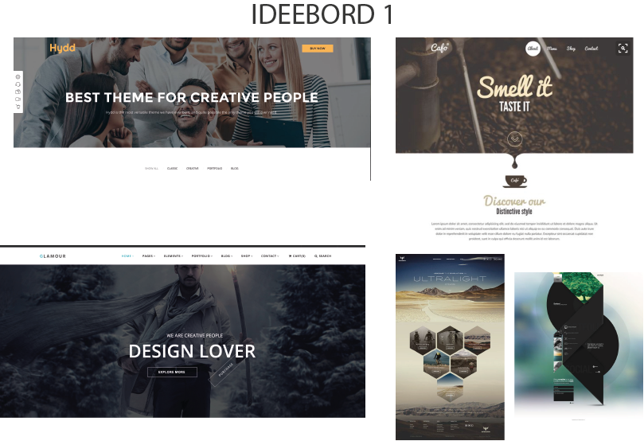
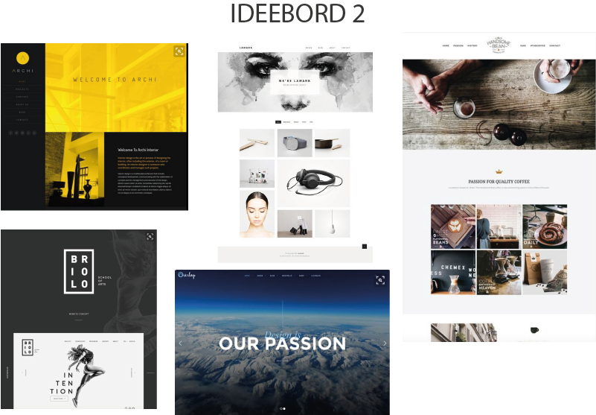
Ideeborden

Slide 3
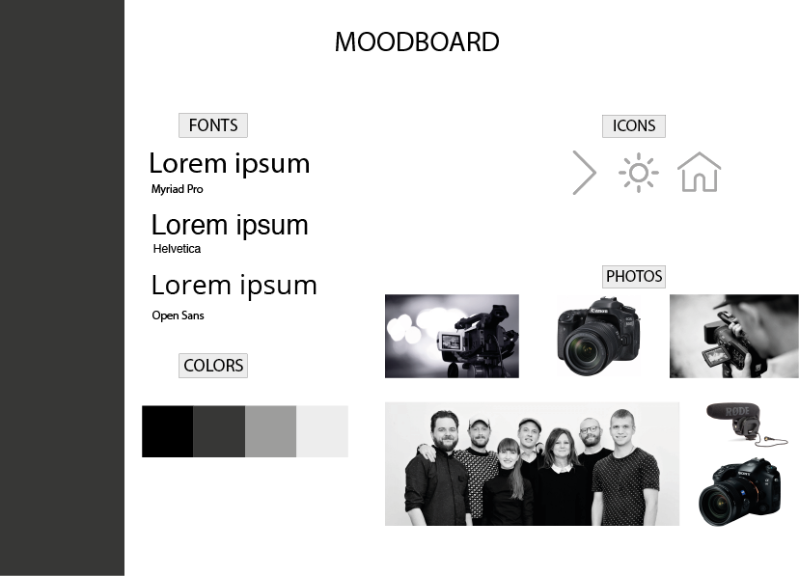
Moodboard

Slide 4
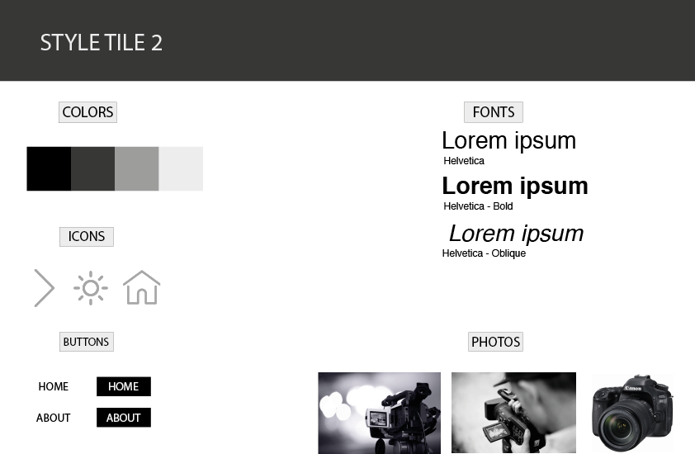
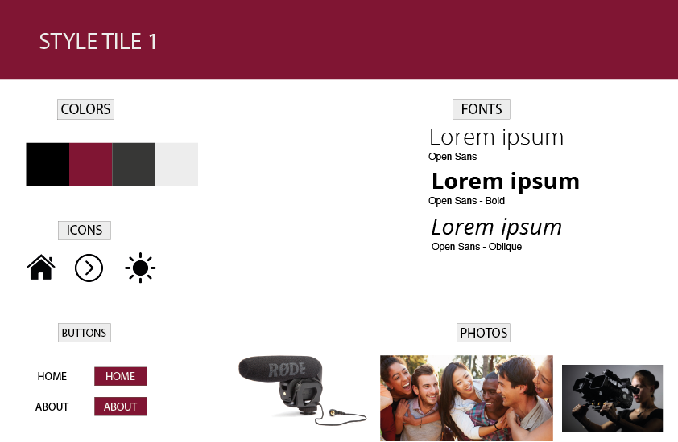
Style tiles

Slide 5
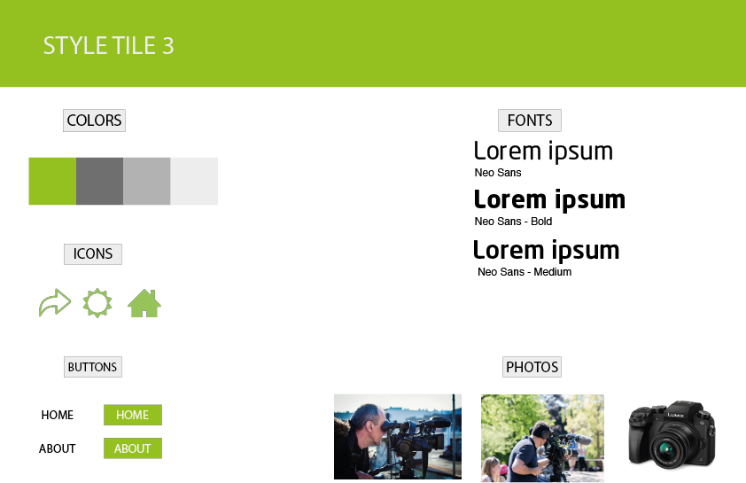
Style tiles

