Slide 1
Playing the Snake Game with
Deep Reinforcement Learning
Chuyang Liu
https://github.com/chuyangliu/snake

Slide 2

Contents
01
Background
02
My Works
03
Algorithms
04
Experiments
05
Summary

Slide 3
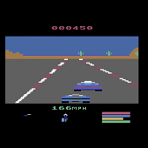
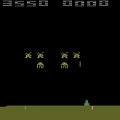
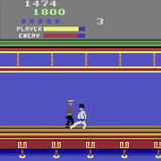
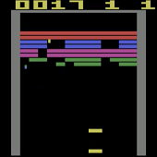
Background
Deep Q-Network (DQN)
DDQN, Prioritized, Duel
Path Search, Hamilton Cycle
Human-Level Control through Deep
Reinforcement Learning (DeepMind)
DQN Optimizations
Snake AI (Chuyang Liu)
2015
2016
2017
Benchmark: Atari 2600
Snake AI
(Hawstein, Tobin Ehlis,
Christopher Lockhart, …)
BFS, Longest Path
Graph Theory, GP, RL, …

Slide 4
My Works
?
DQN
DQN Optimizations
Implemented Deep Q-Network
(Experience Replay & Fixed Target-Net)
Compared the performance of
the three optimizations for DQN
Feature Extraction
Environment
Designed global/local state vector
Discussed absolute/relative move direction
Designed a better reward
policy improving performance

Slide 5

Algorithm: Computation Graph
Loss
Q-Target
Q-Eval
assign
Eval-Net
Target-Net
reward
state’
Environment
action
Policy
state

Slide 6
Algorithm: Environment
FOOD | +1.0
DEAD | -0.5 (game over)
ELSE | -0.005
reward
state’
Environment
action
Policy
state

Slide 7
Algorithm: Computation Graph
Loss
Q-Target
Q-Eval
assign
Eval-Net
Target-Net
reward
state’
Environment
action
Policy
state

Slide 8
Algorithm: Network & State Vector
assign
Eval-Net
Target-Net

Slide 9
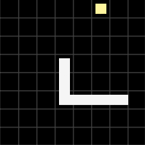
Algorithm: Network & State Vector
Q_{1x3}
Advantage_{1x3}
Value_{1x1}
FC₅₁₂
FC₅₁₂
Eval-Net
FC₁₀₂₄
assign
Conv_{2x2x256}
Target-Net
local (1x3)
Conv_{2x2x128}
Same structure
but different weights and bias
Conv_{3x3x64}
Conv_{3x3x32}
global (8x8x4)

Slide 10
Experiments

Slide 11
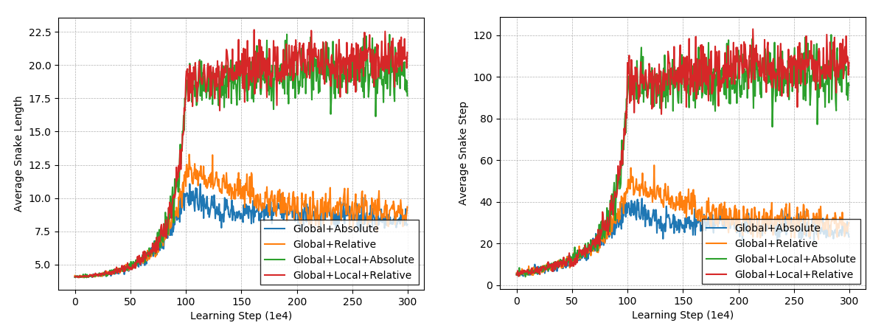
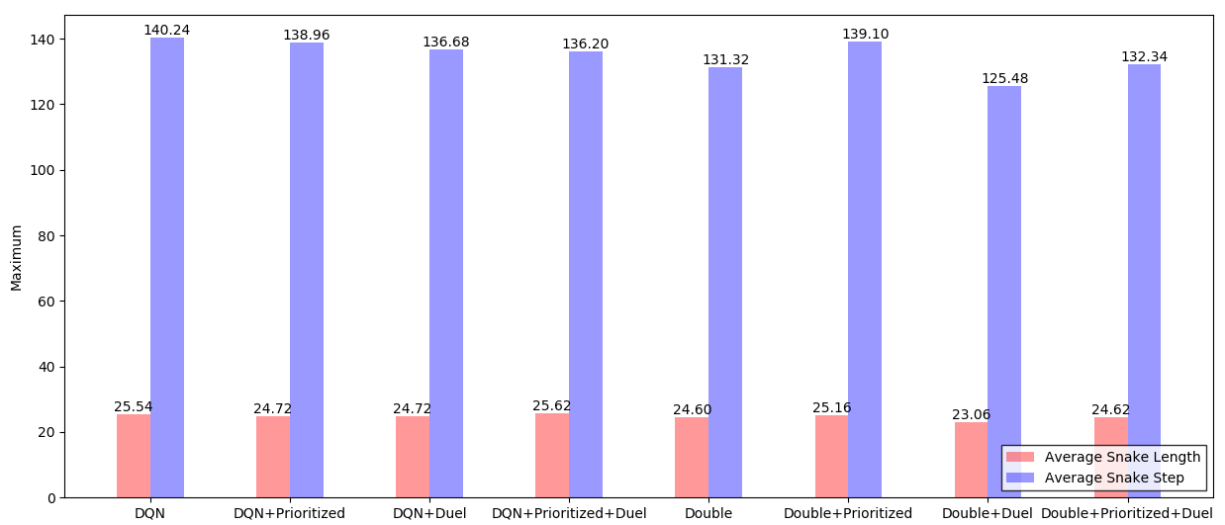
Experiments

Slide 12
Summary
DQN
Training Efficiency
Double DQN
Prioritized Experience Replay
Dueling Network Structure
Deep Neural Network
Deep Q-Learning from Demonstrations (2018)
State & Action
Network Inputs
Feature Extraction
Environment Feedback
Human experience
Pixels input

Slide 13

Thanks
Chuyang Liu
https://github.com/chuyangliu/snake

