Slide 1
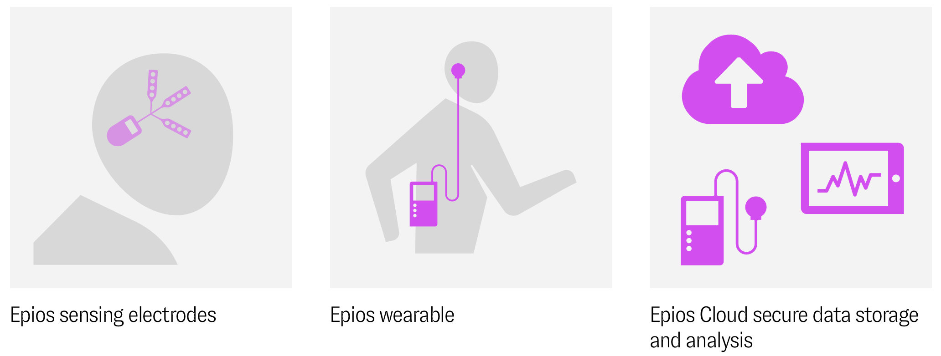
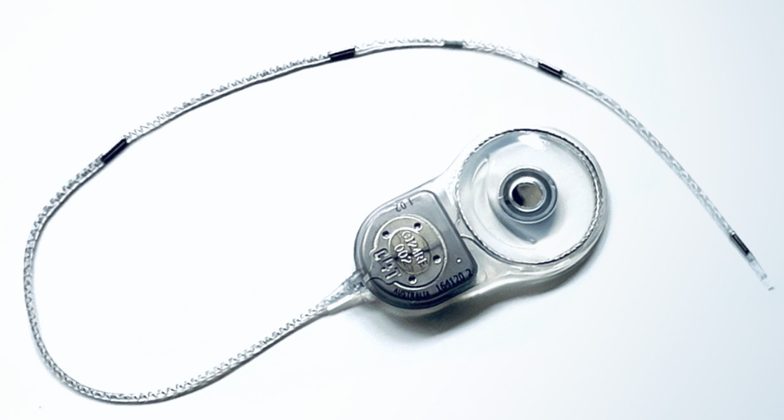
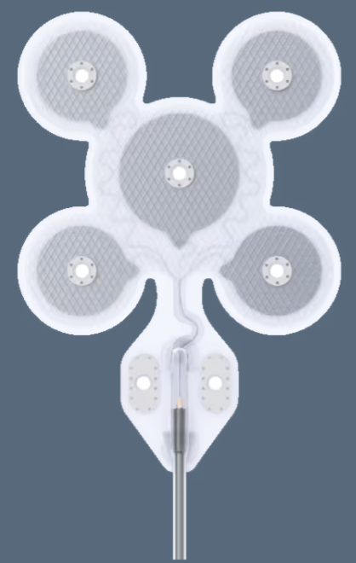
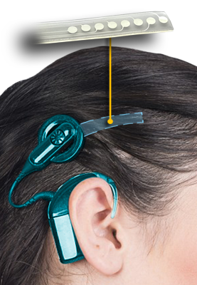
Market analysis for minimally invasive TIS

Slide 2
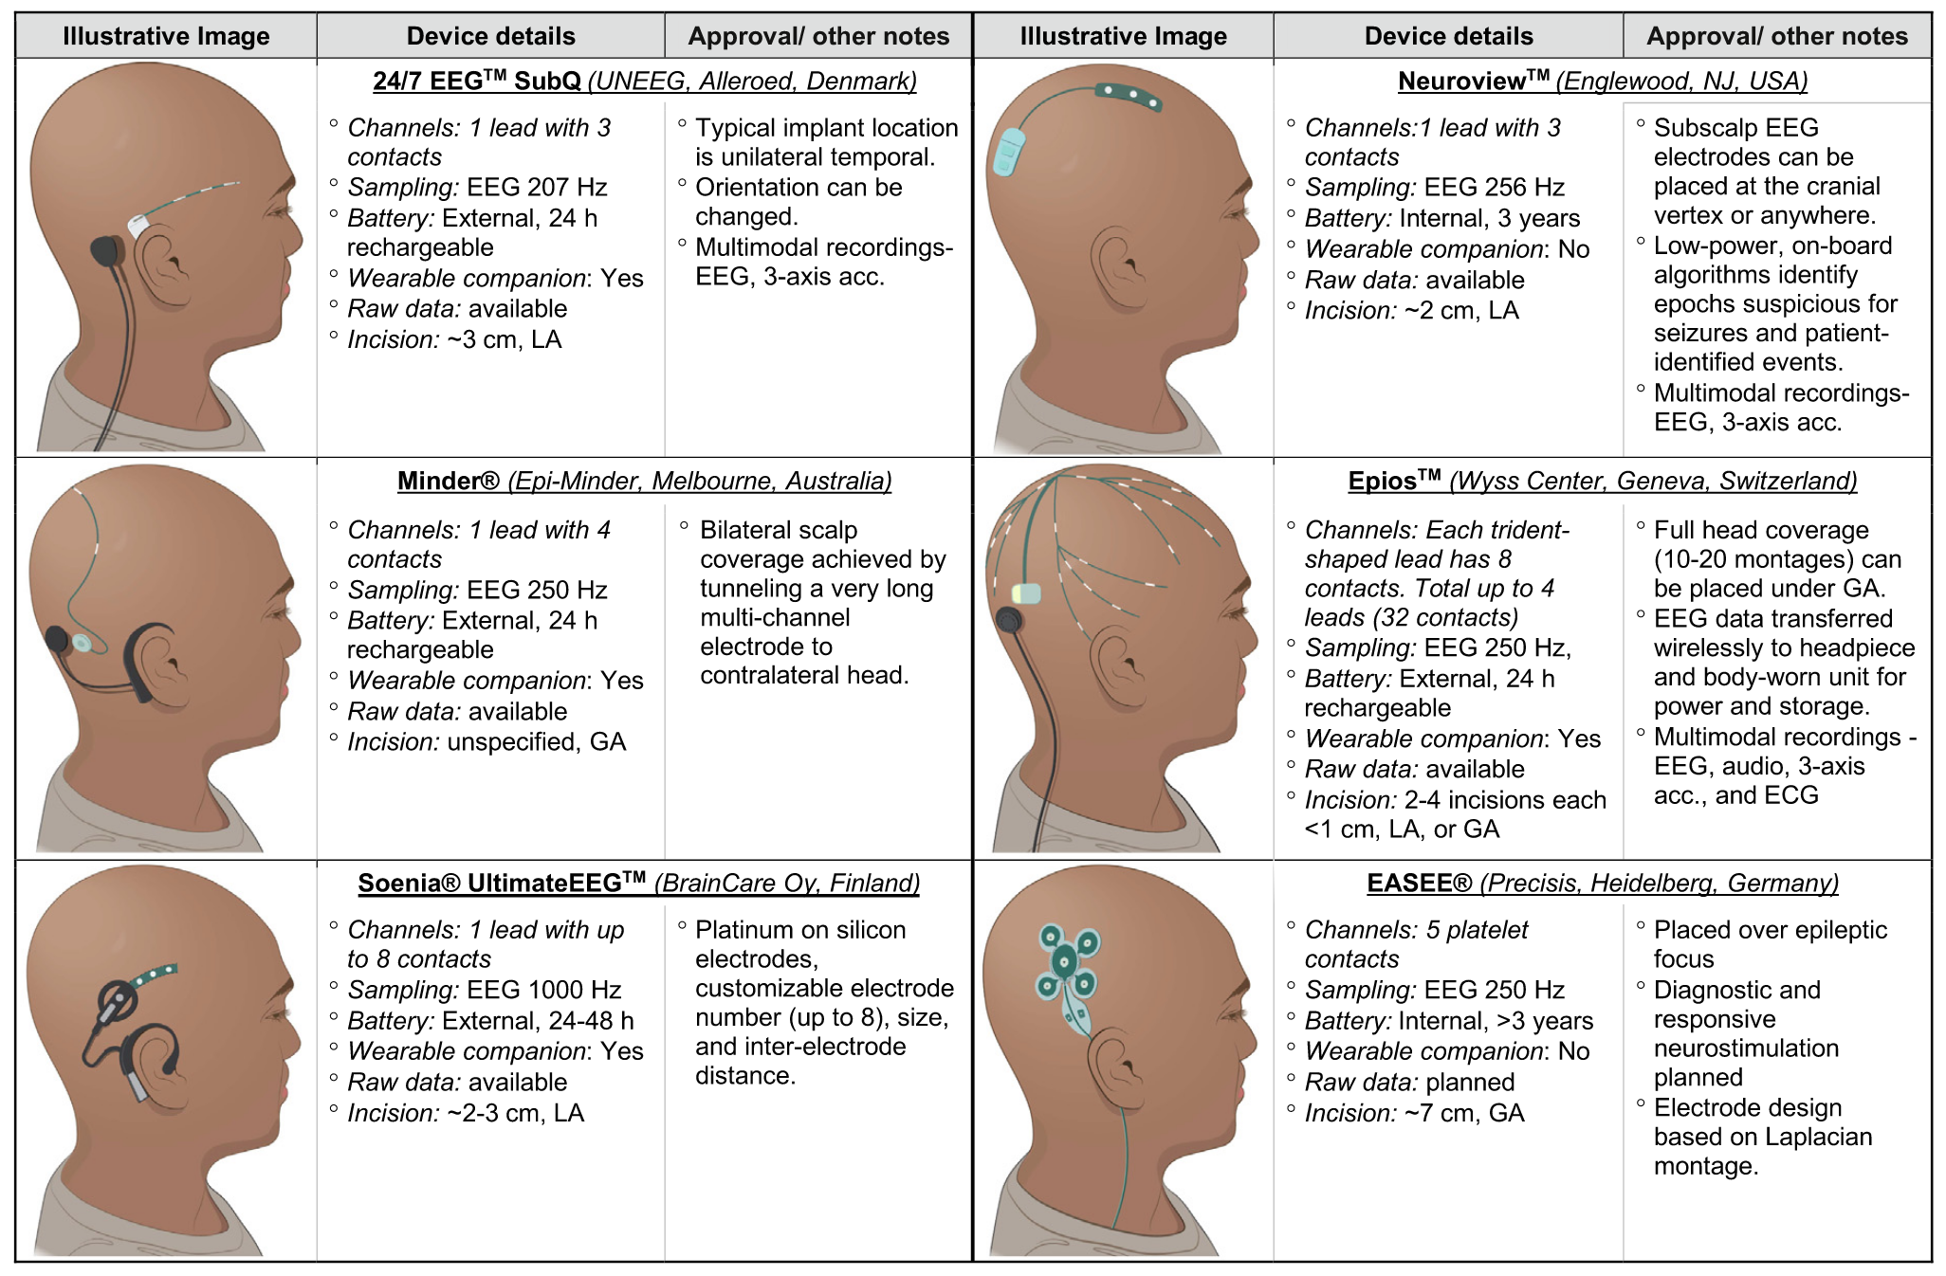
Notes:
LA=local anesthesia
GA=general anesthesia

Slide 3
Epios™ (Wyss Center)
Only recording (bilateral)
Subscalp sensing electrodes + miniature implant beneath the skin powered by an external device (Epios Wearable)
EW held in place on the skin over the implant with a magnet → external receiver and data processor
  Wireless transmission of neural signals to the receiver → conveyed to data processor → stored in the Epios Cloud
Primary target: Epilepsy
Notes:
The first indication of the Epios system is epilepsy, but also spinal cord injury and stroke, as well as Parkinson’s disease, sleep disorders, pain management and neuromodulation of brain circuits for mental health applications.

Slide 4
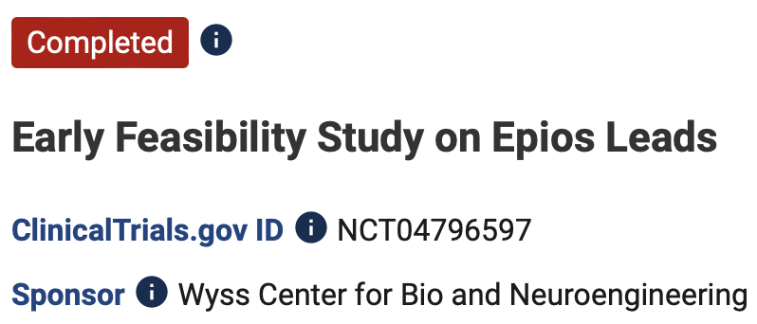
Epios™ (Wyss Center)
Only recording
Subscalp sensing electrodes + miniature implant beneath the skin powered by an external device (Epios Wearable)
EW held in place on the skin over the implant with a magnet → external receiver and data processor
  Wireless transmission of neural signals to the receiver → conveyed to data processor → stored in the Epios Cloud
Primary target: epilepsy
On patients requiring brain surgery:
Step1: intra-operative 10’ rec with Epios leads
On patients with pharmaco-resistant epilepsy:
Step2: clinically iEEG + Epios rec in parallel (<21 days)
→ general anesthesia
University Hospital of Bern
https://www.clinicaltrials.gov/study/NCT04796597

Slide 5
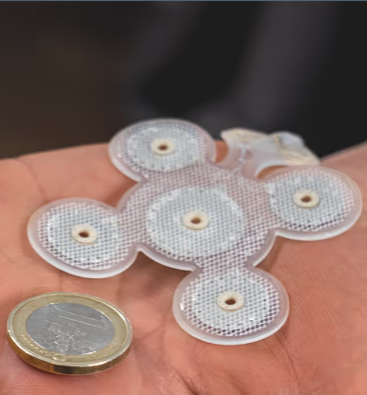
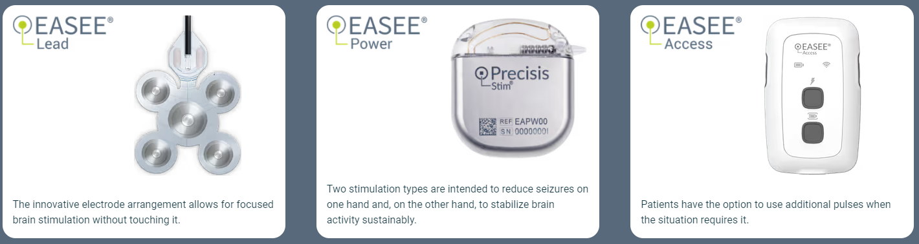
EASEE® (Precisis, Heidelberg)
Recording (unilateral) and stimulation
Target: Epilepsy
Electrode array
Electrode cable tunneled to the chest area and connected to the IPG (subcutaneously implanted, general anesthesia)
5 cm

Slide 6
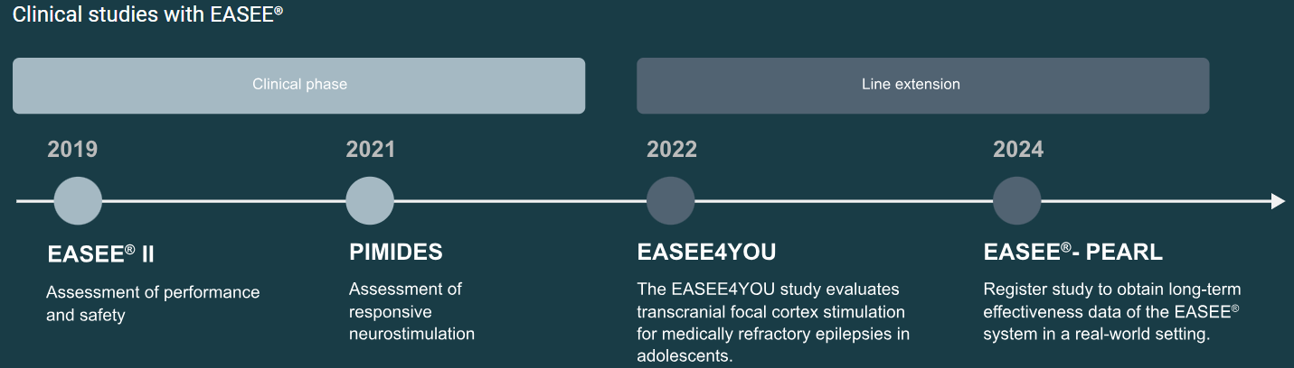
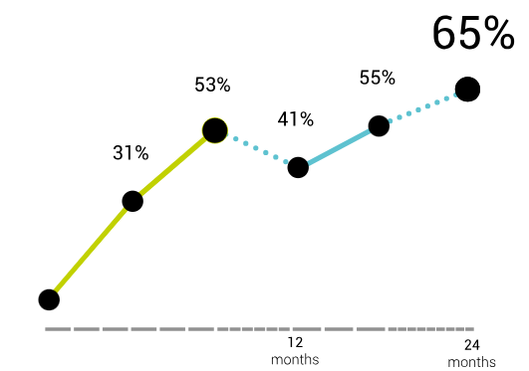
EASEE® (Precisis, Heidelberg)
Target: Epilepsy
Electrode array
Electrode cable tunneled to the chest area and connected to the IPG (subcutaneously implanted)
Responder rate
https://easee.precisis.de/en/health-care-professionals/effects/

Slide 7
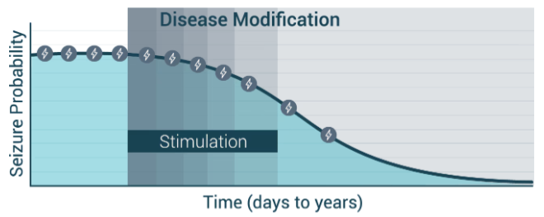
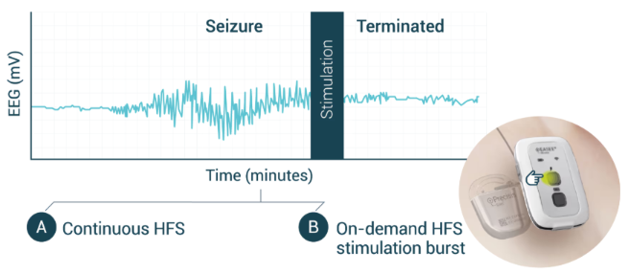
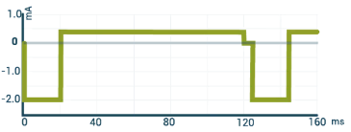
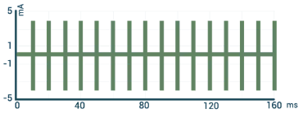
EASEE® (Precisis, Heidelberg)
Two different stimulation patterns
HF pulses for interrupting emerging seizures
DC-like cathodal pulses to reduce brain hyperexcitability (LTD)

Slide 8
EASEE® (Precisis, Heidelberg)
Mean impedance for outer contacts: 3713 Ω (data from 4 patients)
  Min 1475 Ω
  Max 7852 Ω
  Intra-patient variation: between 371 Ω and 1894 Ω
https://www.sciencedirect.com/science/article/pii/S0165027021002302

Slide 9
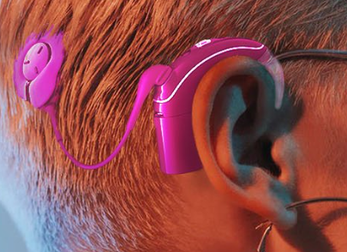
Minder® system (epiminder, Australia)
Recording only (Long-term EEG, bilateral)
Target: Epilepsy
Subscalp lead (4 electrodes) connected to the implant
Coil for data and power transfer between implant and external wearable processor
External wearable processor to transmit data via bluetooth to smartphone
https://epiminder.com/the-minder-system/

Slide 10
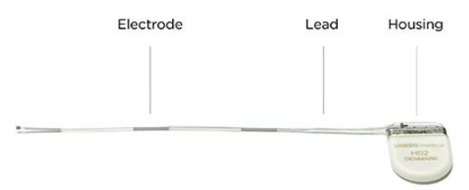
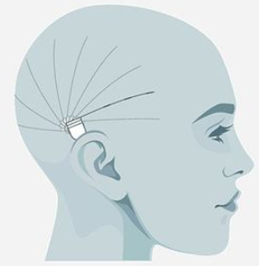
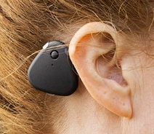
24/7 EEGTM SubQ (UNEEG medical, Denmark)
CE marked (pending FDA approval in 2022)
Recording only (Long-term EEG, up to 15mo)
unilateral
Target: Epilepsy
Two active electrodes, one reference (middle)
  Position chosen to accomodate the clinical question
  Local anesthesia
Implanted lead connects to external storage unit through inductive link
https://www.uneeg.com/

Slide 11
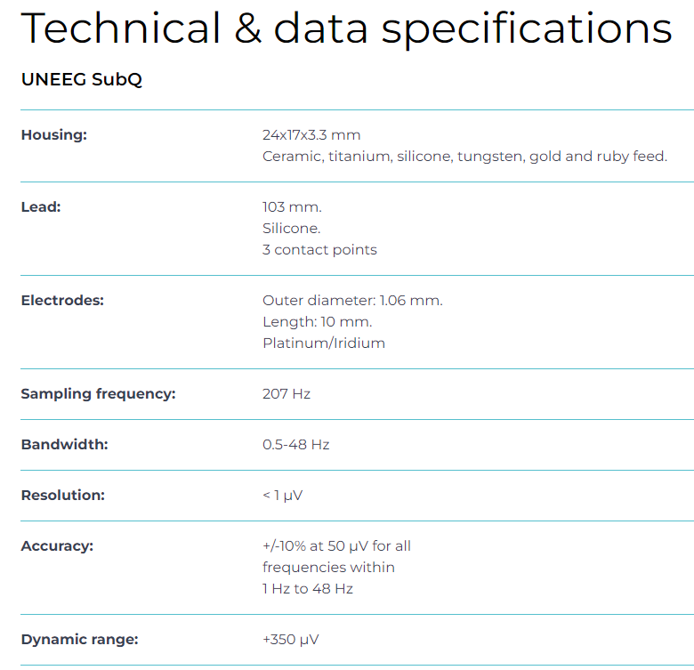
24/7 EEGTM SubQ (UNEEG medical, Denmark)
https://www.uneeg.com/

Slide 12
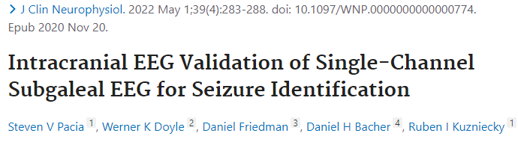
NeuroviewTM (Neuroview Technology, NJ)
Recording only (unilateral)
21 epilepsy patients undergoing iEEG + subgaleal EEG
https://neuroviewtech.com/

Slide 13
Soenia® UltimateEEG™ (Soenia, Finland)
Recording only
Target: Epilepsy
Flexible electrodes
https://soenia.fi/electrode-implant/

Slide 14
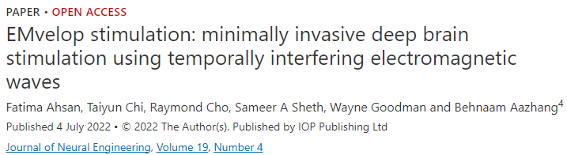
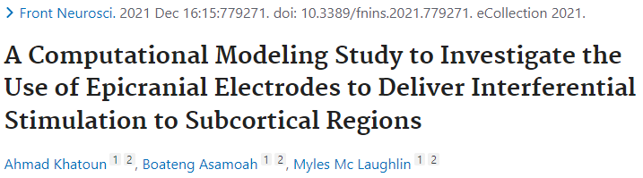
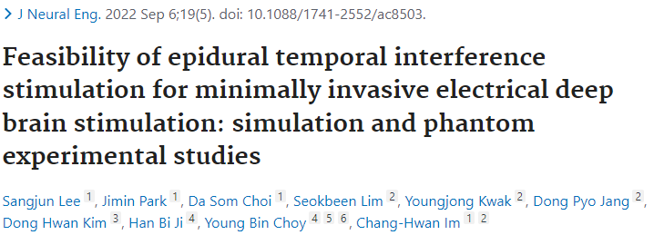
Minimally invasive TIS
Computational studies
Phantom simulations

