Slide 1
GERMEVAL 2017 ASPECT-BASED SENTIMENT ANALYSIS
Prompting vs. Fine-Tuning on German Customer Feedback
Understanding the Dataset, the Tasks, and Why Fine-Tuning Beats Prompting by +14.5 F1
THE BENCHMARK
26,209 German Reviews
19 Aspect Categories × 3 Polarities
THE MAIN RESULT
Fine-Tuning: 0.849 Micro-F1
10-Shot Prompting: 0.703 Micro-F1
THE EFFICIENCY
1,000 Training Examples (~2 min)
Already Match 10-Shot Prompting

Slide 2
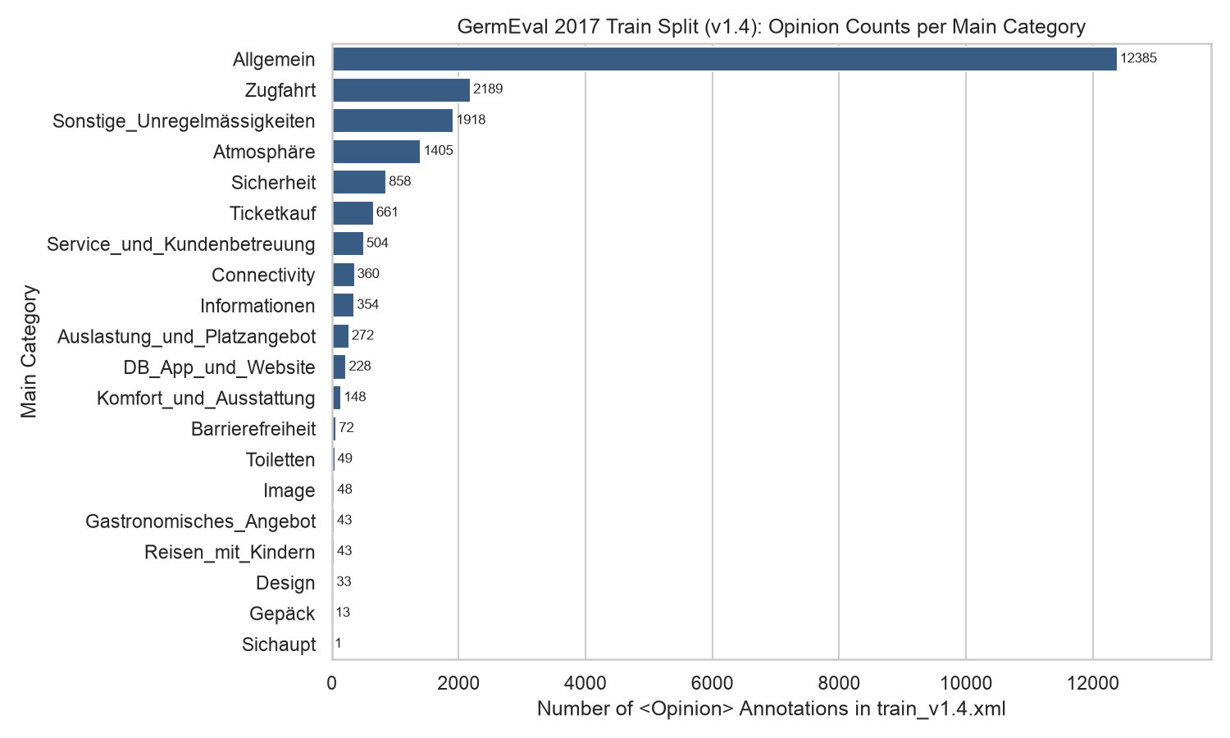
1. The Dataset: Real-World German Customer Feedback
26,209 social media, news, and forum posts about Deutsche Bahn (GermEval 2017 Shared Task)
2 / 7
Corpus Structure & Challenges
• 4 Official Splits (26,209 Docs): Train (19,432) | Dev (2,369) | Synchronic Test (2,566) | Diachronic Test (1,842, collected months later).
• Noisy User-Generated Text: Tweets, forum threads, and news comments with irony, slang, hashtags, and typos.
• 21% Out-of-Domain Noise: Over a fifth of posts mention trains/stations only in passing (relevance=false) and carry 0 opinions.
• Severe Class Imbalance: Dominated by Allgemein, Zugfahrt, and Sonstige_Unregelmässigkeiten; rare categories appear in <1% of docs.

Slide 3
2. The Task: From Unstructured Text to Structured Opinions
What the model receives as input and what it must predict for Task C and Task D
3 / 7
Example Customer Post (Input to Gemma-2-2B-IT)
"@DB_Bahn Mal wieder 45 Minuten Verspätung im ICE nach München und das WLAN geht auch nicht! Personal war aber freundlich."
("Once again 45 minutes delay on the ICE to Munich and the Wi-Fi isn't working either! Staff was friendly though.")
Task C: Aspect–Polarity Classification (Primary)
• Goal: Identify every (Category:polarity) pair expressed in the post.
• 19 Categories × 3 Polarities: e.g., Zugfahrt:negative, Sonstige_Unregelmässigkeiten:negative, Atmosphäre:positive.
• Two Sub-Metrics: Task C1 = Category only | Task C2 = Category + Polarity.
• Predicted JSON Output: {"labels": ["Atmosphäre:positive", "Sonstige_Unregelmässigkeiten:negative", "Zugfahrt:negative"]}
Task D: Opinion Target Extraction (Span-Level)
• Goal: Extract the exact text phrase (target word/span) that triggered each specific opinion.
• Character-Grounded Evaluation: Evaluated by exact character offset match in the original German sentence.
• Predicted JSON Output: {"targets": [{"category": "Zugfahrt", "polarity": "negative", "target": "Verspätung"}, {"category": "Sonstige_Unregelmässigkeiten", "polarity": "negative", "target": "WLAN"}]}

Slide 4
3. The Approaches Compared on Gemma-2-2B-IT
All methods use the exact same 2.6B base model and output the exact same JSON schema
4 / 7
1. Zero-Shot Prompting
• P0 (Minimal): Lists only the 19 category names and 3 polarities (~285 tokens/doc).
• P1 (Guidelines): Includes official German definitions for all 19 categories (~660 tokens/doc).
• No Training Needed: Model weights remain 100% untouched.
2. Few-Shot Prompting
• P2 (2, 5, 10-Shot): Adds labeled German review examples inside the prompt.
• P3 (Dev-Optimized 10-Shot): Selects the 10 most informative examples covering rare categories (~1,760 tokens/doc).
• High Inference Cost: 2.7x more input tokens on every test document.
3. Fine-Tuning (LoRA/QLoRA)
• Trains on 19,432 Docs: Adapts 0.79% of weights (20.8M params) for 3 epochs.
• L1 (16-bit LoRA): Full 16-bit base weights (7.2 GB VRAM).
• Q1 (4-bit QLoRA): Compressed 4-bit base weights (2.9 GB VRAM — runs on any Colab GPU).

Slide 5
4. Main Results: Task C Aspect–Polarity Classification
Fine-tuning outperforms the best 10-shot prompt by +14.5 Micro-F1 (+19.5 on Official Java-Compat F1)
5 / 7
Approach (test_syn = 2,566 docs) | C1 Strict F1 (Category) | C2 Strict F1 (Cat+Pol) | C2 Official Java F1 | Exact Document Match | Diachronic Test C2 F1
P0 Minimal Zero-Shot | 0.555 | 0.464 | 0.302 | 36.8% | 0.435
P1 Guideline Zero-Shot | 0.668 | 0.587 | 0.416 | 47.4% | 0.555
P2 Few-Shot (2 Examples) | 0.706 | 0.639 | 0.469 | 53.4% | 0.608
P2 Few-Shot (5 Examples) | 0.741 | 0.667 | 0.501 | 57.3% | 0.638
P3 Optimized 10-Shot | 0.767 | 0.703 | 0.542 | 60.0% | 0.711
Q1 4-bit QLoRA Fine-Tuned | 0.873 | 0.836 | 0.718 | 75.3% | 0.823
L1 16-bit LoRA Fine-Tuned | 0.882 | 0.849 | 0.737 | 76.8% | 0.818
Three Key Findings from the Benchmark Table
• 1. Guidelines help Zero-Shot (+12.3 F1) and 10-Shot helps further (+11.6 F1), but Prompting plateaus at 0.703.
• 2. Fine-Tuning jumps to 0.849 F1 (predicting the exact full set of opinions on 76.8% of documents vs. 60.0% for 10-shot).

Slide 6
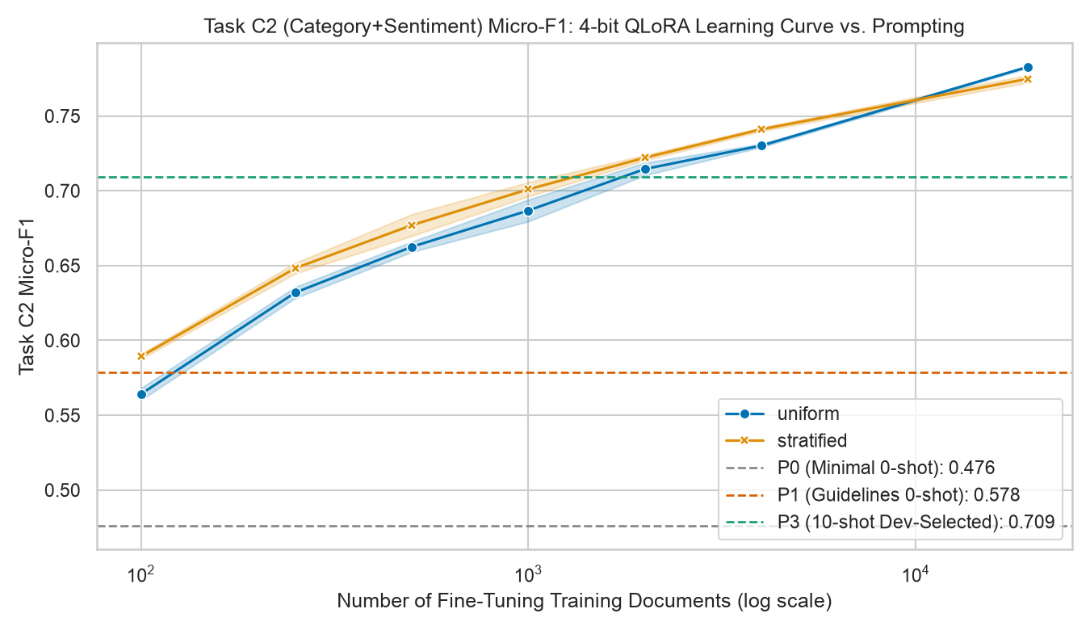
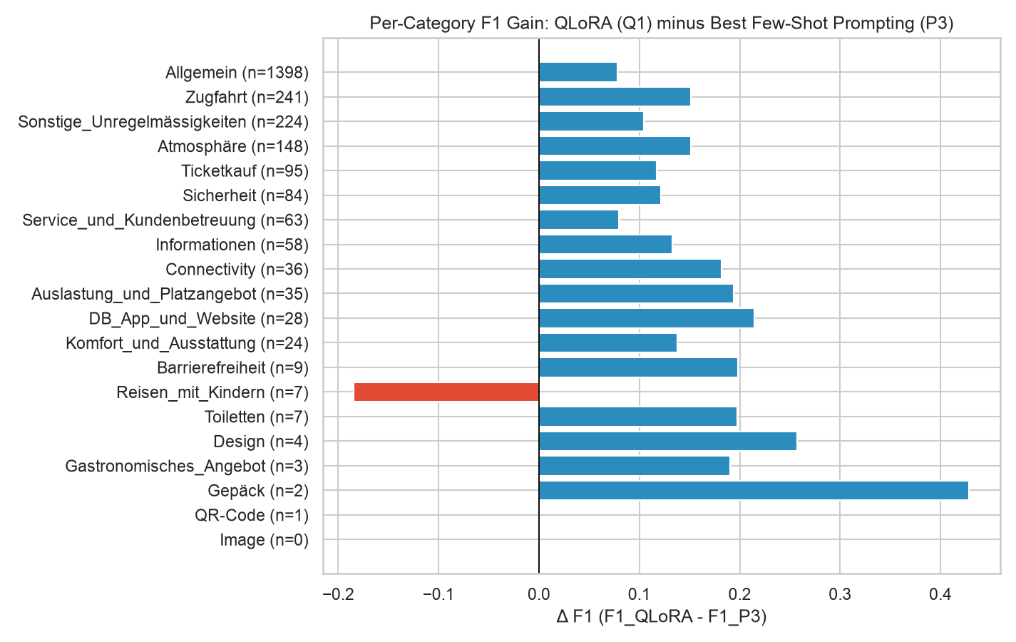
5. Sample Efficiency & Per-Category Improvements
How many labeled reviews are needed to beat prompting, and which categories improve most?
6 / 7
Sample Efficiency (Left Chart)
• 1,000 docs (5% of train): Reaches 0.701 F1 in 1.6 GPU minutes — matching 10-shot prompting.
• 2,000+ docs: Clearly surpasses all prompting baselines.
Category Gains & Span Extraction (Right Chart)
• All 19 Categories Improve: Largest gains on subtle/implicit categories (Allgemein, Zugfahrt, Sicherheit).
• Task D Target Extraction: Exact span F1 jumps from 0.566 (5-shot) to 0.762 (QLoRA, +19.6 F1).

Slide 7
6. Main Takeaways of the Experiment
When to use Prompting vs. Fine-Tuning for domain-specific classification & extraction
7 / 7
1. Prompting Hits a Ceiling
• Good for Prototyping: Adding official guidelines (P1) and 10 examples (P3) lifts F1 from 0.464 to 0.703.
• Cannot Master Boundaries: Even 10 examples cannot capture all domain nuances across 19 categories and noisy German posts.
• Expensive at Scale: 2.7x higher token cost on every single inference request.
2. Fine-Tuning Wins Big
• +14.5 F1 Accuracy Jump: Reaches 0.849 Strict Micro-F1 on Task C2 and +19.6 F1 on Task D span extraction.
• High Data Efficiency: Just 1,000 labeled reviews match 10-shot prompting; 2,000+ beat it decisively.
• Robust Over Time: Maintains 0.823 F1 on the diachronic test set collected months later.
3. 4-Bit QLoRA = Best ROI
• 98.5% of 16-Bit Accuracy: 4-bit QLoRA achieves 0.836 F1 vs. 0.849 F1 for 16-bit LoRA.
• Runs on Any GPU (2.9 GB): Fits easily on a free Google Colab T4 or L4 GPU.
• Fast & CompactInference: Uses compact prompts at test time with 100.0% valid JSON output.

