Slide 1
AGENTIC RAG CHATBOT
A Modular System for Intelligent Document Analysis using a Multi-Agent Communication Protocol
Presented by: PHILIP SIMON DEROCK
Notes:
This presentation introduces the Agentic RAG Chatbot, a system designed for advanced document analysis. We'll cover its architecture, the flow of information, the technology behind it, and future directions.

Slide 2
Agent-based Architecture with MCP
The system is built on a modular, agent-based architecture where each agent has a specific responsibility.
Communication is handled by the Model Context Protocol (MCP), a lightweight, in-memory message bus that facilitates asynchronous communication between agents.
Key Agents:
• UIAgent: Manages the Streamlit frontend, handles user interactions, and communicates with backend agents.
• IngestionAgent: Receives documents and splits them into processable chunks.
• RetrievalAgent: Embeds and stores chunks in ChromaDB; retrieves context for queries.
• LLMResponseAgent: Uses context from RetrievalAgent and Gemini LLM to generate responses.
Notes:
The core of our system is its modularity. By separating concerns into distinct agents, we create a system that is easier to maintain, test, and scale. The MCP is the glue that holds it all together, allowing these specialized agents to work in concert without being tightly coupled.

Slide 3
System Flow: From Upload to Answer
1. Document Ingestion:
• UIAgent uploads file to IngestionAgent
• IngestionAgent parses file and sends chunks to RetrievalAgent
• RetrievalAgent embeds and stores chunks in ChromaDB
2. Query & Response:
• UIAgent sends query to LLMResponseAgent
• LLMResponseAgent requests context from RetrievalAgent
• RetrievalAgent performs semantic search and returns context
• LLMResponseAgent generates answer using Gemini LLM
• UIAgent displays final response
Notes:
This diagram illustrates the two primary workflows. The ingestion process is asynchronous and populates our knowledge base. The query process is a direct chain of requests and responses, starting with the user's question and ending with a contextually rich answer generated by the LLM.

Slide 4
Technology Stack
• Frontend: Streamlit
• Backend & Core Logic: Python, asyncio
• LLM: Google Gemini (gemini-1.5-flash-latest)
• Vector Storage & Search: ChromaDB
• Text Embeddings: sentence-transformers
• Document Parsers: PyPDF2 (PDF), python-pptx (PowerPoint), pandas (CSV), python-docx (Word)
• Communication: Custom MCP (Model Context Protocol)
Notes:
We chose this stack for its powerful open-source libraries and rapid development capabilities. Streamlit is excellent for building interactive UIs quickly, while ChromaDB and sentence-transformers provide a solid foundation for the RAG pipeline. Gemini was selected for its strong performance and large context window.

Slide 5
Challenges and Future Improvements
Challenges Faced:
• Asynchronous UI Updates: Managed async message passing with polling mechanism.
• State Management: Used st.session_state to persist vector store and agent states.
• Dependency Versioning: Had to pin versions of pandas, numpy, etc., for compatibility.
Future Scope:
• Enhanced UI Feedback: Show real-time processing status to users.
• Scalable Message Bus: Replace MCP with RabbitMQ or Redis for production.
• Advanced Retrieval: Add hybrid search or result re-ranking strategies.
Notes:
Building this system presented interesting engineering challenges, particularly around integrating an asynchronous backend with Streamlit. Looking ahead, our focus is on improving user experience, enhancing scalability for production environments, and increasing the intelligence of our retrieval system.

Slide 6
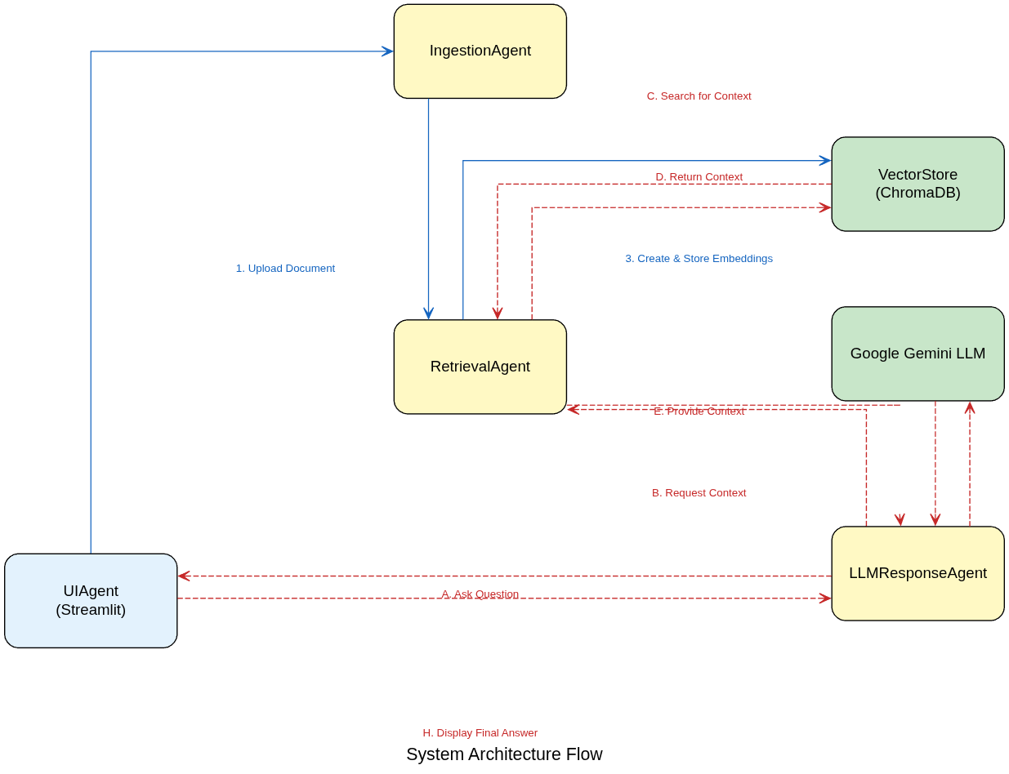
System flow diagram

Slide 7
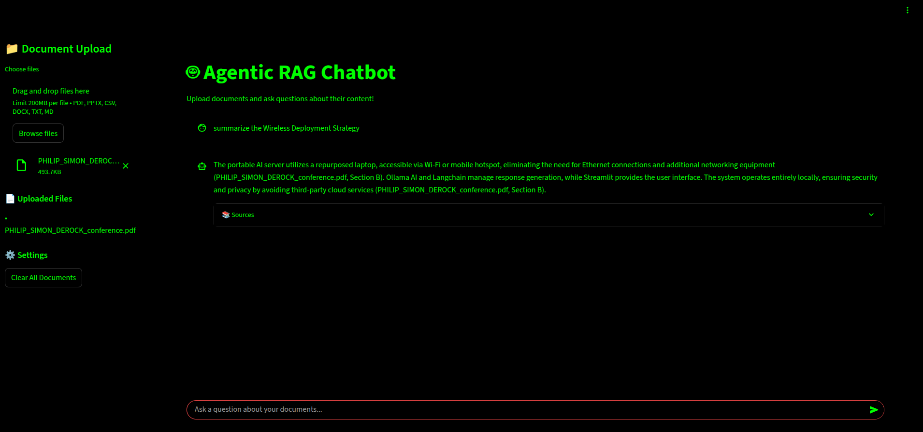
Output
Project Live Link: https://huggingface.co/spaces/philip11/Agentic-RAG-Chatbot

