Slide 1
Personalization Toolkit:
Training Free Personalization of Large Vision Language Models
Soroush Seifi*, Vaggelis Dorovatas, Daniel Olmeda Reino, Rahaf Aljundi
Toyota Motor Europe
https://arxiv.org/abs/2502.02452

Slide 2
Introduction
L(V)LMs are dominating the world of personal assistants.
Large Vision Language Model¹ (LVLMs) have the potential to become personalized assistants.
The field of LVLMs personalization has emerged.
The goal is to detect personal objects in user images and provide tailored responses.
1 – E.g. Llava

Slide 3
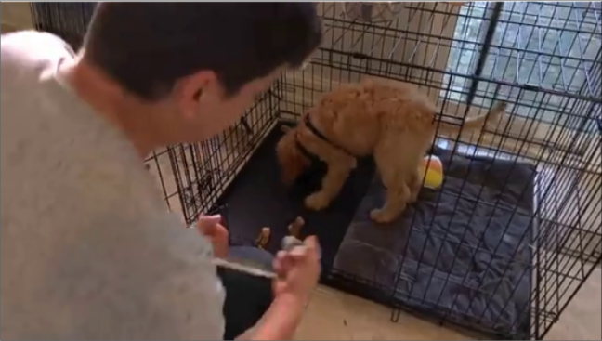
Introduction
Karl
User: What is Karl doing?
PeKit: Karl is standing on a black mat inside a cage
LLaVA: Karl is playing with a dog

Slide 4
Introduction
Current methodologies¹ rely on test-time training for each user and object.
Computing-intensive.
Privacy concerns with training on user images.
Limits model ability to incrementally learn new personalized concepts.
1 – E.g. Yo’LLaVA, MyVLM
Notes:
New concept added with training can interfere with old ones, causing catastrophic forgetting

Slide 5
Introduction
PeKit approach: Leverage training-free methods to provide a personalized experience.
Localizes objects instances using open-world object detectors¹
Stores objects feature embeddings in a memory module
On user query, the retrieval module, R, query the memory, M, and visual-prompt the LVLM which uses in-context learning to provide personalized answers.
PeKit beats training-based approaches
Potential to scales to large number of objects per user
No training on user images, no storage of user personal images
Supports multiple personalized objects per image
PeKit provides a new benchmark for LVLM personalization: This-is-My-Img
1 – E.g. GroundingDINO

Slide 6
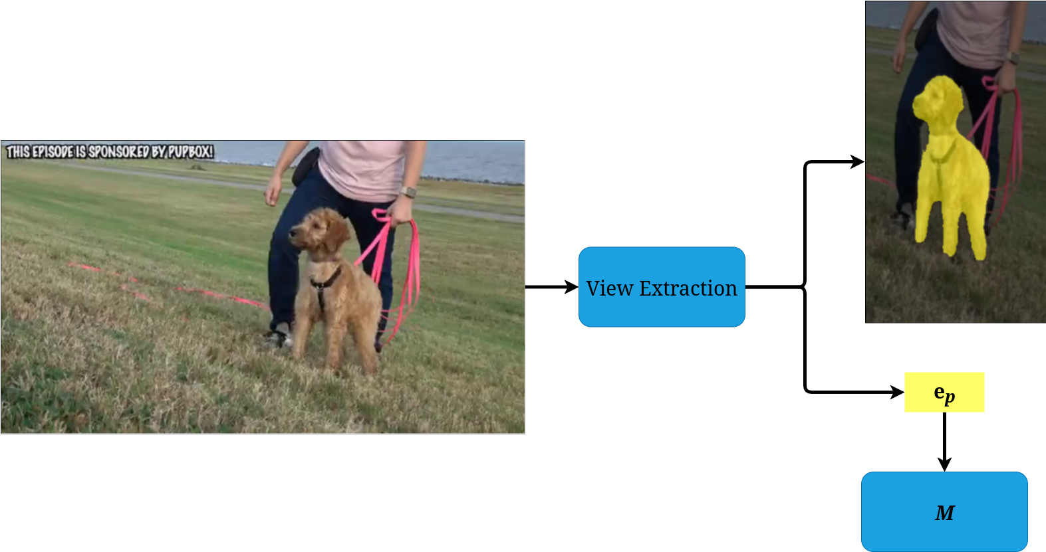
Method – Personalized object introduction
This is my dog Karl

Slide 7



Method – Personalized object introduction
Localizes object p in the image I_{p} and find its mask S_{p} using an open-vocabulary segmentation network¹ F_{ext}
Extracts object features e_{p} using an image encoder² F_{emb} by average pooling of the embedding vectors of the patches matching the object mask
The N e_{p} of a given object from N images are merged in E_{p}
The embeddings matrix Ep is stored in the memory module M with the object identifier n_{p} and its context c_{p}
M can be implemented as a Vector database³ with Appromixate Nearest Neighbor search
1 – E.g. GroundedSAM
2 – E.g. DINOv2
3 – E.g. Milvus

Slide 8
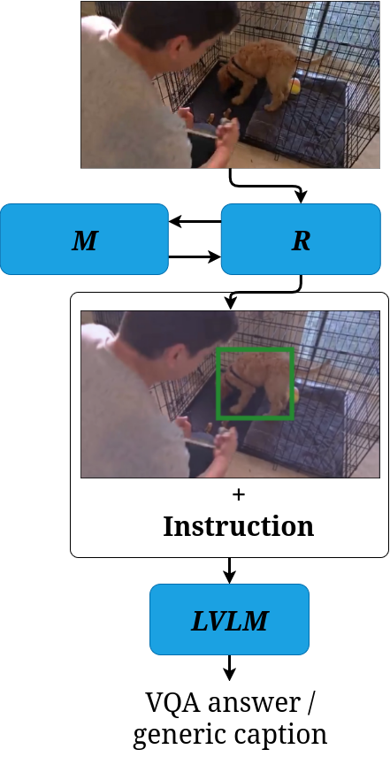
Method – Personalized object retrieval

Slide 9


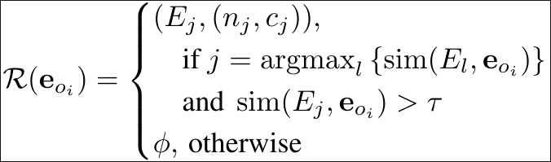
Method – Personalized object retrieval
Generate a set of object proposals O for input image I using an object proposal technique¹
Generate the average embedding vector e_{oi} for each object proposal in O
Retrieve the matching user object entry from the retrieval module R
with
1 – E.g. GroundingDINO

Slide 10
Method – Personalized answer generation
Instruction: In this image, the entity enclosed in a GREEN box is called Karl. Without mentioning the bounding box and its color, what is Karl sitting on?
[Optional] Give more details using the information from <Karl is my dog>.

Slide 11
Evaluation – New This-Is-My-Img dataset
Existing datasets (Yo'LLaVA, MyVLM) are simple, object-centric and lack complexity
Creation of This-Is-My-Img dataset
Bases off This-Is-My¹ dataset
Positive set composed of frame with the object in it
Negative set composed of:
"Hard" frame of the same sequence, without the object
"Other" frame from video of other objects
"Fake" frames generated by ChatGPT-4o
Challenges: Montion blur, background-foreground objects, synthetic images
70 VQA evaluation set
1 – https://github.com/danielchyeh/this-is-my

Slide 12
Evaluation – Results
PeKit (G-DINO and G-SAM versions) is compared to Yo'LLaVA and MyVLM
PeKit reaches SOTA and beyond on MyVLM, Yo'LLaVA and This-Is-My-Img datasets:
+ 1.9% in accuracy on MyVLM dataset
+ 2.5% in accuracy on the Yo'LLaVA dataset
Challenged on similar fake and small objects
Ablation of GroundedSAM with GroundingDINO gives slightly lower results
Usage of InternVL instead of LLaVA gives up to 7% boost on This-Is-My-Img
Notes:
Accurcy = overall
Precision = True positive / all positives predictions
Recall (positive accuracy) = True positive / true positives + false negatives
Specificity (negative accuracy) = True negative / true negative + false positives
Clipscore (similarity between image and generated caption)

Slide 13
The end

