Slide 1

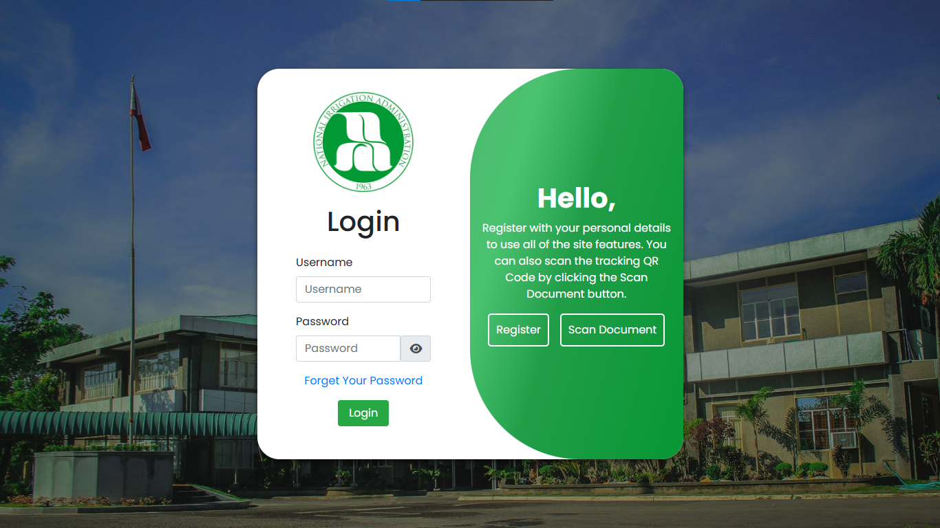
NIA DOCUMENT TRACKING AND MANAGEMENT SYSTEM
Presented By: Adelan, Almario, Bayani, Delos Santos, Redera, Javier

Slide 2
Abstract
The study focused on creating a web-based document tracking and management system for the National Irrigation Administration (NIA) in Pila, Laguna. It aimed to make document tracking faster, easier, and more organized by improving how documents are processed and reports are created. The system was built using the Rapid Application Development (RAD) method.
To test the system, ten IT experts used black box testing, and all features worked perfectly with a 100% success rate. The researchers also used the Technology Acceptance Model (TAM) to check if users found the system useful. Ninety-seven people answered the survey, and the results showed that the system was "Highly Acceptable" based on six criteria. This means the users were very satisfied with the system.

Slide 3
System Overview
1. The System Admin Account
2. Record Office Account
3. Document Handler Account
4. Guest Account

Slide 4

The System Admin Account

Slide 5
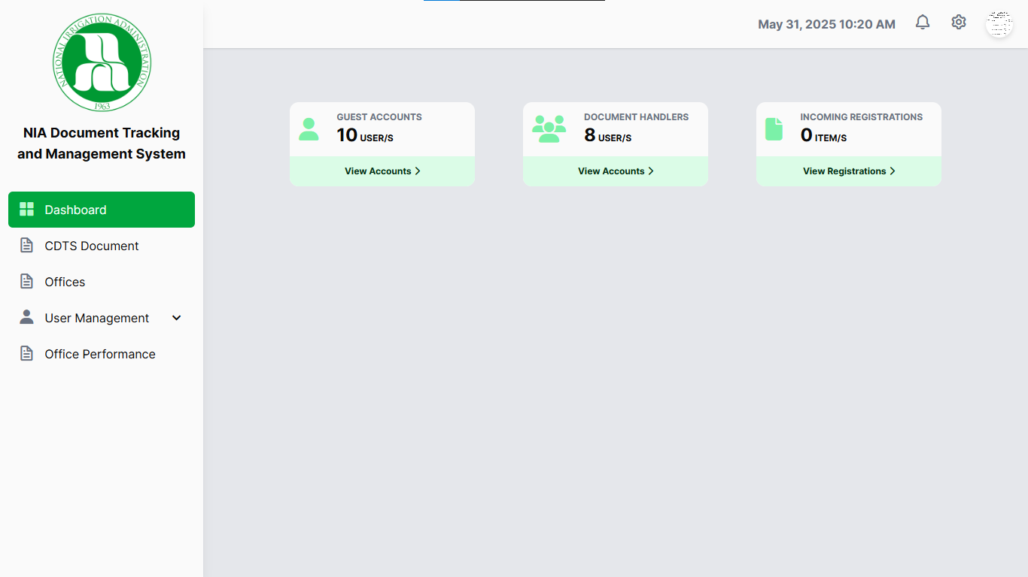
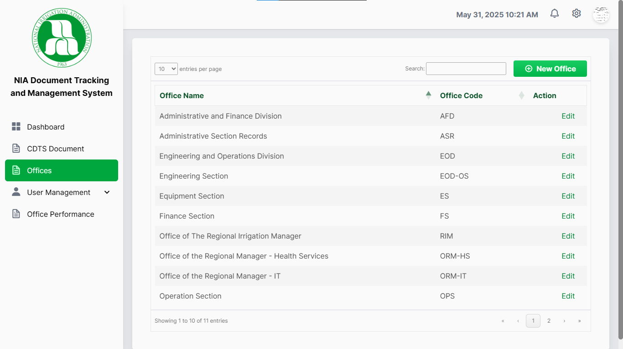
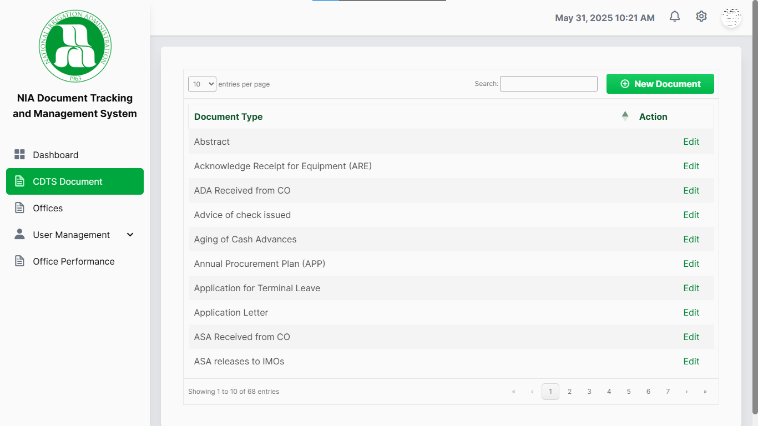
Admin Dashboard
Use buttons to access Dashboard, CDTS Documents, Offices, and User Management.
Offices Page
Add new documents by entering type and clicking "add." – You can search, edit, and save document changes.
CDTS Documents Page
Add new documents by entering type and clicking "add." – You can search, edit, and save document changes.

Slide 6
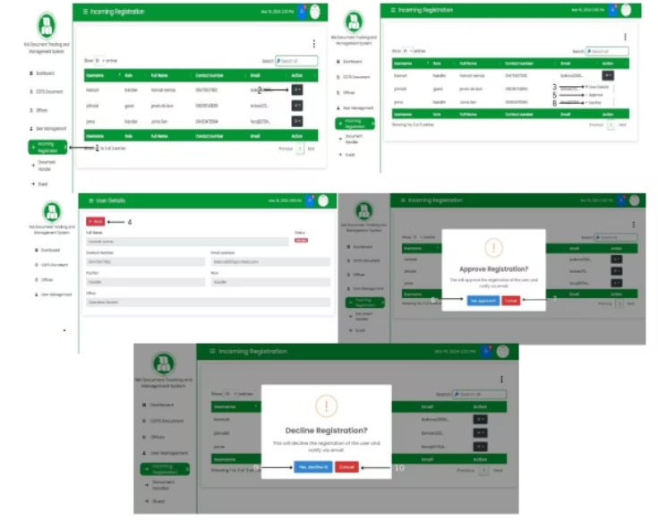
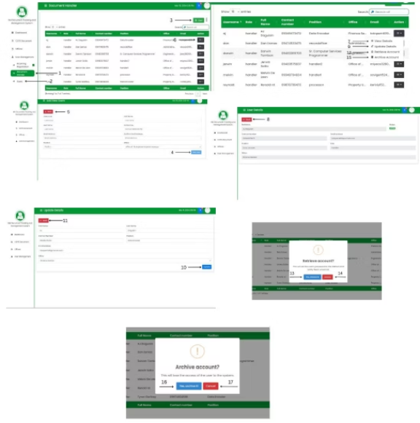
User Management: Incoming Registration
User Management: Document Handler and Guest
View details of user registration. – Approve or decline registration requests with confirmation options.
Add new users by entering their info. – View, update, retrieve, or archive user accounts. – All actions have options to confirm or cancel.

Slide 7
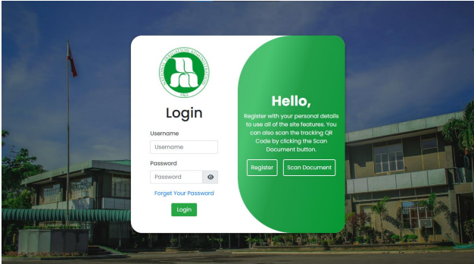
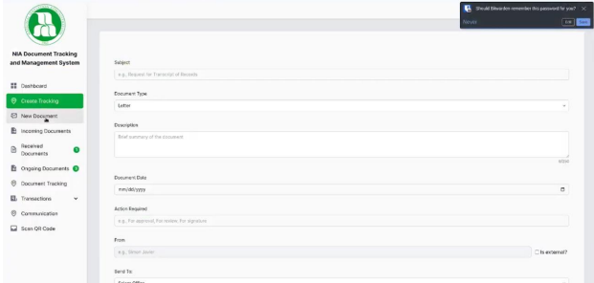
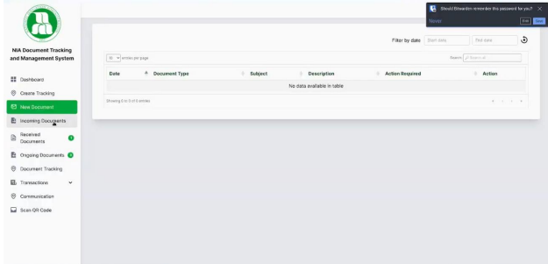
Record Office Account
Record Office Login
Create Tracking
New Documents
Go to the login page and enter username and password, then click "Login."
Fill out a form to track a document. – You can submit, clear, print, or go back.
Filter by date to search for new documents. – Download documents and either accept or decline them with confirmation.

Slide 8
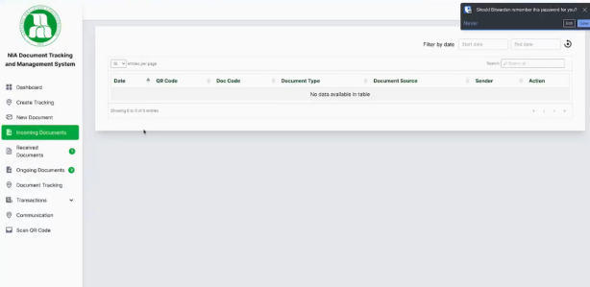
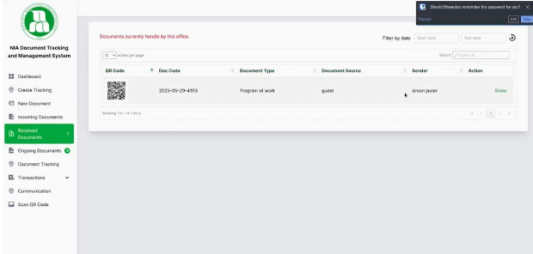
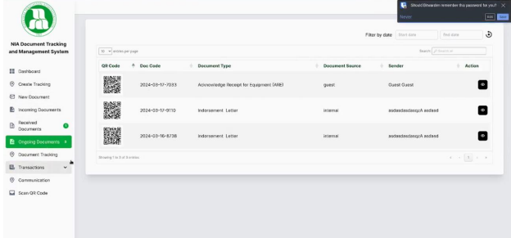
Incoming Documents
Download incoming documents and confirm receipt.
Received Documents
Mark documents as transferred or complete. – View details, select actions, and send to other offices. – You can also submit or cancel actions.
Ongoing Documents
View and take action on ongoing documents.

Slide 9
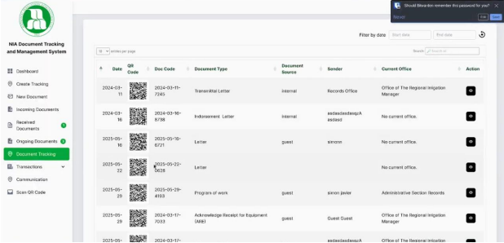
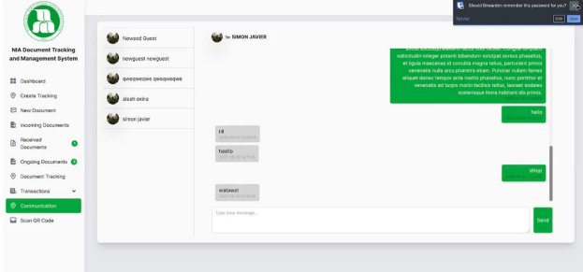
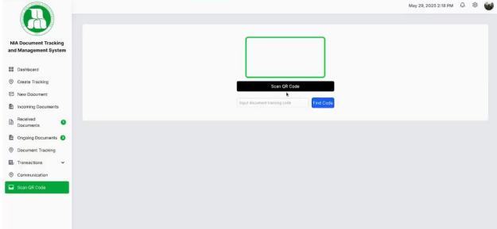
Document Tracking
Communication
Track documents, notify offices, and view details. – You can go back to the previous page.
Search and select a user to start a conversation.
Scan QR Code
Scan a document’s QR code, enter the tracking code, and either accept or decline it.

Slide 10
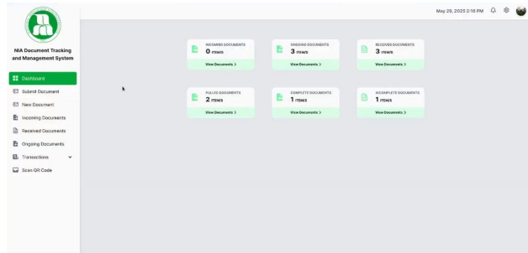
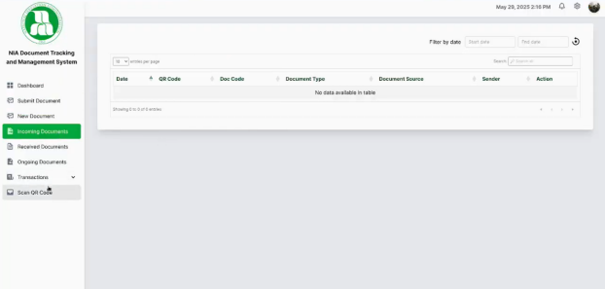
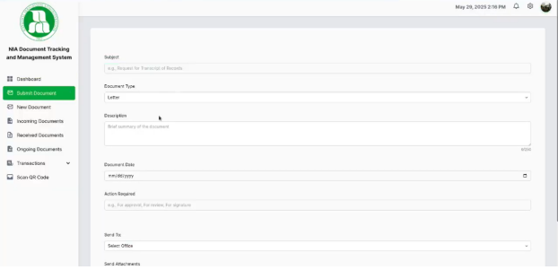
Document Handler Account
Dashboard
Buttons are available to access: Dashboard, Submit Documents, New Documents, Incoming Documents, Received Documents, Ongoing Documents, Transactions, and Scan QR Code.
Submit Documents
Incoming Documents
View and download incoming documents. – You can accept or cancel receiving the document.
Fill out a form to submit a document. – You can submit, clear, go back, or print the form.

Slide 11
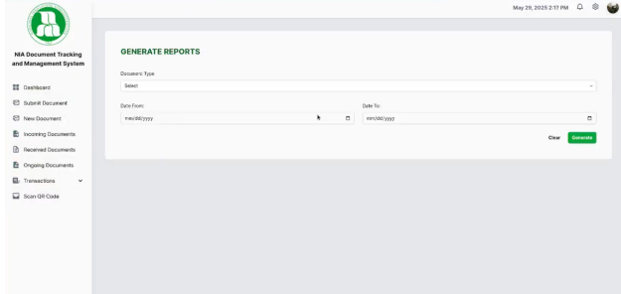
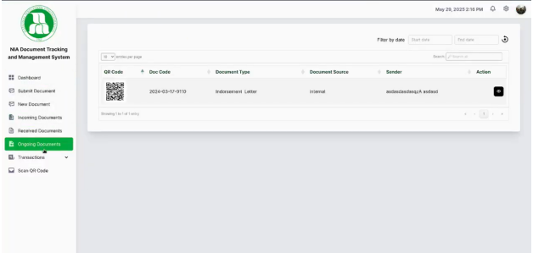
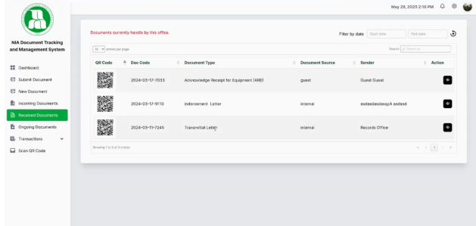
Ongoing Documents
Generate Report
View and manage ongoing documents. – You can go back to the previous page.
nter document type and date to generate a report. – You can clear the form, save as PDF, or save as CSV.
Received Documents
Mark documents as transferred or complete. – View details, take action, choose the office to send it to, and submit or cancel.

Slide 12
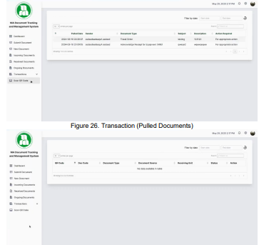
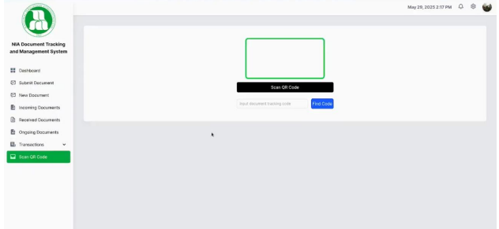
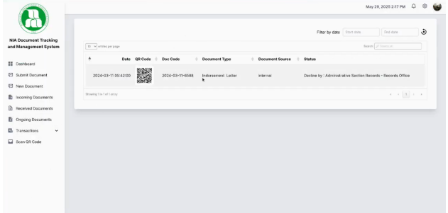
Scan QR Code
Scan a QR code, enter the tracking code, then accept or decline the document.
Pulled, Complete, Incomplete Documents
This part explains how the document handler can submit, receive, track, and process documents in the system.
View lists of documents based on their status (pulled, complete, or incomplete).

Slide 13
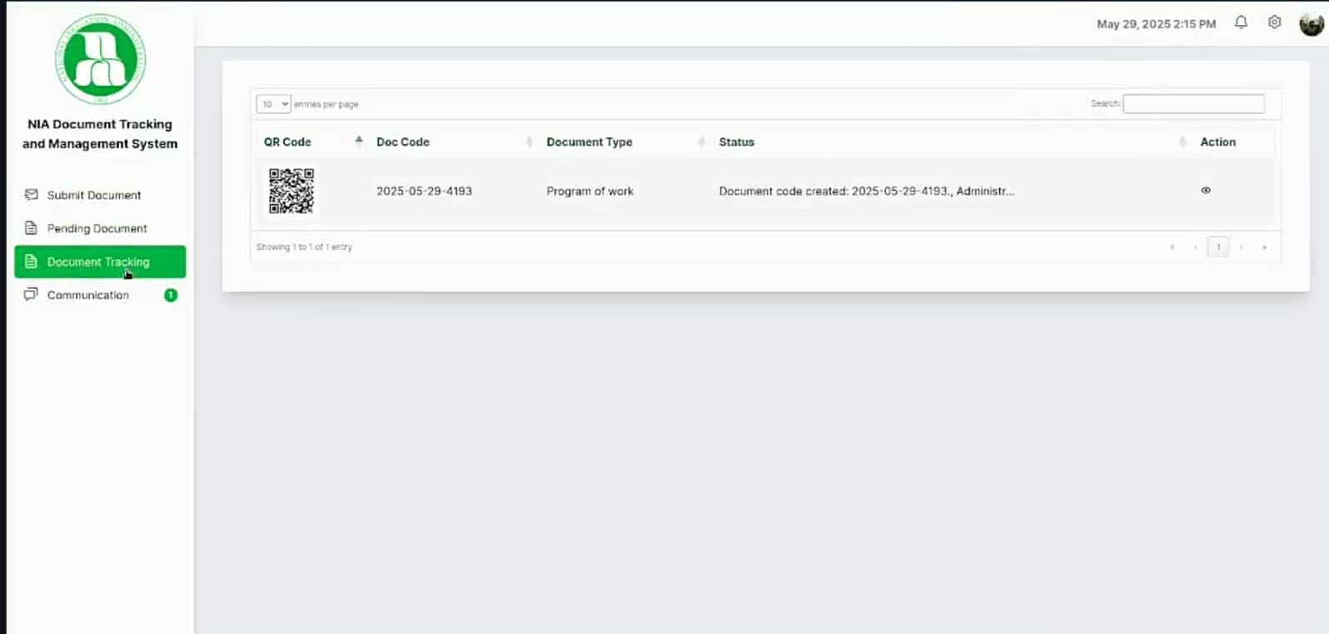
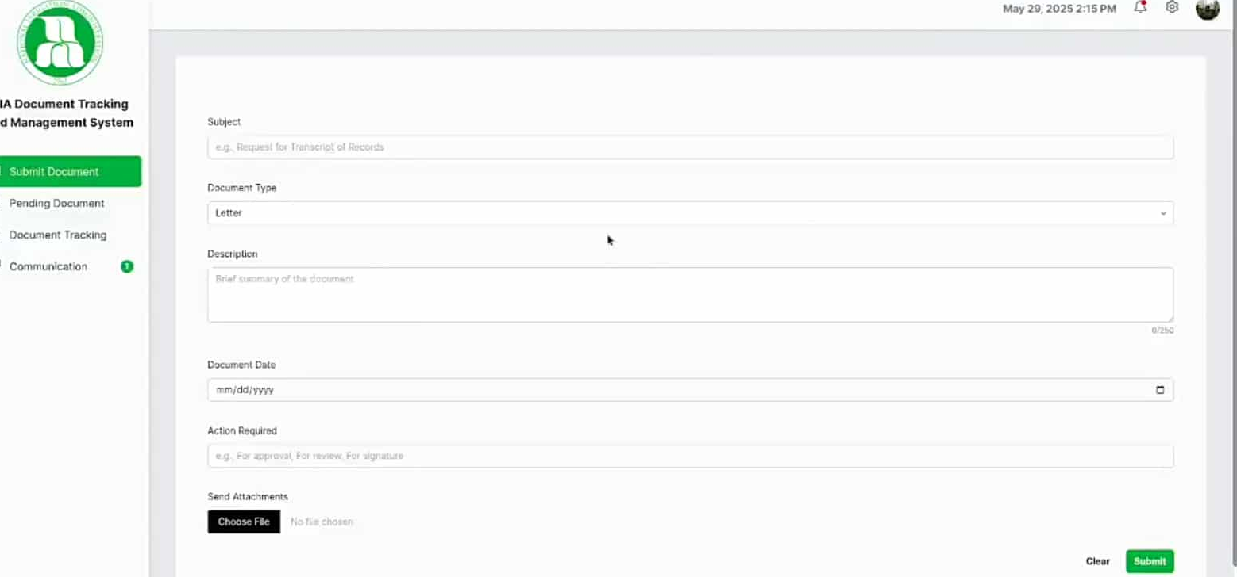
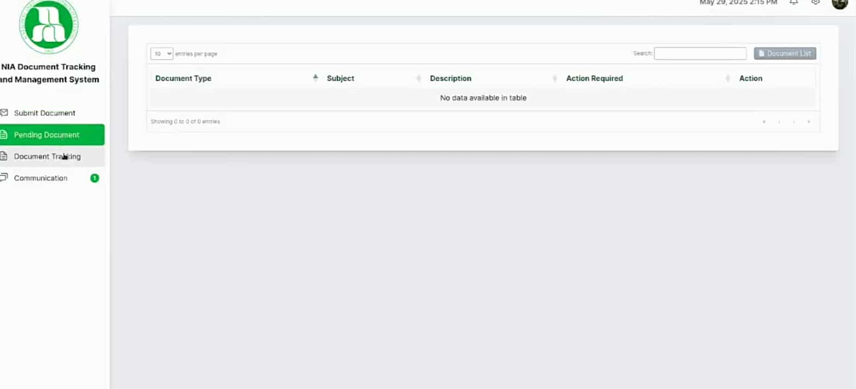
Guess Account
Submit Document
Document Tracking
Fill out the form to submit a document. – Click “Submit” and “Clear,” then confirm with “OK” after successful submission.
Track document status. – Notify the office, view document details, or go back to the previous page.
Pending Document
Go to the Pending Documents page. – Click “Edit” or mark as “Pulled.” – Update details and go back. – If marking as pulled, confirm with “Yes, pulled it” or cancel.

Slide 14
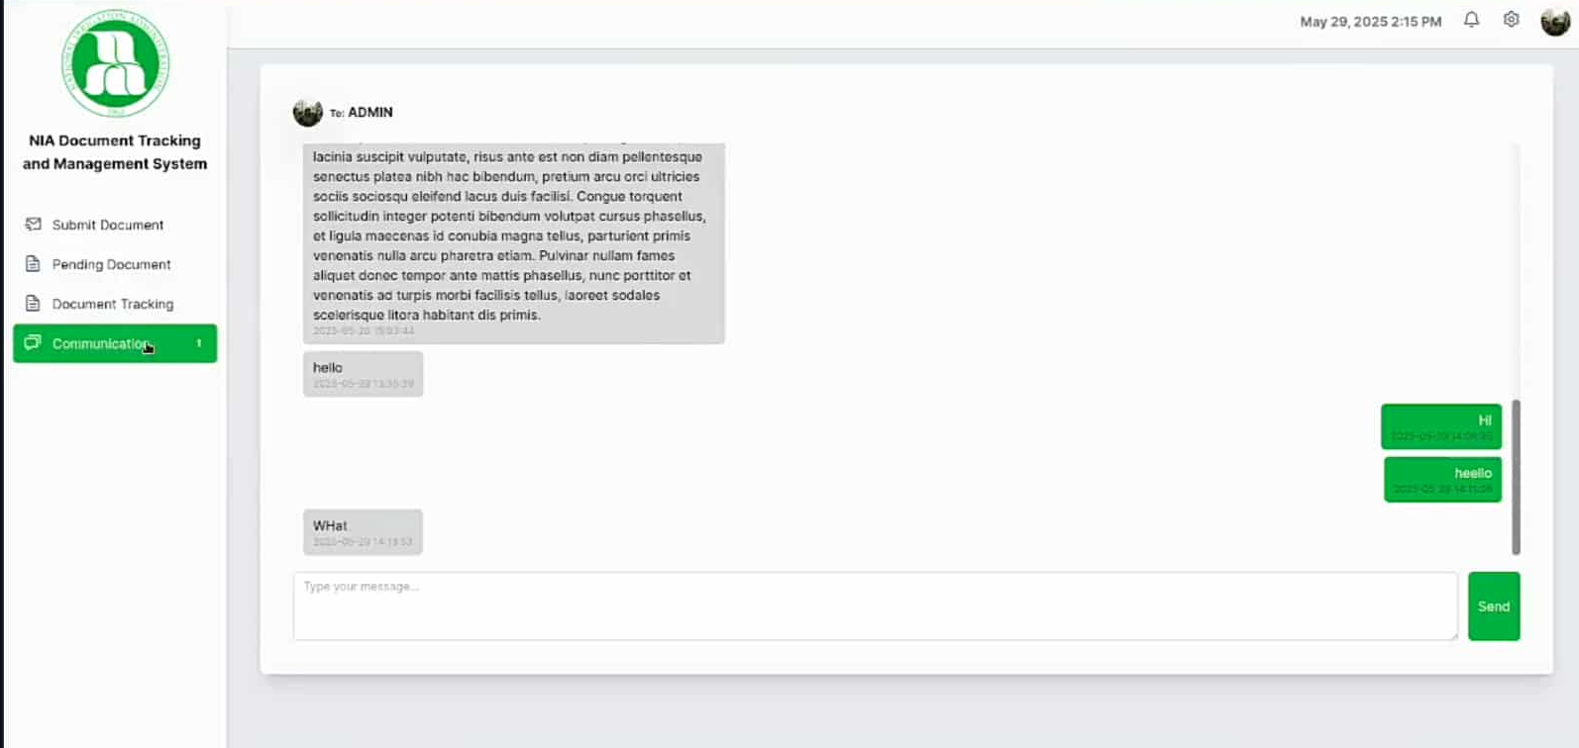
Communication
Send a message to the office. – Just type your message and click “Send.”

Slide 15
Key Features of the System
The system was designed to solve NIA Regional IV-A’s issues in managing and tracking office documents. It allows users to:
Track documents in real-time
Check the current status of documents (pending, received, finished, released)
Reduce confusion and save time in processing
Make document handling more organized
Improve the overall document process of NIA
Ensure system reliability and accurate data management
Include essential features and meet software standards

Slide 16


Features Added / Enhanced
🔄 Migrated from Bootstrap to Tailwind CSS for a cleaner, modern look
🎨 Improved and modernized UI/UX for better navigation and user experience

