Slide 1
Week 12 Discussion Section
4/16/2017

Slide 2
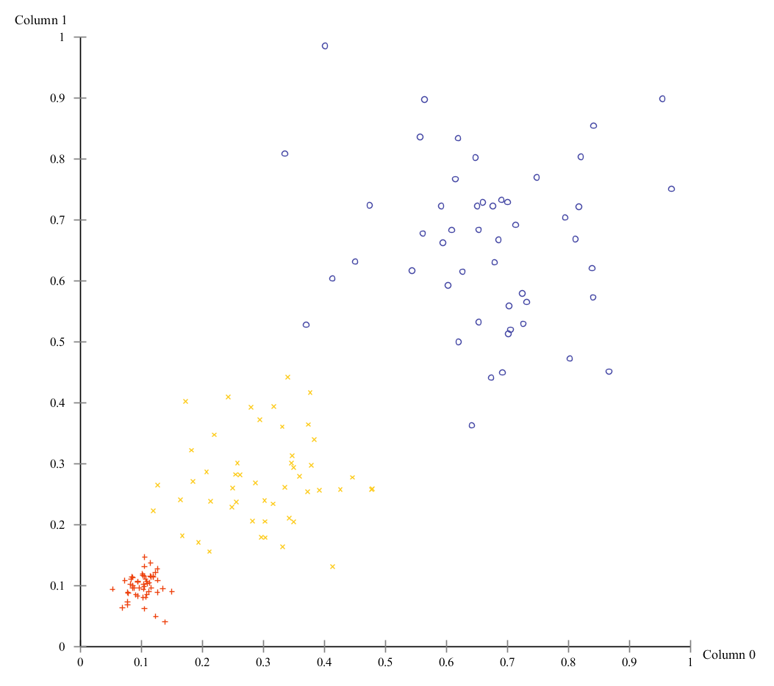
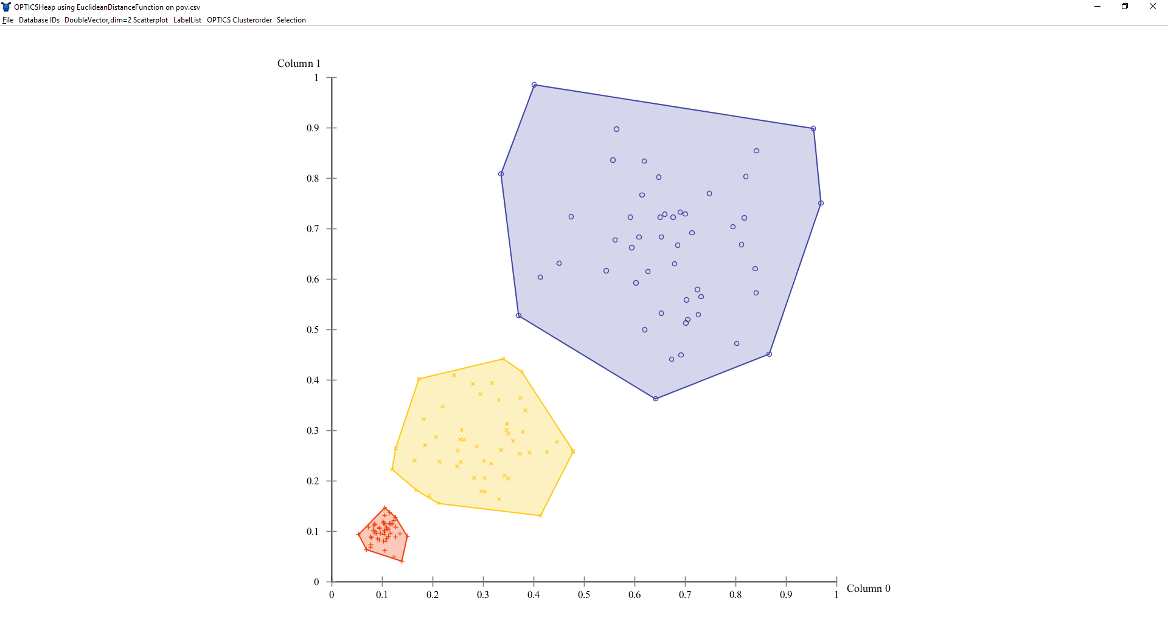
OPTICS: Motivation
DBSCAN, while powerful, has some shortcomings
When the dataspace exhibits different density patterns, DBSCAN cannot effectively identify clusters simultaneously
OPTICS was proposed to remedy this issue, the idea being that you fix MinPts and allow Eps to take on any value up to some maximum, using the output you can produce a reachability plot which can be interpreted at infinitely many values of Eps

Slide 3
Reachability
Now that Eps is no longer fixed and may range in value up to some maximum, we need to new concepts to capture the whole picture for reachability
core-distance(p)
The smallest distance ε’ (<= ε) such that p would be a core-point with respect to MinPts and ε’
If there is no such ε’ <= ε then core-distance(p) is undefined
reachability-distance(p,o)
The smallest distance such that p is directly density-reachable from o
Can’t be smaller than core-distance(o), even if p is closer to o than core-distance(o), because in that case o wouldn’t be a core point
If it isn’t possible for o to be a core point (i.e., core-distance(o) is undefined) then reachability-distance(p,o) is undefined

Slide 4
Reachability
core-distance(p)
Let p be an object from a database D, let ε be a distance value, let N_{ε}(p) be the ε-neighborhood of p, let MinPts be a natural number and let MinPts-distance(p) be the distance from p to its MinPts’ neighbor. Then, the core-distance of p is defined as core-distance_{ε,MinPts}(p) =
UNDEFINED, if |N_{ε}(p)| < MinPts
MinPts-distance(p), otherwise
reachability-distance(p,o)
Let p and o be objects from a database D, let N_{ε}(o) be the ε-neighborhood of o, and let MinPts be a natural number. Then, the reachability-distance of p with respect to o is defined as reachability-distance_{ε,MinPts}(p, o) =
UNDEFINED, if |N_{ε}(o)| < MinPts
max(core-distance(o), distance(o,p)), otherwise
{
{

Slide 5
OPTICS: High level overview
For a point p
set reachability-distance(p) = UNDEFINED
find N_{ε}(p)
find core-distance(p)
Output p, core-distance(p), reachability-distance(p)
If core-distance(p) != UNDEFINED, add all the neighbors to a queue, update their minimum reachability distance, and process them in the order of their descending (minimum) reachability-distance in the same manner as above until the queue is empty
Otherwise, move to the next point

Slide 6
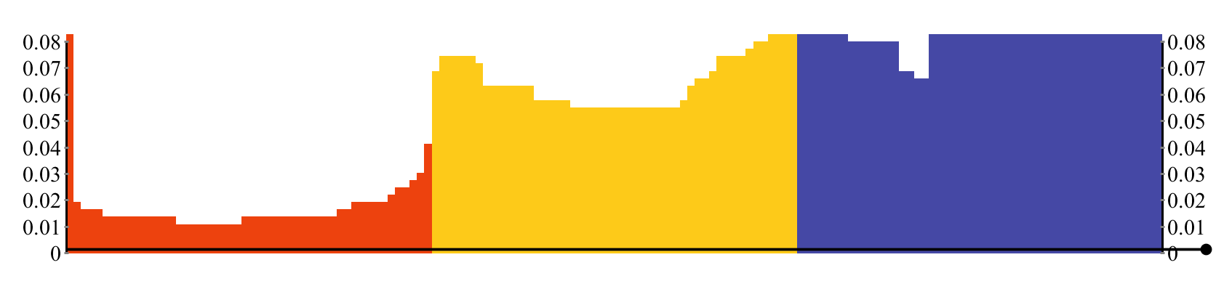
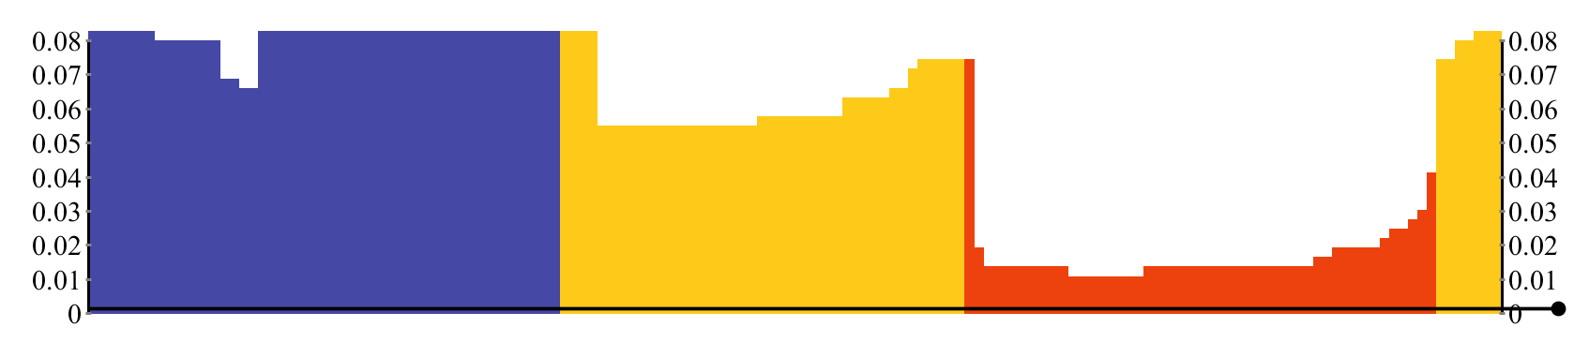
Reachability Plots
Eps = 0.08, MinPts=10

Slide 7
Interpreting Reachability Plots
The reachability-distance of a point which is shown in the reachability plot is the minimum reachability-distance of the point to the set of points which came before it in the plot.
Points with the highest values have undefined reachability-distances and are not likely to be in any clusters at the given maximum value of Eps.
Based on these two observations, clusters can be identified by the valleys or dents in the reachability plot. Groups of points which have small reachability distances to their predecessors make good clusters.
Algorithmic methods for determining clustering based on the reachability plot are proposed in the paper as well

Slide 8
Demo
ELKI
https://elki-project.github.io/
ELKI Vary Denisty Data Set
150 objects, 2 dimensions, 3 Gaussian clusters with variable density
https://elki-project.github.io/datasets/

Slide 9
Resources
Original OPTICS paper
http://www.dbs.ifi.lmu.de/Publikationen/Papers/OPTICS.pdf
Wikipedia
https://en.wikipedia.org/wiki/OPTICS_algorithm

