Slide 1
Week 12 Discussion Section
4/12/2017

Slide 2
A quick language clarification
For Quiz 5 Question 2, the word “may” should be taken in the optional sense of the word rather than the regulatory sense
“I may not go to the gym tonight” means that there is a scenario in which I won’t go to the gym tonight rather than I am not permitted to go to the gym tonight.
Mathematically this would be considered a statement of existence.
“Points p and q may not be in the same cluster” can be stated as:
There exists a scenario in which p is not in a cluster, q is not in a cluster, or p and q are in different clusters.
Or even more thoroughly: There exists a scenario in which the dataset from which p and q were drawn contains other points such that p is not in a cluster, q is not in a cluster, or p is in cluster A and q is in cluster B and A is not equal to B.

Slide 3
Examples
For a given eps and minpts,
Points p and q may not be in the same cluster
True if there exists a scenario in which one of the following holds:
p is not in a cluster or q is not in a cluster or p and q are in different clusters
False if, for all scenarios, the following hold:
p is in a cluster and q is in a cluster and p and q are in the same cluster
Points p and q may be in different clusters
True if there exists a scenario in which all of the following hold:
p is in a cluster and q is in a cluster and p and q are in different clusters
False if, for all scenarios, one of the following holds:
p is not in a cluster or q is not in a cluster or p and q are in the same cluster

Slide 4
Examples
For a given eps and minpts,
Points p and q must be in different clusters
True if, for all scenarios, the following hold:
p is in a cluster and q is in a cluster and p and q belong to different clusters
False if there exists a scenario where one of the following holds:
p is not in a cluster or q is not in a cluster or p and q belong to the same cluster
Points p and q must be in the same cluster
True if, for all scenarios, the following hold:
p is in a cluster and q is in a cluster and p and q belong to the same cluster
False if there exists a scenario where one of the following holds:
p is not in a cluster or q is not in a cluster or p and q belong to different clusters

Slide 5
eps = 1cm, minpts = 2
d(p,q) = 1cm
eps = 1cm, minpts = 4
d(p,q) = 1cm
Statement: Points p and q may be in different clusters.
Statement: Points p and q may be in different clusters.
p and q will always be in the same cluster so the statement is false.
Can we find a scenario in which points p and q are in different clusters?
Yes, so the statement is true.
Statement: Points p and q must be in the same cluster.
Statement: Points p and q must be in different clusters.
As before, p and q will always be in the same cluster, no matter what other data points exist, so the statement is true.
Can we find a scenario in which points p and q are in the same cluster?
Yes, so the statement is false.

Slide 6
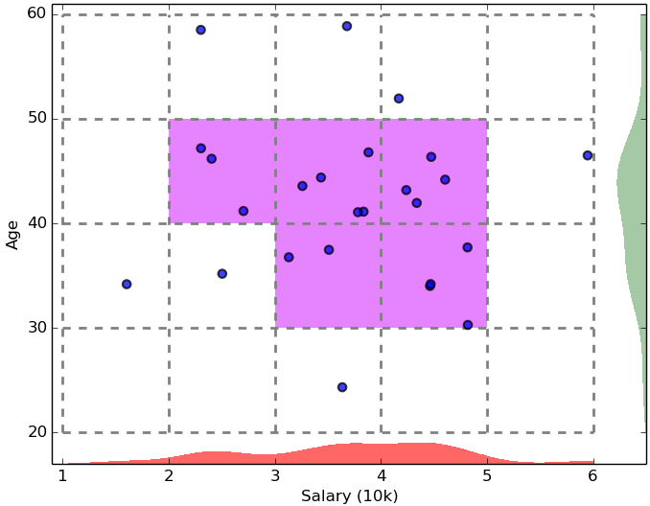
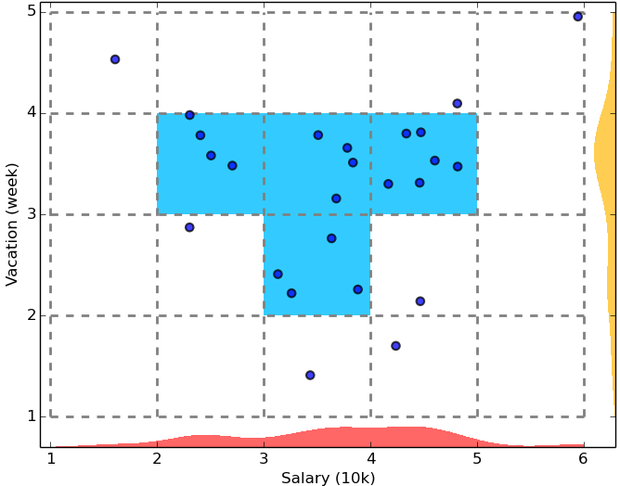
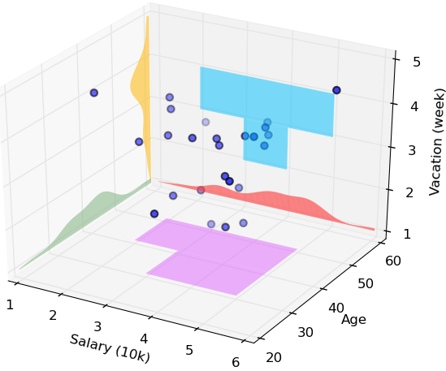
CLIQUE: SubSpace Clustering with Aprori Pruning
Start at 1-D space and discretize numerical intervals in each axis into grid
Find dense regions (clusters) in each subspace and generate their minimal descriptions
Use the dense regions to find promising candidates in 2-D space based on the Apriori principle
Repeat the above in level-wise manner in higher dimensional subspaces
Notes:
First find dense areas in 1D space. How can we apply Apriori? We know that in order to be frequent in 2D space a grid cell must be frequent in the projected 1D space, so we can ignore grid cells which aren’t frequent in 1D space. Our candidate generation, thus, is an application of the apriori principle.
We can say for sure that points not in a dense region in k-D space won’t be in a dense region in (k+1)-D space.

Slide 7
CLIQUE
In the application of the Apriori principle for frequent pattern mining we found frequent 1-item patterns, then combined those to find candidates for frequent 2-item patterns and scanned the data to determine which were truly frequent, and so on.
In CLIQUE we find dense regions in 1-dimension, then combine those to find candidates for dense regions in 2-dimensions, we scan the data to verify which candidates are truly dense, and so on.
1-item frequent patterns:
a, b, c
Candidate 2-item patterns:
ab, ac, bc
Figure from R. Agrawal, J. Gehrke, D. Gunopulos, and P. Raghavan. Automatic Subspace Clustering of High Dimensional Data for Data Mining Applications. SIGMOD’98

Slide 8
Appendix

Slide 9
DBSCAN: A Density-Based Spatial Clustering Algorithm
DBSCAN (M. Ester, H.-P. Kriegel, J. Sander, and X. Xu, KDD’96)
Discovers clusters of arbitrary shape: Density-Based Spatial Clustering of Applications with Noise
A density-based notion of cluster
A cluster is defined as a maximal set of density-connected points
Two parameters:
Eps (ε): Maximum radius of the neighborhood
MinPts: Minimum number of points in the
Eps-neighborhood of a point
The Eps(ε)-neighborhood of a point q:
N_{Eps}(q): {p belongs to D | dist(p, q) ≤ Eps}
p
MinPts = 5
Eps = 1 cm
q
Outlier
Outlier/noise: not in a cluster
Border
Core point: dense neighborhood
Core
Border point: in cluster but neighborhood is not dense

Slide 10
DBSCAN: Density-Reachable and Density-Connected
Directly density-reachable:
A point p is directly density-reachable from a point q w.r.t. Eps (ε), MinPts if
p belongs to N_{Eps}(q)
core point condition: |N_{Eps} (q)| ≥ MinPts
Density-reachable:
A point p is density-reachable from a point q w.r.t. Eps, MinPts if there is a chain of points p₁, …, p_{n}, p₁ = q, p_{n} = p such that p_{i+1} is directly density-reachable from p_{i}
Density-connected:
A point p is density-connected to a point q w.r.t. Eps, MinPts if there is a point o such that both p and q are density-reachable from o w.r.t. Eps and MinPts
p
MinPts = 5
Eps = 1 cm
q
p
p₂
q
p
q
o

Slide 11
CLIQUE: Grid-Based Subspace Clustering
CLIQUE (Clustering In QUEst) (Agrawal, Gehrke, Gunopulos, Raghavan: SIGMOD’98)
CLIQUE is a density-based and grid-based subspace clustering algorithm
Grid-based: It discretizes the data space through a grid and estimates the density by counting the number of points in a grid cell
Density-based: A cluster is a maximal set of connected dense units in a subspace
A unit is dense if the fraction of total data points contained in the unit exceeds the input model parameter
Subspace clustering: A subspace cluster is a set of neighboring dense cells in an arbitrary subspace. It also discovers some minimal descriptions of the clusters
It automatically identifies subspaces of a high dimensional data space that allow better clustering than original space using the Apriori principle

Slide 12
CLIQUE: SubSpace Clustering with Aprori Pruning
Start at 1-D space and discretize numerical intervals in each axis into grid
Find dense regions (clusters) in each subspace and generate their minimal descriptions
Use the dense regions to find promising candidates in 2-D space based on the Apriori principle
Repeat the above in level-wise manner in higher dimensional subspaces

Slide 13
Major Steps of the CLIQUE Algorithm
Identify subspaces that contain clusters
Partition the data space and find the number of points that lie inside each cell of the partition
Identify the subspaces that contain clusters using the Apriori principle
Identify clusters
Determine dense units in all subspaces of interests
Determine connected dense units in all subspaces of interests
Generate minimal descriptions for the clusters
Determine maximal regions that cover a cluster of connected dense units for each cluster
Determine minimal cover for each cluster

Slide 14
Additional Comments on CLIQUE
Strengths
Automatically finds subspaces of the highest dimensionality as long as high density clusters exist in those subspaces
Insensitive to the order of records in input and does not presume some canonical data distribution
Scales linearly with the size of input and has good scalability as the number of dimensions in the data increases
Weaknesses
As in all grid-based clustering approaches, the quality of the results crucially depends on the appropriate choice of the number and width of the partitions and grid cells

