Slide 1
Week 13 Discussion
Honglei Zhuang

Slide 2
Outline
Constructing Clustering-Partition Matrix
Purity Calculation
NMI Concepts and Calculation

Slide 3
Ground-truth
(Partition)
Clustering results
 | T1 | T2 | T3 | Sum
C1
C2
C3
Sum | 3 | 4 | 3 | 10

Slide 4
Ground-truth
(Partition)
Clustering results
 | T1 | T2 | T3 | Sum
C1 | 3 | 1 | 0 | 4
C2
C3
Sum | 3 | 4 | 3 | 10

Slide 5
Ground-truth
(Partition)
Clustering results
 | T1 | T2 | T3 | Sum
C1 | 3 | 1 | 0 | 4
C2 | 0 | 2 | 0 | 2
C3
Sum | 3 | 4 | 3 | 10

Slide 6
Ground-truth
(Partition)
Clustering results
 | T1 | T2 | T3 | Sum
C1 | 3 | 1 | 0 | 4
C2 | 0 | 2 | 0 | 2
C3 | 0 | 1 | 3 | 4
Sum | 3 | 4 | 3 | 10

Slide 7
Ground-truth
(Partition)
Clustering results
 | T1 | T2 | T3 | Sum
C1 | 3 | 1 | 0 | 4
C2 | 0 | 2 | 0 | 2
C3 | 0 | 1 | 3 | 4
Sum | 3 | 4 | 3 | 10

Slide 8
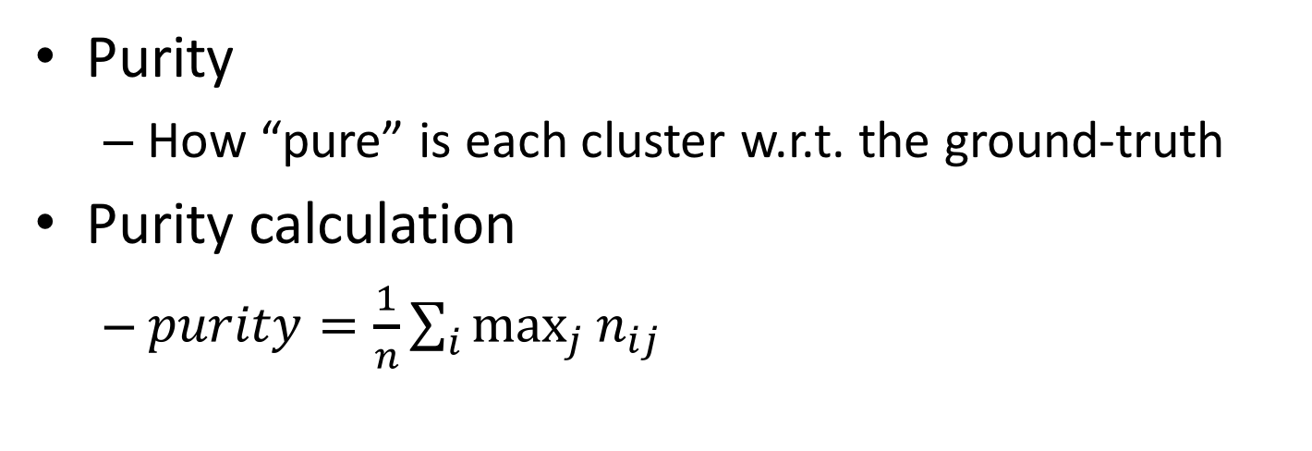
 | T1 | T2 | T3 | Sum
C1 | 3 | 1 | 0 | 4
C2 | 0 | 2 | 0 | 2
C3 | 0 | 1 | 3 | 4
Sum | 3 | 4 | 3 | 10
Purity
How “pure” is each cluster w.r.t. the ground-truth
Purity calculation
$purity=\frac{1}{n}\sum_{i}{\max_{j}{n_{ij}}}$

Slide 9

 | T1 | T2 | T3 | Sum
C1 | 3 | 1 | 0 | 4
C2 | 0 | 2 | 0 | 2
C3 | 0 | 1 | 3 | 4
Sum | 3 | 4 | 3 | 10
Purity calculation
$purity=\frac{1}{n}\sum_{i}{\max_{j}{n_{ij}}}=\frac{1}{10}\left(3+?+?\right)=?$

Slide 10

 | T1 | T2 | T3 | Sum
C1 | 3 | 1 | 0 | 4
C2 | 0 | 2 | 0 | 2
C3 | 0 | 1 | 3 | 4
Sum | 3 | 4 | 3 | 10
Purity calculation
$purity=\frac{1}{n}\sum_{i}{\max_{j}{n_{ij}}}=\frac{1}{10}\left(3+2+?\right)=?$

Slide 11

 | T1 | T2 | T3 | Sum
C1 | 3 | 1 | 0 | 4
C2 | 0 | 2 | 0 | 2
C3 | 0 | 1 | 3 | 4
Sum | 3 | 4 | 3 | 10
Purity calculation
$purity=\frac{1}{n}\sum_{i}{\max_{j}{n_{ij}}}=\frac{1}{10}\left(3+2+3\right)=0.8$

Slide 12
 | T1 | T2 | T3 | Sum
C1 | 3 | 1 | 0 | 4
C2 | 0 | 2 | 0 | 2
C3 | 0 | 1 | 3 | 4
Sum | 3 | 4 | 3 | 10
Purity calculation
$purity=\frac{1}{n}\sum_{i}{\max_{j}{n_{ij}}}=\frac{1}{10}\left(3+2+3\right)=0.8$

Slide 13
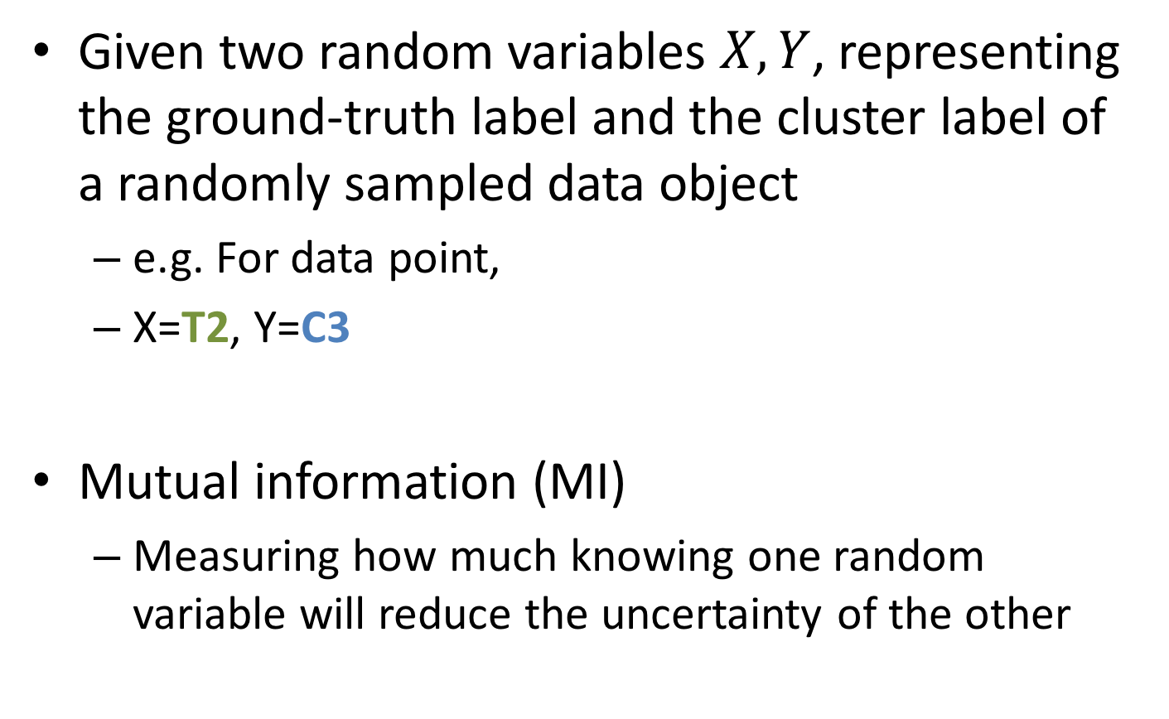
Normalized Mutual Information
Given two random variables $X,Y$, representing the ground-truth label and the cluster label of a randomly sampled data object
e.g. For data point,
X=T2, Y=C3
Mutual information (MI)
Measuring how much knowing one random variable will reduce the uncertainty of the other

Slide 14
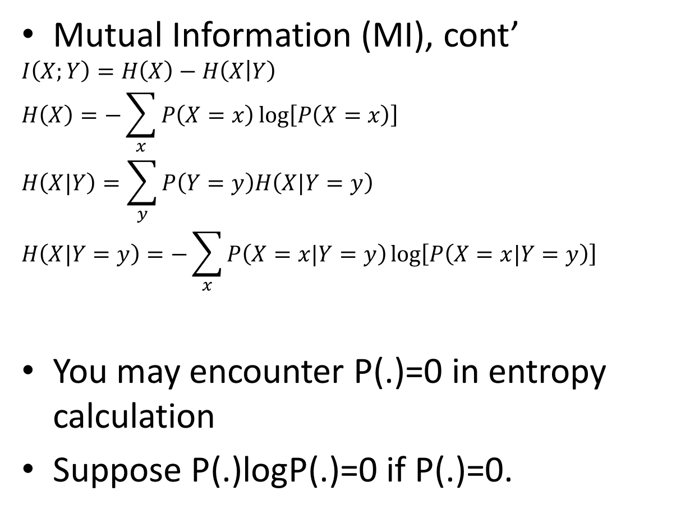
Normalized Mutual Information
Mutual Information (MI), cont’
$$I\left(X;Y\right)=H\left(X\right)−H\left(X | Y\right)$$
$$H\left(X\right)=−\sum_{x}{P\left(X=x\right)\log\left[P\left(X=x\right)\right]}$$
$$H\left(X|Y\right)=\sum_{y}{P\left(Y=y\right)H\left(X|Y=y\right)}$$
$$H\left(X|Y=y\right)=−\sum_{x}{P\left(X=x|Y=y\right)\log\left[P\left(X=x|Y=y\right)\right]}$$
You may encounter P(.)=0 in entropy calculation
Suppose P(.)logP(.)=0 if P(.)=0.
Entropy, measuring the uncertainty of a random variable
Conditional entropy, measuring the uncertainty of X if Y is given
Measuring the uncertainty of X if Y is given as y

Slide 15
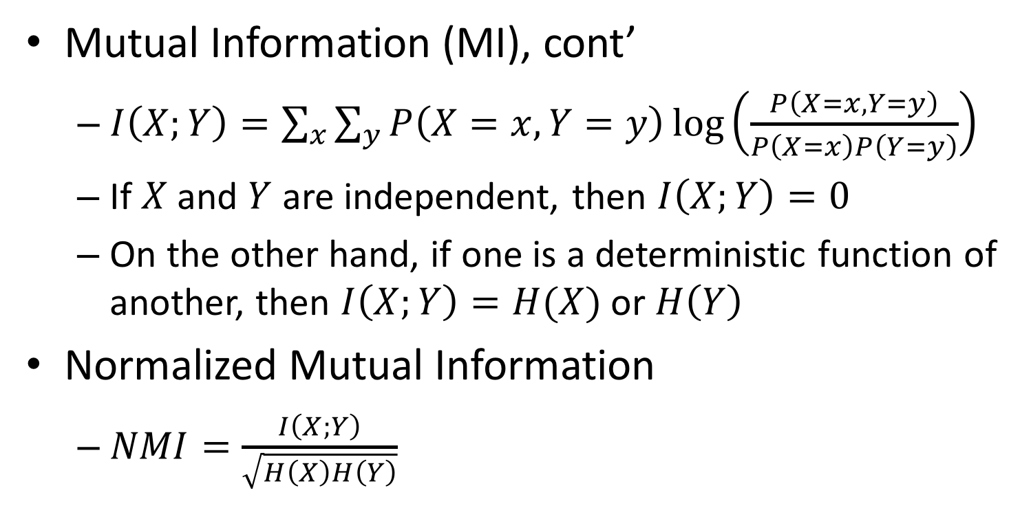
Normalized Mutual Information
Mutual Information (MI), cont’
$I\left(X;Y\right)=\sum_{x}{\sum_{y}{P\left(X=x,Y=y\right)\log\left(\frac{P\left(X=x,Y=y\right)}{P\left(X=x\right)P\left(Y=y\right)}\right)}}$
If $X$ and $Y$ are independent, then $I\left(X;Y\right)=0$
On the other hand, if one is a deterministic function of another, then $I\left(X;Y\right)=H(X)$ or $H\left(Y\right)$
Normalized Mutual Information
$NMI=\frac{I\left(X;Y\right)}{\sqrt{H\left(X\right)H\left(Y\right)}}$

Slide 16
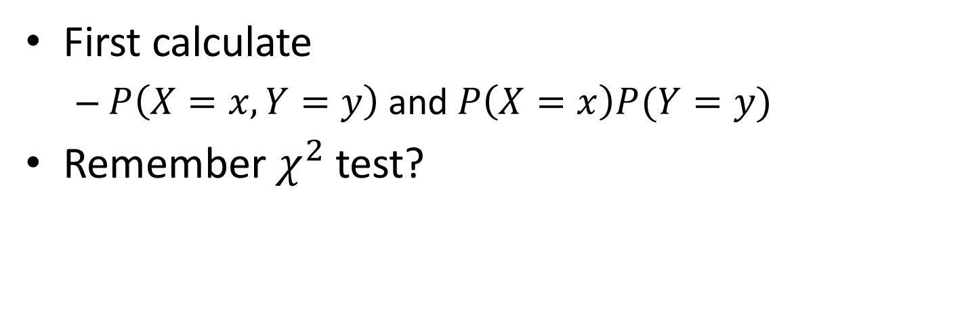
 | T1 | T2 | T3 | Sum
C1 | 3 | 1 | 0 | 4
C2 | 0 | 2 | 0 | 2
C3 | 0 | 1 | 3 | 4
Sum | 3 | 4 | 3 | 10
First calculate
$P\left(X=x,Y=y\right)$ and$P\left(X=x\right)P(Y=y)$
Remember $χ^{2}$ test?

Slide 17
 | X=T1 | X=T2 | X=T3 | Sum
Y=C1 | 0.3 (0.12) | 0.1 (0.16) | 0 (0.12) | 0.4
Y=C2 | 0 (0.06) | 0.2 (0.08) | 0 (0.06) | 0.2
Y=C3 | 0 (0.12) | 0.1 (0.16) | 0.3 (0.12) | 0.4
Sum | 0.3 | 0.4 | 0.3 | 10
First calculate
$P\left(X=x,Y=y\right)$ and$P\left(X=x\right)P(Y=y)$
Remember $χ^{2}$ test?

Slide 18
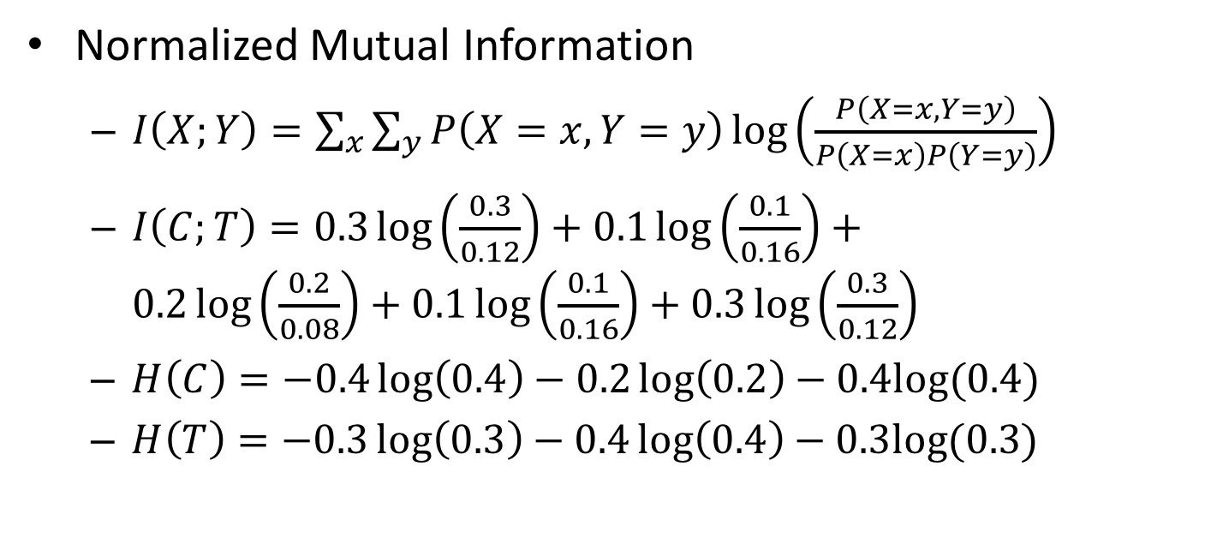
 | X=T1 | X=T2 | X=T3 | Sum
Y=C1 | 0.3 (0.12) | 0.1 (0.16) | 0 (0.12) | 0.4
Y=C2 | 0 (0.06) | 0.2 (0.08) | 0 (0.06) | 0.2
Y=C3 | 0 (0.12) | 0.1 (0.16) | 0.3 (0.12) | 0.4
Sum | 0.3 | 0.4 | 0.3 | 10
Normalized Mutual Information
$I\left(X;Y\right)=\sum_{x}{\sum_{y}{P\left(X=x,Y=y\right)\log\left(\frac{P\left(X=x,Y=y\right)}{P\left(X=x\right)P\left(Y=y\right)}\right)}}$
$I\left(C;T\right)=0.3\log\left(\frac{0.3}{0.12}\right)+0.1\log\left(\frac{0.1}{0.16}\right)+0.2\log\left(\frac{0.2}{0.08}\right)+0.1\log\left(\frac{0.1}{0.16}\right)+0.3\log\left(\frac{0.3}{0.12}\right)$
$H\left(C\right)=−0.4\log\left(0.4\right)−0.2\log\left(0.2\right)−0.4log⁡(0.4)$
$H\left(T\right)=−0.3\log\left(0.3\right)−0.4\log\left(0.4\right)−0.3log⁡(0.3)$

Slide 19
Supplementary Material
The following slides are some running example for basic concepts like entropy, conditional entropy, mutual information
It does not mean that you always have to calculate the mutual information in this way: the steps given above should be easier. They are for your better understanding of NMI
The left and the right figures show a comparison of how these values may vary in different scenarios

Slide 20
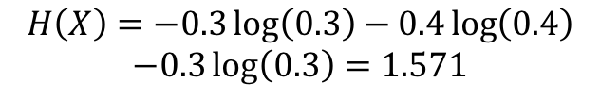
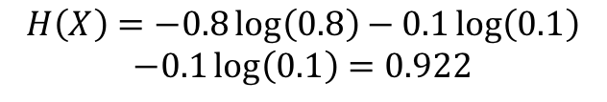

Supplementary Material
Entropy:
$H\left(X\right)=−\sum_{x}{P\left(X=x\right)\log\left[P\left(X=x\right)\right]}$
Measuring the uncertainty of a random variable
$$H\left(X\right)=−0.3\log\left(0.3\right)−0.4\log\left(0.4\right)$$
$$−0.3\log\left(0.3\right)=1.571$$
$$H\left(X\right)=−0.8\log\left(0.8\right)−0.1\log\left(0.1\right)$$
$$−0.1\log\left(0.1\right)=0.922$$

Slide 21
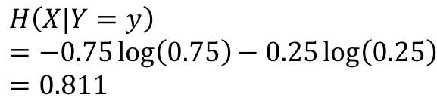
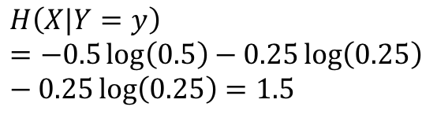

Supplementary Material
Conditional Entropy (Given Y=C1)
$H\left(X|Y=y\right)=−\sum_{x}{P\left(X=x|Y=y\right)\log\left[P\left(X=x|Y=y\right)\right]}$
Measuring the entropy of random variable when another random variable is given
$$H\left(X|Y=y\right)=−0.75\log\left(0.75\right)−0.25\log\left(0.25\right)=0.811$$
$$H\left(X|Y=y\right)=−0.5\log\left(0.5\right)−0.25\log\left(0.25\right)−0.25\log\left(0.25\right)=1.5$$

Slide 22
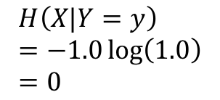
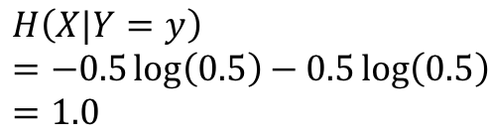

Supplementary Material
Conditional Entropy (Given Y=C2)
$H\left(X|Y=y\right)=−\sum_{x}{P\left(X=x|Y=y\right)\log\left[P\left(X=x|Y=y\right)\right]}$
Measuring the entropy of random variable when another random variable is given
$$H\left(X|Y=y\right)=−1.0\log\left(1.0\right)=0$$
$$H\left(X|Y=y\right)=−0.5\log\left(0.5\right)−0.5\log\left(0.5\right)=1.0$$

Slide 23

Supplementary Material
Conditional Entropy (Given Y=C3)
$H\left(X|Y=y\right)=−\sum_{x}{P\left(X=x|Y=y\right)\log\left[P\left(X=x|Y=y\right)\right]}$
Measuring the entropy of random variable when another random variable is given
$$H\left(X|Y=y\right)=−0.75\log\left(0.75\right)−0.25\log\left(0.25\right)=0.811$$
$$H\left(X|Y=y\right)=−0.5\log\left(0.5\right)−0.25\log\left(0.25\right)−0.25\log\left(0.25\right)=1.5$$

Slide 24
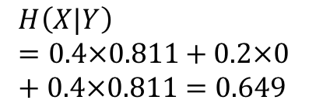
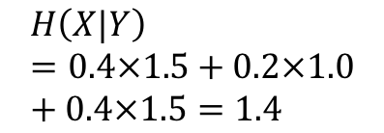

Supplementary Material
Conditional Entropy
$H\left(X|Y\right)=\sum_{y}{P\left(Y=y\right)H\left(X|Y=y\right)}$
Expected entropy of a random variable when another random variable is given
$$H\left(X|Y\right)=0.4×0.811+0.2×0+0.4×0.811=0.649$$
$$H\left(X|Y\right)=0.4×1.5+0.2×1.0+0.4×1.5=1.4$$

Slide 25



Supplementary Material
Mutual Information
$I\left(X;Y\right)=H\left(X\right)−H\left(X|Y\right)$
Uncertainty reduced for a random variable when another random variable is given
$$I\left(X;Y\right)=1.571−0.649=0.922$$
$$I\left(X;Y\right)=1.571−1.4=0.171$$

